Slide 1

Pricing Tool Assistant
Real Pricing Based On Real Items
By: Kevin Kern

Slide 2
About The Developer/Project
Developer
Kevin Kern
kevinak941@gmail.com
Project
https://github.com/kevinak941/csc385
Hosted Domain:
http://www.epta.co

Slide 3
Introduction

Slide 4

The Problem
Limited historical data for optimal price validation
Trending Price
Not based on various item parameters
Advanced options for electronic devices
iPads
iPhones
etc

Slide 5
The Solution
Combine local and live eBay data by comparing item properties and outputting them in aesthetically pleasing graphical user interface.

Slide 6


Required Technologies
CodeIgniter
PHP Framework
Provides MVC Code Structure
Provides simple adapters (database, session, etc)
jQuery
JavaScript Framework
Just makes life easier
Bootstrap
Just the CSS
Rapid Styling

Slide 7
The API
Part Of The eBay Developers Program
RESTful API Design
Uses URL Endpoints
Supplies XML
Supplies live item data

Slide 8
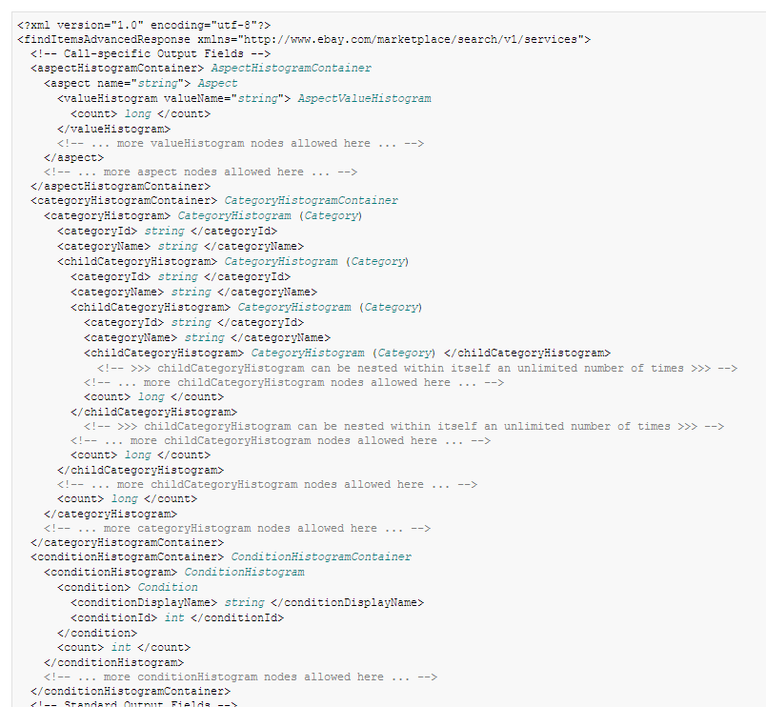
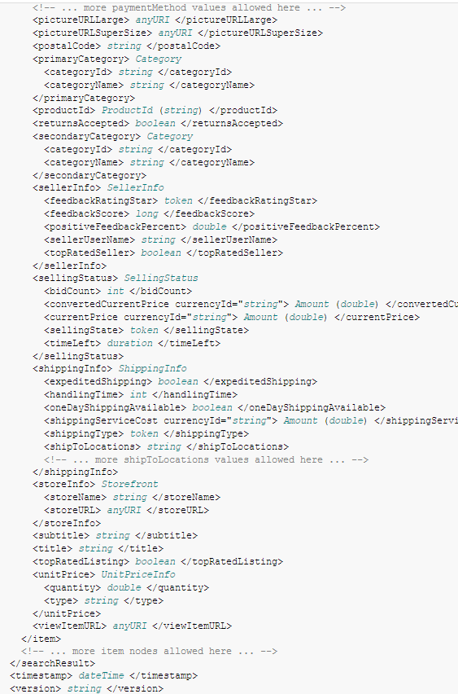
The output
Simple Right?

Slide 9

Custom Libraries
5 Libraries
Fork
Linker
Parser
Query Builder
Store
Modular design
Data Collection
Data Parsing
Data Storage

Slide 10
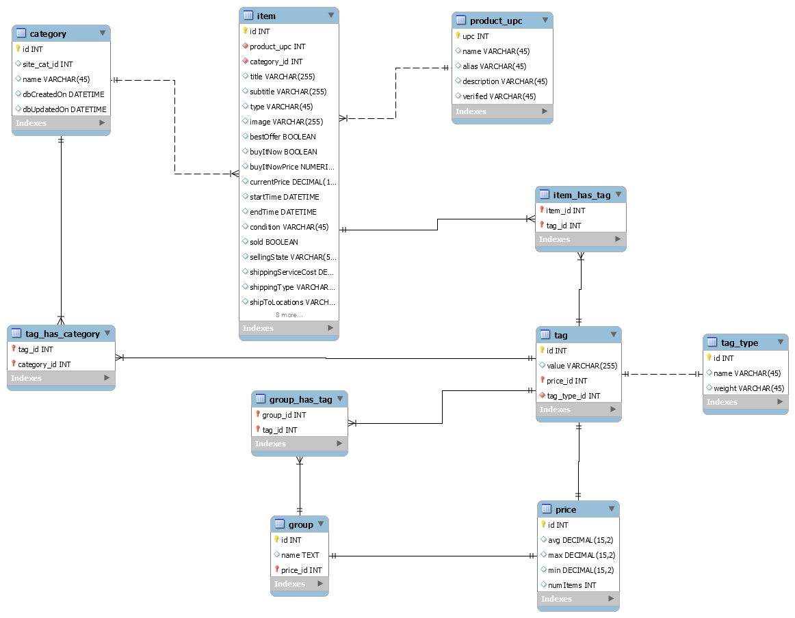
One Database To Store Them All

Slide 11
Data Processing

Slide 12
CI Instance
Library
keywords
Query Builder
Search Controller
URL String
Library
API Requests
eBay
API
Fork
URLs
Results
API Responses
Library
Results
Parser
Parsed Data

Slide 13
Query Builder
Simplest Component
Builds URL endpoint strings
In the form of query strings
?operation-name=findCompletedItems&…
Uses posted form variables
Builds more complex strings (advanced search)
Referred to as item filters
Some query strings can be lengthy
Thus the need for a unified manager
Room for future enhancements

Slide 14
Fork? Is it Lunchtime Yet?
Fork Origins
API request can take between 2 and 4 seconds
API caps total items per request at 100.
Getting 500 items
Need to fire 5 requests
In a linear manner…
3 seconds * 5 requests = 15 seconds
Only to get the items
No internal processing

Slide 15
Fork – Parallel Processing
Native PHP = No support
Work around, use cURL
Stands For Client URL Request Library
Get/Send files using URL syntax
curl_multi
Specify list of URLs
Handle content of each response as it returns
Group results
Achieved X*n requests in the time of one request
Pending on server stats

Slide 16
Fork – Background Processing
cURL cannot do this
Must wait for response
To achieve, we must do it the “manual way”
Parse the url (host, path, port, query string)
Open socket using fsockopen
Craft a packet with appropriate headers
Write packet over socket
POST /csc385/curl/addPostItem HTTP/1.1
Host: localhost
Content-Type: application/x-www-form-urlencoded
Content-Length: 4506
Connection: Close
<!– DATA →

Slide 17
Parser – The Power House
Breaks down both live/stored data
Sorts into price groupings
Performs title matching
Determines item inclusion
Is it worth including? Outliers
Weighted Keywords
Common Tracking
Makes all data available to its caller
Search Controller

Slide 18
Title Matching Algorithm
What items are really the same physical items?
Break Down The Title String
Calculate The Weighted Tag Score For Each Tag
WTS = ( Number Of Single Tag Occurrences /
Number Of Total Non Unique Tags)
Calculate The Total Item Rating For Each Item
TIR = ( WTS_{Tag1} + WTS_{Tag2} + ... + WTS_{TagN} ),
n = Total Number Of Tags Linked To Item
Organize Items By Total Item Rating

Slide 19
Title Matching Example
Search Term: bat man gloves
Results
Bat man gloves red
Bat man gloves red Christmas
Bat man gloves red
Bat man gloves
Bat man hat
Dog man over mitt

Slide 20
Title Matching Example Cont.
The Matching Index
{bat, 5}, {man, 6}, {gloves, 4}, {red, 3}, {hat, 1}, {Christmas, 1}, {dog, 1}, {oven, 1}, {mitt, 1}
Total Non unique Tags: 23
5+6+4+3+1+1+1+1+1
Applying The Matching Algorithm
bat: 5/23, man: 5/23, gloves: 4/23, red: 3/23,
hat: 1/23, Christmas: 1/23, oven: 1/23, mitt: 1/23
Result: Total Item Ratings bat man gloves red 5/23+6/23+4/23+3/23 = 18/23
bat man gloves red Christmas 5/23+6/23+4/23+3/23 = 18/23
bat man gloves red 5/23+6/23+4/23+3/23 = 18/23
bat man gloves 5/23+6/23+4/23 = 15/23
bat man hat 5/23+6/23 = 11/23
dog man oven mitt 6/23 = 6/23

Slide 21
Data Storage

Slide 22
When Do We Store Data?
Can be anywhere from 1-1000 rows to store
Initially done at expense of user
Processed linearly
Thanks to the fork
Background process
Funnels all internal storing into a separate process
Runs on the server
Independent of user output
Not waiting around

Slide 23
Tag Storage
Can be 1,000,000 or more tags per search
Each is a row linked to price data
Apply the fork
Now the user doesn’t even know this is occuring

Slide 24


Self Learning Item Data
All live data is stored
Stored data is injected into resulting live data
All calculations based on both live and stored data
Able to ignore duplicates through unique IDs

Slide 25
Future Thoughts

Slide 26
Future Thoughts
Trend Tracking
By Title
What titles really sell for the most money?
Psychological Factor
What Other Properties Have Greatly Changed The Price?
Condition
Seasons (Chainsaws, Snowboards, etc)
Involves Analyzing Historical Data
Could predict the best time of the year to sell
Maybe even the best day of the year to sell
Open Source Analyzes Like This Could Change Everything

Slide 27



Future Thoughts: MORE DATA
affiliate marketing feeds

Slide 28
Future Thoughts: UPC Validation
Open Source Project
http://www.upcdatabase.com/
Confirm items against recognized UPCs

Slide 29
Thank You
Any Questions?

