Slide 1

Data Collection

Slide 2
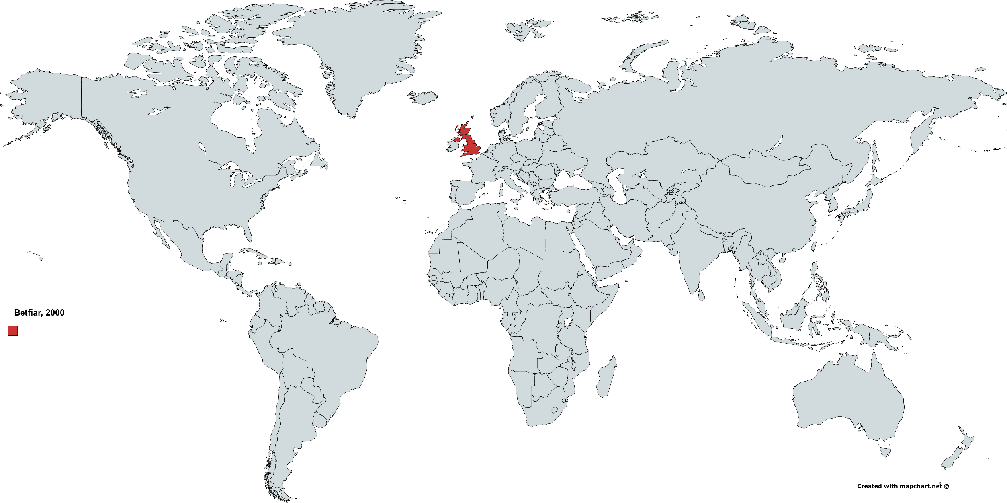
Data Collection

Slide 3
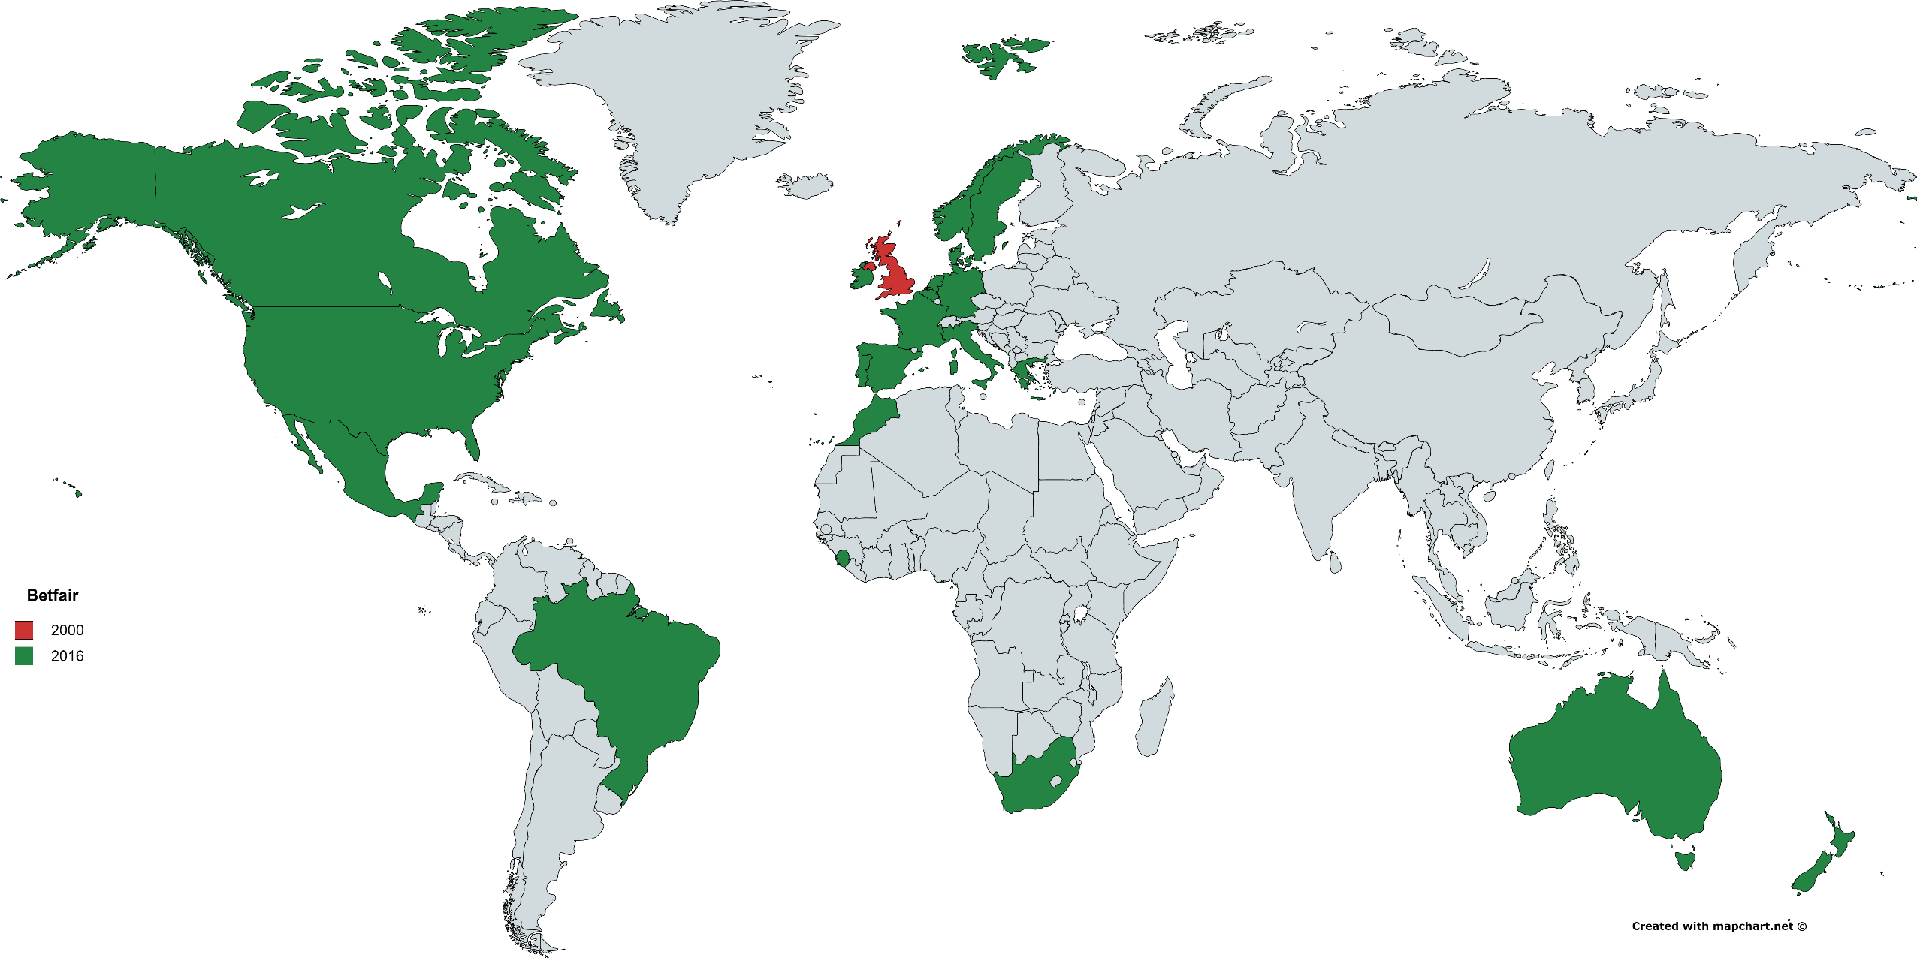
Data Collection

Slide 4
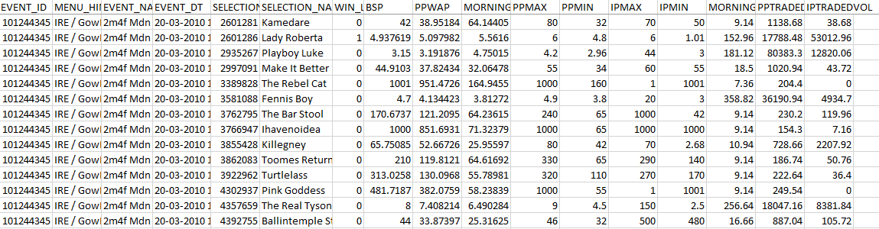
Data Collection
EVENT_ID: Identifies each session/match
SELECTION_NAME: Identifies each horse
WIN_LOSE: Place, unplaced
BSP: Starting price of bets
PPMAX: Maximum price of bet placed before event
IPMAX: Maximum price of bet placed during event

Slide 5
Data Collection
22,500 files, 120 rows of data per set
About 4 events per dataset, which gives us about 90,000 events (data sets) to analyze
Issues:
Some races do not have betting data included
Some races do not report winners

