Slide 1
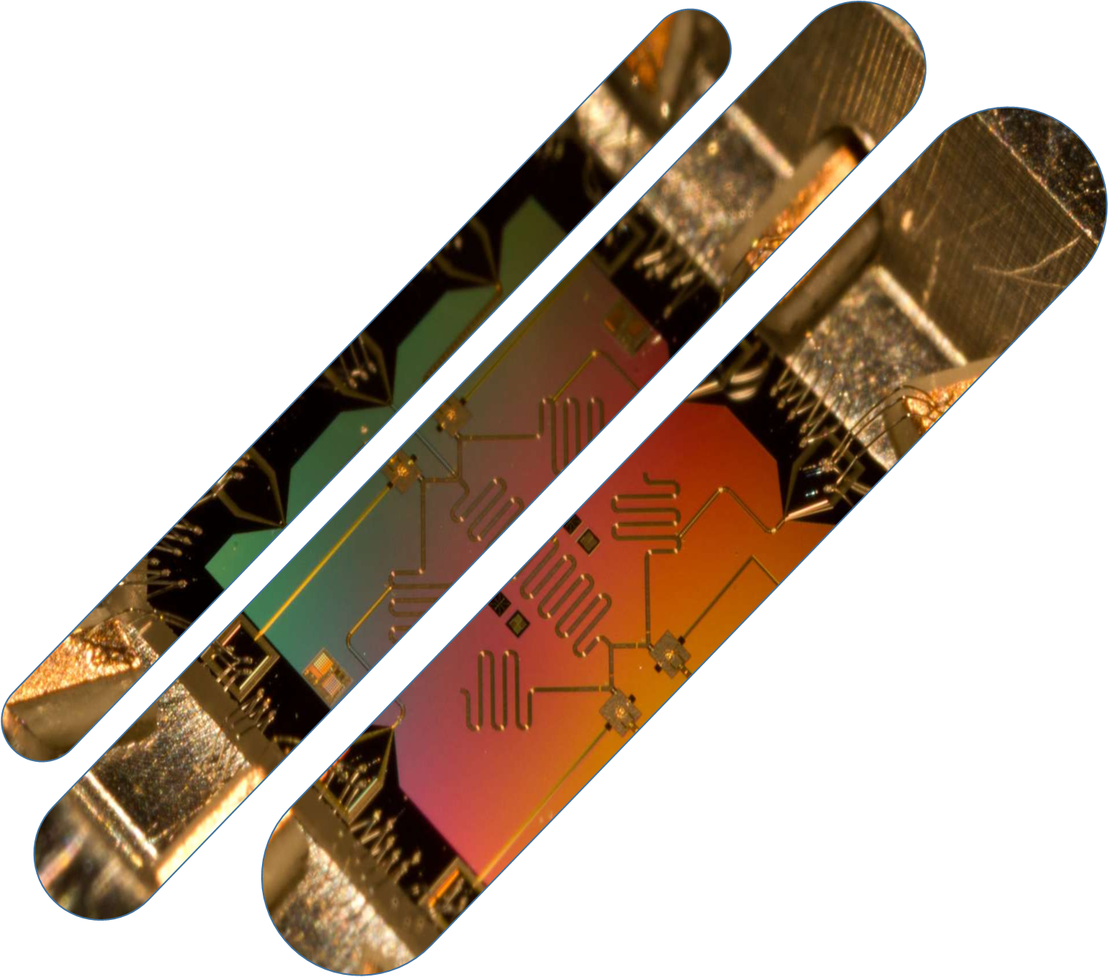
ALONSO Kévin
M2I 2016/2017 - IIA Saint-Berthevin
Technological watch : Computer Quantum

Slide 2
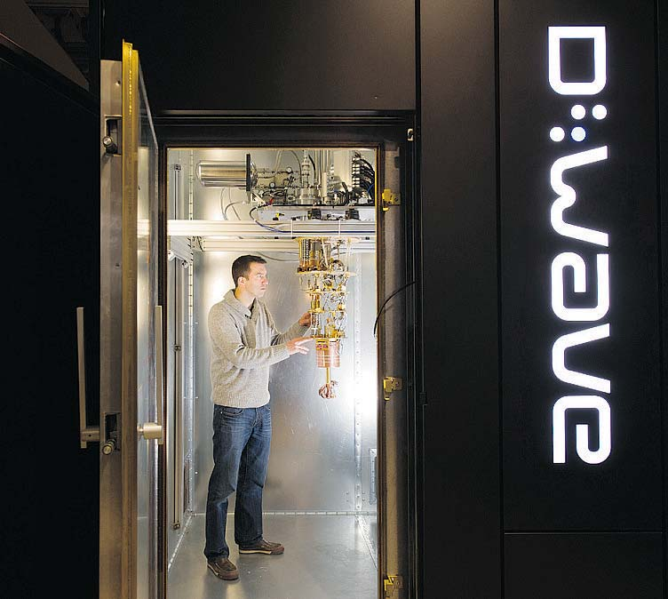
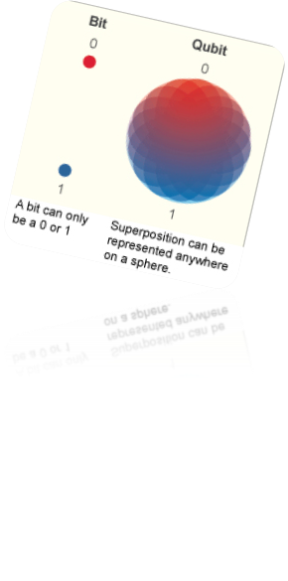


What is a computer quantum ?
Use
Power = 24 000 times more than a ordinary computer
Temperature
-273,15 °C
Electricity consumption
25 KW

Slide 3



The problems from computer quantum

Slide 4

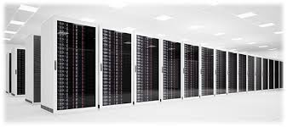



Where is using computer quantum ?

Slide 5



Security
Man in the middle
New algorithm
Message
Send message
Receive message
Hacker

Slide 6


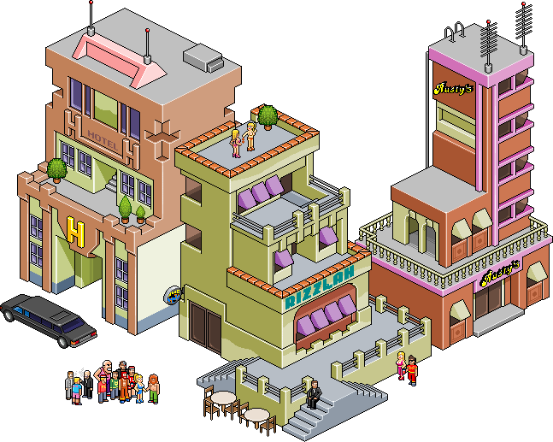

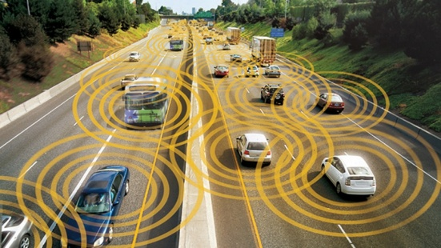

Discovery
Teleportation
Satellite communication
Artificial intelligence
1200
City A
City B
Road traffic
Medical

Slide 7

The world impact

Slide 8
Conclusion

Slide 9

How I make my technological watch
Search from Google
Google Alerte
Pearltrees
Netvibes
InnoReader

Slide 10

Questions ?

