Slide 1







Stories.JSON
Compose large formatted documents with AI
Apps and Customers:
Schedule AI content compositions
Document structure
Computer History Museum
Created by Kevin Ashley Labs: http://kevinashley.com
Kevin Ashley Labs: http://kevinashley.com

Slide 2



Stories.JSON
Task
OpenAI GPT
ChatGPT
Create a document with 100 pages
…3 illustrations, 2 code snippets and text
…schedule 5 documents to run at 4AM Monday
…insert advertisement in documents
…post docs on Twitter automatically
Kevin Ashley Labs: http://kevinashley.com

Slide 3
Stories.JSON
Open source format created by Kevin Ashley for composing large language models
Kevin Ashley Labs: http://kevinashley.com

Slide 4

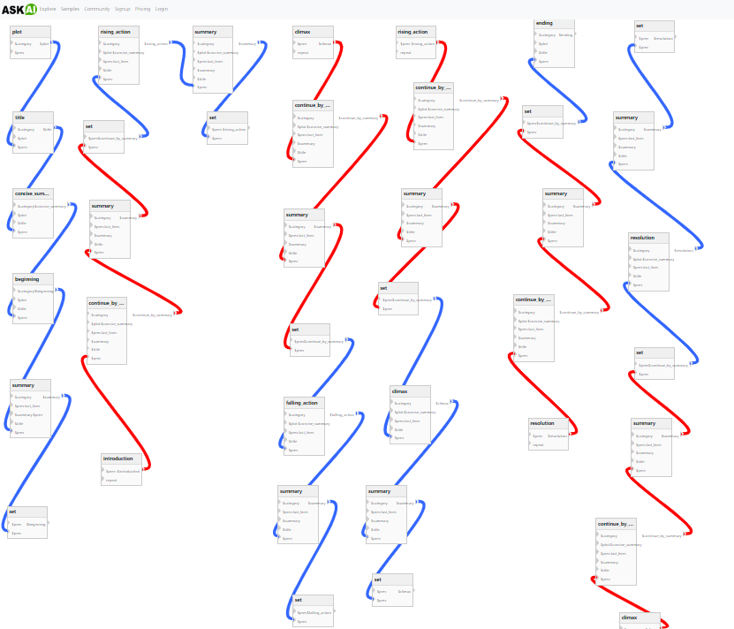
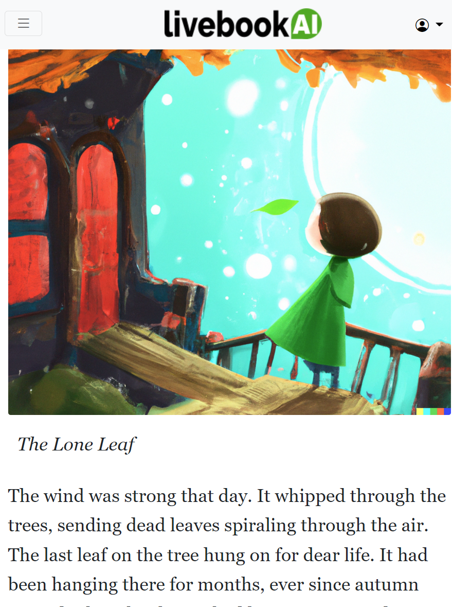
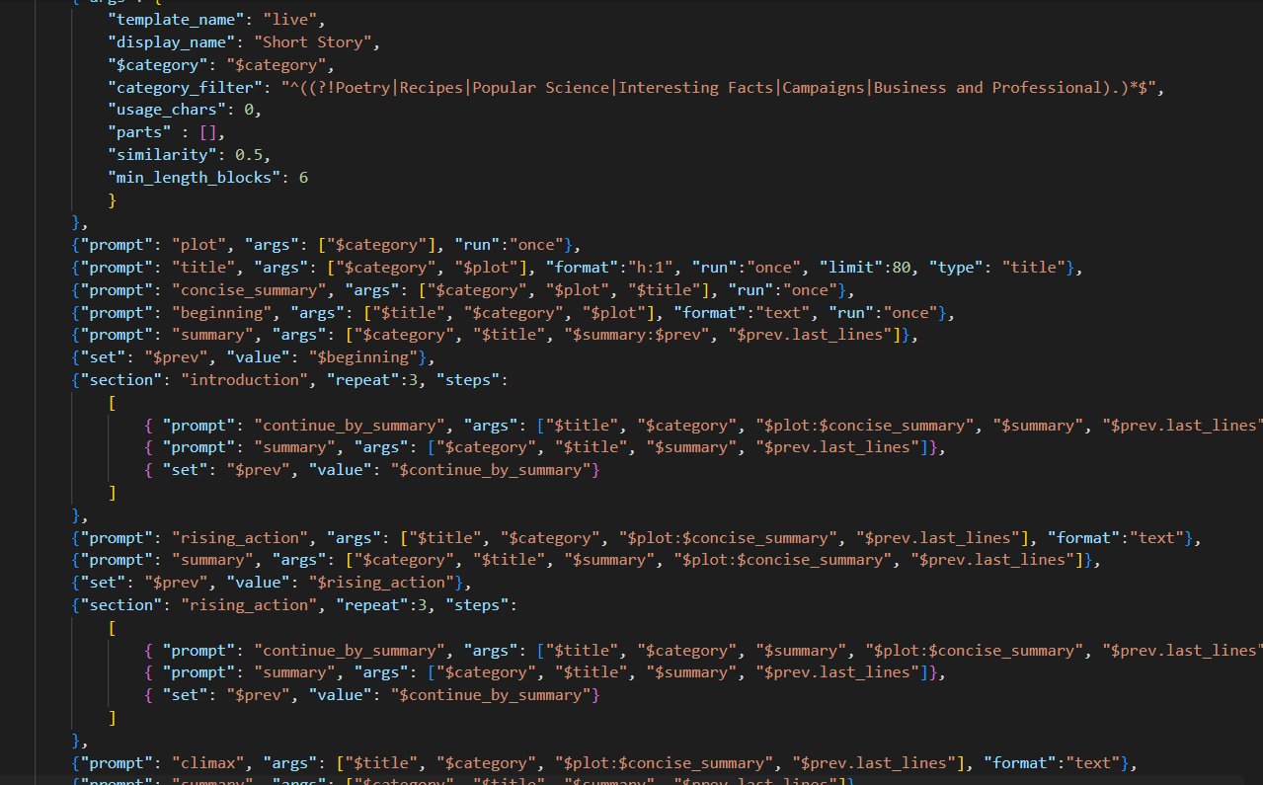

Today…
with
Results…
Example: 7 Point Narrative Story Structure
100 pages long, formatted with illustrations
LLM, GPT-3 API
Simple question
Simple answer
Kevin Ashley
Kevin Ashley Labs
stuff from the future

Slide 5
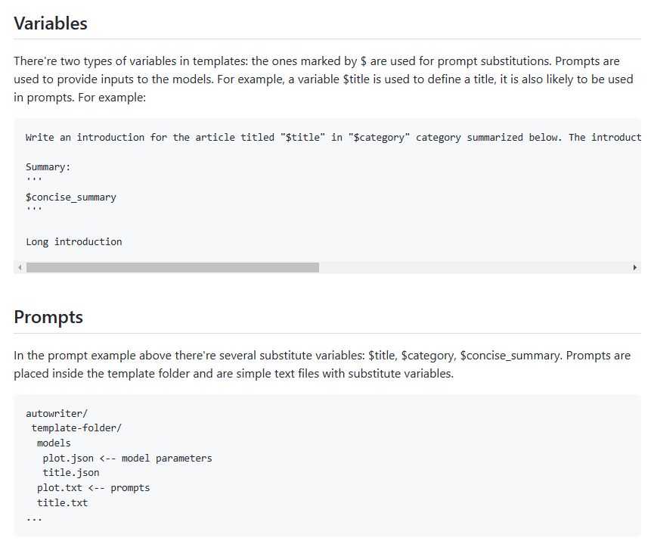
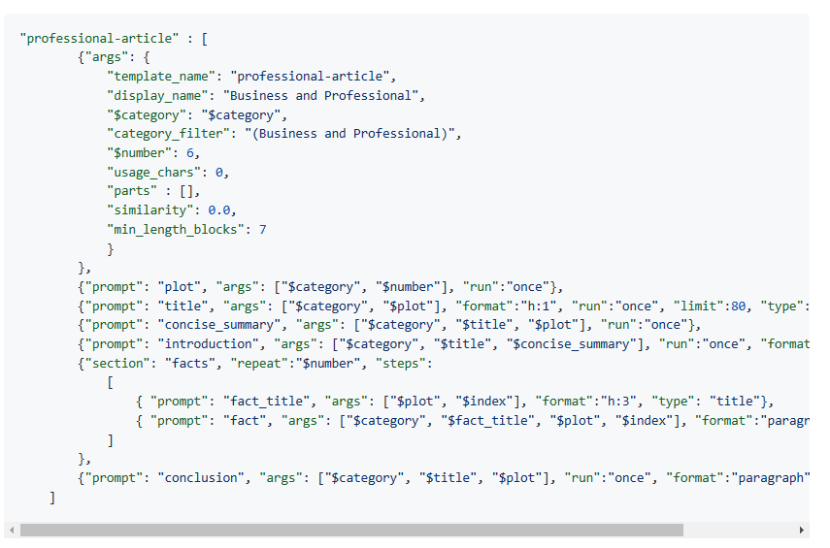
Stories.JSON
Variables & Prompts
Kevin Ashley Labs: http://kevinashley.com

Slide 6
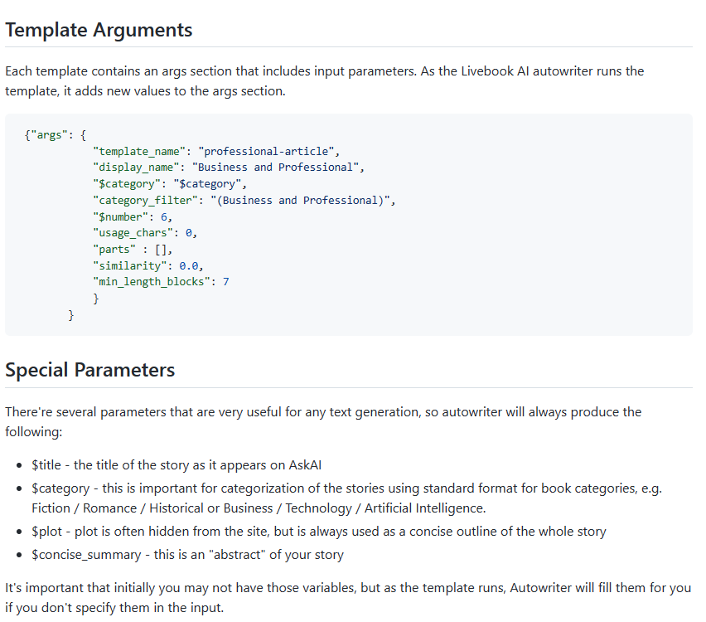
Stories.JSON
Template Arguments
Kevin Ashley Labs: http://kevinashley.com

Slide 7
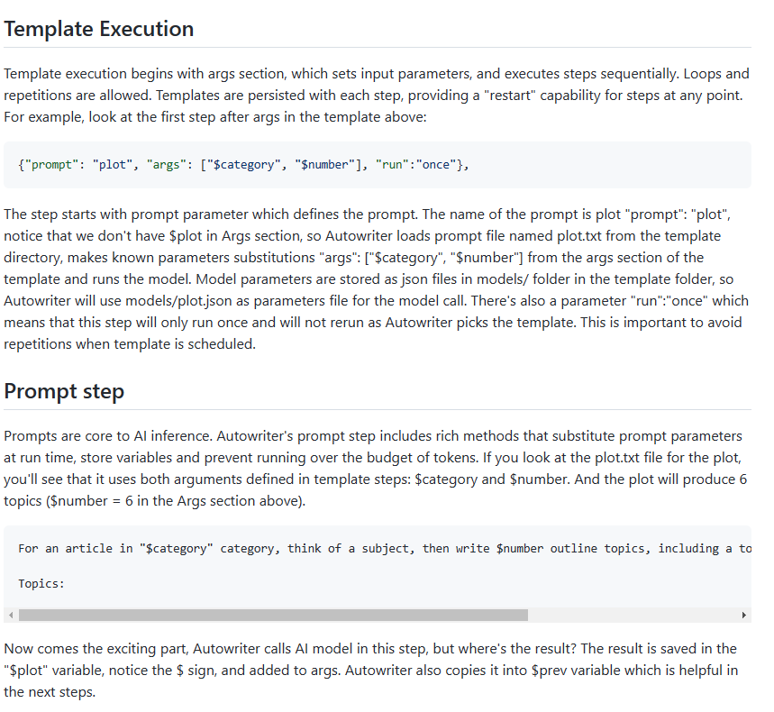
Stories.JSON
Template Execution
Kevin Ashley Labs: http://kevinashley.com

Slide 8
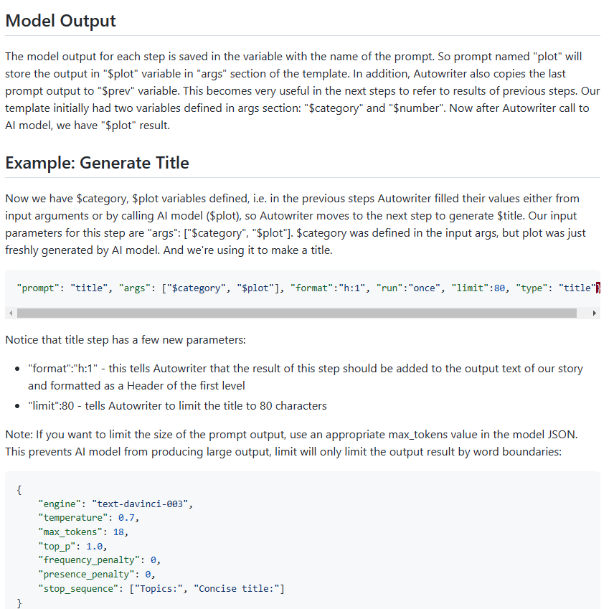
Stories.JSON
Model Output
Kevin Ashley Labs: http://kevinashley.com

Slide 9
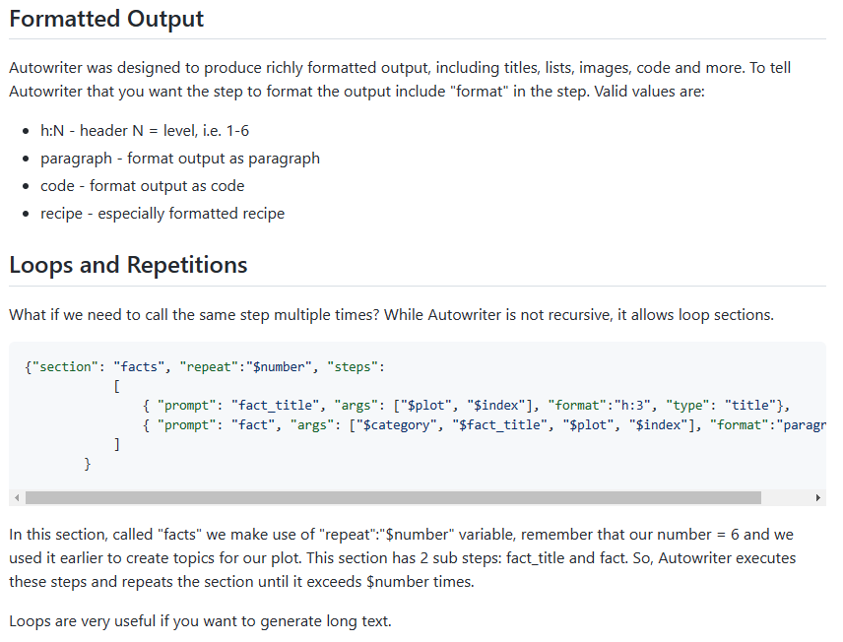
Stories.JSON
Loops and Repetitions
Kevin Ashley Labs: http://kevinashley.com

Slide 10
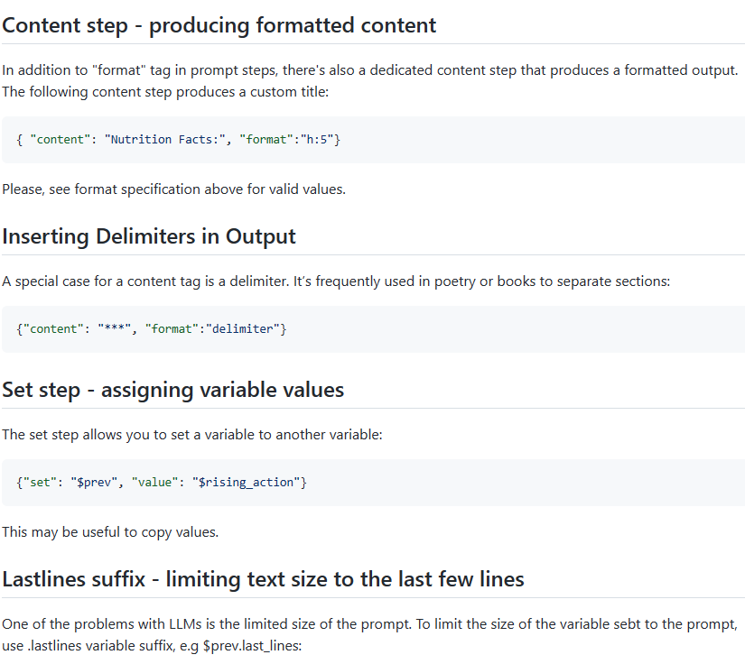
Stories.JSON
Utilities
Kevin Ashley Labs: http://kevinashley.com

Slide 11
Developer Designer
Kevin Ashley
Kevin Ashley Labs: http://kevinashley.com

