Slide 1
Cytogenetic QC of CLL del17p cohort
2021-12-01
Christopher Hartl

Slide 2
Executive Summary
Del17p cohort divides into 2 sub-cohorts: diploid and tetraploid
17p copy number alteration is typically -1 or less for most (but not all) samples
Some samples show low cellularity (i.e., low purity)
Little correspondence between FISH scores for other chromosomes and Battenberg calls

Slide 3
Data & definitions
Data: Battenberg CNV calls for 54 CLL del17p patients plus clinical information
Data handling: If Battenberg provided multiple “equivalent” models, the model with the smallest subclonal population was used
Event ploidy is defined as # major + # minor
Relative ploidy is defined as (event ploidy - tumor ploidy)
A deletion is “-1”

Slide 4
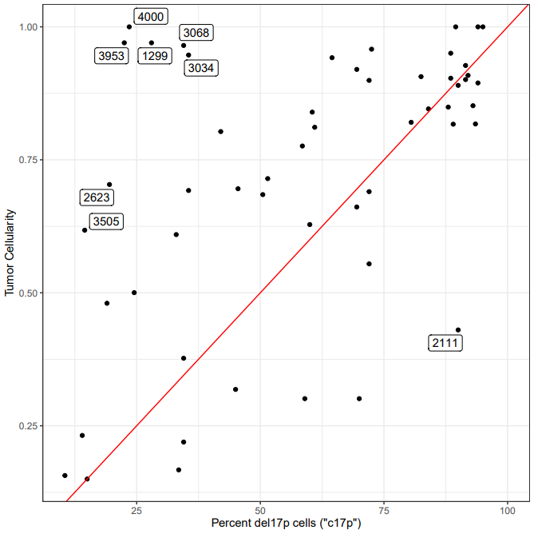
Cellularity estimates coarsely match cytogenetic estimates of d17p nuclei

Slide 5
Most of the del17p cohort (38/54) show a confident 17p loss
Low cellularity is not a clear driver of 17p estimate failure

Slide 6
A small but significant fraction of the cohort are whole-genome duplicated
1292: Diploid clone w/ two tetraploid subclones (complexity 5)
Diploid: 0x17p
-17,add(17)(p11.2)
Tetra 1: 1x17p
-17,-17,add(17)(p11.2)
Tetra 2: 2x17p
-17,-17
2946: Highly complex clonal diploid (complexity 8)
Diploid: 0x17p
-17,-17
(These 2 pilot samples have detailed notes from cytogenetics investigator)
-1

Slide 7
“Abnormal” P53 does not appear to be driving call failures
-1

Slide 8
FISH scores do not generally appear to coincide with Battenberg (relative) ploidies

Slide 9
FISH scores do not generally appear to coincide with Battenberg (relative) ploidies
This looks good

Slide 10
FISH scores do not generally appear to coincide with Battenberg (relative) ploidies

Slide 11
Filtering options
Remove only samples with low purity (<50%)
Retain N=42/54
Remove only samples with extreme 17p+ CNA
Retain N=48/54
Remove low-purity, 17p+ CNA samples
Retain N=40/54
Remove samples that do not have 17p- CNA
Retain N=38/54
Remove low-purity, non-17p- CNA samples
Retain N=33/54

