Slide 1
CLL WGS/RNASeq QC Review
IPS/Translational Bioinformatics

Slide 2
del17P WGS/ RNAseq Pilot Review
N=12 Tumor and N=10 germline samples were sequenced (60XT/30XG WGS, RNAseq) and processed
NGS pipeline work accomplished by optimizing and running alternative tumor only pipeline to account for unpaired samples
WGS-Variants >10% VAF can be detected in the data; filtering will be tweaked as per TiN contamination in samples
CNV calling will be done by battenburg, continue to refine pipeline for calls and correlation to CK data
SV calling will be done by Manta; Continue to refine pipeline
RNAseq data is satisfactory with majority of the reads uniquely mapped
Next steps:
No selection needed based on purity. Mayo will extract DNA/RNA (100ng) and ship to EA. Tumor and germline purity will be shared with BMS.
Proceed with sample processing for RNAseq and WGS (60X tumor/30X germline)

Slide 3
Del17p WGS/RNAseq- remaining samples
46 tumor and germline DNA and RNA were received
TiN contamination (n= 6 > 10%)
Complex Karyotyping data received for the complete cohort
Final cohort for WGS and RNAseq, n=54
 | RNAseq | WGS-Tumor | WGS-germline
Mayo Shipped | 58 | 58 | 58
Sequenced | 54 | 56 | 56
QC passed | 54 | 54 | 54

Slide 4
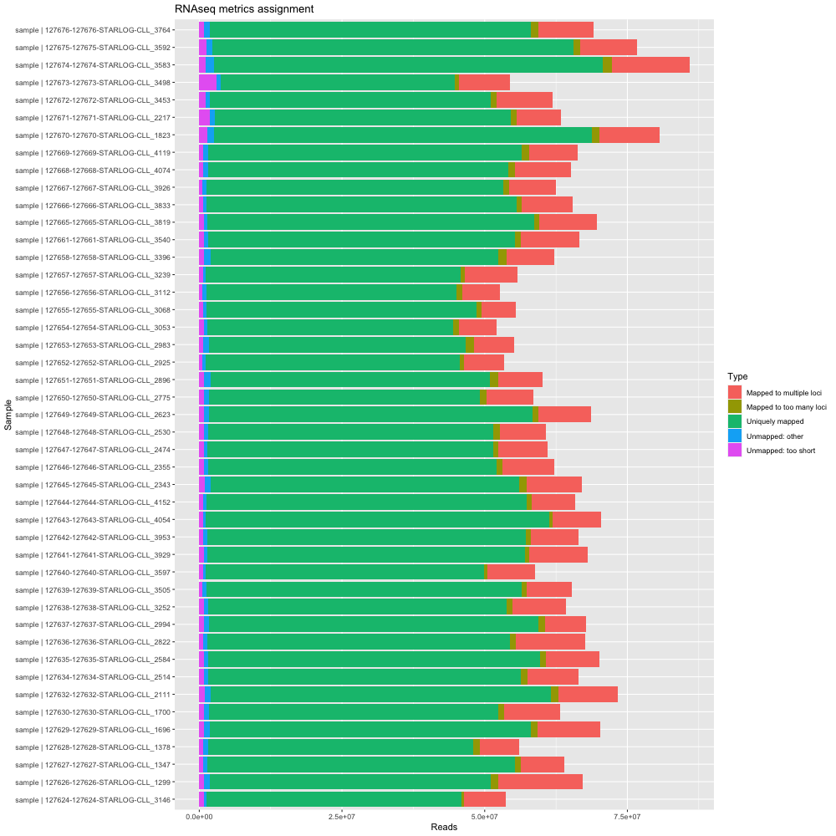
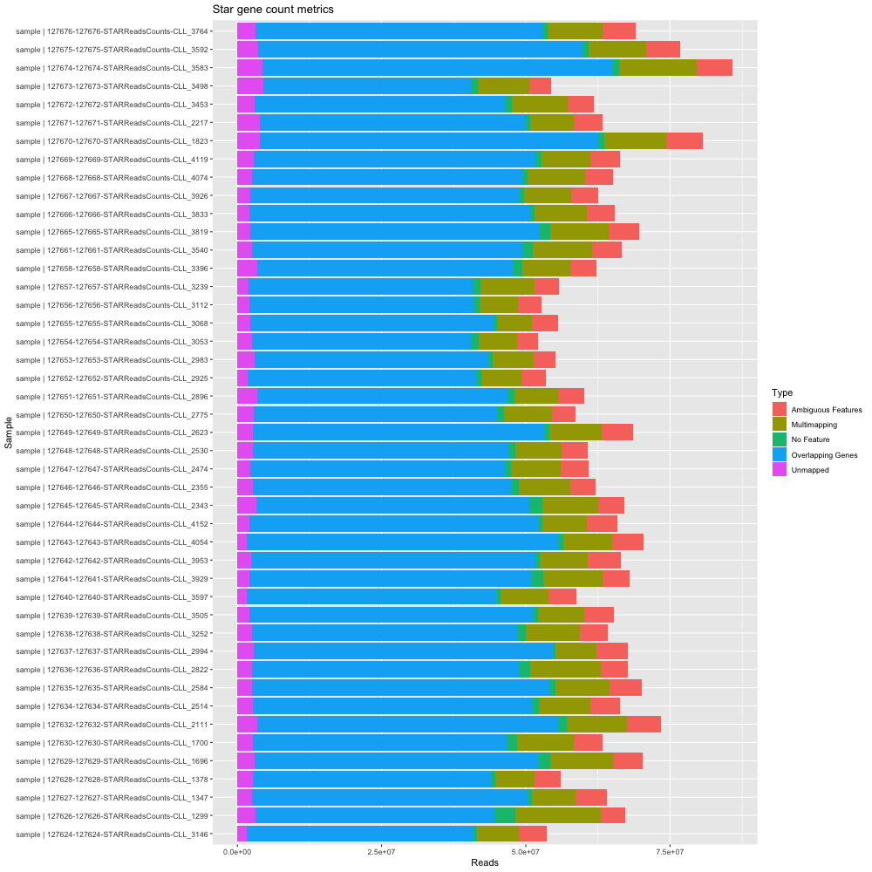
RNAseq MultiQC
Alignment QC
Gene count

Slide 5
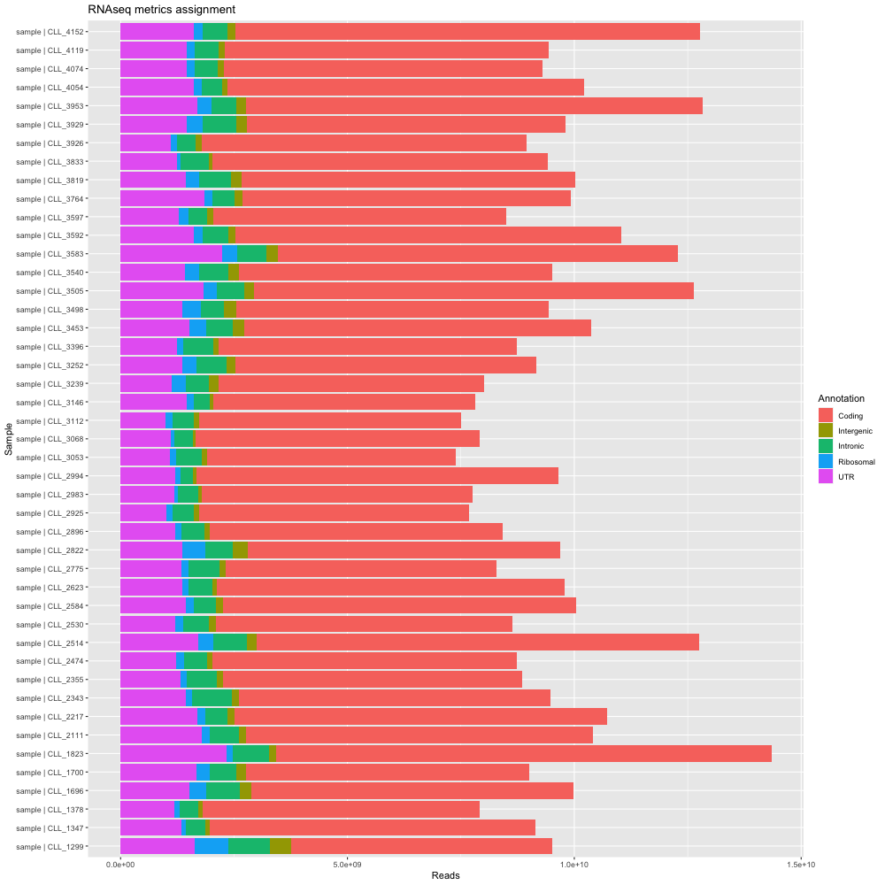
RNAseq MultiQC
RNAseq quality is good for alignment and read metrics
Read annotation

Slide 6
FASTQ data QC- WGS
Summary stats of raw and clipped FASTQ
‘clipping’ performed with fastp
Data shown as mean values for R1 and R2 combined
Data type | # reads | # bases | Read length | Qual (min) | Qual (max) | Qual (mean)
Raw | 493378318 | 74500126024 | 151 | 34.53 | 36.35 | 35.79
Clipped | 486816958.3 | 71626529987 | 146.72 | 34.73 | 36.40 | 35.90

Slide 7
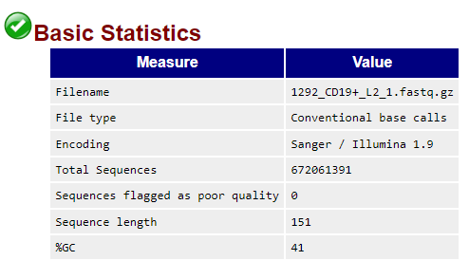
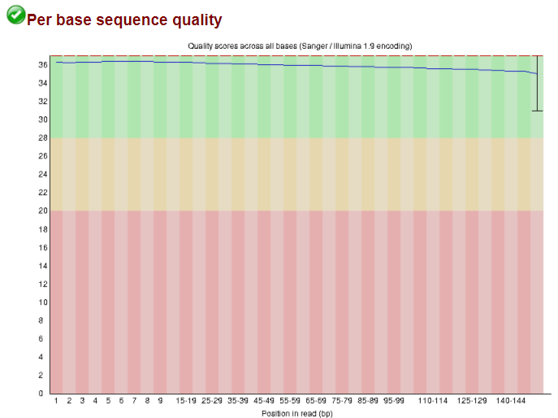
FASTQ data QC- WGS
FastQC run on all samples
Quality looks good for most metrics

Slide 8
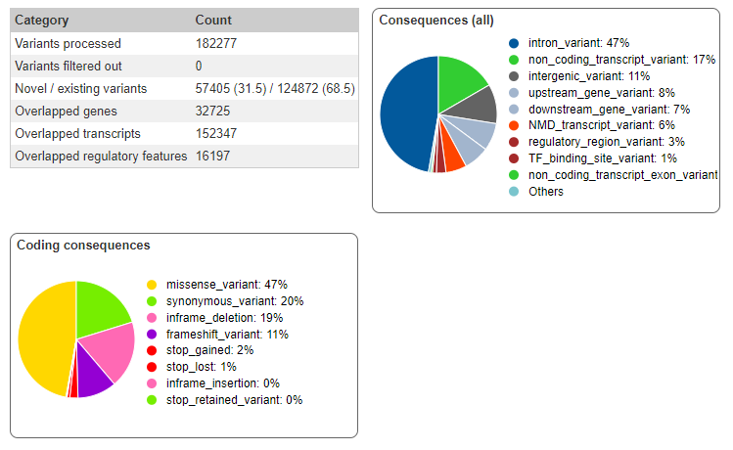
VCF data annotation
All variant calls are comprehensively annotated
Shown is output from VEP
Sample shown: 1292

Slide 9
TNhaplotyper2 somatic variant calls
Sample | SNVs | InDels | Percent ≥40X
1174 | 7931 | 13050 | 92.82
1292 | 4236 | 12805 | 90.95
1299 | 5214 | 15014 | 95.61
1347 | 4290 | 16729 | 96.04
1378 | 12040 | 13126 | 95.57
1584 | 8981 | 15144 | 95.15
1696 | 5093 | 14093 | 95.38
1700 | 4879 | 15144 | 94.20
1823 | 4680 | 19374 | 97.43
2111 | 3389 | 13825 | 93.80
2217 | 3681 | 14674 | 95.15
2297 | 4644 | 19419 | 96.08
2327 | 5829 | 19178 | 96.08
2343 | 6805 | 23226 | 97.86
2474 | 7219 | 26799 | 98.87
2514 | 11972 | 12168 | 92.30
2530 | 5280 | 18548 | 96.81
2584 | 9053 | 12841 | 93.18
2596 | 4800 | 18552 | 95.91
2623 | 5954 | 23213 | 98.16
2822 | 3745 | 14893 | 94.93
2896 | 6551 | 24529 | 98.15
2925 | 7097 | 22419 | 97.93
2946 | 3513 | 16763 | 94.88
2983 | 5370 | 21150 | 97.65
2994 | 4983 | 18349 | 95.99
3034 | 7208 | 18048 | 97.44
54 tumor-normal pairs with genome-wide somatic variant calls
Variant caller, TNhaplotyper2 (https://support.sentieon.com/manual/usages/general/#tnhaplotyper2-algorithm)
Annotated via SnpSift
COSMIC
ClinVar
in silico functional / pathogenicity predictors
Allele frequencies from all population databases
plus more
88 ‘tumor-only’ samples
calls made individually for tumor (n=44) and matched normal (n=44) samples
all tumor-only samples have corresponding somatic variant calls

Slide 10
TNhaplotyper2 somatic variant calls (continued)
Sample | SNVs | InDels | Percent ≥40X
3053 | 5601 | 23600 | 98.04
3068 | 6186 | 21424 | 98.21
3112 | 8678 | 26111 | 98.88
3146 | 4332 | 16468 | 94.81
3239 | 6174 | 17478 | 97.53
3252 | 5150 | 15357 | 95.25
3396 | 7173 | 23303 | 97.49
3453 | 3693 | 14891 | 95.28
3498 | 3181 | 14106 | 95.06
3505 | 12019 | 13510 | 94.31
3520 | 3552 | 16994 | 96.05
3540 | 3544 | 14816 | 96.54
3583 | 7618 | 18872 | 97.16
3592 | 4189 | 17113 | 96.99
3597 | 5160 | 14282 | 93.86
3764 | 4972 | 19305 | 97.43
3819 | 3292 | 14079 | 95.90
3833 | 4150 | 13543 | 95.19
3926 | 5071 | 15460 | 95.53
3929 | 4307 | 16577 | 97.25
3953 | 14258 | 13192 | 95.75
4000 | 6447 | 18609 | 95.16
4054 | 11281 | 13684 | 93.78
4074 | 4479 | 15545 | 95.82
4090 | 6174 | 20424 | 97.57
4119 | 4530 | 15708 | 95.81
4152 | 11583 | 11618 | 94.55
Somatic variant calls per sample
Single Nucleotide Variants (SNVs)
Insertions & Deletions (InDels)
Filtered for those with PASS filter criteria
Large proportion called at ≥40x

Slide 11
Manta somatic structural variant calls
Sample | # SVs |  | Sample | # SVs
1174 | 118 |  | 3053 | 54
1292 | 13 |  | 3068 | 45
1299 | 79 |  | 3112 | 72
1347 | 51 |  | 3146 | 27
1378 | 210 |  | 3239 | 44
1584 | 84 |  | 3252 | 40
1696 | 83 |  | 3396 | 63
1700 | 49 |  | 3453 | 50
1823 | 42 |  | 3498 | 60
2111 | 29 |  | 3505 | 187
2217 | 29 |  | 3520 | 14
2297 | 19 |  | 3540 | 35
2327 | 29 |  | 3583 | 49
2343 | 78 |  | 3592 | 44
2474 | 100 |  | 3597 | 47
2514 | 228 |  | 3764 | 55
2530 | 47 |  | 3819 | 38
2584 | 138 |  | 3833 | 32
2596 | 30 |  | 3926 | 51
2623 | 47 |  | 3929 | 50
2822 | 48 |  | 3953 | 246
2896 | 56 |  | 4000 | 44
2925 | 81 |  | 4054 | 196
2946 | 18 |  | 4074 | 39
2983 | 56 |  | 4090 | 23
2994 | 57 |  | 4119 | 61
3034 | 32 |  | 4152 | 166
54 tumor-normal pairs with somatic Manta SV calls
36 ‘tumor-only’ samples
calls made individually for normal samples only
all ‘tumor-only’ samples have corresponding somatic variant calls
Filtered for those with PASS filter criteria
All calls are unique across the entire cohort, i.e., every SV is private to the sample in question
Higher number of SVs seen as compared to published cohort ( Burns et.al., 2018 Leukemia)

Slide 12
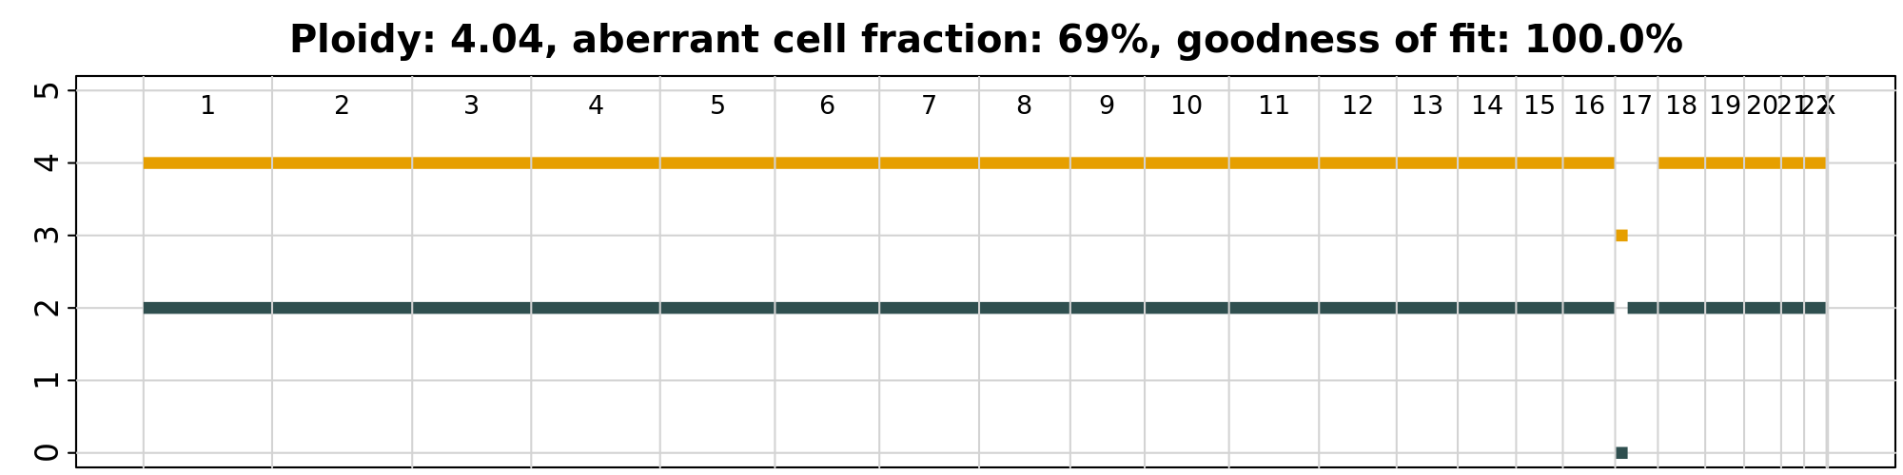
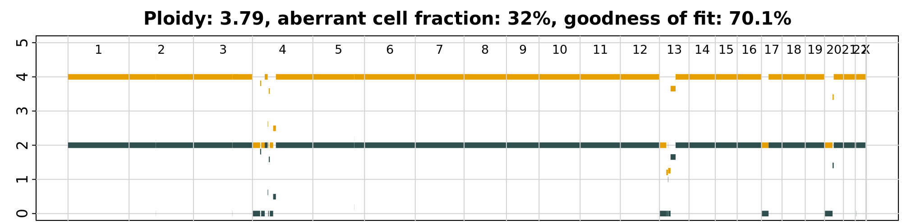
CNA Calls: Battenberg data
Battenberg CN calls for 54 CLL del17p patients
Cellularity and ploidy per sample available
FISH scores available for comparison

Slide 13
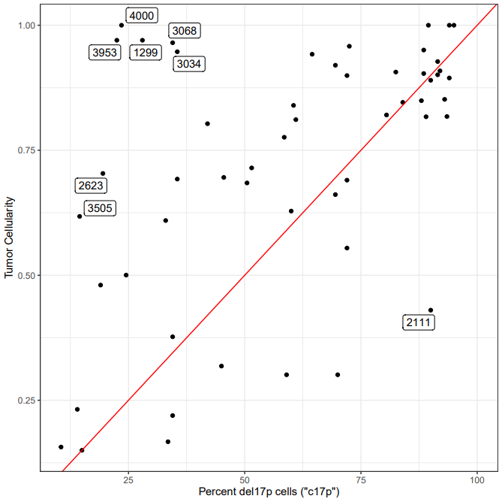
Cellularity estimates coarsely match cytogenetic estimates of del17p nuclei

Slide 14
Majority del17p cohort (38/54) show 17p loss
Low cellularity is not a clear driver of 17p estimate failure

Slide 15
Next Steps for finalizing QC
Identify somatic mutations in del17p cohort and compare with published cohorts
Identify P53 mutations in cohort and compare to clinical data with P53 status
Compare Battenburg calls for del11q, Tri12, del13q, chr6 and chr14 and compare to FISH data
Validate del17p status for remaining samples using Sclust and/or InferCNV

Slide 16
Back up

Slide 17
CLL Pilot WGS/RNASeq QC Review
IPS/Translational Bioinformatics
Nick Stong, Ph.D.

Slide 18
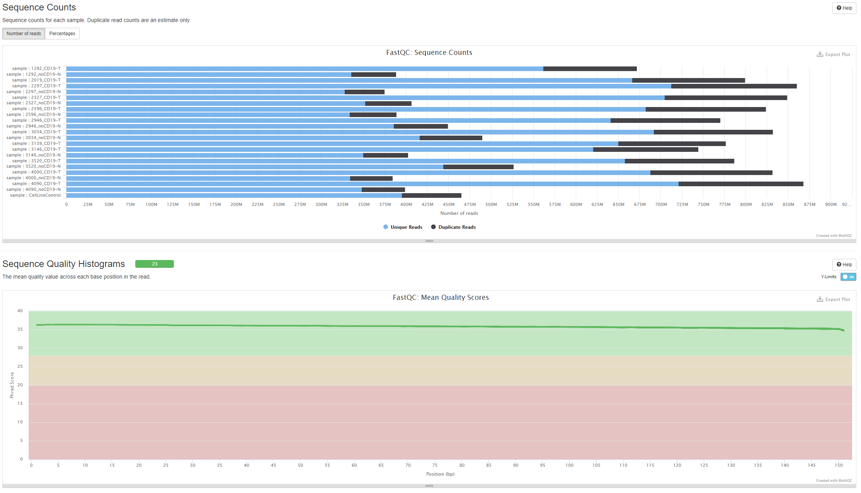
Picard/FastQC WGS

Slide 19
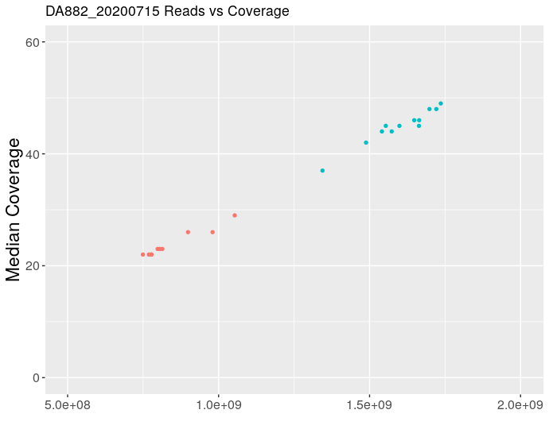
WGS Coverage
Expected coverage for tumor and normal samples
>40x Tumor (60x raw sequence)
>20x Normal (30x raw sequence)
Consistent with previous genome projects
Good library quality with consistent coverage for amount of sequence generated

Slide 20
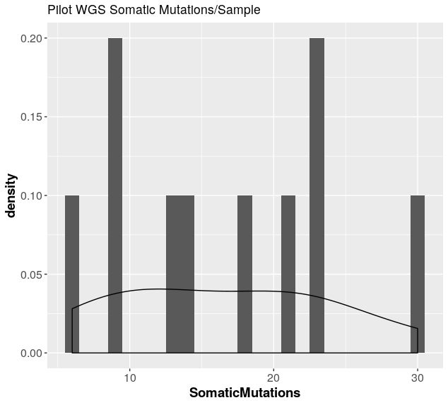
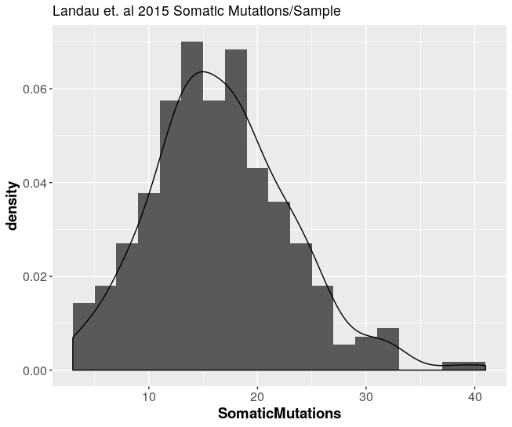
MUTECT2 Mutation Calls
Landau et. al 2015
16 median mutations
278 tumor/normal pairs
DA882_20200715
16 median mutations

Slide 21
MUTECT2 Mutation Calls
Sample | Qubit ug/ul | Total (ug) | CD19- cells recovered (MM) | % TIN | % live cells | SomaticMutations
2327 CD19- | 0.032 | 2.798 | 1.4 | 17 | 59.1 | 21
3146 CD19- | 0.025 | 2.2 | 3.2 | 15.2 | 28.7 | 13
1292 CD19- | 0.032 | 2.842 | 2.6 | 11 | 90.1 | 18
2297 CD19- | 0.005 | 0.402 | 1.4 | 7.6 | 35.4 | 9
3520 CD19- | 0.012 | 1.021 | 1.6 | 6.5 | 72.5 | 6
2946 CD19- | 0.02 | 1.778 | 1.2 | 4.4 | 66 | 9
3034 CD19- | 0.022 | 1.954 | 3.5 | 3.3 | 68.3 | 23
4000 CD19- | 0.024 | 2.094 | 1.3 | 3 | 61.2 | 23
2596 CD19- | 0.025 | 2.182 | 2 | 2.9 | 53.8 | 14
4090 CD19- | 0.027 | 2.332 | 3.6 | 2.17 | 75.7 | 30
Number of mutations not effected by TiN contamination

Slide 22
Pipeline
FASTQ
BAM
Tumor
Alignment (BWA)
Mutect2 Tumor/Normal
VCF
Filtering
HighQuality VCF
FASTQ
BAM
Normal
Alignment (BWA)
Tumor Only Pipeline
FASTQ
BAM
VCF
Filtering
HighQuality VCF
Alignment (BWA)
Mutect2 Tumor Only
Analysis VCF
FASTQ
BAM
Mutect2 Tumor Only
VCF
Filtering
HighQuality VCF
Alignment (BWA)
>25% VAF

Slide 23
MUTECT2 Mutation Calls Tumor Only Pipeline
Sample | Qubit ug/ul | Total (ug) | CD19- cells recovered (MM) | % TIN | % live cells | SomaticMutations | Tumor Only Pipeline
2327 CD19- | 0.032 | 2.798 | 1.4 | 17 | 59.1 | 21 | 104
3146 CD19- | 0.025 | 2.2 | 3.2 | 15.2 | 28.7 | 13 | 97
1292 CD19- | 0.032 | 2.842 | 2.6 | 11 | 90.1 | 18 | 109
2297 CD19- | 0.005 | 0.402 | 1.4 | 7.6 | 35.4 | 9 | 77
3520 CD19- | 0.012 | 1.021 | 1.6 | 6.5 | 72.5 | 6 | 62
2946 CD19- | 0.02 | 1.778 | 1.2 | 4.4 | 66 | 9 | 61
3034 CD19- | 0.022 | 1.954 | 3.5 | 3.3 | 68.3 | 23 | 83
4000 CD19- | 0.024 | 2.094 | 1.3 | 3 | 61.2 | 23 | 92
2596 CD19- | 0.025 | 2.182 | 2 | 2.9 | 53.8 | 14 | 86
4090 CD19- | 0.027 | 2.332 | 3.6 | 2.17 | 75.7 | 30 | 97
Many variants called from tumor only pipeline results in large files
WGS data called through Sentieon implementation
High number of somatic functional mutations
Limit to PASS in new version
Limit to hotspot genes

Slide 24
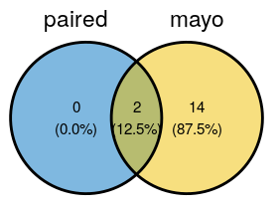
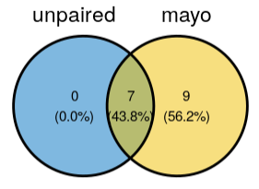
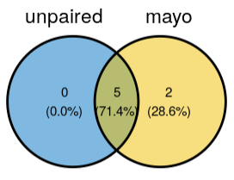
Recall of Mutation Panel Variants
All VAF > 10% variants are in the unfiltered tumor only variant calls
Two variants filtered due to tumor in normal contamination
1. High VAF at variant in normal (30%)
VAF at variant in tumor (50%)
Other KMT2D variant in sample has 21% VAF in normal sample
2. High VAF at variant in normal (42%)
Matches VAF of variant in tumor
No variant called in other TP53 variant in normal
Likely a truly germline variant
Filtering criteria will need to be tuned based on tumor in normal contamination
Use more sensitive parameters in genes of interest
Paired Tumor Normal Pipeline
Tumor Only Pipeline
Tumor Only Pipeline – VAF > 10%

Slide 25
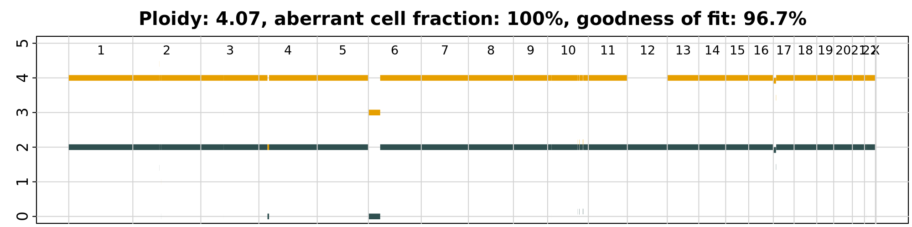
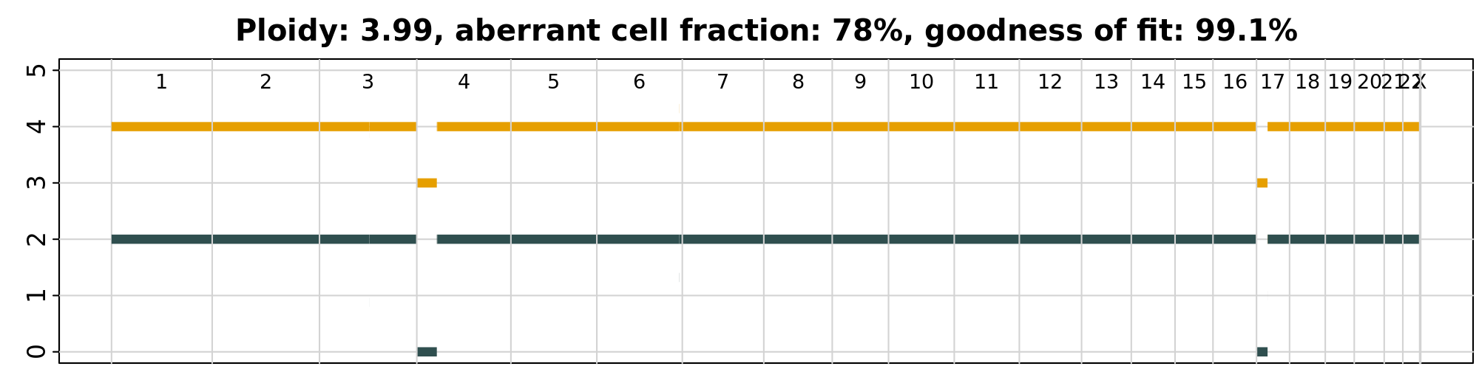
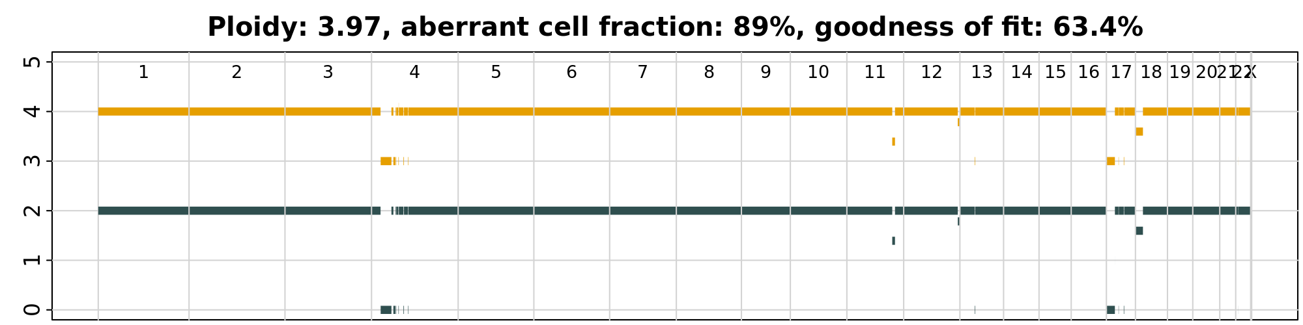
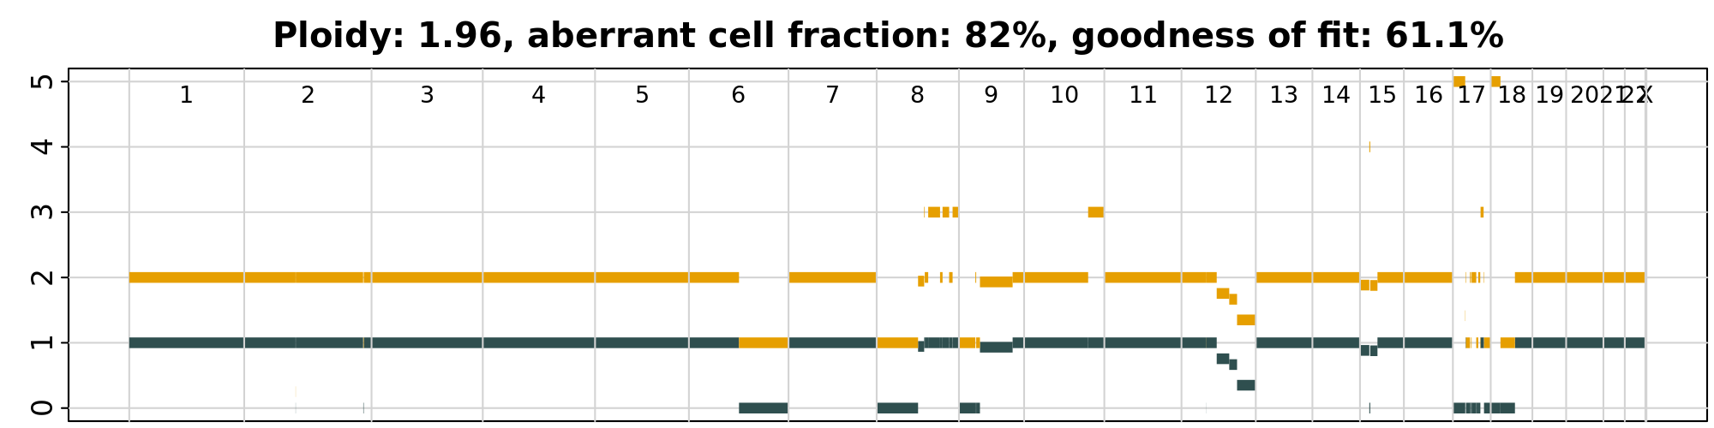
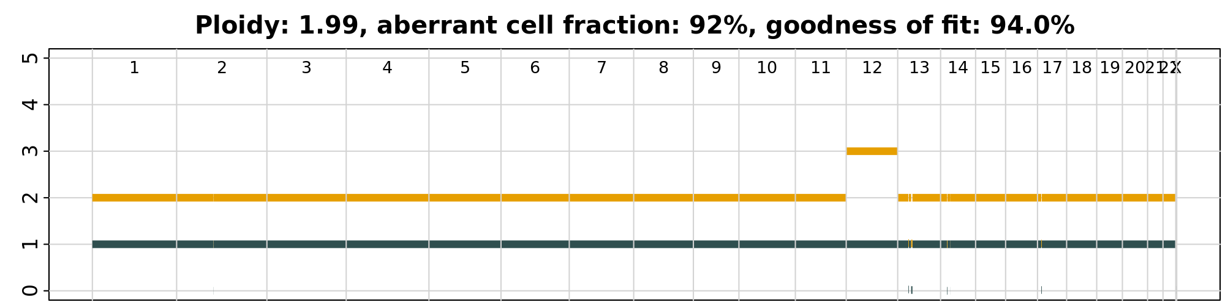
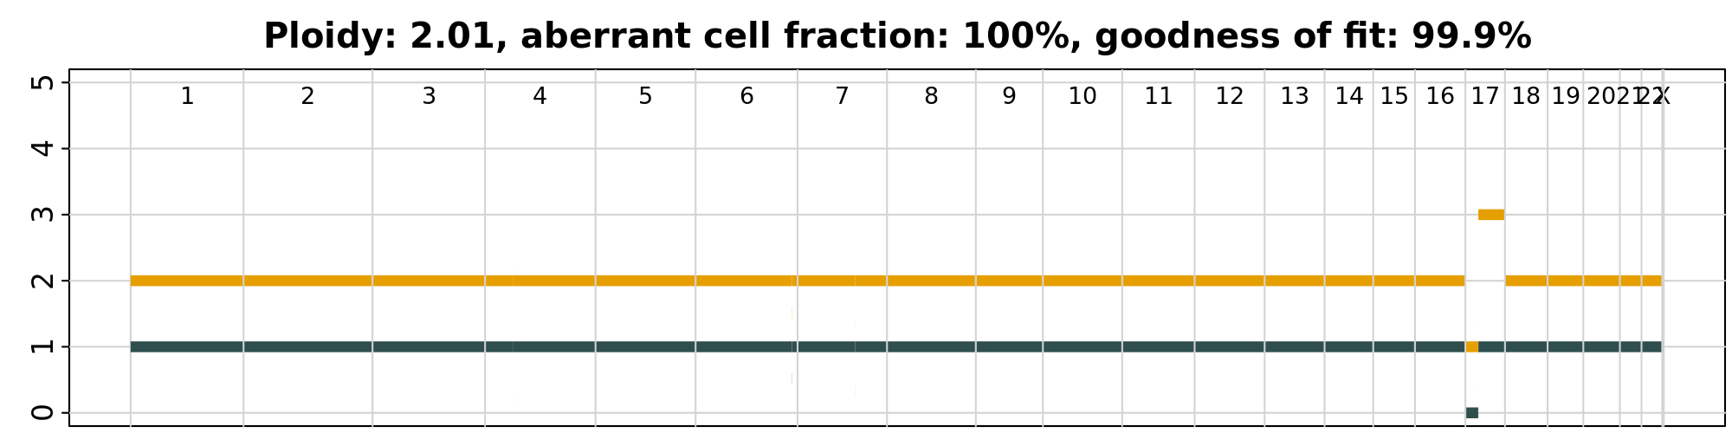
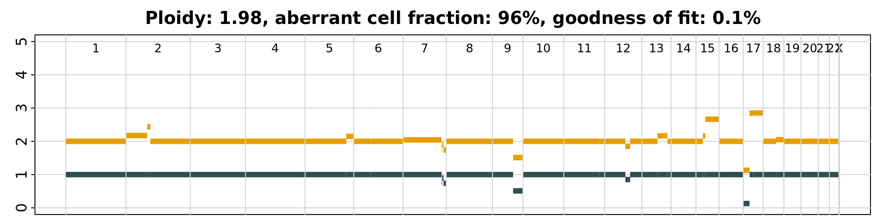
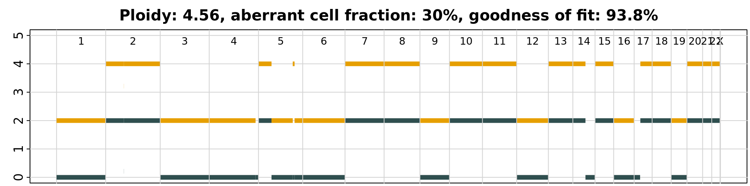
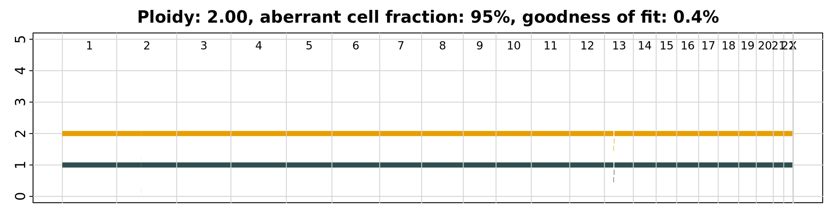
CNA Calls Battenberg
4000
4090
2297
2946
3250
2327
3146
1292
3034

Slide 26
SV Calls
Sample | SV Calls
2297 | 16
4000 | 41
3520 | 13
3034 | 25
2596 | 20
3146 | 24
1292 | 9
2327 | 24
2946 | 15
4090 | 16
Calls made by MANTA 1.6
Count of all PASS translocations
Previously used recurrent SV to filter
Limit to expected regions
Recurrent SVs in CLL?
Quality metric filtering can be used
Less sensitive
Correlation with complex karyotype?

Slide 27
del17P WGS/ RNAseq Pilot Study Summary
Results
Mayo will extract DNA/RNA (100ng) and ship to EA. Tumor and germline purity will be shared with BMS.
NGS pipeline work accomplished by optimizing and running alternative tumor only pipeline to account for
RNAseq data is satisfactory with at least x% of the reads uniquely mapped
WGS-Variants >10% VAF can be detected in the data; filtering will be tweaked as per TiN contamination in samples
CNV calling will be done by battenburg, continue to refine pipeline for calls and correlation to CK data
SV calling will be done by Manta; Continue to refine pipeline
Recommendation
No selection needed based on purity
Continue to refine pipeline for CNV and SV calls
Proceed with sample processing for RNAseq and WGS (60X tumor/30X germline)

Slide 28
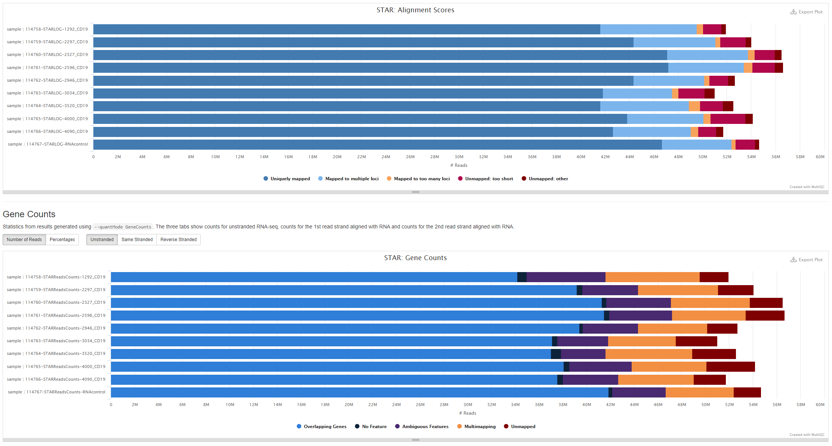
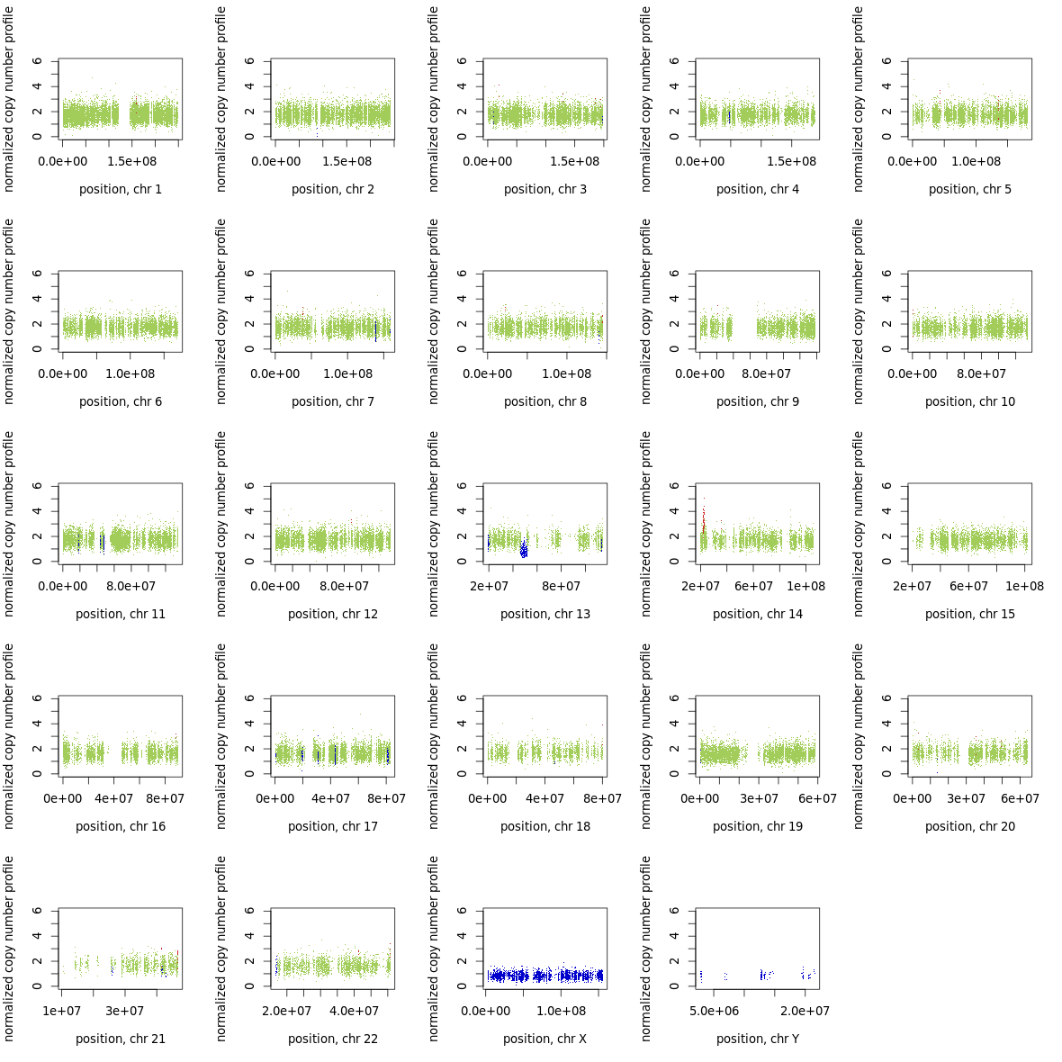
RNASeq MultiQC
 | Purity | Ploidy | Tumor Purity | Normal Contamination
CLL56 | 44.2% | 4 | 90 | ?
CLL33 | 41.1% | 3 | 94 | 6
CLL7 | 82.5% | 2 | 94 | 13
CLL19 | 44.7% | 4 | 95 | 22
ControlFREEC
Tumor/normal exome analysis
Also applies to WGS data
Provides CNV and subclonal calls
Does not depend on somatic SNVs
Not dependent on SNV pipeline
Troubleshooting Sclust as alternative

Slide 29
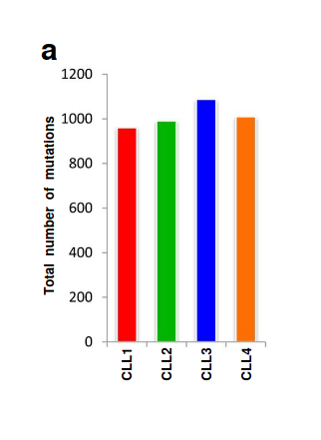
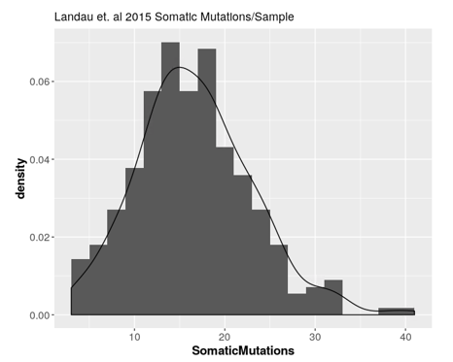
Expectations
16 coding mutations per sample (median)
Total somatic mutations in range of previously published CLL mutations data
Total number of somatic substitutions per genome.
Puente, X., Pinyol, M., Quesada, V. et al. Whole-genome sequencing
identifies recurrent mutations in chronic lymphocytic leukaemia.
Nature 475, 101–105 (2011). https://doi.org/10.1038/nature10113

Slide 30
Applied Filters
Quality & autosome filters
Remove common variants (POP_AF < 0.01)
Remove known dbSNP variants
Increase TLOD, NLOD thresholds (TLOD > 7, NLOD > 4)
Coding variants retained: frameshift_variant, stop_gained, stop_lost, start_lost, splice_acceptor_variant, splice_donor_variant, missense_variant, disruptive_inframe_insertion, conservative_inframe_insertion, disruptive_inframe_deletion, conservative_inframe_deletion

Slide 31
Total variants retained after filtering
POP_AF < 0.01
958151
Non-dbSNP variant
674239
TLOD >= 7 NLOD >= 4
317759
NA = 66185
311170
622889
220174
223217

Slide 32
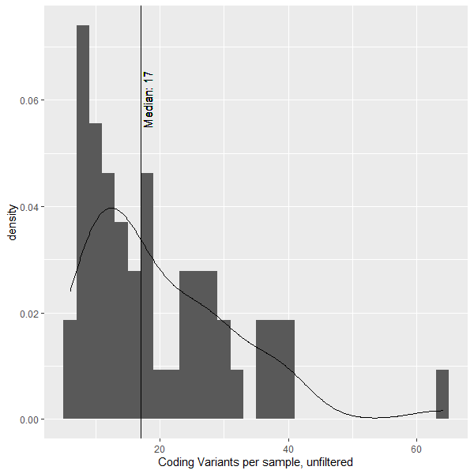
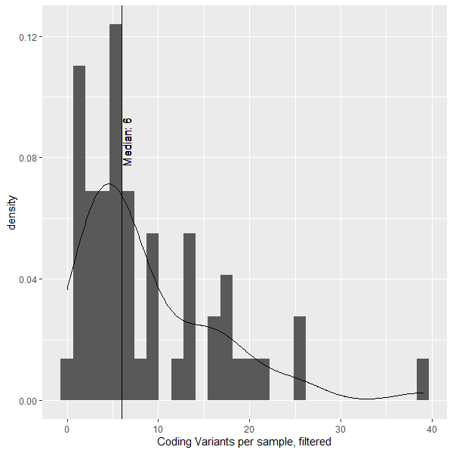
Coding Variants per Sample

Slide 33
Samples with High Coding Variant Counts
Unfiltered (>30 coding variants)
3953-T-3953-N | 64
1378-T-1378-N* | 41
4054-T-4054-N* | 40
1584-T-1584-N* | 39
3505-T-3505-N* | 38
2584-T-2584-N | 36
1174-T-1174-N* | 36
4090_CD19-4090_CD19-* | 33
3583-T-3583-N | 31
4152-T-4152-N | 30
Filtered (>20 coding variants)
3953-T-3953-N | 39
1378-T-1378-N* | 26
1584-T-1584-N* | 25
4054-T-4054-N* | 22
2584-T-2584-N | 20
* Indicates ploidy = 4
* Indicates ploidy = 4

Slide 34
TiN contamination and % Abnormal nuclei
patient | c17p
1174 | 45.0
1292 | 59.0
1299 | 28.0
1347 | 89.5
1378 | 72.0
1584 | 50.5
1696 | 34.5
1700 | 88.0
1823 | 24.5
2019 | 62.5
2111 | 90.0
2217 | 94.0
2297 | 90.0
2327 | 94.0
2343 | 89.0
2355 | 69.5
2474 | 91.5
2514 | 95.0
2530 | 64.5
2584 | 92.0
2596 | 91.5
2623 | 19.5
2775 | 11.0
2822 | 72.0
2896 | 88.5
2925 | 42.0
2946 | 93.5
2983 | 82.5
2994 | 15.0
3034 | 35.5
3053 | 93.0
3068 | 34.5
3112 | 33.0
3139 | 100.0
3146 | 72.5
3239 | 80.5
3252 | 88.5
3396 | 61.0
3453 | 33.5
3498 | 91.5
3505 | 14.5
3520 | 69.5
3540 | 69.5
3583 | 14.0
3592 | 45.5
3597 | 10.5
3764 | 72.0
3819 | 19.0
3833 | 35.5
3926 | 60.5
3929 | 34.5
3953 | 22.5
4000 | 23.5
4054 | 51.5
4074 | 70.0
4090 | 58.5
4119 | 84.0
4152 | 60.0
Sample ID | Group | % tumor cells (CD19+CD5+) in germline fraction | Notes
2983-07/11/2011-B | del 17p Ibrutinib tx 1st line | 13.7
2994-08/03/2011-B | del 17p Ibrutinib tx 1st line | 0.59
3396-07/22/2014-B | del 17p Ibrutinib tx 1st line | 5.47
3453-10/24/2014-B | del 17p Ibrutinib tx 1st line | 7.64
3498-02/17/2015-B | del 17p Ibrutinib tx 1st line | 5.54
3540-05/19/2015-B | del 17p Ibrutinib tx 1st line | 6.02
3592-09/28/2015-B | del 17p Ibrutinib tx 1st line | 1.64
3597-10/08/2015-B | del 17p Ibrutinib tx 1st line | 0.7
3764-01/06/2017-B | del 17p Ibrutinib tx 1st line | 0.1
3819-05/31/2017-B | del 17p Ibrutinib tx 1st line | 4.14
4074-07/03/2019-B | del 17p Ibrutinib tx 1st line | 2.21
4119-10/23/2019-B | del 17p Ibrutinib tx 1st line | 0.81
1174-6/25/2001-B | del 17p non-Ibrutinib tx 1st line | 7.5
1299-5/9/2002-B | del 17p non-Ibrutinib tx 1st line | 14.8
1584-6/3/2004-B | del 17p non-Ibrutinib tx 1st line | 3.26
1696-11/3/2004-B | del 17p non-Ibrutinib tx 1st line | 44.6 | only 2 vials available-used both. No vials remaining to repeat sort
1700-1/25/2005-B | del 17p non-Ibrutinib tx 1st line | 10.8
2111-5/22/2006-B | del 17p non-Ibrutinib tx 1st line | 8.6
2217-10/5/2006-B | del 17p non-Ibrutinib tx 1st line | 3.37
2343-5/24/2007-B | del 17p non-Ibrutinib tx 1st line |  | No flow check. Cell count too low at 65,000. Just sent pellet
2355-6/6/2007-B | del 17p non-Ibrutinib tx 1st line |  | No flow check. Cell count too low at 75,000. Just sent pellet
2474-1/17/2008-B | del 17p non-Ibrutinib tx 1st line | 6.95
2530-5/5/2009-B | del 17p non-Ibrutinib tx 1st line | 1.88
2623-4/3/2009-B | del 17p non-Ibrutinib tx 1st line | 4.08
2775-1/29/2010-B | del 17p non-Ibrutinib tx 1st line |  | No flow check. Cell count too low at 65,000. Just sent pellet
2896-10/6/2010-B | del 17p non-Ibrutinib tx 1st line | 5.21
2925-1/28/2011-B | del 17p non-Ibrutinib tx 1st line | 2.01
3053-1/27/2012-B | del 17p non-Ibrutinib tx 1st line | 18.4
3068-2/28/2012-B | del 17p non-Ibrutinib tx 1st line | 2.21
3112-7/30/2012-B | del 17p non-Ibrutinib tx 1st line | 1.29
3239-7/8/2013-B | del 17p non-Ibrutinib tx 1st line | 2.79
3583-9/1/2015-B | del 17p non-Ibrutinib tx 1st line | 0.82
3833-7/13/2017-B | del 17p non-Ibrutinib tx 1st line | 0.53
3926-5/3/2018-B | del 17p non-Ibrutinib tx 1st line | 0.25
2584-04/15/2010-B | del 17p untreated | 8.49
4152-03/13/2020-B | del 17p untreated | 2.06
2822-05/06/2010-B | del 17p untreated | 4.97
1378-03/04/2003-B | del 17p untreated | 1.26
3953-08/03/2018-B | del 17p untreated | 4.64
1347-11/12/2002-B | del 17p untreated | 4.39
1823-05/17/2005-B | del 17p untreated | 16.8
2514-04/29/2008-B | del 17p untreated | 2.46
3252-07/31/2013-B | del 17p untreated | 3.58
3505-03/17/2015-B | del 17p untreated | 3.26
3929-05/08/2018-B | del 17p untreated | 10.4
4054-05/17/2019-B | del 17p untreated | 9.93

