Slide 1

R
Kevin Blighe, Ph.D.
Postdoctoral Researcher (Bioinformatics)
k.blighe@qmul.ac.uk
Lu Zou, Ph.D.
Postdoctoral Biostatistician
lu.zou@qmul.ac.uk

Slide 2
Today’s presentation
Introduction to R Programming Language
Structure of R
Installation and set-up
Data-types in R
Simple statistics: correlation and t-test

Slide 3
1. Introduction to R Programming Language
R is a computing language that first appeared in the 1990s (c.1993)
Originally developed at the University of Auckland, New Zealand
Intended use was for performing statistics and generating graphics
Use now extends to many other areas:
  DNA arrays
  Gene expression arrays
  RNA-seq analysis
Predecessor to R was S Programming Language, developed at Bell Laboratories in 1970s
R has come to be one of the primary computing languages used in bioinformatics

Slide 4
1. Introduction to R Programming Language
R is fundamentally a 'scripting' language, not a high-end programming language
Therefore it is limited in what it can do
High-end programming languages include C, C++, JAVA, Fortran, et cetera - these can be used to build complex, mainstream computer applications
R is mainly for short programs that are interpreted in a batch-like (sequential) manner
R was created using C and Fortran code
Nota Bene – In this tutorial, code that you are expected to type is coloured red

Slide 5
Today’s presentation
Introduction to R Programming Language
Structure of R
Installation and set-up
Data-types in R
Simple statistics: correlation and t-test

Slide 6
2. Structure of R
The R environment is comprised of 'packages' (1,000s)
Packages are stored on the World Wide Web in repositories like CRAN (Comprehensive R Archive Network) and Bioconductor
A package can be thought as a set of functions that perform related tasks
  ggplot2 package provides many graphical functions
  aroma.affymetrix package provides functions that analyse Affymetrix arrays
  stats package provides statistical functionality
When you first install R, many 'core' packages come bundled with the installation; other packages must be manually added

Slide 7
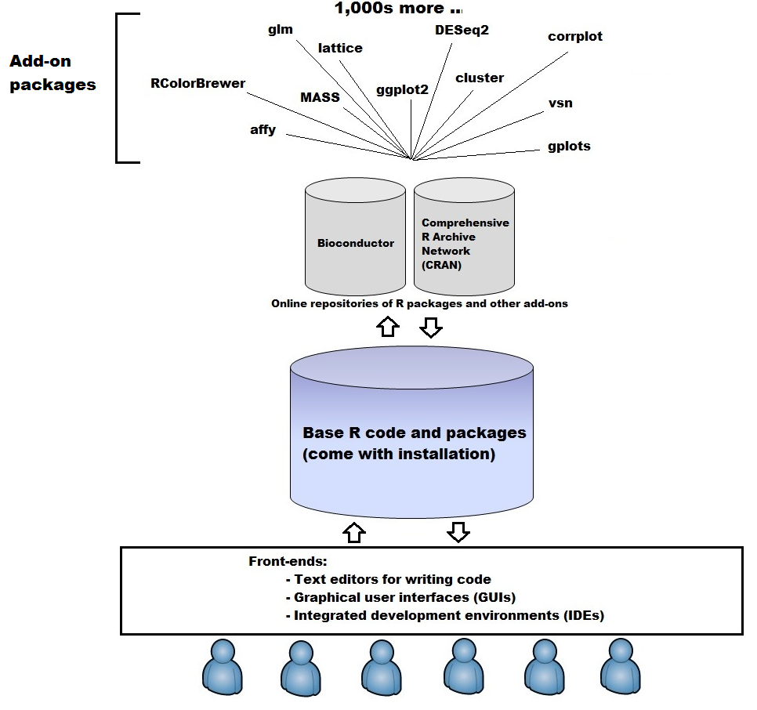

Slide 8
Today’s presentation
Introduction to R Programming Language
Structure of R
Installation and set-up
Data-types in R
Simple statistics: correlation and t-test

Slide 9
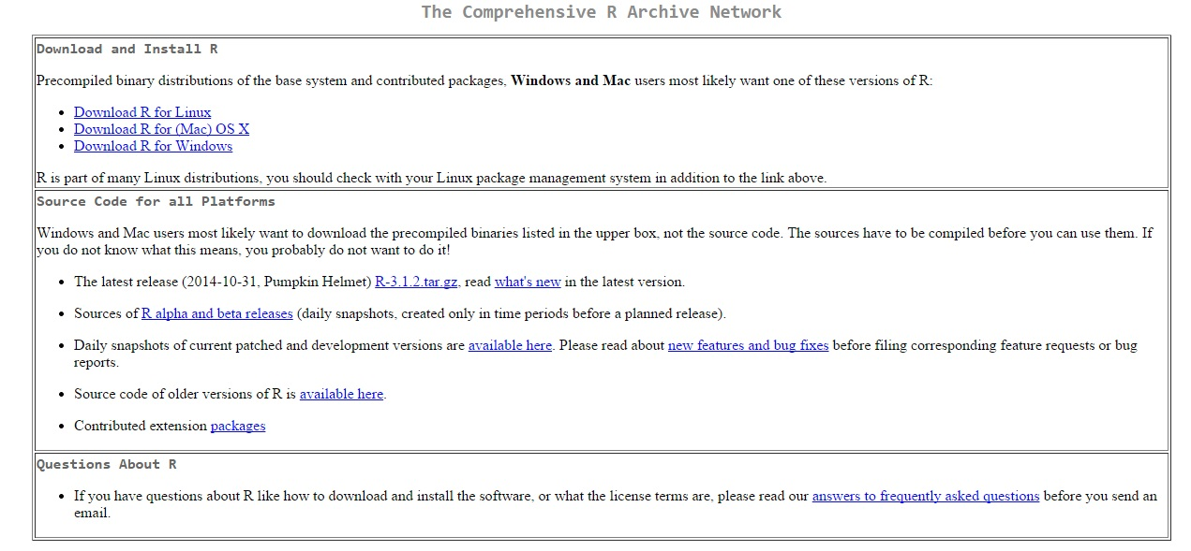
3. Installation and set-up
Navigate to the R website: http://www.r-project.org/
Select the link to download the R front-end for Windows, Mac OS, or Linux platforms
Select your 'mirror' (eight available in UK – any mirror from any country is okay)
Download the install file, execute/run it, and then proceed with installation using default settings
*One can also use Rstudio, which is an integrated development environment (IDE) that has more advanced functionality over the basic R front-end, including a console, syntax-highlighting editor, et cetera. Available from: https://www.rstudio.com/products/rstudio/download/

Slide 10
3. Installation and set-up
Once you run R, to install a package, first link your R session to an online repository. Here, we link to the very popular Bioconductor repository.
source("http://bioconductor.org/biocLite.R")
Install a suite of basic and commonly-use Bioconductor packages in one go:
biocLite()
*During installation, you may be asked to use a personal library – this is an issue when you don’t have admin access to the default install location on your PC. Select ‘yes’ to use the personal library. You may also be asked to update other packages. Selecting to update all will, generally, not cause any issues.
To download and install an individual package (here limma)
biocLite(“limma")
Load the package into your current session
library(“limma")

Slide 11
3. Installation and set-up
Packages can also be installed from the CRAN repository. Try this:
install.packages("ggplot2")
library("ggplot2")
*You will probably be asked to select your mirror during this process. Choose whichever country/territory you wish.
To get help on any function in any package, use the question mark symbol, as follows:
?plot, retrieves the help pages for the plot function
?cor, retrieves the help pages for the cor function
*If using Windows or Mac OS, a web-page should open in your default browser; if using a linux platform, the help page will open on-screen, in which case use up/down arrows to scroll and 'q' to quit)

Slide 12
Today’s presentation
Introduction to R Programming Language
Structure of R
Installation and set-up
Data-types in R
Simple statistics: correlation and t-test

Slide 13
4. Data-types in R
In R, values for all data-types are assigned using the ‘less than’ sign and hyphen typed one after the other:
<-
More intuitively, one can just use the equality sign instead of the above:
=
There are different data-types in R:
  Simple variable
  Vector
  Data matrix
  Data frame
  List
  *More complex data-types exist, but it is not yet necessary to know specifics about them
When completing the following series of commands, remember also that R is case-sensitive. For example, ‘QMUL’, ‘qmul’, and ‘QmUl’ are the same to a human, but to a computer they are entirely different.

Slide 14
4. Data-types in R: simple variable
Simple variable
Stores a single value, either numeric or text ('string')
num1 <- 23
num2 <- 34
num3 <- 3
name1 <- "Fred"
message <- "Hello world"
Then re-type the variable name to display it
Simple arithmetic can then be performed on the variables that are numeric:
Addition, num1 + num2
Subtraction, num1 - num2
Multiplication, num1 * num2
Division, num1 / num2
Power, num1^num3

Slide 15
4. Data-types in R: simple variable
For string (i.e. text) variables, use the paste function
paste(name1, "says:", message)
The paste function can also be used to merge numeric and string variables
paste("The age of", name1, "is", num1)

Slide 16
4. Data-types in R: vector
Vector
Stores a series of single values of the same type (i.e. numeric or text).
A vector can be defined using the c function, as follows:
names <- c("Fred", "Jane", "Marie", "Tom", "George")
ages <- c(23, 34, 45, 16, 55)
scaling <- c(1, 2, 3, 4, 5)
To access an individual element, indexing can be used:
Display 3rd element of names, names[3]
Display 2nd-4th element of ages, ages[2:4]
Arithmetic can also be performed on vectors:
ages*2
ages-10

Slide 17
4. Data-types in R: vector
Arithmetic can also be applied to two or more vectors
ages*scaling
ages*(scaling/10)
ages-scaling
Vectors can also be used with the paste function. Here we also use the 'sep' parameter of paste in order to control how each element is separated when displayed.
paste(names, ages, sep=", ")
paste(names, ages, sep=", age=")
Other useful functions that can be applied to vectors include:
mean, sd, max, min, length
(for example, mean(ages); sd(ages)

Slide 18
4. Data-types in R: vector
To generate a ‘random’, un-normalised vector of numbers, the runif function can be used.
Generate vectors of 50 random numbers between 0 and 100
test1 <- runif(50, 0, 100)
test2 <- runif(50, 0, 100)
To generate a ‘random’, normally-distributed vector of numbers, use rnorm.
Generate vectors of 100 normally-distributed random numbers of mean 0 and standard deviation 1.
test3 <- rnorm(100, 0, 1)
test4 <- rnorm(100, 0, 1)
Now check the distribution of values using the hist function (type these one at a time)
hist(test1)
hist(test2)
hist(test3)
hist(test4)

Slide 19
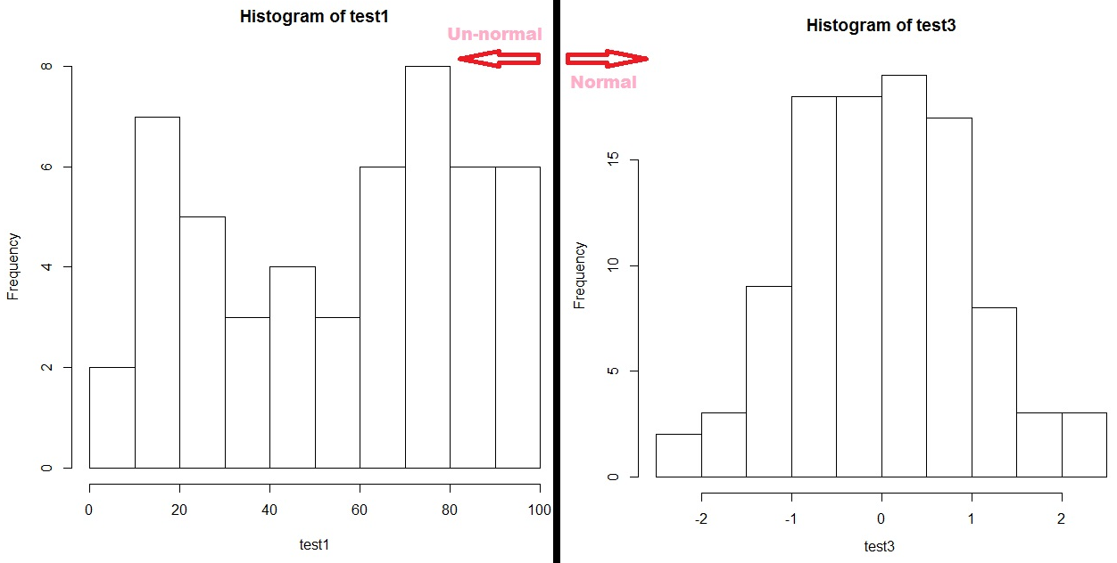

Slide 20
4. Data-types in R: data matrix
Data matrix
2-dimensional vector that can have row and column names/labels. The rows must all be the same length, as must the columns.
Generate a matrix of 50 random numbers spread across 5 rows in total
matrix1 <- matrix(runif(50, 0, 100), 5)
Check the number of rows and columns with nrow and ncol
numrows <- nrow(matrix1) …or numrows <- dim(matrix1)[1]
numrows
numcols <- ncol(matrix1) …or numcols <- dim(matrix1)[2]
numcols
Better yet, just use the ‘dim’ command to get the dimensions (rows by columns). This will store the dimensions in a vector of length 2.
dimensions <- dim(matrix1)
dimensions

Slide 21
4. Data-types in R: data matrix
Generate 2 matrices, each consisting of the merging of 3 sets of random numbers (uses cbind and rbind functions)
matrix2 <- as.matrix(cbind(runif(50, 0, 100), runif(50, 0, 100), runif(50, 0, 100)))
matrix3 <- as.matrix(rbind(runif(50, 0, 100), runif(50, 0, 100), runif(50, 0, 100)))
*Check the differences between cbind (column bind) and rbind (row bind) by displaying the matrices on screen after you’ve generated them
Merge our vectors, generated previously, and then add column names using colnames
matrix4 <- as.matrix(rbind(ages, scaling))
colnames(matrix4) <- names
matrix4

Slide 22
4. Data-types in R: data matrix
To access an individual row, column, or individual value, use the powerful sub-setting function in R through the use of square brackets, i.e. [row_index, col_index]
Element (value) at Row 3, Column 4 of matrix1, matrix1[3, 4]
First element of matrix2, matrix2[1,1]
  Last element of matrix2, matrix2[nrow(matrix2), ncol(matrix2)]
  Row 3 of matrix3, matrix3[3, ]
  Col 20 of matrix3, matrix3[, 20]
  Col 10 to 15 of matrix3, matrix3[ ,10:15]
  Row 2 to 3, Col 5 to 10 of matrix3, matrix3[2:3, 5:10]
Arithmetric operations can still be applied to matrices. See the effects of:
matrix1 + 1
matrix1 * 10
sum(matrix1)
mean(matrix1)
sd(matrix1)
matrix1 * matrix1 (i.e. matrix1^2)
matrix1 %x% matrix1
*In the final case, every element in the first matrix will be multiplied by every element in the second matrix, effectively squaring the dimensions of the resulting matrix.

Slide 23
4. Data-types in R: data matrix
Using the which function in combination with sub-setting, matrices can be filtered
First, display the ages
matrix4[1,]
Check which ages are greater than 30 - this returns column indices where the age is greater than 30.
which(matrix4[1,]>30)
To then filter the matrix using the indices, combine the which and sub-setting functions
matrix4[ , which(matrix4[1,]>30)]
This can also be achieved without the which function, as follows:
matrix4[ , matrix4[1,]>30]

Slide 24
4. Data-types in R: data frame
Data frame
A more flexible version of a data matrix, in that data of different types can be stored. The row and column lengths can also be different in certain circumstances.
Here, we create a data-frame using numbers, text, and boolean (i.e., true/false) values
a <- c(1, 2, 3, 4, 5, 6, 7, 8, 9, 10)
b <- c("male", "fem", "male", "fem", "male", "male", "male", "fem", "fem", "fem")
c <- c(45, 78, 67, 24, 90, 58, 76, 80, 90, 100)
d <- c(TRUE, TRUE, TRUE, FALSE, TRUE, TRUE, TRUE, TRUE, TRUE, TRUE)
dataframe1 <- data.frame(a, b, c, d)

Slide 25
4. Data-types in R: data frame
Add column names
colnames(dataframe1) <- c("ID", "Sex", "Mark", "Passed")
Use the dollar sign ($) to display different columns. This produces the same output as the sub-setting function
dataframe1$ID
dataframe1[ ,1]
dataframe1$Sex
dataframe1[ ,2]
The which function can again be used to filter the data-frame for those with mark greater and then less than 40
dataframe1[which(dataframe1$Mark>40), ]
dataframe1[which(dataframe1$Mark<40), ]

Slide 26
4. Data-types in R: list
List
Lists are somewhat like data frames in that they can store data of different types; however, the information in a list is not accessed in the same way as that in a data-frame.
Some functions in R output results in the form of a list.
One of the key things to know when working with lists is how to find out the different types of data stored within it. This can be accomplished using the names function.
names(list1)
Note bene – We will not be focusing on lists in this tutorial.

Slide 27
Today’s presentation
Introduction to R Programming Language
Structure of R
Installation and set-up
Data-types in R
Simple statistics: correlation and t-test

Slide 28
5. Simple statistics: correlation and t-test
Correlation
Generate two vectors of random, un-normalised numbers.
test1 <- runif(50, 0, 100)
test2 <- runif(50, 0, 100)
Quickly visualise the distribution of the data (should be un-normal) using hist, as before
hist(test1)
hist(test2)
Test the correlation between both. As the data-set is small and there is no assumption that it follows a normal distribution (i.e. it is non-parametric), use the non-parametric method Spearman rank correlation
cor(test1, test2, method="spearman")
Another function, cor.test, also performs correlation but will in addition return a P value.
cor.test(test1, test2, method="spearman")

Slide 29
5. Simple statistics: correlation and t-test
Now perform Pearson correlation on two normally-distributed parametric vectors
test3 <- rnorm(100, 0, 1)
test4 <- rnorm(100, 0, 1)
hist(test3)
hist(test4)
cor(test3, test4, method="pearson")
Remember that both runif and rnorm functions produces random numbers, but only rnorm produces normally-distributed numbers

Slide 30
5. Simple statistics: correlation and t-test
Correlation can also be applied to an individual matrix - this generates a correlation matrix.
Generate a matrix of 100 random numbers, again, this time of 10 rows
matrix5 <- matrix(runif(100, 0, 100), 10)
Add row names and col names so that we can see how the cor function behaves
rownames(matrix5) <- c("row1", "row2", "row3", "row4", "row5", "row6", "row7", "row8", "row9", "row10")
colnames(matrix5) <- c("col1", "col2", "col3", "col4", "col5", "col6", "col7", "col8", "col9", "col10")
Display the matrix to see the names and values.
matrix5

Slide 31
5. Simple statistics: correlation and t-test
Perform the correlation - as you'll see, each column is compared on a pairwise basis, i.e., each column is compared to itself and every other column.
cor(matrix5, method="spearman")
In order to perform correlation on the rows, transpose the matrix using the efficient and useful t function
matrix5_transpose <- t(matrix5)
cor(matrix5_transpose, method="spearman")
Correlation between 2 different matrices of the same dimension follows the same general idea:
matrix6 <- matrix(runif(100, 0, 100), 10)
cor(matrix5, matrix6, method="spearman")

Slide 32
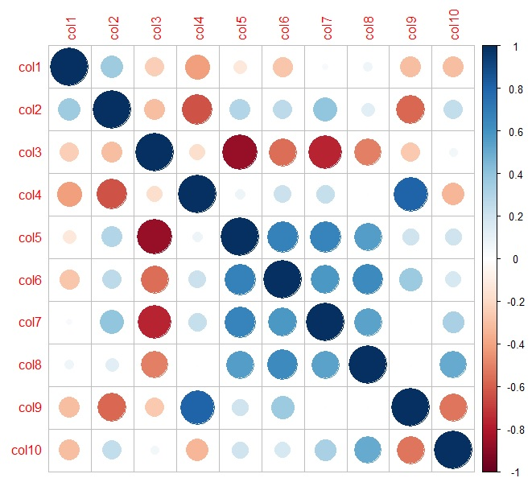
5. Simple statistics: correlation and t-test
For a nice way to visualise correlation results, use the corrplot package
biocLite("corrplot")
library("corrplot")
corrplot(cor(matrix5, method="spearman"))

Slide 33
5. Simple statistics: correlation and t-test
t-test
Perform an unpaired t-test between the two previously-defined vectors of random numbers. The results are stored in a list.
ttest_results <- t.test(test1, test2, paired=FALSE)
*Note that if it's a paired analysis, use paired=TRUE
To get a summary of the results
ttest_results
t.test is one of those R functions whose output is a list. Find out the types of results produced by this function using the names function:
names(ttest_results)
To access an individual part of the results, use the dollar sign ($)
Access P value, ttest_results$p.value

Slide 34
Congratulations on completing this course.
You have now added a new skill to your repertoire!

