Slide 1

R - lecture notes 2
Kevin Blighe, Ph.D.
Postdoctoral Researcher (Bioinformatics)
k.blighe@qmul.ac.uk
Lu Zou, Ph.D.
Postdoctoral Biostatistician
lu.zou@qmul.ac.uk

Slide 2
Introduction to lecture notes 2
Reading and writing simple data
Basic manipulation of ‘large data’
Introduction to plotting functions

Slide 3
1. Introduction to lecture notes 2
Now that we are all experts at R (and have it on our CVs), it’s time to broaden our repertoire of R functions even more…
In the majority of cases, R is not used as the sole tool to produce or analyse data.
R is, in fact, mostly used as a ‘downstream’ analysis tool, i.e., the final tool used in a workflow where all of the main results and graphics are produced.

Slide 4
1. Introduction to lecture notes 2
Practical examples of where R can be used include:
  Analysis of clinical patient data that has been compiled in a Microsoft Excel® spreadsheet
  Analysis of mass spectrometry data, stored as plain text (TXT)
  Analysis of RNA-seq data, stored as raw/normalised counts
  *Example workflow next slide
  Analysis of gene expression or DNA copy number data, stored as fluorescent intensities

Slide 5
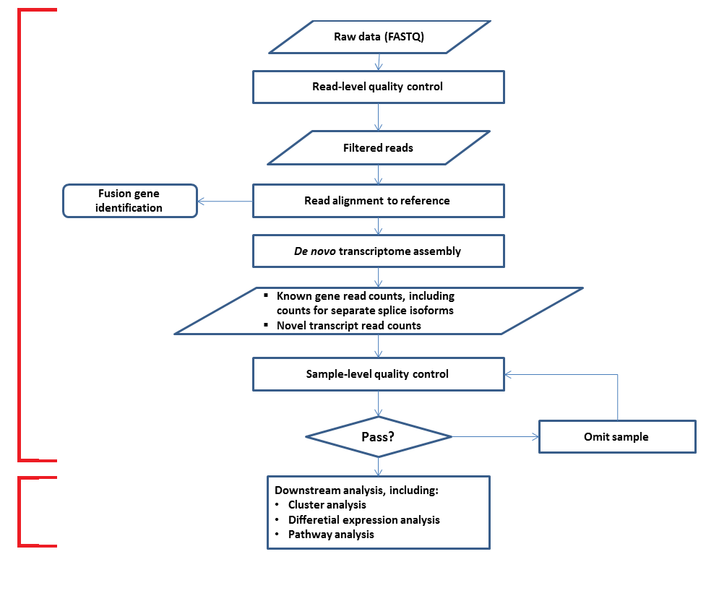
Conducted in a Unix/Linux environment using tools that are independent of R.
Conducted in R
This is a RNA-seq workflow. As you can see, most of the workflow is actually conducted outside of R, with R only used at the very end.

Slide 6
1. Introduction to lecture notes 2
R, therefore, must interact with other computer programs, workflows, et cetera.
One of the main ways that R achieves this is through the reading and writing of data from/to the ‘outside environment’.
The outside environment, in this sense, is everything that exists on your computer, your local network, removable storage, and/or the World Wide Web.

Slide 7
1. Introduction to lecture notes 2
In this set of lecture notes, you will acquire the following skills:
  Reading and writing simple data from/to your local computer.
  Reading in ‘large data’ and getting familiar with managing it within R.
  Getting introduced to plotting functions and applying them to large datasets.

Slide 8
Introduction to lecture notes 2
Reading and writing simple data
Basic manipulation of ‘large data’
Introduction to plotting functions

Slide 9
2. Reading and writing simple data
Introduction to section
Before you start to read data from your local computer, you first have to know where you are…
Each time you open a R session (as per the first set of lecture notes), your program ‘links’ itself to a certain directory on your local computer – this is called the ‘working directory’.
Within your open R session, type the following:
getwd()
What do you see? – I see the following:
[1] "C:/Users/Kevin/Documents"

Slide 10
2. Reading and writing simple data
This means that if I begin to use R functions that are designed for interacting with the external environment, these functions will automatically look in "C:/Users/Kevin/Documents", unless otherwise specified.
I do not like "C:/Users/Kevin/Documents"; so, I am going to change it…
Type the following to change your working directory to the default temporary directory:
setwd("C:/temp") *Windows
setwd("/tmp") *MAC OS
There is a much easier way to change the working directory. In your open R session, go to ‘File’ (at the top) and then click on ‘Change dir…’
There, select the directory into which you saved the file SmallData.txt
*The adventurous amongst you can try to change to this directory using the setwd() command

Slide 11
2. Reading and writing simple data
Reading-in data from a local file
Read in data using the ‘read.table’ function. This reads the data into a data-frame (a data-frame allows for text and numerical data together – review your notes from the first lecture)
smalldata <- read.table("SmallData.txt", sep="\t", dec=".", header=TRUE, skip=0, na.strings="NA")
Display the contents of the file:
smalldata
What do you see?

Slide 12
2. Reading and writing simple data
Here is an explanation of each of the parameters used with the read.table function:
  “SmallData.txt” → The name of the file whose contents you are reading-in
  sep=“\t” → Instructs R to expect the fields (columns) in the file as tab-spaces
  *Sometimes, columns are separated by a comma (‘,’) or space (“ “) and are not tab-delimited
  dec=“.” → Instructs R that the decimal point used for numbers in the file is the full-stop
  *In many countries —such as Italy, Spain, Argentina, etc.— the decimal symbol is a comma (‘,’)
  header=TRUE → Instructs R that the file contains a header, i.e., names for each column
  skip=0 → Instructs R to skip zero lines in the file being read
  na.strings=“NA” → Instructs R that we will be using ‘NA’ for any missing values

Slide 13
2. Reading and writing simple data
Bring up the help page of the read.table function in order to understand it better
?read.table
‘Wrappers’ for the read.table function exist, such as ‘read.csv’ and ‘read.delim’; however, as these are wrappers of read.table, they are fundamentally built on read.table and do not provide much additional functionality.
As per the first set of R notes, you can now view different parts of your data-frame, such as individual or multiple rows or columns —or even just individual values— using the sub-setting function. Let’s do a revision (next slide):

Slide 14
2. Reading and writing simple data
Element (value) at Row 3, Column 4, smalldata[3, 4]
Dimensions (rows and columns), dim(smalldata)
First value, smalldata[1, 1]
Number of rows, nrow(smalldata)
Number of columns, ncol(smalldata)
Last value, smalldata[nrow(smalldata), ncol(smalldata)]
*same as smalldata[25, 4]
  Row 2, smalldata[2, ]
  Column 2 to 3, smalldata[ ,2:3]
  Row 20 to 25, Column 1 to 3, smalldata[20:25, 1:3]
Display ‘Population’ column values, smalldata$Population
Which populations are greater than 1 billion?,
smalldata[which(smalldata$Population > 1000000000),]
Order by country name, smalldata[order(smalldata$Country),]

Slide 15
2. Reading and writing simple data
Writing data to a local file
Before we learn how to write data from the R environment to our local disk, let’s manipulate our World population data-frame a little…
We are going to add a new column that will contain the projected population in 1 year’s time. We can use the information contained within columns 2 (Population) and 4 (Growth [per year]) in order to achieve this.
As the data in the growth column is percent increase, we must divide the population by 100 and then multiply by the growth percent:
(smalldata$Population/100) * smalldata$Growth
*same as (smalldata[,2]/100) * smalldata[,4]
This gives the population increase/decrease per year for each country; however, the values are returned with decimal places. We must round them up to integers (whole numbers):
round(((smalldata$Population/100) * smalldata$Growth), 0)

Slide 16
2. Reading and writing simple data
Let’s get a little more cunning… we want to add the projected population as a new [fifth] column. We can do this using the ‘cbind’ (‘column bind’) function.
First, save the projected increase/decrease in an array:
Projected1YearIncDec <- round(((smalldata$Population/100) * smalldata$Growth), 0)
Then, save the projected 1 year population in another array by adding the projected increase/decrease to the current population:
Projected1YearPop <- smalldata$Population + Projected1YearIncDec
Then, bind the data as a fifth column and store the new data-frame as a new object called ‘smalldatav2’:
smalldatav2 <- cbind(smalldata, Projected1YearPop)
smalldatav2
*One can also try:
smalldatav2 <- data.frame(smalldata, Projected1YearPop)

Slide 17
2. Reading and writing simple data
Now, write the new data frame to the local disk:
write.table(smalldatav2, "SmallDatav2.txt", sep= " \t", append=FALSE, row.names=FALSE, col.names=TRUE, quote=FALSE)
Check that the contents were written. The new file should be in the same directory as that to which you changed earlier in these notes
Here is an explanation of each of the parameters used with the read.table function:
  smalldatav2 → The R data frame whose contents you are going to write to the local disk.
  “SmallDatav2.txt” → The name of the file to which you are going to write the contents of the smalldatav2 R object.
  sep=“\t” → Instructs R to separate the fields (columns) in the file as tab-spaces.
  append=FALSE → If the file ‘SmallDatav2.txt’ already exists, then this will result in R overwriting its contents.
  *append=TRUE would result in appending the contents of the R object smalldatav2 to the file

Slide 18
2. Reading and writing simple data
  row.names=FALSE → If the smalldatav2 data-frame has row names, this instructs R not to write them to the file
  col.names=TRUE → If the smalldatav2 data-frame has column names, this instructs R to write them to the file
  quote=FALSE → Instructs R to not use quotation marks when writing out words to file
  *Numbers will automatically not have quotes, unless they have been factorised in the data-frame being written to file

Slide 19
Introduction to lecture notes 2
Reading and writing simple data
Basic manipulation of ‘large data’
Introduction to plotting functions

Slide 20
3. Basic manipulation of ‘large data’
Now, we are going to get our first taste of ‘large data’… We are going to read in a fake/testing data-set containing 50,000 probe values across 20 samples (10 controls; 10 disease samples)
Although this is actually quite small when compared to modern day microarray chips, the data-set is sufficiently large such that you cannot analyse it by simply using your eye.
Read in the file LargeData.txt
largedata <- read.table("LargeData.txt", sep="\t", dec=".", header=TRUE, skip=0, na.strings="NA")
Try to display the data … you’ll see that R eventually gives up because the data-set is too large
largedata

Slide 21
3. Basic manipulation of ‘large data’
Let’s check the dimensions of the data
dim(largedata)
You should see 50000 x 21. You’ll notice how R says that there are 21 columns. The extra column (20 samples + 1 unknown) is due to the probe names having also been read in by R as the first column from the file.
We need to switch this column to become the row names. We can do this using the following sequence of commands:
rownames(largedata) <- largedata[,1]
*Assigns the contents of the first column of largedata as the rownames of the data-frame
largedata <- largedata[,-1] or largedata <- (largedata[,2:ncol(largedata)])
*Both of these commands do the same thing, i.e., eliminate the first column. Try to understand why both are doing the same thing

Slide 22
3. Basic manipulation of ‘large data’
Now that our data-set is ready, try to become familiar, again, with the subsetting functions. See the effects of:
largedata[1:5,]
largedata[1:5,1:5]
largedata[40000:40050,]
In order to do some very basic diagnostics in R, we can use the quite versatile ‘apply’ function
Get the means of all rows (probes), apply(largedata, 1, mean)
*’1’ indicates to apply the function row-wise
*One can also use rowMeans(largedata)
Get the means of all columns (samples), apply(largedata, 2, mean)
*’2’ indicates to apply the function column-wise
*One can also use colMeans(largedata)
With the ‘apply’ function, instead of ‘mean’, you can also use ‘var’ (variance), ‘sd’ (standard deviation), ‘min’ (minimum value), and ‘max’ (maximum value)

Slide 23
3. Basic manipulation of ‘large data’
When we deal with large data, more often than not there is a lot of ‘meta’ data associated with the numerical data. Meta-data is anything that describes other data – for us, meta-data comes in the form of clinical information for patients.
Let’s read in some meta-data for our file LargeData.txt
largemetadata <- read.table("LargeMetaData.txt", sep="\t", dec=".", header=TRUE, skip=0, na.strings="NA")
Display the contents of the meta-data
largemetadata
You’ll see that we have the following columns:
SampleID, DiseaseState, Ethnicity, Surgery, DiseaseUnitsAtDiagnosis

Slide 24
3. Basic manipulation of ‘large data’
In order to use meta-data, there has to be information that links it to the numerical data. In our example, the key is the SampleID
Next, we are going to merge the meta-data with the numerical data in order to create a ‘unified’ data-set. If you look at the meta-data, however, you’ll see that the sample IDs are not ordered in the same was as per the numerical data – this complicates the merging, but we can still achieve our goal by using the sample ID as lookup.
In order to merge the datasets, use the following sequence of commands:
translargedata <- t(largedata)
*Transposes the numerical data so that we have samples as rows and probes as columns
lookupindices <- match(rownames(translargedata), largemetadata$SampleID)
*Returns a row index. ‘Match’ searches for each rowname of ‘translargedata’ in largemetadata$SampleID and returns it’s row index in largemetadata

Slide 25
3. Basic manipulation of ‘large data’
Using the lookup indices, re-order the meta-data such that it is lined up, row-by-row, for merging with the numerical data
largemetadatav2 <- largemetadata[lookupindices,]
largemetadatav2
Merge the re-ordered meta-data with the numerical data
largedatav2 <- cbind(largemetadatav2, translargedata)
Set the row names of the new merged data-set
rownames(largedatav2) <- largedatav2[,1]
Remove the first column, which have just became the row names through the previous command
largedatav2 <- largedatav2[,-1]
Display the first 10 columns of the unified data-set
largedatav2[,1:10]

Slide 26
3. Basic manipulation of ‘large data’
Now that we have a working data-set in hand, it’s time to learn how we can filter different parts of it.
First, select out only the disease samples (and the first 8 columns):
largedatav2[which(largedatav2$DiseaseState %in% "Disease"),1:8]
Select out only the Italians (and the first 8 columns):
largedatav2[which(largedatav2$Ethnicity %in% "White_Italian"),1:8]
Eliminate the Irish sample:
largedatav2[-which(largedatav2$Ethnicity %in% "White_Irish"),1:8]
*To select just the Irish sample, use:
largedatav2[which(largedatav2$Ethnicity %in% "White_Irish"),1:8]

Slide 27
Introduction to lecture notes 2
Reading and writing simple data
Basic manipulation of ‘large data’
Introduction to plotting functions

Slide 28
4. Introduction to plotting functions
With our same data as before (largedatav2), we are now going to perform some basic plotting and statistics.
First, as we can only plot numerical data, save a new object that contains just the numerical portion of our data-frame:
plotdata <- largedatav2[,5:ncol(largedatav2)]
Boxplot
Create a boxplot of the data and use the ‘DiseaseState’ to name the samples
boxplot(t(plotdata), main="Boxplot testing", names=largedatav2$DiseaseState, las=2)
*Note that we have to transpose plotdata using the ‘t’ function. This is due to the way that the ‘boxplot’ function uses the data, i.e., it creates boxplots column-wise. If we did not transpose plotdata, then a boxplot of each probe would be created.
*Note also that attention must be given to the labeling system that is used. The order of labels in the largedatav2$DiseaseState object must match the ordering of samples (columns) in t(plotdata).

Slide 29
4. Introduction to plotting functions
Trust me – data never looks that neat when it comes fresh from the instrument! ☺
Set some plotting colours to shade the samples according to disease state:
plotcolours <- c(rep("red", 10), rep("blue", 10))
*Look up the ‘rep’ function to see how it functions
Re-create the boxplot using the new colour-scheme – the ‘col’ parameter of the boxplot function is required
boxplot(t(plotdata), main="Boxplot testing", names=largedatav2$DiseaseState, las=2, col=plotcolours)

Slide 30
4. Introduction to plotting functions
Histogram
Generate a histogram for each sample to check the distribution of probe values. Divide the values into 50 bins using the ‘break’ parameter
hist(t(plotdata), breaks=50, main="Histogram testing")
Pairs correlation plot
Explore the correlation between the first 5 probes using a ‘pairs’ plot – this can be a useful diagnostic tool if problems are encountered with any particular probe in a dataset:
pairs(plotdata[,1:5], cex=0.8)
*’cex’ is a very useful parameter used in all graphics functions – it controls the size/scaling of plotting elements. By default, cex is 1.0

Slide 31
4. Introduction to plotting functions
Heatmap with dendrogram
Generate a very rudimentary heatmap with clustering dendrograms for all samples using the first 40 probes:
heatmap(as.matrix(t(plotdata))[1:40,], ColSideColors=plotcolours)
In real experimental data, generating a simple heatmap like this is insufficient as there are many ways in which the data can be scaled and clustered. In addition, we are only clustering using 40 probes here.
Principal components analysis bi-plot
Perform principal components analysis and create a bi-plot
pca <- prcomp(plotdata)
plot(pca$x, type="n", main="PCA bi-plot")
points(pca$x, col=plotcolours, pch=16, cex=1.5)
You’ll notice that the controls (blue dots) are all piled into the same position. This is because they are very similar to each other, whereas the disease samples (red dots) are more different from each other.

Slide 32
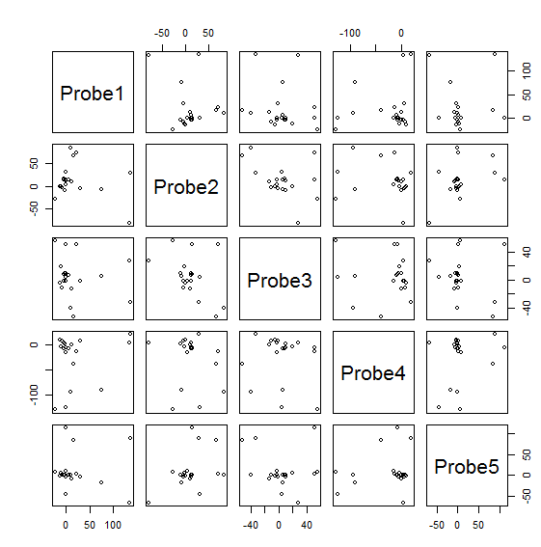
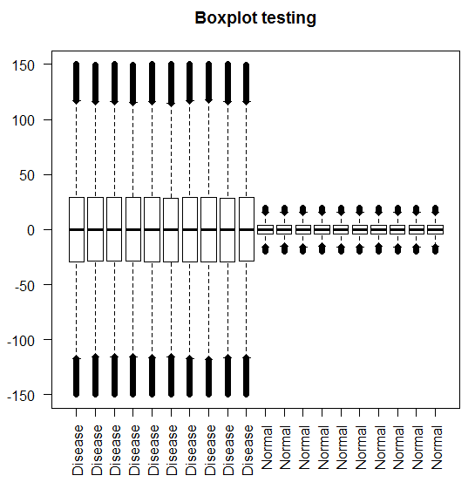
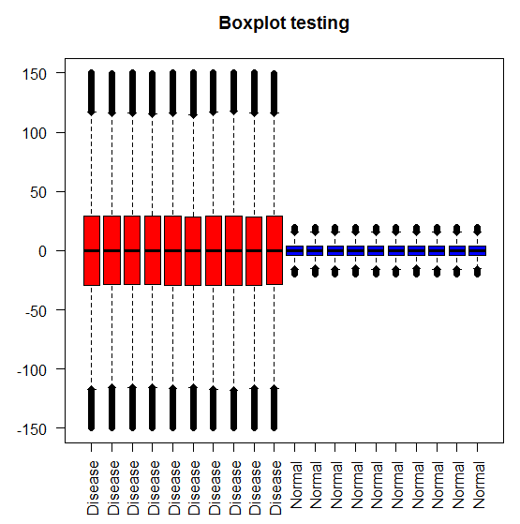
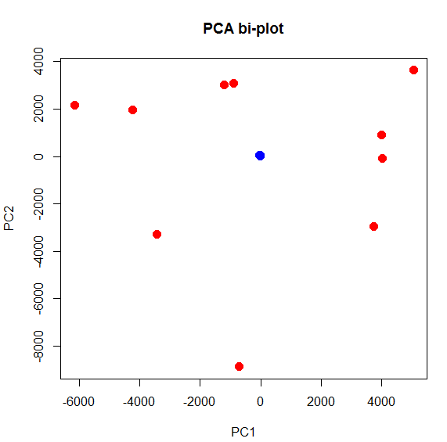
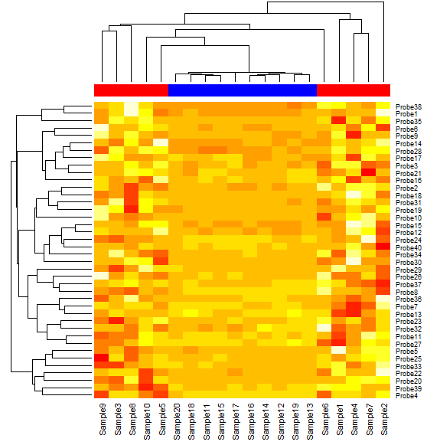
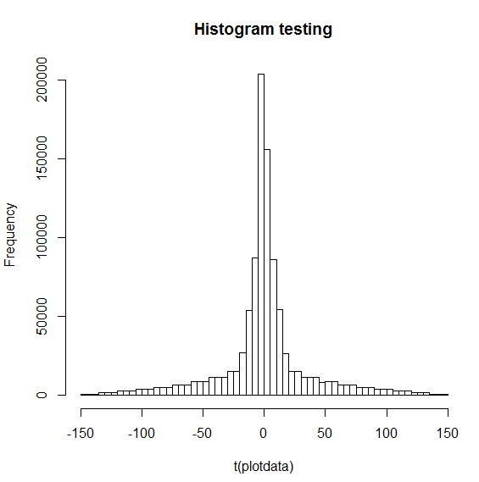
Plots generated in this R training session

Slide 33
Congratulations on completing this second R training course!
You can now [almost] begin to convince others that you can code in R...

