Slide 1
To clear creds credential manager
http://bit.ly/credkiller
Copy and Paste into non admin command prompt

Slide 2
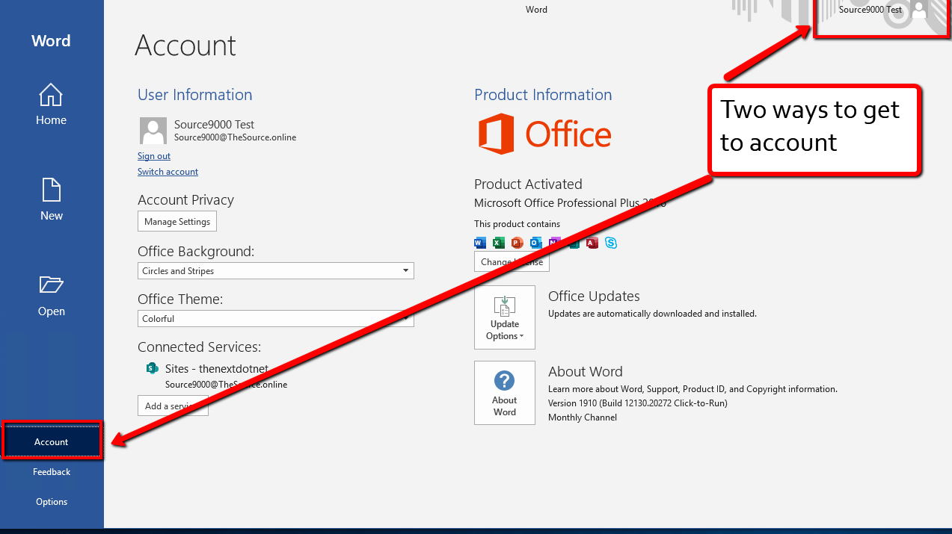

Slide 3
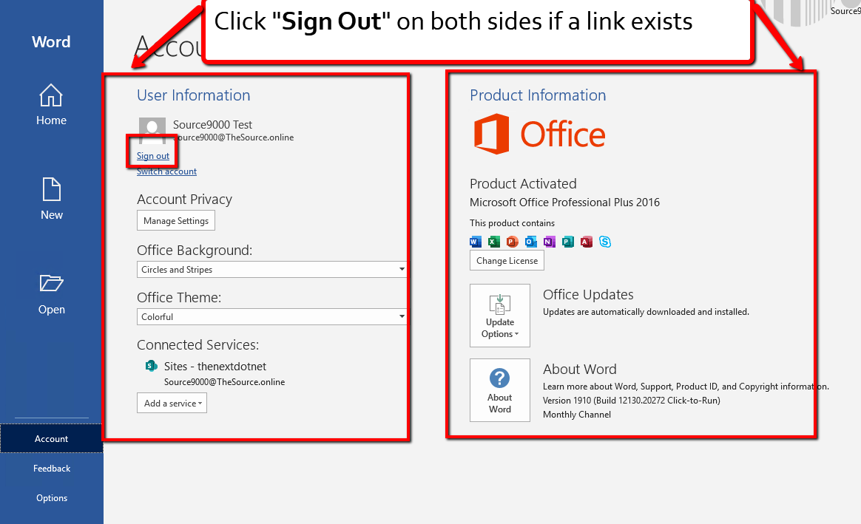

Slide 4
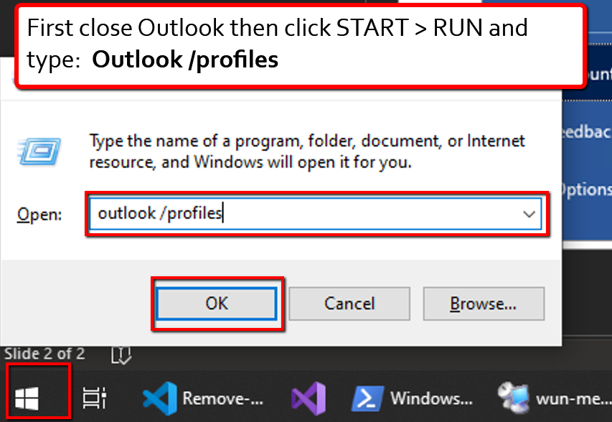

Slide 5
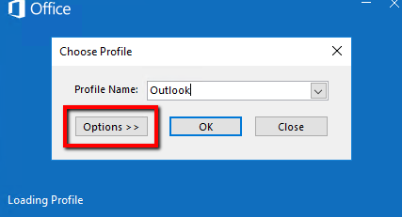
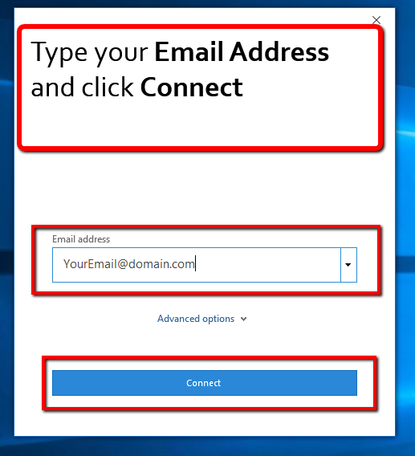
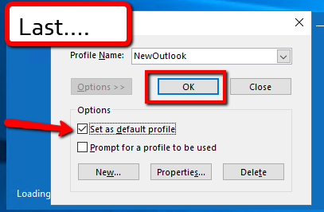
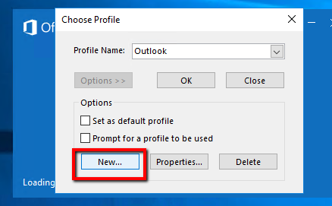
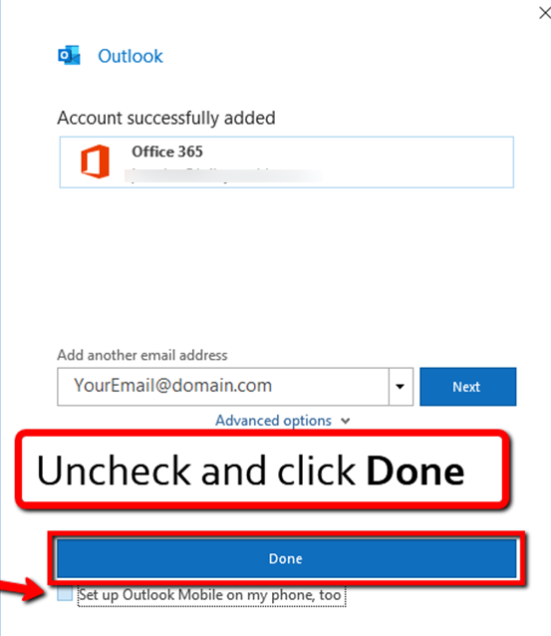
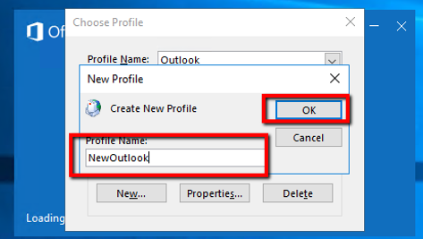

Slide 6
Save to notepad and name with .vbs extension:
To this location:
C:\scripts\offclean.vbs
http://bit.ly/remlicense
Then run this from a command prompt
cscript "C:\scripts\offclean.vbs“ if it worked the result will just be this:
Microsoft (R) Windows Script Host Version 5.812 Copyright (C) Microsoft Corporation. All rights reserved.

