Slide 1
To clear creds credential manager
for /F "tokens=1,2 delims= " %G in ('cmdkey /list ^| findstr Target') do cmdkey /delete %H
Same text can be found here
http://bit.ly/credkiller
Copy and Paste into non admin command prompt

Slide 2
http://bit.ly/remlicense
Save the text in the link to notepad and name with .vbs extension:
To this location:
C:\scripts\offclean.vbs
Then run this from a command prompt
cscript "C:\scripts\offclean.vbs“ if it worked the result will just be this:
Microsoft (R) Windows Script Host Version 5.812 Copyright (C) Microsoft Corporation. All rights reserved.

Slide 3
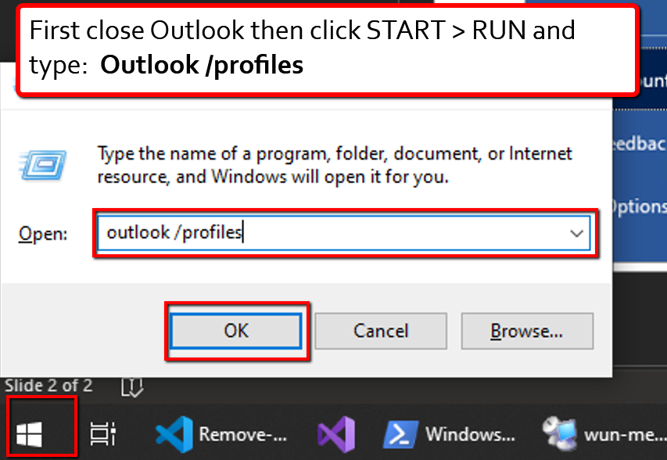
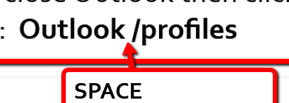
Note the space after Outlook
Note: In rare cases, some computers require Outlook.exe /profiles

Slide 4
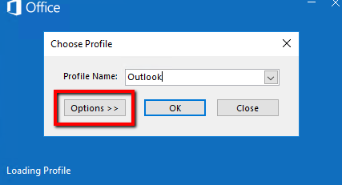
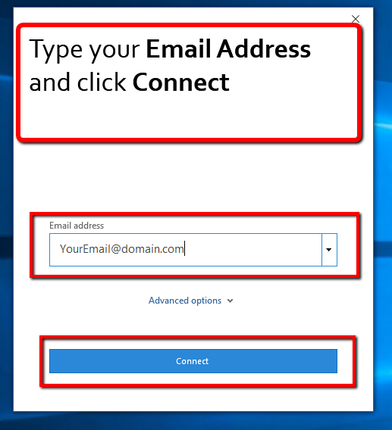
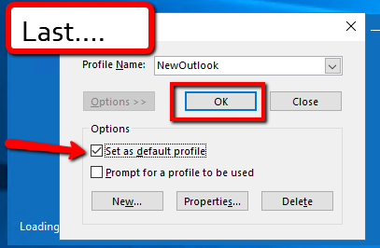
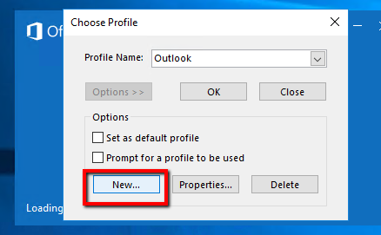
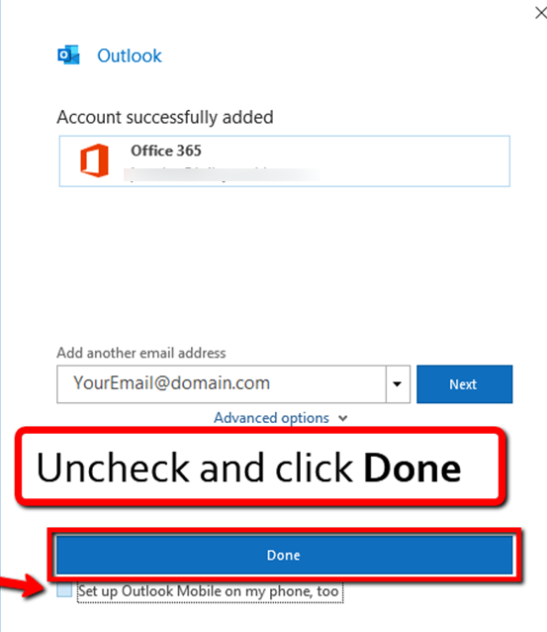
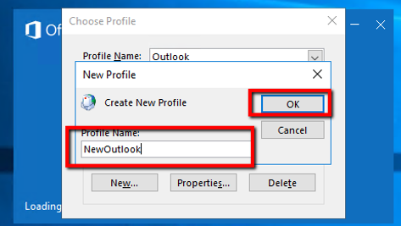

Slide 5
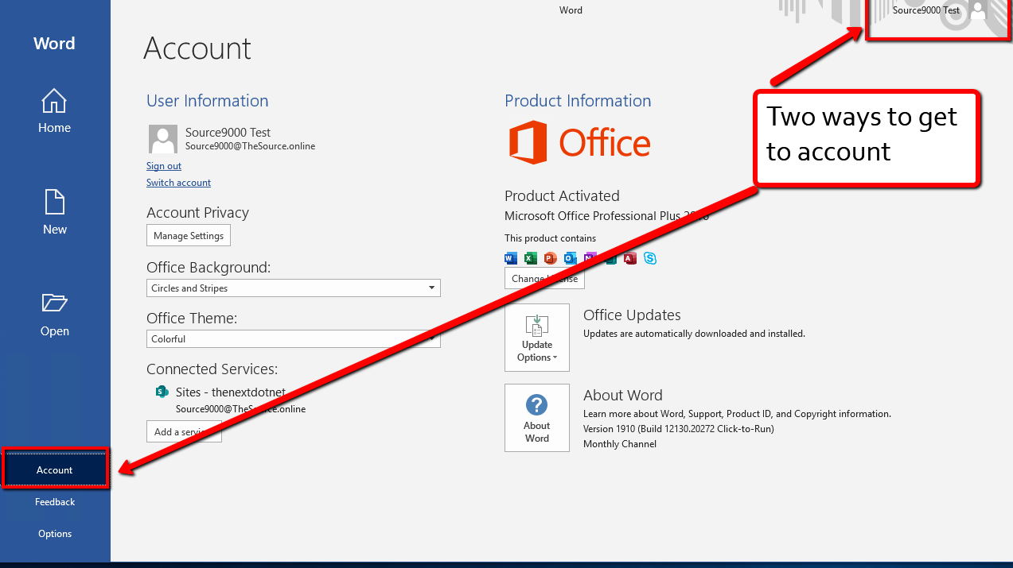
If needed, remove connected Services - OneDrive and SharePoint

Slide 6
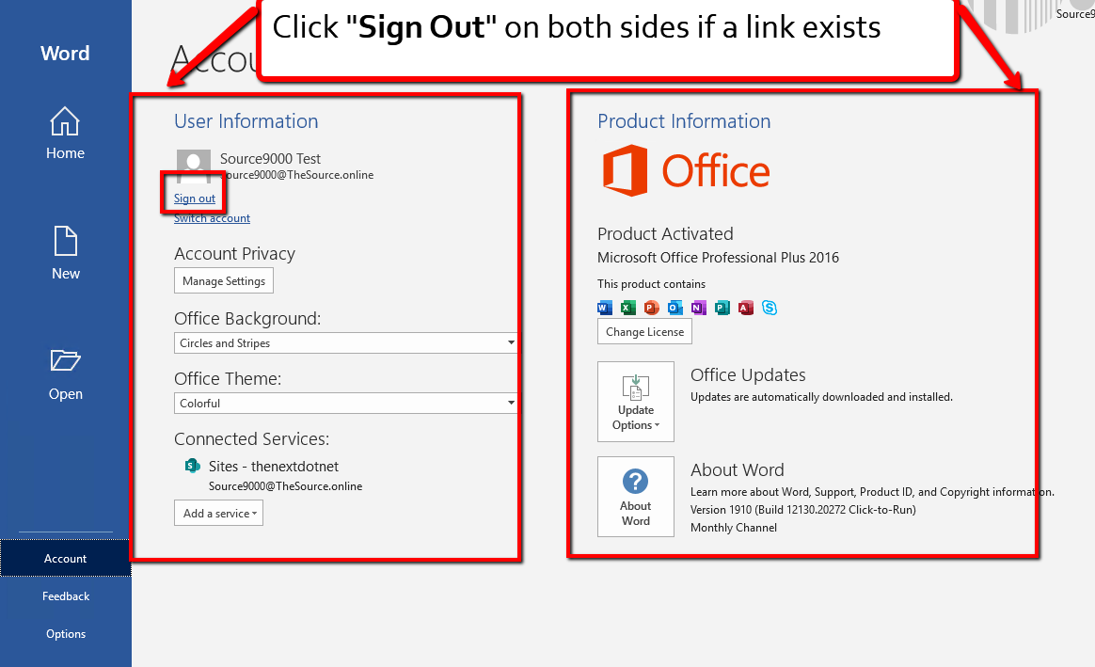
remove connected Services - OneDrive and SharePoint

