Slide 1
iPhone X vs Galaxy S9
A Twitter Analysis
Doyle Ervin
Andrew Egelhof
Kansas State University
MIS 670
Spring 2018

Slide 2
Business Case & Questions
The Apple iPhone X and Samsung Galaxy S9 are the two most popular smartphones available today.
How are tweets about the two phones different?
How are tweets about the two phones the same?
Do descriptive, content and network analytics on tweets provide insight to what sets users of the two devices apart?

Slide 3
Data Gathering
A dataset of tweets was gathered over 24 hours from ##/##/#### to ##/##/#### using Python scripting (tweepy) and the Twitter API.
For iPhone X tweets the following terms were used:
#iPhoneX','iPhoneX', and 'iPhone X’
For Galaxy S9 tweet the following terms were used:
'galaxys9','samsungs9', '#GalaxyS9','Galaxy S9’
Overall 38,000 tweets were collected for analysis.

Slide 4
Data Gathering
For the tweets collected the following data was available for each tweet:
Text of the tweet
Screen Name of the Twitter User
Location (optional)
Whether it is a Retweet or Original tweet
Hashtags user
User Mentions
URLs within the tweets
Language of the tweet

Slide 5
iPhone X Analysis

Slide 6
iPhone X Descriptive Analytics Important Findings
26,458 Total tweets
21,541 Unique users
10,521 Original Tweets
15,937 Retweets
22,516 User Mentions
4,849 URLs
7,215 Hashtags
1.2 Avg. tweets Per User
0.85 User Mentions per tweet
0.18 URLs per tweet
0.27 Hashtags per tweet

Slide 7
iPhone X Content Analytics Findings
Most Popular terms in iPhone X tweets
‘Iphone’, ‘giveaway’, ‘post’, ‘notification’, ‘lang’, ‘para’
After data cleaning, the python package genism topic analysis showed an optimal number of topics at 3.
Topics were broken down into:
Life, living and social media
Photography
Prize contests and giveaways

Slide 8

iPhone X Network Analysis Findings
Fruchterman Reingold Layout
Text size scaled on Eigenvector Centrality
Avg. Degree 2.096
Over 2100 classes
0.936 Modularity
Graph Density 0.04
Most popular nodes are related to a contest of Giveaway for free things.
Additionally, photography or art is popular as well.

Slide 9
Galaxy S9 Analysis

Slide 10
Galaxy S9 Descriptive Analytics Important Findings
8,168 Total tweets
6,169 Unique users
4,374 Original Tweets
3,793 Retweets
7,642 User Mentions
4,231 URLs
6,996 Hashtags
1.3 Avg. tweets Per User
0.94 User Mentions per tweet
0.52 URLs per tweet
0.86 Hashtags per tweet

Slide 11
Galaxy S9 Content Analytics Findings
Most Popular terms in iPhone X tweets
‘galaxy’, ‘samsung’, ‘plus’, ‘case’, ‘giveaway’, ‘new’
After data cleaning, the python package genism topic analysis showed an optimal number of topics at 4.
Topics were broken down into:
Samsung Galaxy giveaway
Galaxy S9 video. The slow motion video mode is a popular feature.
Galaxy S9 comparison to Huwaei P20 Pro phone
Galaxy S9 AR Emoji feature.

Slide 12
Galaxy S9 Sentiment Analysis
Sentiment analysis was performed against English tweets using TextBlob which relies on the Pattern package.
There were 1006 tweets with positive polarity
There were 248 tweets with negative polarity
There were 1384 tweets with neutral polarity
That's 38.1% positive, 9.4% negative, and 52.5% neutral

Slide 13
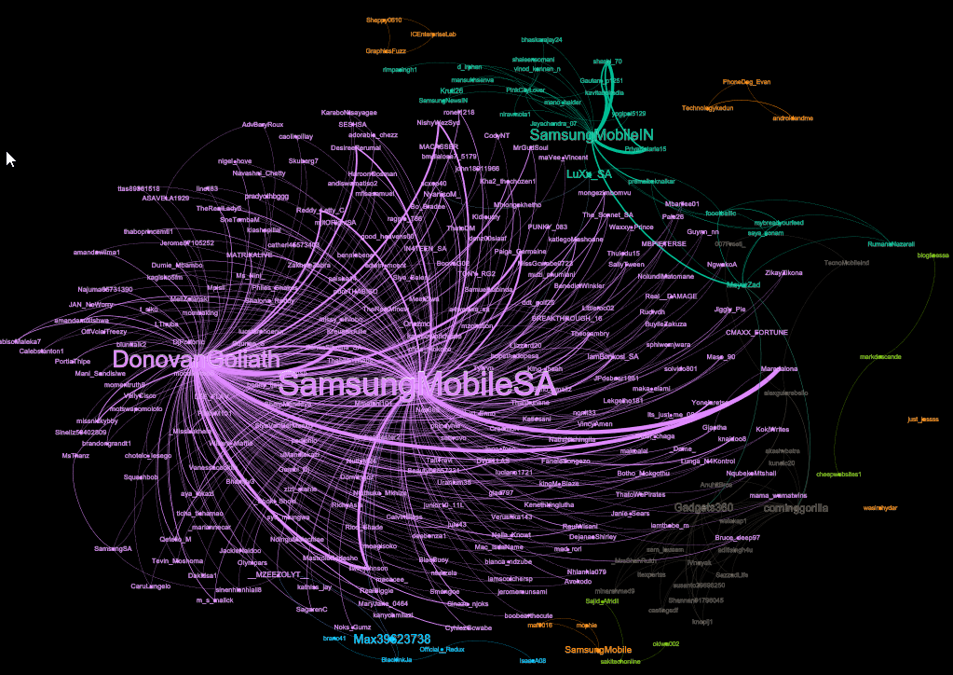
Galaxy S9 Network Analytics (Mention Network)
Several orphaned clusters not connected to the central figures.
Based on Degree and Eigenvector centrality, central figures are
DonovanGoliath (comedian in South Africa)
SamsungMobileSA (Samsung Mobile South Africa)
Corninggorilla (Gorilla Glass)

Slide 14
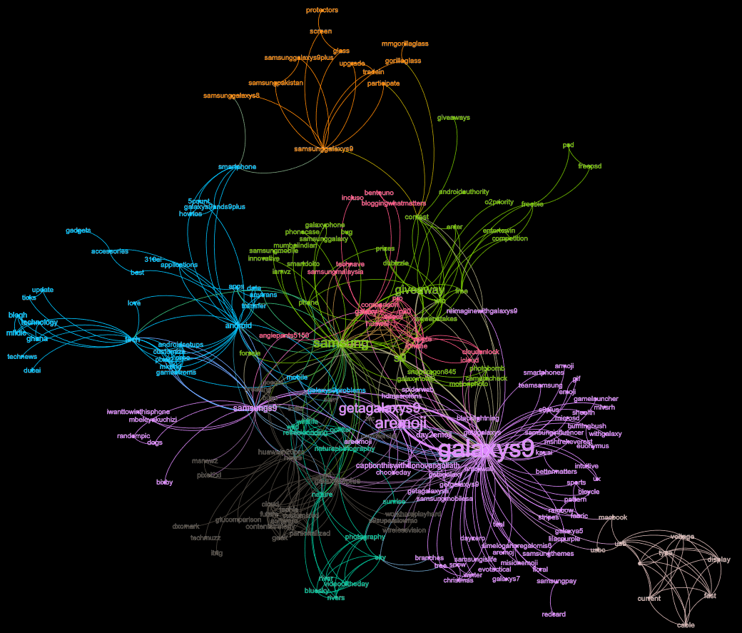
Galaxy S9 Network Analytics (Co-Hashtag Network)
Centrality Analysis.
Weighted degree centrality most influential hashtags are #galaxys9, #aremoji, #getagalaxys9, #samsung, #giveaway.
Eigenvector centrality most influential hashtags are #galaxys9, #samsung, #samsungs9, #android, #galaxys9plus.
Betweenness centrality most influential are #galaxys9, #samsung, #android, #samsungs9, #contest.
Clustering Analysis
Largest cluster associated with #galaxys9. Topic appears to be AR Emoji feature and promoting Galaxy S9.
Second largest cluster associated with #samsung. Topic appears to be Galaxy S9 giveaways.
Third largest cluster associated with #tech. Topic appears to be about technology, Galaxy S9, and Android.

Slide 15
Final Analysis

Slide 16
Final Analysis, Differences
“Tweet share” 74.9% iPhone X and 23.1% Galaxy S9
Vs. Actual Market share of 21.9% Samsung, 15.2% Apple ¹
Sentiment Analysis
iPhone X 47.0% Positive, 5.3% Negative, 47.8% Neutral
Galaxy S9 38.1% Positive, 9.4% Negative, 52.5% Neutral

Slide 17
Final Analysis, Differences
FIX SUMSUNG #’s

Slide 18
Final Analysis, Differences
Tweet Metrics
Item | Samsung Galaxy S9 | iPhone X
Retweet % | 31.40% | 60.00%
Original Tweet % | 68.50% | 39.60%
Tweets From Unique Users | 67.3 | 81.1
Avg. Tweets Per User | 1.48 | 1.22
Avg. Hashtag per Tweet | 0.78 | 0.27
Avg. User Mentions per Tweet | 0.91 | 0.85
Avg. URLs per Tweet | 1.42 | 0.18
FIX SUMSUMG #’s

Slide 19
Final Analysis, Similarities
Many tweets from both sides contained tweets about contests or giveaways.
Photography is another popular subject among the two sides
Only Overlapping Top 10 User Mention, @Youtube. #7 on iPhone X and #2 on Galaxy S9
Only Overlapping Top 10 word frequency was “Giveaway”, #2 on iPhone X and #4 on Galaxy S9
Only Overlapping #Hashtag was again “#giveaway”, @5 on iPhone X and #2 on Galaxy S9

Slide 20
Final Analysis, Insight
Based upon tweet volume and sentiment, there appears to be more enthusiasm for iPhone X than the Galaxy S9. There were 3 times as many tweets about the iPhone X than the Galaxy S9 even though Samsung has a larger market share.
Smart phones are much more than just phones to users. From hashtag analysis and topic modelling, these phones are used for creating and capturing memories through photography, videos, and augmented reality (Animoji & AR Emoji).
Both topics commonly share YouTube videos as evidenced by the user mentioning.
Galaxy S9 Users more commonly use hashtags, do more user mentions and include more URLs than iPhone X users

Slide 21
References
1. http://fortune.com/2018/02/13/apple-iphone-samsung-market-share/

