Slide 1
iPhone X vs Galaxy S9
A Twitter Analysis
Doyle Ervin
Andrew Egelhof
Kansas State University
MIS 670
Spring 2018

Slide 2
Business Case & Questions
The Apple iPhone X and Samsung Galaxy S9 are the two most popular smartphones available today.
How are tweets about the two phones different?
How are tweets about the two phones the same?
Do descriptive, content and network analytics on tweets provide insight to what sets users of the two devices apart?

Slide 3
Data Gathering
A dataset of tweets was gathered over 24 hours from ##/##/#### to ##/##/#### using Python scripting (tweepy) and the Twitter API.
For iPhone X tweets the following terms were used:
#iPhoneX','iPhoneX', and 'iPhone X’
For Galaxy S9 tweet the following terms were used:
'galaxys9','samsungs9', '#GalaxyS9','Galaxy S9’
Overall 38,000 tweets were collected for analysis.

Slide 4
Data Gathering
For the tweets collected the following data was available for each tweet:
Text of the tweet
Screen Name of the Twitter User
Location (optional)
Whether it is a Retweet or Original tweet
Hashtags user
User Mentions
URLs within the tweets
Language of the tweet

Slide 5
iPhone X Descriptive Analytics Important Findings
26,458 Total tweets
21,541 Unique users
10,521 Original Tweets
15,937 Retweets
22,516 User Mentions
4,849 URLs
7,215 Hashtags
1.2 Avg. tweets Per User
0.85 User Mentions per tweet
0.18 URLs per tweet
0.27 Hashtags per tweet

Slide 6
iPhone X Content Analytics Findings
Most Popular terms in iPhone X tweets
‘Iphone’, ‘giveaway’, ‘post’, ‘notification’, ‘lang’, ‘para’
After data cleaning, the python package genism topic analysis showed an optimal number of topics at 3.
Topics were broken down into:
Life, living and social media
Photography
Prize contests and giveaways

Slide 7
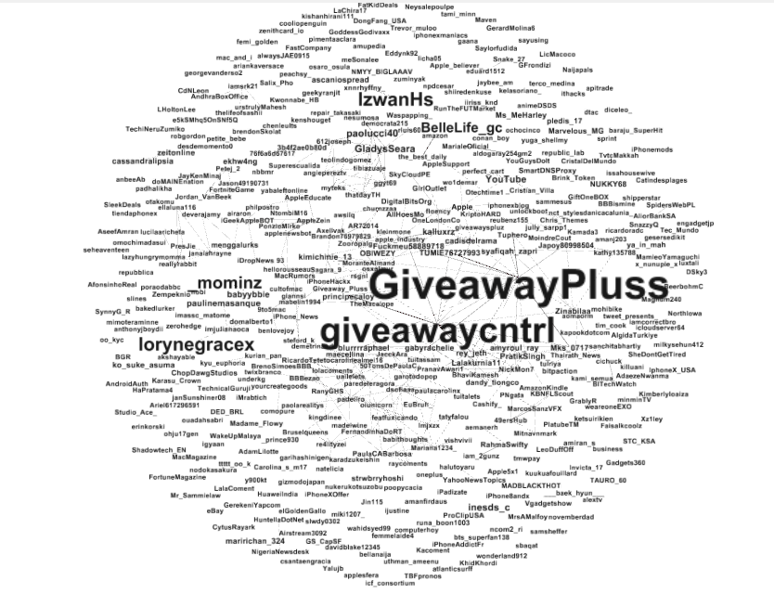
iPhone X Content Network Analysis Findings
Fruchterman Reingold Layout
Text size scaled on Eigenvector Centrality
Avg. Degree 2.096
Over 2100 classes
0.936 Modularity
Graph Density 0.04
Most popular nodes are related to a contest of Giveaway for free things.
Additionally, photography or art is popular as well.

Slide 8
Galaxy S9 Descriptive Analytics Important Findings
8,168 Total tweets
6,169 Unique users
4,374 Original Tweets
3,793 Retweets
7,642 User Mentions
4,231 URLs
6,996 Hashtags
1.3 Avg. tweets Per User
0.94 User Mentions per tweet
0.52 URLs per tweet
0.86 Hashtags per tweet

Slide 9
Galaxy S9 Content Analytics Findings
Most Popular terms in iPhone X tweets
‘galaxy’, ‘samsung’, ‘plus’, ‘case’, ‘giveaway’, ‘new’
After data cleaning, the python package genism topic analysis showed an optimal number of topics at 4.
Topics were broken down into:
Samsung Galaxy giveaway
Galaxy S9 video. The slow motion video mode is a popular feature.
Galaxy S9 comparison to Huwaei P20 Pro phone
Galaxy S9 AR Emoji feature.

Slide 10
Galaxy S9 Sentiment Analysis
Sentiment analysis was performed against English tweets using TextBlob which relies on the Pattern package.
There were 1006 tweets with positive polarity
There were 248 tweets with negative polarity
There were 1384 tweets with neutral polarity
That's 38.1% positive, 9.4% negative, and 52.5% neutral

Slide 11
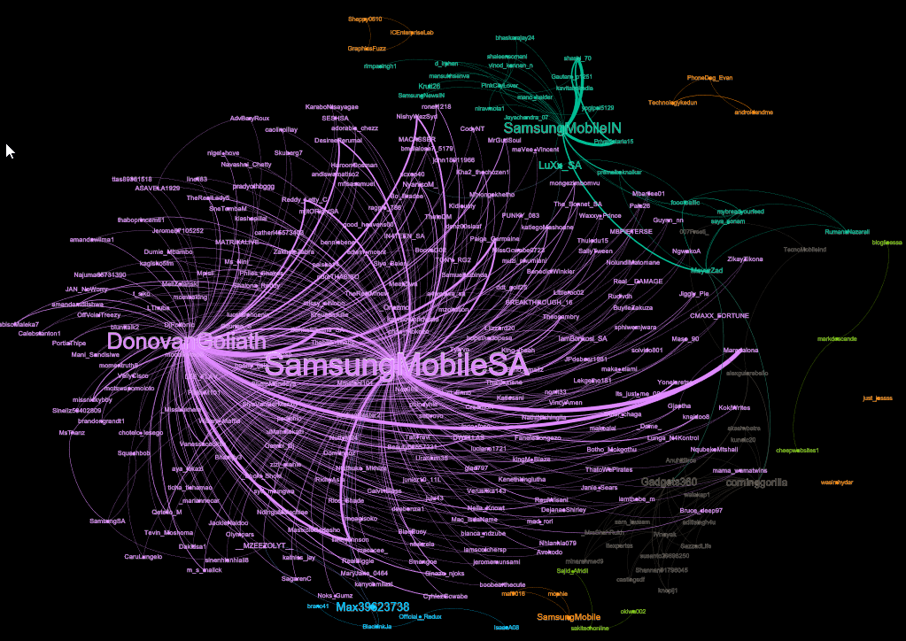
Galaxy S9 Network Analytics (Mention Network)
Several orphaned clusters not connected to the central figures.
Based on Degree and Eigenvector centrality, central figures are
DonovanGoliath (comedian in South Africa)
SamsungMobileSA (Samsung Mobile South Africa)
Corninggorilla (Gorilla Glass)

Slide 12
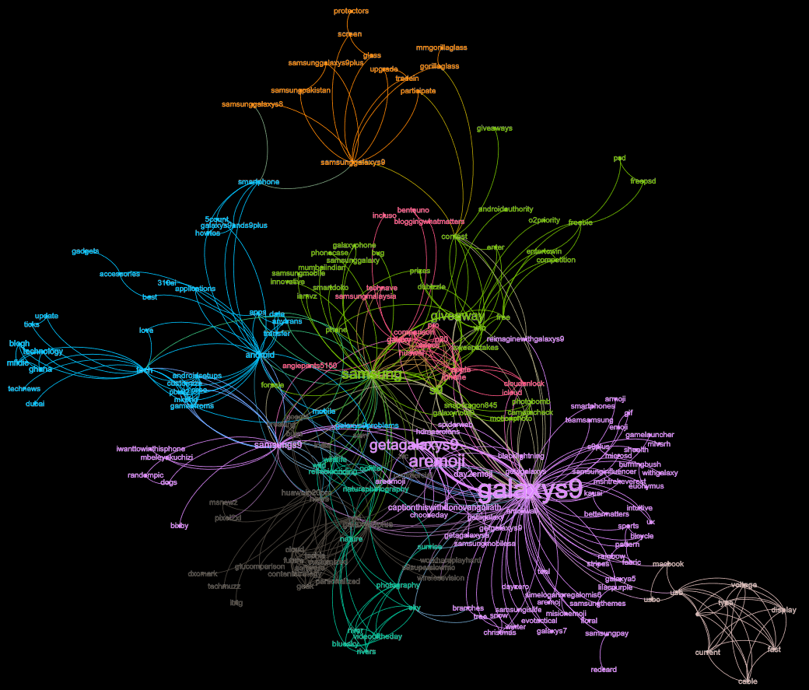
Galaxy S9 Network Analytics (Co-Hashtag Network)
Centrality Analysis.
Weighted degree centrality most influential hashtags are #galaxys9, #aremoji, #getagalaxys9, #samsung, #giveaway.
Eigenvector centrality most influential hashtags are #galaxys9, #samsung, #samsungs9, #android, #galaxys9plus.
Betweenness centrality most influential are #galaxys9, #samsung, #android, #samsungs9, #contest.
Clustering Analysis
Largest cluster associated with #galaxys9. Topic appears to be AR Emoji feature and promoting Galaxy S9.
Second largest cluster associated with #samsung. Topic appears to be Galaxy S9 giveaways.
Third largest cluster associated with #tech. Topic appears to be about technology, Galaxy S9, and Android.

Slide 13
Final Analysis

