Slide 1
Real-time fraud inference with a transaction foundation model
Technical blueprint and business value — Cloudera AI + Impala on VAST Data S3
Thursday, July 9, 2026

Slide 2
Agenda
A working fraud-inference application, and why the platform underneath it matters
1 | The application: live fraud scoring on Cloudera AI
2 | Blueprint: the full flow on Cloudera + VAST Data
3 | The platform services behind the application
4 | Configuring VAST Data behind Impala
5 | Why Cloudera on VAST Data
6 | The value: proof points and what it unlocks

Slide 3
Technical Blueprint
Part 1

Slide 4
What the Application Is
A fraud-inference cockpit — an Applied ML Prototype running on Cloudera AI
Score any card transaction in real time, with foundation-model context
One CML application: React front end, FastAPI backend and GPU inference in a single container
NVIDIA Transaction Foundation Model produces a 512-d embedding per transaction, feeding three XGBoost heads: raw features, embeddings, combined
Data prep and model export run as background jobs over the 24M-row TabFormer card-transaction dataset
Every byte lives once — Parquet on VAST S3, registered as Impala external tables
Everything runs on a single NVIDIA L4 24 GB GPU with RAPIDS — cuDF, cuML, XGBoost on one RMM memory pool

Slide 5
Blueprint: The Full Flow on Cloudera + VAST Data
DataFlow ingests, Impala queries, Cloudera AI scores — one copy of the data, as Parquet on VAST
SOURCES & CONSUMERS
Transaction sources
payment switch · streams · files
BI & ad-hoc SQL
analysts, dashboards, Hue
Fraud cockpit
this application — live scoring UI
CLOUDERA DATA PLATFORM
Cloudera DataFlow
NiFi flows ingest & enrich events, land Parquet
Cloudera Data Engineering
scheduled prep: temporal splits, refresh
Data Warehouse — Impala
EXTERNAL TABLES on s3a:// · SQL in place
Cloudera AI (GPU)
TFM embeddings · XGBoost · live inference
SDX — one catalog, one security model, full lineage across every service
VAST Data — S3 storage layer
s3://mschuler-cloudera @ s3.previewhub.dev · Parquet, open formats · one copy for every engine

Slide 6




End-to-End Data Flow
From the payment switch to the fraud desk — one copy of the data all the way
01
02
03
Ingest
Cloudera DataFlow streams card transactions from source systems and lands them as Parquet on VAST.
Prepare & query
Data Engineering builds the temporal training splits; Impala external tables make them queryable in place.
Train & serve
Cloudera AI turns transactions into TFM embeddings, trains the XGBoost heads and serves live fraud scores.

Slide 7
The Platform Services Behind the Application
Each Cloudera service plays one role — VAST holds the one copy of the data they all share
Cloudera DataFlow — continuous, schema-aware ingest from payment switches, files and APIs, landing Parquet on VAST
Cloudera Data Engineering — scheduled jobs that build and refresh the temporal training splits
Cloudera Data Warehouse (Impala) — SQL on those same objects for the application, analysts and BI
Cloudera AI — GPU notebooks and jobs for embeddings and training, plus the deployed fraud cockpit itself
SDX — one catalog, one security model and full lineage across every service that touches the VAST bucket

Slide 8
Configuring VAST Data Behind Impala
Four bucket-scoped properties in Cloudera Data Warehouse — no base-cluster changes, nothing else affected
Cloudera Data Warehouse side
Set the same four fs.s3a properties on the Impala Virtual Warehouse (coordinator, executor, catalogd) and on the Database Catalog metastore:
fs.s3a.bucket.mschuler-cloudera.endpoint = https://s3.previewhub.dev
fs.s3a.bucket.….path.style.access = true — required by VAST
fs.s3a.bucket.….access.key / .secret.key — config properties, never SQL SET
Then CREATE DATABASE … LOCATION 's3a://mschuler-cloudera/…' — the URI names bucket and path only, never the endpoint hostname
VAST Data side
One namespace, served to every engine on the platform:
S3-enabled view with an identity policy scoped to the bucket (mschuler-cloudera)
DNS endpoint s3.previewhub.dev on a VIP pool, with TLS the warehouse JVM trusts
Path-style addressing and standard SigV4 — the same S3 semantics NiFi, Impala and Cloudera AI all speak
Validate end to end: CREATE EXTERNAL TABLE probe → INSERT → SELECT, then list the bucket and watch the Parquet land

Slide 9
The Value of Cloudera on VAST Data
Part 2

Slide 10
Why Cloudera on VAST Data
Three pillars this application proves in practice
One open lakehouse
Parquet on S3-compatible storage — no proprietary formats
Impala queries the very objects your applications write
External tables let storage and compute scale independently
AI where the data lives
GPU training and inference inside Cloudera AI
Data never leaves governance to reach a GPU
Foundation-model scoring on a single, modest L4
Exabyte-scale economics
VAST all-flash keeps hot and historical data on one tier
Train on full history, not a sampled window
S3 semantics your teams already operate

Slide 11

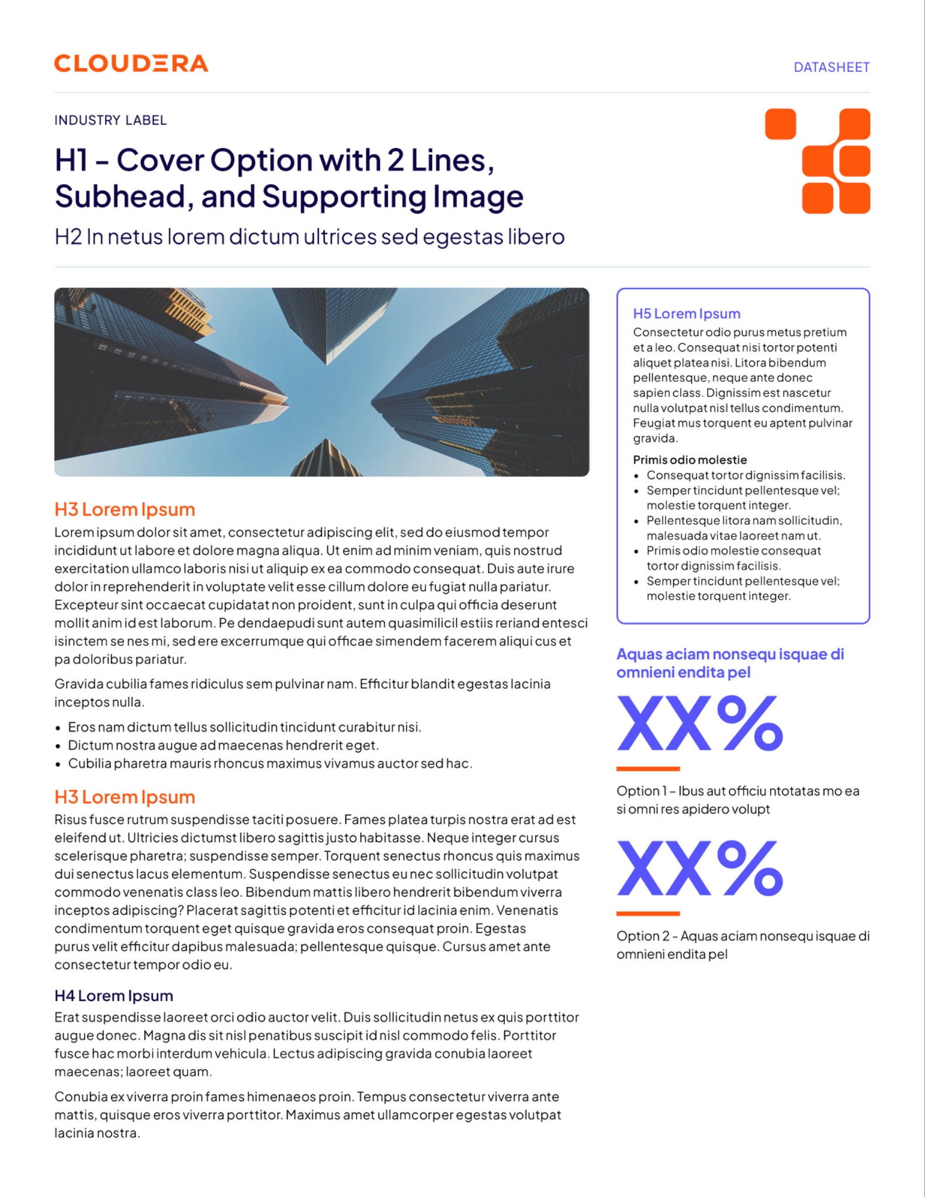
What This Unlocks
From a demo pattern to production fraud programs
Real-time decisions with context
Foundation-model embeddings see behavior that rules and point features miss — and score it in milliseconds
Faster iteration: prepare → embed → retrain is a repeatable platform job, not a data-science science project
One governed copy of the data serves warehouse SQL, GPU training and BI simultaneously
The same stack generalizes: AML, credit risk, payments abuse, churn
Commodity GPU footprint — this entire pipeline fits one NVIDIA L4

Slide 12
Proof Points from the Running Application
Measured on Cloudera AI over VAST Data S3
24M
Transactions, one platform
TabFormer card transactions prepared, split and governed entirely inside Cloudera — no copies leaving the lakehouse.
512-d
Context per transaction
Every transaction is scored with a 512-dimension foundation-model embedding — behavioral context rules never see.
3
Models, one verdict
Raw-feature, embedding and combined XGBoost heads run side by side, so the lift from AI is measured, not asserted.

Slide 13
Thank You

