Slide 1


A novel differentiable unification of least absolute deviations and least squares
Kevin Burke | University of Limerick

Slide 2
LEAST SQUARES VS ABSOLUTE DEVIATIONS

Slide 3
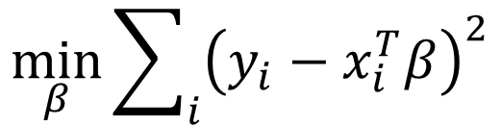
LEAST SQUARES VS ABSOLUTE DEVIATIONS
Least squares
$$\min_{β}{\sum_{i}{{\left(y_{i}−x_{i}^{T}β\right)}^{2}}}$$

Slide 4
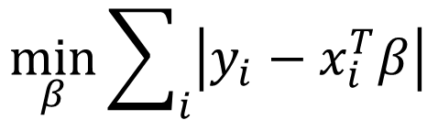
LEAST SQUARES VS ABSOLUTE DEVIATIONS
Least squares
$$\min_{β}{\sum_{i}{{\left(y_{i}−x_{i}^{T}β\right)}^{2}}}$$
Least absolute deviations
$$\min_{β}{\sum_{i}{\left|y_{i}−x_{i}^{T}β\right|}}$$

Slide 5

LEAST SQUARES VS ABSOLUTE DEVIATIONS
Least squares
$$\min_{β}{\sum_{i}{{\left(y_{i}−x_{i}^{T}β\right)}^{2}}}$$
Least absolute deviations
$$\min_{β}{\sum_{i}{\left|y_{i}−x_{i}^{T}β\right|}}$$
Model
$$y_{i}=x_{i}^{T}β+σε_{i}$$

Slide 6
LEAST SQUARES VS ABSOLUTE DEVIATIONS
Least squares
$$\min_{β}{\sum_{i}{{\left(y_{i}−x_{i}^{T}β\right)}^{2}}}$$
Gaussian
Least absolute deviations
$$\min_{β}{\sum_{i}{\left|y_{i}−x_{i}^{T}β\right|}}$$
Model
$$y_{i}=x_{i}^{T}β+σε_{i}$$

Slide 7
LEAST SQUARES VS ABSOLUTE DEVIATIONS
Least squares
$$\min_{β}{\sum_{i}{{\left(y_{i}−x_{i}^{T}β\right)}^{2}}}$$
Gaussian
Least absolute deviations
Laplace
$$\min_{β}{\sum_{i}{\left|y_{i}−x_{i}^{T}β\right|}}$$
Model
$$y_{i}=x_{i}^{T}β+σε_{i}$$

Slide 8
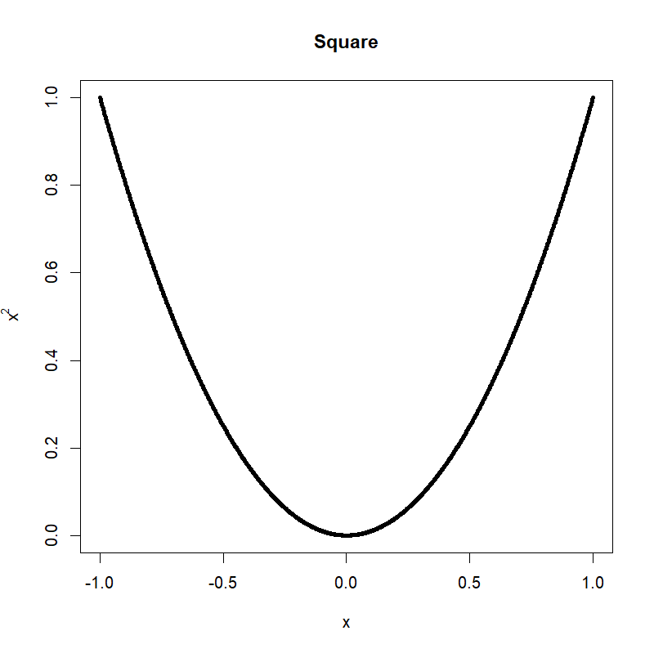
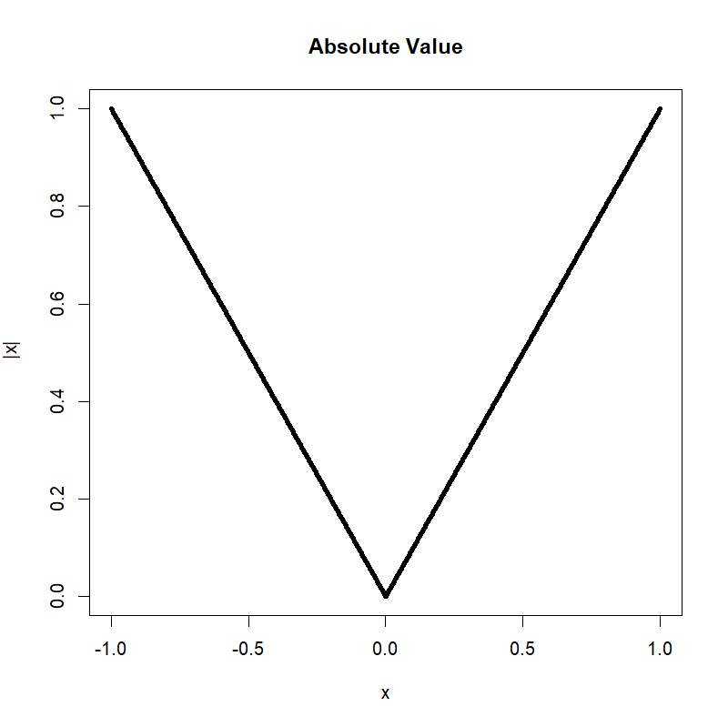
SQUARE VS ABSOLUTE VALUE FUNCTION

Slide 9
SQUARE VS ABSOLUTE VALUE FUNCTION
Differentiable

Slide 10
SQUARE VS ABSOLUTE VALUE FUNCTION
Differentiable
Non-Differentiable

Slide 11

DIFFERENTIABLE APPROXIMATION
$$a_{τ}\left(x\right)= \sqrt{x^{2}+τ^{2}}−τ$$
Jaouimaa, Ha, & Burke (2019). Penalized Variable Selection in Multi-Parameter Regression Survival Modelling. arXiv.
Burke & Patilea (2021). A likelihood-based approach for cure regression models. TEST.

Slide 12

DIFFERENTIABLE APPROXIMATION
$$\sqrt{x^{2}}=\left|x\right|$$
$$a_{τ}\left(x\right)= \sqrt{x^{2}+τ^{2}}−τ$$
Jaouimaa, Ha, & Burke (2019). Penalized Variable Selection in Multi-Parameter Regression Survival Modelling. arXiv.
Burke & Patilea (2021). A likelihood-based approach for cure regression models. TEST.

Slide 13
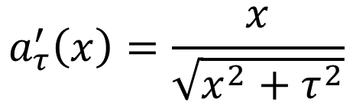
DIFFERENTIABLE APPROXIMATION
$$\sqrt{x^{2}}=\left|x\right|$$
$$a_{τ}\left(x\right)= \sqrt{x^{2}+τ^{2}}−τ$$
$$a_{τ}^{′}\left(x\right)=\frac{x}{\sqrt{x^{2}+τ^{2}}}$$
(differentiable)
Jaouimaa, Ha, & Burke (2019). Penalized Variable Selection in Multi-Parameter Regression Survival Modelling. arXiv.
Burke & Patilea (2021). A likelihood-based approach for cure regression models. TEST.

Slide 14
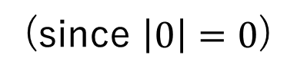

DIFFERENTIABLE APPROXIMATION
$$\sqrt{x^{2}}=\left|x\right|$$
$$a_{τ}(0)=0$$
(since $\left|0\right|=0$)
$$a_{τ}\left(x\right)= \sqrt{x^{2}+τ^{2}}−τ$$
$$a_{τ}^{′}\left(x\right)=\frac{x}{\sqrt{x^{2}+τ^{2}}}$$
(differentiable)
Jaouimaa, Ha, & Burke (2019). Penalized Variable Selection in Multi-Parameter Regression Survival Modelling. arXiv.
Burke & Patilea (2021). A likelihood-based approach for cure regression models. TEST.

Slide 15
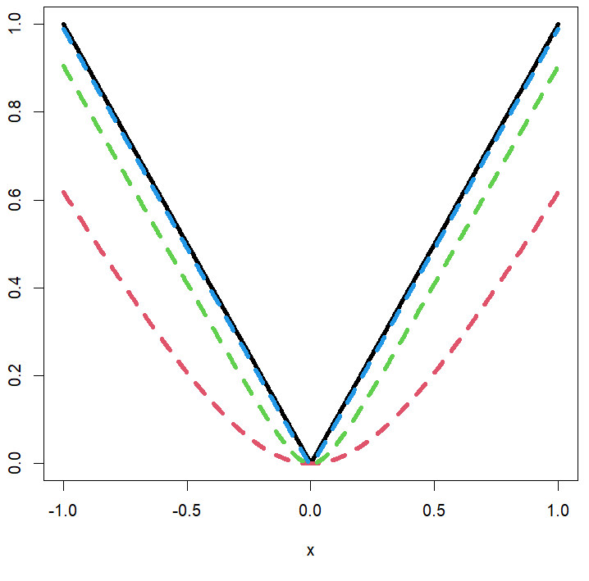




DIFFERENTIABLE APPROXIMATION
$$\sqrt{x^{2}}=\left|x\right|$$
$$a_{τ}(0)=0$$
(since $\left|0\right|=0$)
$$a_{τ}\left(x\right)= \sqrt{x^{2}+τ^{2}}−τ$$
$$τ=0.01$$
$$\lim_{τ→0}{a_{τ}\left(x\right)}=\left|x\right|$$
$$τ=0.1$$
$$a_{τ}^{′}\left(x\right)=\frac{x}{\sqrt{x^{2}+τ^{2}}}$$
$$τ=0.5$$
(differentiable)
Jaouimaa, Ha, & Burke (2019). Penalized Variable Selection in Multi-Parameter Regression Survival Modelling. arXiv.
Burke & Patilea (2021). A likelihood-based approach for cure regression models. TEST.

Slide 16
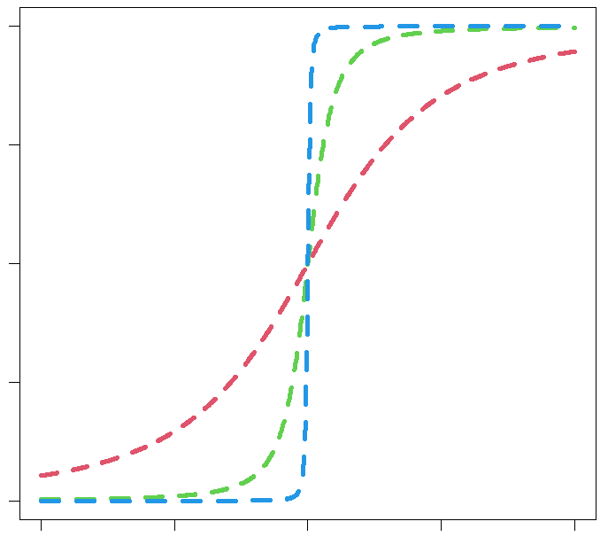

DIFFERENTIABLE APPROXIMATION
$$\sqrt{x^{2}}=\left|x\right|$$
$$a_{τ}(0)=0$$
(since $\left|0\right|=0$)
$$a_{τ}\left(x\right)= \sqrt{x^{2}+τ^{2}}−τ$$
$$τ=0.01$$
$$\lim_{τ→0}{a_{τ}\left(x\right)}=\left|x\right|$$
$$τ=0.1$$
$$a_{τ}^{′}\left(x\right)=\frac{x}{\sqrt{x^{2}+τ^{2}}}$$
$$τ=0.5$$
(differentiable)
1.0
$$a_{τ}′(x)$$
0.0
-1.0
-1.0
0.0
1.0
Jaouimaa, Ha, & Burke (2019). Penalized Variable Selection in Multi-Parameter Regression Survival Modelling. arXiv.
Burke & Patilea (2021). A likelihood-based approach for cure regression models. TEST.

Slide 17

SMOOTH LAPLACE DISTRIBUTION
$$y=x^{T}β+σε$$

Slide 18
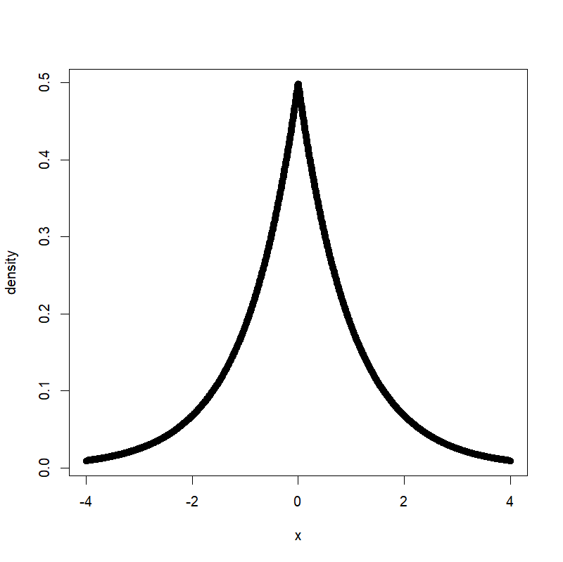


SMOOTH LAPLACE DISTRIBUTION
$$y=x^{T}β+σε$$
$$f\left(ε\right)=\frac{1}{2}e^{−\left|ε\right|}$$
Laplace
$$ε$$

Slide 19
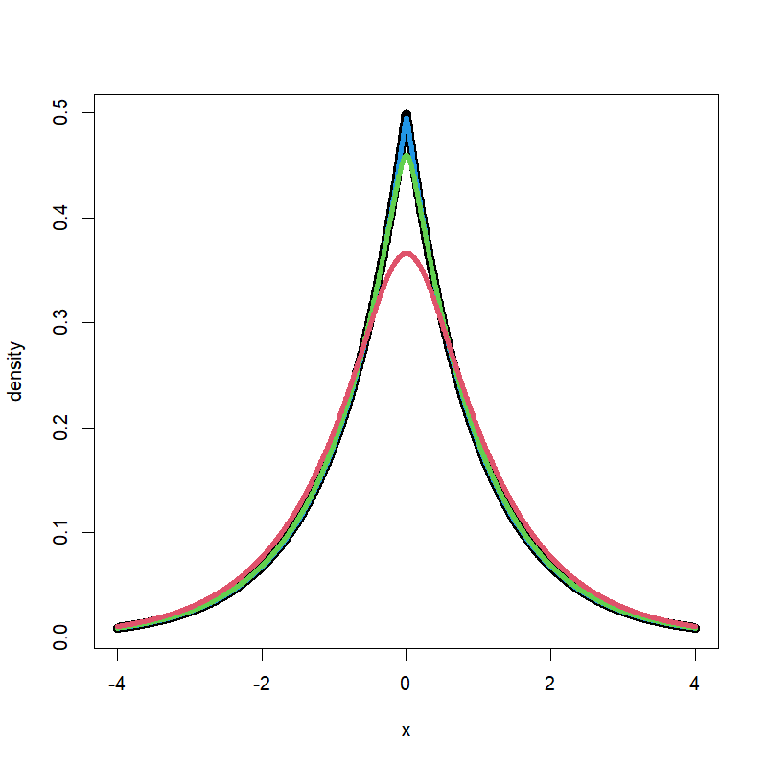




SMOOTH LAPLACE DISTRIBUTION
$$y=x^{T}β+σε$$
$$f\left(ε\right)=\frac{1}{2}e^{−\left|ε\right|}$$
$$f_{τ}\left(ε\right)=c_{τ}e^{−a_{τ}(ε)}$$
Laplace
Smooth Laplace
$$τ=0.01$$
$$τ=0.1$$
$τ=0.$5
$$ε$$
$$ε$$

Slide 20
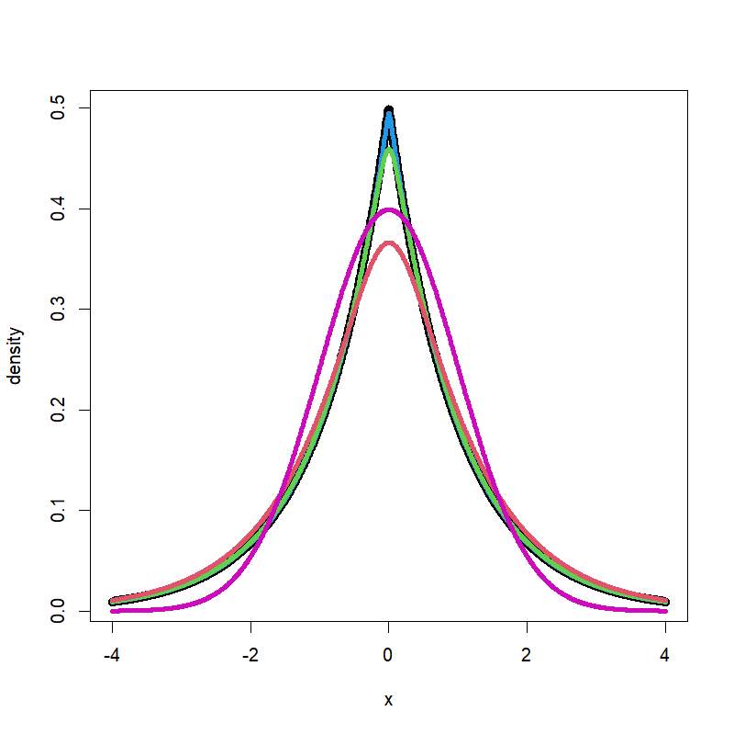
SMOOTH LAPLACE DISTRIBUTION
$$y=x^{T}β+σε$$
$$f\left(ε\right)=\frac{1}{2}e^{−\left|ε\right|}$$
$$f_{τ}\left(ε\right)=c_{τ}e^{−a_{τ}(ε)}$$
Laplace
Normal
(for comparison)
Smooth Laplace
$$τ=0.01$$
$$τ=0.1$$
$τ=0.$5
$$ε$$
$$ε$$
$$ε$$

Slide 21

LIKELIHOOD ESTIMATION
Log-likelihood function
$$ℓ\left(β,σ\right)=n\log{c_{τ}}−n\log{σ}−\sum_{i}{a_{τ}\left(\frac{y_{i}−x_{i}^{T}β}{σ}\right)}$$

Slide 22

LIKELIHOOD ESTIMATION
Log-likelihood function
$$ℓ\left(β,σ\right)=n\log{c_{τ}}−n\log{σ}−\sum_{i}{a_{τ}\left(\frac{y_{i}−x_{i}^{T}β}{σ}\right)}$$
Differentiable in $β$ and $σ$

Slide 23
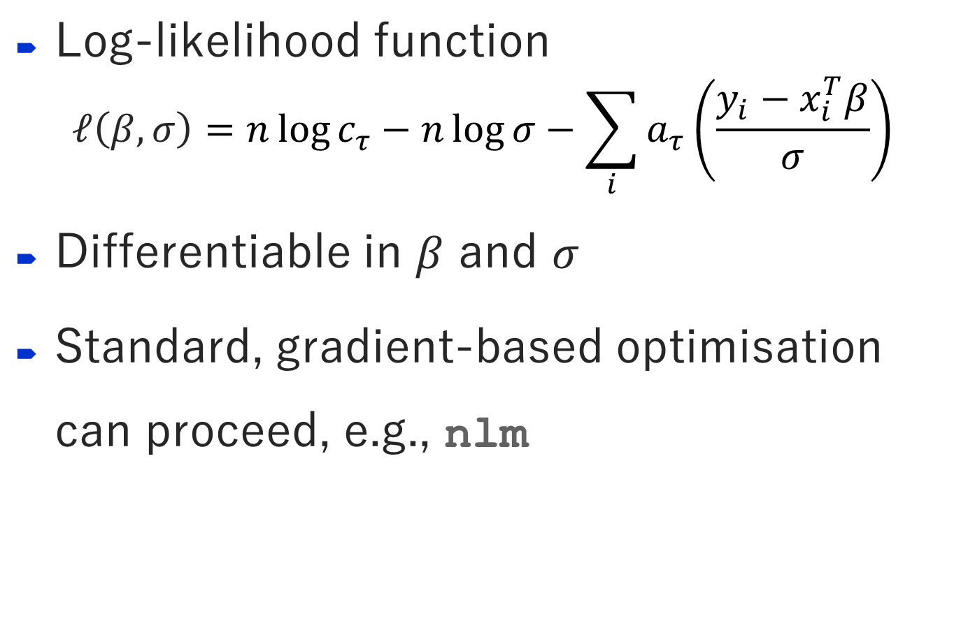
LIKELIHOOD ESTIMATION
Log-likelihood function
$$ℓ\left(β,σ\right)=n\log{c_{τ}}−n\log{σ}−\sum_{i}{a_{τ}\left(\frac{y_{i}−x_{i}^{T}β}{σ}\right)}$$
Differentiable in $β$ and $σ$
Standard, gradient-based optimisation can proceed, e.g., nlm

Slide 24
STACK LOSS DATA FIT
“stackloss”: data on industrial process for oxidising ammonia to nitric acid
Response: stack_loss (inefficiency)
Inputs: air_flow, water_temp, acid_conc
Brownlee (1960) Statistical Theory and Methodology in Science and Engineering

Slide 25
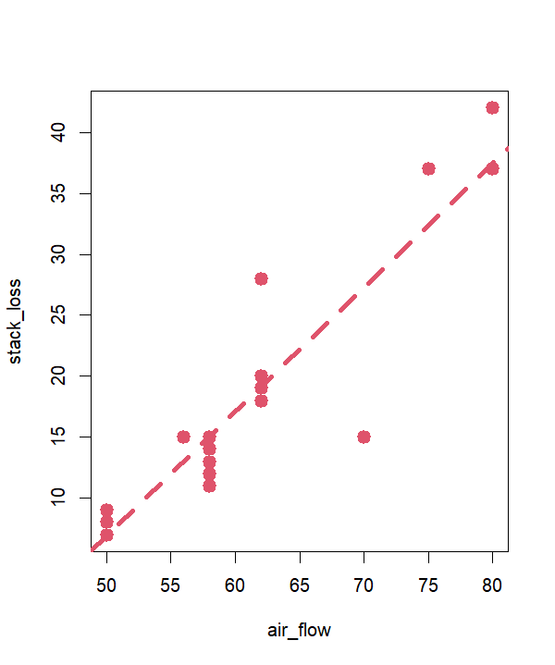
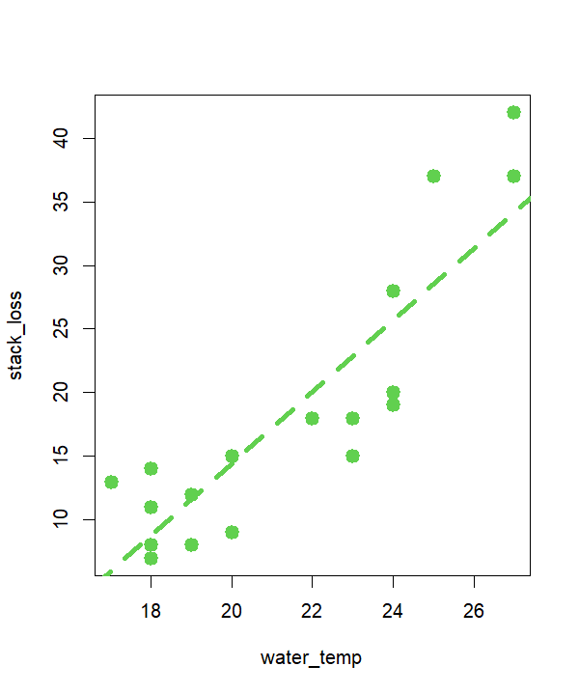
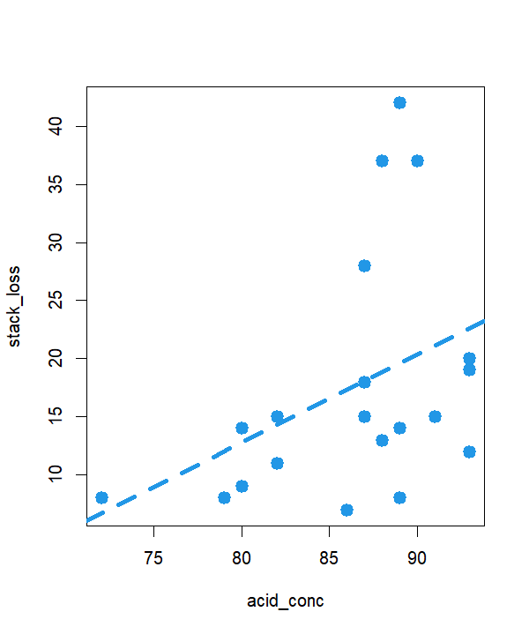
STACK LOSS DATA FIT
“stackloss”: data on industrial process for oxidising ammonia to nitric acid
Response: stack_loss (inefficiency)
Inputs: air_flow, water_temp, acid_conc
Brownlee (1960) Statistical Theory and Methodology in Science and Engineering

Slide 26
STACK LOSS DATA FIT
“stackloss”: data on industrial process for oxidising ammonia to nitric acid
Response: stack_loss (inefficiency)
Inputs: air_flow, water_temp, acid_conc
Brownlee (1960) Statistical Theory and Methodology in Science and Engineering

Slide 27
STACK LOSS DATA FIT
“stackloss”: data on industrial process for oxidising ammonia to nitric acid
Response: stack_loss (inefficiency)
Inputs: air_flow, water_temp, acid_conc
 | LAD | 0.01
air_flow | -0.83 | -0.83
water_temp | -0.57 | -0.57
acid_conc | -0.06 | -0.06
Brownlee (1960) Statistical Theory and Methodology in Science and Engineering

Slide 28
STACK LOSS DATA FIT
“stackloss”: data on industrial process for oxidising ammonia to nitric acid
Response: stack_loss (inefficiency)
Inputs: air_flow, water_temp, acid_conc
L1pack::lad
 | LAD | 0.01
air_flow | -0.83 | -0.83
water_temp | -0.57 | -0.57
acid_conc | -0.06 | -0.06
Brownlee (1960) Statistical Theory and Methodology in Science and Engineering

Slide 29

STACK LOSS DATA FIT
“stackloss”: data on industrial process for oxidising ammonia to nitric acid
Response: stack_loss (inefficiency)
Inputs: air_flow, water_temp, acid_conc
L1pack::lad
$$τ$$
 | LAD | 0.01
air_flow | -0.83 | -0.83
water_temp | -0.57 | -0.57
acid_conc | -0.06 | -0.06
Brownlee (1960) Statistical Theory and Methodology in Science and Engineering

Slide 30
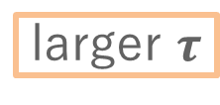
STACK LOSS DATA FIT
“stackloss”: data on industrial process for oxidising ammonia to nitric acid
Response: stack_loss (inefficiency)
Inputs: air_flow, water_temp, acid_conc
L1pack::lad
$$τ$$
larger $τ$
 | LAD | 0.01 | 0.1 | 0.5
air_flow | -0.83 | -0.83 | -0.83 | -0.83
water_temp | -0.57 | -0.57 | -0.59 | -0.69
acid_conc | -0.06 | -0.06 | -0.07 | -0.10
 | LAD | 0.01
air_flow | -0.83 | -0.83
water_temp | -0.57 | -0.57
acid_conc | -0.06 | -0.06
Brownlee (1960) Statistical Theory and Methodology in Science and Engineering

Slide 31
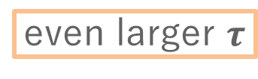
STACK LOSS DATA FIT
“stackloss”: data on industrial process for oxidising ammonia to nitric acid
Response: stack_loss (inefficiency)
Inputs: air_flow, water_temp, acid_conc
L1pack::lad
$$τ$$
larger $τ$
even larger $τ$
 | LAD | 0.01 | 0.1 | 0.5 | 2 | 5 | 10
air_flow | -0.83 | -0.83 | -0.83 | -0.83 | -0.81 | -0.77 | -0.75
water_temp | -0.57 | -0.57 | -0.59 | -0.69 | -0.92 | -1.09 | -1.18
acid_conc | -0.06 | -0.06 | -0.07 | -0.10 | -0.12 | -0.14 | -0.14
 | LAD | 0.01 | 0.1 | 0.5
air_flow | -0.83 | -0.83 | -0.83 | -0.83
water_temp | -0.57 | -0.57 | -0.59 | -0.69
acid_conc | -0.06 | -0.06 | -0.07 | -0.10
 | LAD | 0.01
air_flow | -0.83 | -0.83
water_temp | -0.57 | -0.57
acid_conc | -0.06 | -0.06
Brownlee (1960) Statistical Theory and Methodology in Science and Engineering

Slide 32
STACK LOSS DATA FIT
“stackloss”: data on industrial process for oxidising ammonia to nitric acid
Response: stack_loss (inefficiency)
Inputs: air_flow, water_temp, acid_conc
L1pack::lad
$$τ$$
larger $τ$
even larger $τ$
 | LAD | 0.01 | 0.1 | 0.5 | 2 | 5 | 10 | lm
air_flow | -0.83 | -0.83 | -0.83 | -0.83 | -0.81 | -0.77 | -0.75 | -0.72
water_temp | -0.57 | -0.57 | -0.59 | -0.69 | -0.92 | -1.09 | -1.18 | -1.30
acid_conc | -0.06 | -0.06 | -0.07 | -0.10 | -0.12 | -0.14 | -0.14 | -0.15
 | LAD | 0.01 | 0.1 | 0.5 | 2 | 5 | 10
air_flow | -0.83 | -0.83 | -0.83 | -0.83 | -0.81 | -0.77 | -0.75
water_temp | -0.57 | -0.57 | -0.59 | -0.69 | -0.92 | -1.09 | -1.18
acid_conc | -0.06 | -0.06 | -0.07 | -0.10 | -0.12 | -0.14 | -0.14
 | LAD | 0.01 | 0.1 | 0.5
air_flow | -0.83 | -0.83 | -0.83 | -0.83
water_temp | -0.57 | -0.57 | -0.59 | -0.69
acid_conc | -0.06 | -0.06 | -0.07 | -0.10
 | LAD | 0.01
air_flow | -0.83 | -0.83
water_temp | -0.57 | -0.57
acid_conc | -0.06 | -0.06
Brownlee (1960) Statistical Theory and Methodology in Science and Engineering

Slide 33
STACK LOSS DATA FIT
“stackloss”: data on industrial process for oxidising ammonia to nitric acid
Response: stack_loss (inefficiency)
Inputs: air_flow, water_temp, acid_conc
L1pack::lad
$$τ$$
larger $τ$
even larger $τ$
 | LAD | 0.01 | 0.1 | 0.5 | 2 | 5 | 10 | lm
air_flow | -0.83 | -0.83 | -0.83 | -0.83 | -0.81 | -0.77 | -0.75 | -0.72
water_temp | -0.57 | -0.57 | -0.59 | -0.69 | -0.92 | -1.09 | -1.18 | -1.30
acid_conc | -0.06 | -0.06 | -0.07 | -0.10 | -0.12 | -0.14 | -0.14 | -0.15
 | LAD | 0.01 | 0.1 | 0.5 | 2 | 5 | 10
air_flow | -0.83 | -0.83 | -0.83 | -0.83 | -0.81 | -0.77 | -0.75
water_temp | -0.57 | -0.57 | -0.59 | -0.69 | -0.92 | -1.09 | -1.18
acid_conc | -0.06 | -0.06 | -0.07 | -0.10 | -0.12 | -0.14 | -0.14
 | LAD | 0.01 | 0.1 | 0.5
air_flow | -0.83 | -0.83 | -0.83 | -0.83
water_temp | -0.57 | -0.57 | -0.59 | -0.69
acid_conc | -0.06 | -0.06 | -0.07 | -0.10
 | LAD | 0.01
air_flow | -0.83 | -0.83
water_temp | -0.57 | -0.57
acid_conc | -0.06 | -0.06
..tending to least squares?
Brownlee (1960) Statistical Theory and Methodology in Science and Engineering

Slide 34
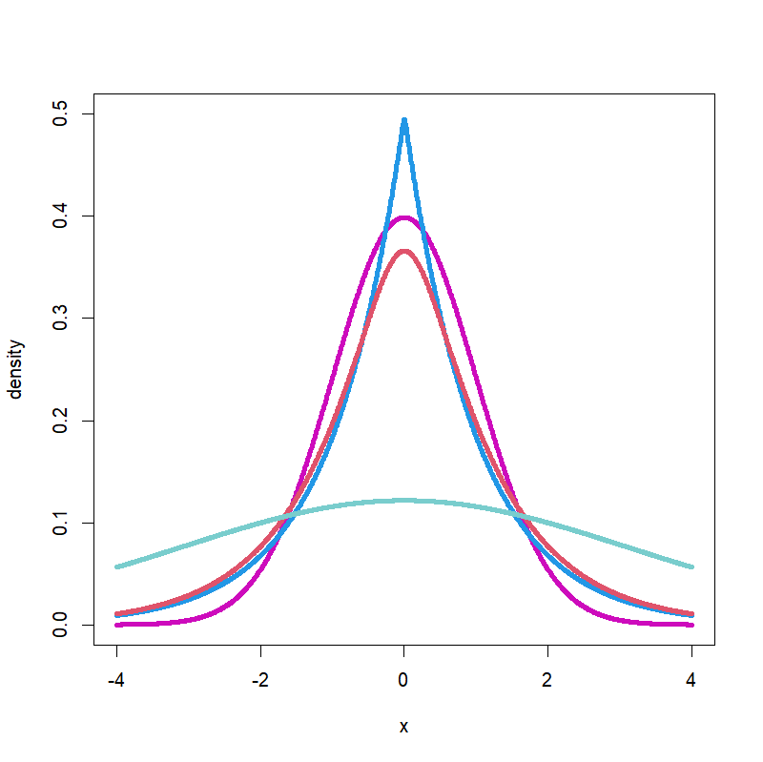




INCREASING $τ$
$$τ=0.01$$
Normal
$$τ=0.5$$
$$τ=10$$
$$ε$$

Slide 35

INCREASING $τ$
$$τ=0.01$$
$$f_{τ}\left(ε\right)=c_{τ}e^{−a_{τ}(ε)}$$
Normal
$$τ=0.5$$
$$τ=10$$
$$ε$$

Slide 36
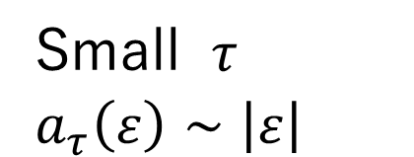
INCREASING $τ$
$$τ=0.01$$
$$f_{τ}\left(ε\right)=c_{τ}e^{−a_{τ}(ε)}$$
Normal
$$τ=0.5$$
Small $τ$
$a_{τ}\left(ε\right)∼\left|ε\right|$
$$τ=10$$
$$ε$$

Slide 37
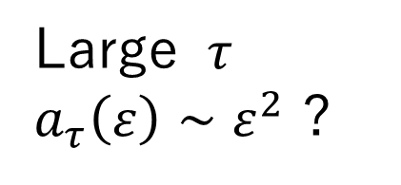
INCREASING $τ$
$$τ=0.01$$
$$f_{τ}\left(ε\right)=c_{τ}e^{−a_{τ}(ε)}$$
Normal
$$τ=0.5$$
Small $τ$
$a_{τ}\left(ε\right)∼\left|ε\right|$
$$τ=10$$
Large $τ$
$a_{τ}\left(ε\right)∼ε^{2}$ ?
$$ε$$

Slide 38
BEHAVIOUR FOR LARGE $τ$

Slide 39

BEHAVIOUR FOR LARGE $τ$
Expand at $τ=∞$: $a_{τ}\left(ε\right)≈ε^{2}/(2τ)$

Slide 40

BEHAVIOUR FOR LARGE $τ$
Expand at $τ=∞$: $a_{τ}\left(ε\right)≈ε^{2}/(2τ)$
Suggest using: ${\tilde{a}}_{τ}\left(ε\right)=\left(τ+1\right){ a}_{τ}\left(ε\right)$

Slide 41

BEHAVIOUR FOR LARGE $τ$
Expand at $τ=∞$: $a_{τ}\left(ε\right)≈ε^{2}/(2τ)$
Suggest using: ${\tilde{a}}_{τ}\left(ε\right)=\left(τ+1\right){ a}_{τ}\left(ε\right)$
$\lim_{τ→0}{{\tilde{a}}_{τ}\left(ε\right)}=\left|ε\right|$

Slide 42

BEHAVIOUR FOR LARGE $τ$
Expand at $τ=∞$: $a_{τ}\left(ε\right)≈ε^{2}/(2τ)$
Suggest using: ${\tilde{a}}_{τ}\left(ε\right)=\left(τ+1\right){ a}_{τ}\left(ε\right)$
$\lim_{τ→0}{{\tilde{a}}_{τ}\left(ε\right)}=\left|ε\right|$
$\lim_{τ→∞}{{\tilde{a}}_{τ}\left(ε\right)}=ε^{2}/2$

Slide 43
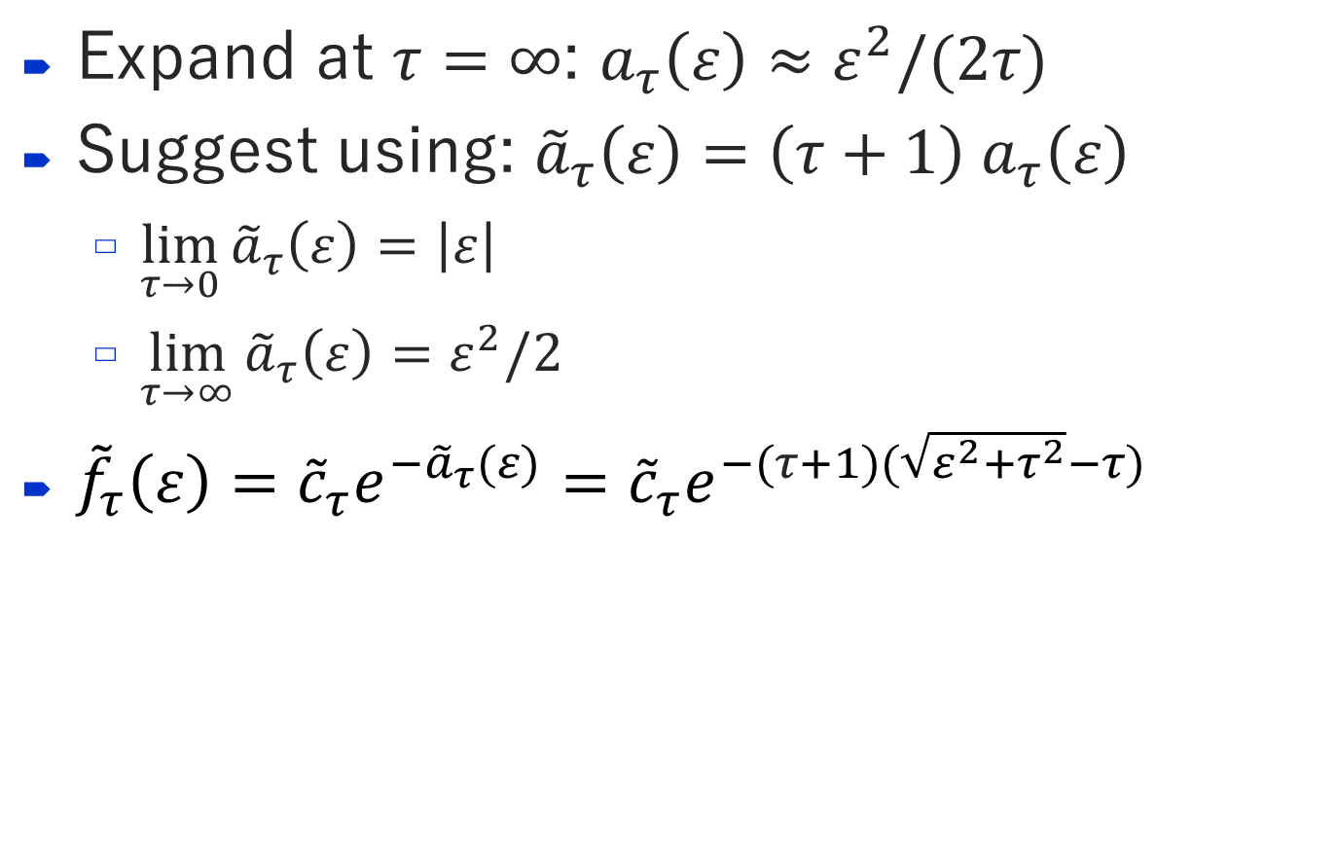
BEHAVIOUR FOR LARGE $τ$
Expand at $τ=∞$: $a_{τ}\left(ε\right)≈ε^{2}/(2τ)$
Suggest using: ${\tilde{a}}_{τ}\left(ε\right)=\left(τ+1\right){ a}_{τ}\left(ε\right)$
$\lim_{τ→0}{{\tilde{a}}_{τ}\left(ε\right)}=\left|ε\right|$
$\lim_{τ→∞}{{\tilde{a}}_{τ}\left(ε\right)}=ε^{2}/2$
${\tilde{f}}_{τ}\left(ε\right)={\tilde{c}}_{τ}e^{−{\tilde{a}}_{τ}(ε)}={\tilde{c}}_{τ}e^{−(τ+1)(\sqrt{ε^{2}+τ^{2}}−τ)}$

Slide 44
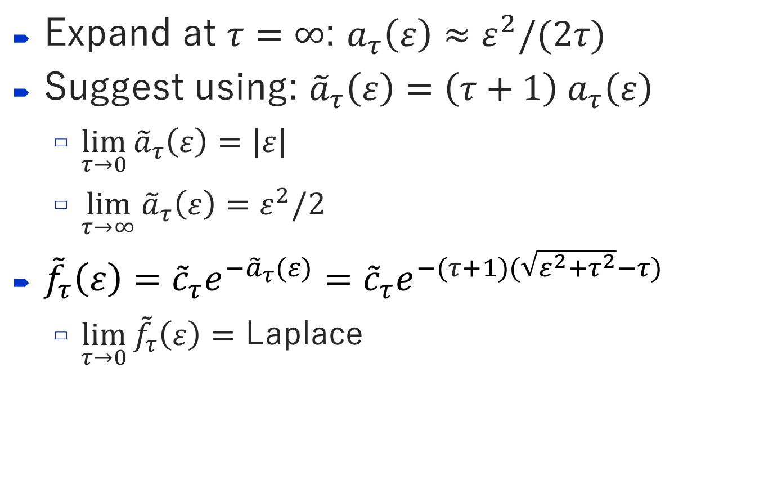
BEHAVIOUR FOR LARGE $τ$
Expand at $τ=∞$: $a_{τ}\left(ε\right)≈ε^{2}/(2τ)$
Suggest using: ${\tilde{a}}_{τ}\left(ε\right)=\left(τ+1\right){ a}_{τ}\left(ε\right)$
$\lim_{τ→0}{{\tilde{a}}_{τ}\left(ε\right)}=\left|ε\right|$
$\lim_{τ→∞}{{\tilde{a}}_{τ}\left(ε\right)}=ε^{2}/2$
${\tilde{f}}_{τ}\left(ε\right)={\tilde{c}}_{τ}e^{−{\tilde{a}}_{τ}(ε)}={\tilde{c}}_{τ}e^{−(τ+1)(\sqrt{ε^{2}+τ^{2}}−τ)}$
$\lim_{τ→0}{{\tilde{f}}_{τ}\left(ε\right)}=$ Laplace

Slide 45
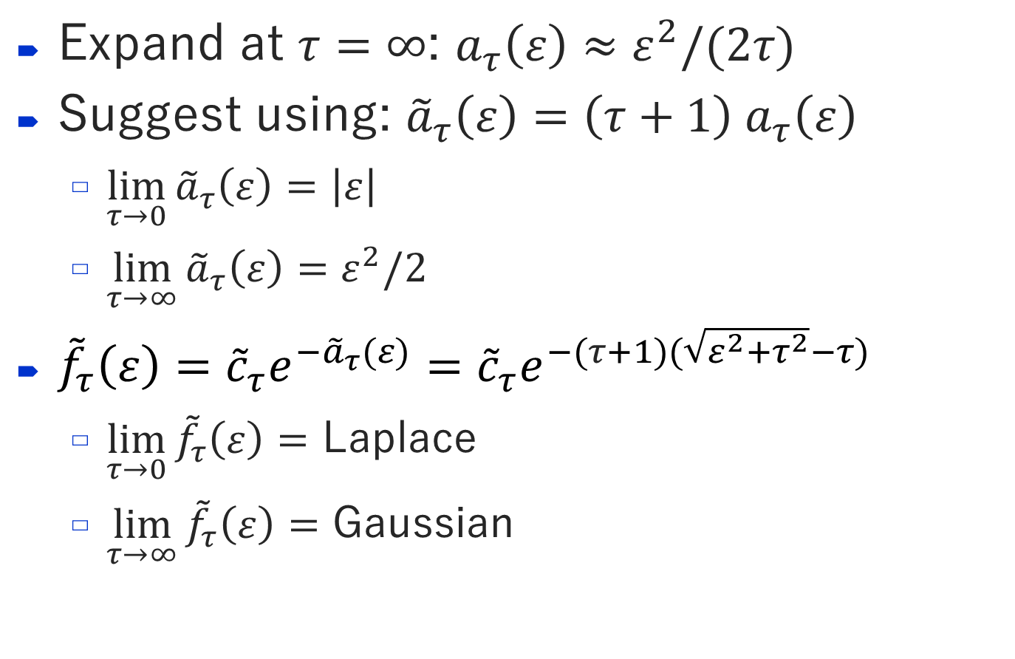
BEHAVIOUR FOR LARGE $τ$
Expand at $τ=∞$: $a_{τ}\left(ε\right)≈ε^{2}/(2τ)$
Suggest using: ${\tilde{a}}_{τ}\left(ε\right)=\left(τ+1\right){ a}_{τ}\left(ε\right)$
$\lim_{τ→0}{{\tilde{a}}_{τ}\left(ε\right)}=\left|ε\right|$
$\lim_{τ→∞}{{\tilde{a}}_{τ}\left(ε\right)}=ε^{2}/2$
${\tilde{f}}_{τ}\left(ε\right)={\tilde{c}}_{τ}e^{−{\tilde{a}}_{τ}(ε)}={\tilde{c}}_{τ}e^{−(τ+1)(\sqrt{ε^{2}+τ^{2}}−τ)}$
$\lim_{τ→0}{{\tilde{f}}_{τ}\left(ε\right)}=$ Laplace
$\lim_{τ→∞}{{\tilde{f}}_{τ}\left(ε\right)}=$ Gaussian

Slide 46


NEW PARAMETERISATION
$$f_{τ}\left(ε\right)$$
$$ε$$

Slide 47
NEW PARAMETERISATION
$$f_{τ}\left(ε\right)$$
Normal
$$ε$$

Slide 48



NEW PARAMETERISATION
$$f_{τ}\left(ε\right)$$
$$τ=0.01$$
Normal
$$τ=0.5$$
$$τ=10$$
$$ε$$

Slide 49
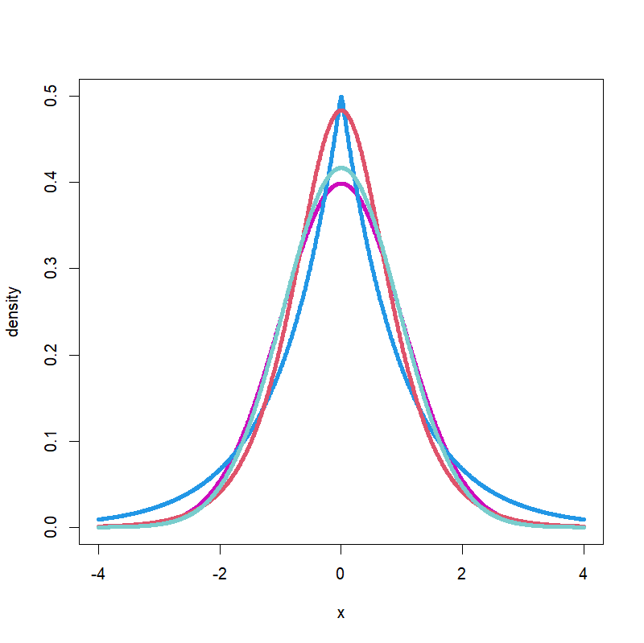


NEW PARAMETERISATION
$$f_{τ}\left(ε\right)$$
$${\tilde{f}}_{τ}\left(ε\right)$$
$$τ=0.01$$
Normal
$$τ=0.5$$
$$τ=10$$
$$ε$$
$$ε$$

Slide 50



NEW PARAMETERISATION
$$f_{τ}\left(ε\right)$$
$${\tilde{f}}_{τ}\left(ε\right)$$
$$τ=0.01$$
Normal
$$τ=0.01$$
$$τ=0.5$$
$$τ=10$$
$$τ=0.5$$
$$τ=10$$
$$ε$$
$$ε$$

Slide 51
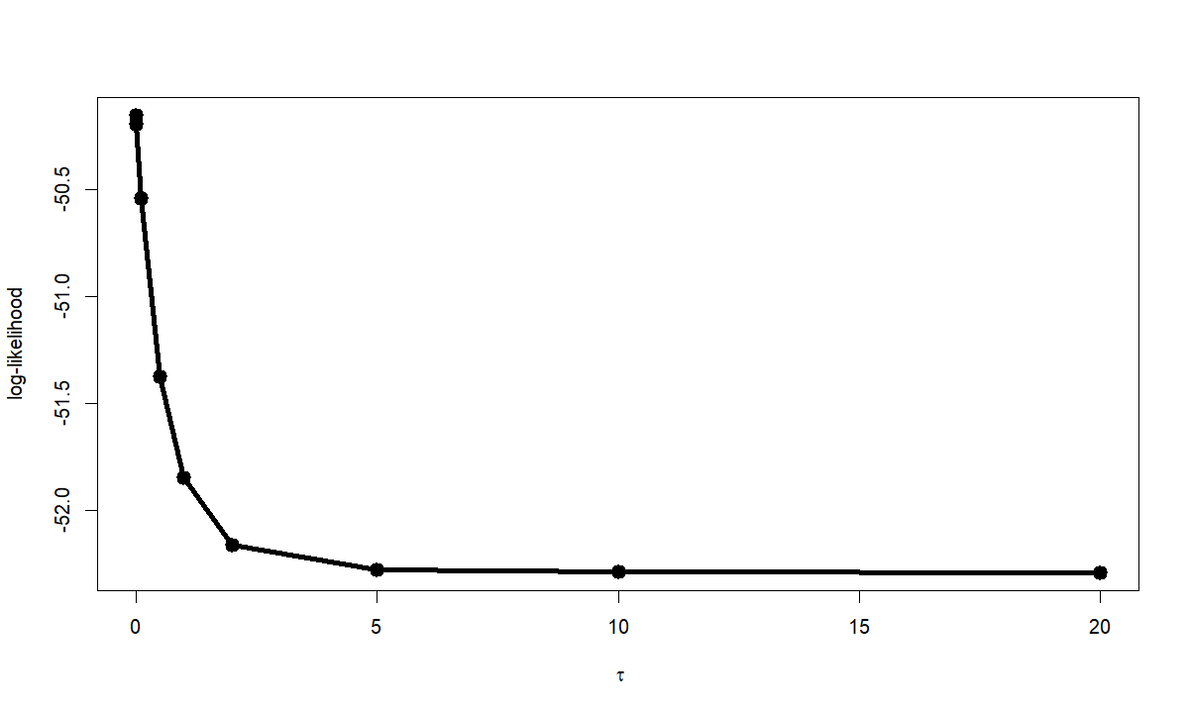



STACKLOSS: LOG-LIKELIHOOD
log-likelihood
$$∞$$
$$τ$$
$$τ∈\left\{0, 0.01, 0.1, 1, 2, 5, 10,∞\right\}$$
lad
lm

Slide 52
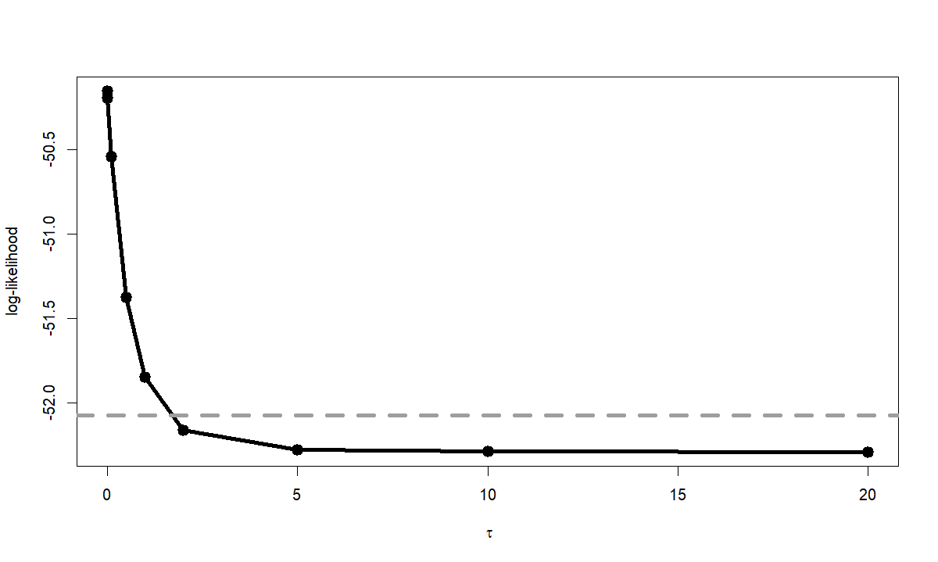


STACKLOSS: LOG-LIKELIHOOD
$$\text{max}\left(ℓ\right)−3.84/2$$
log-likelihood
$$∞$$
$$∞$$
$$τ$$
$$τ∈\left\{0, 0.01, 0.1, 1, 2, 5, 10,∞\right\}$$
lad
lm

Slide 53
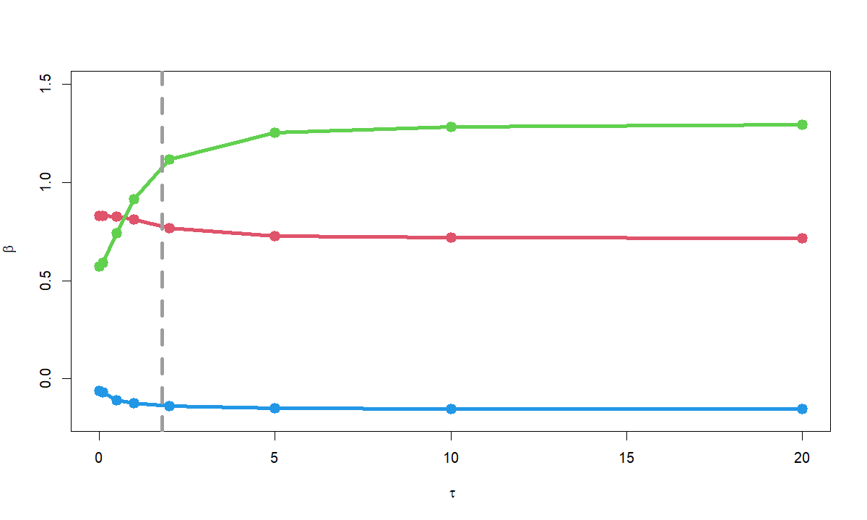

STACKLOSS: BETA COEFFICIENTS
water_temp
air_flow
$$β$$
acid_conc
$$∞$$
$$τ$$
$$τ∈\left\{0, 0.01, 0.1, 1, 2, 5, 10,∞\right\}$$
lad
lm

Slide 54
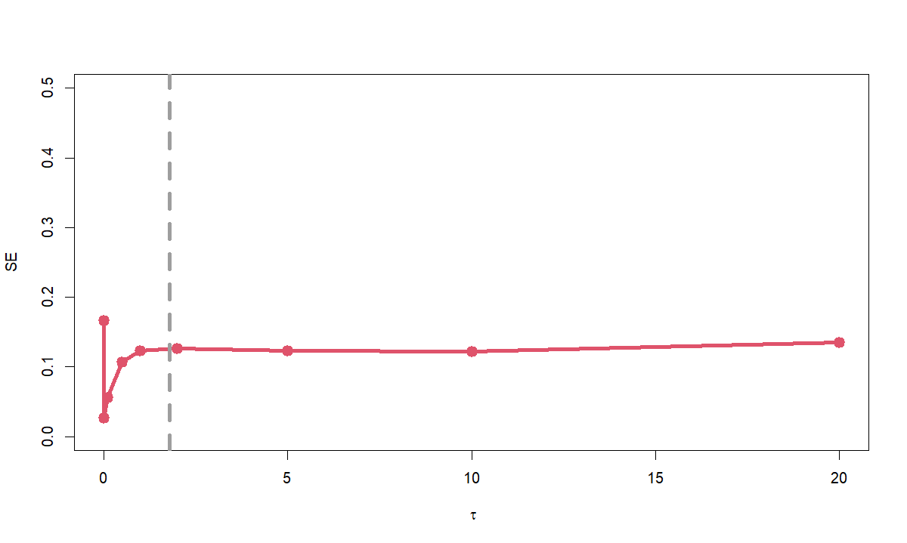
STACKLOSS: STANDARD ERRORS
air_flow
standard error
likelihood SE
$$∞$$
$$τ$$
$$τ∈\left\{0, 0.01, 0.1, 1, 2, 5, 10,∞\right\}$$
lad
lm

Slide 55
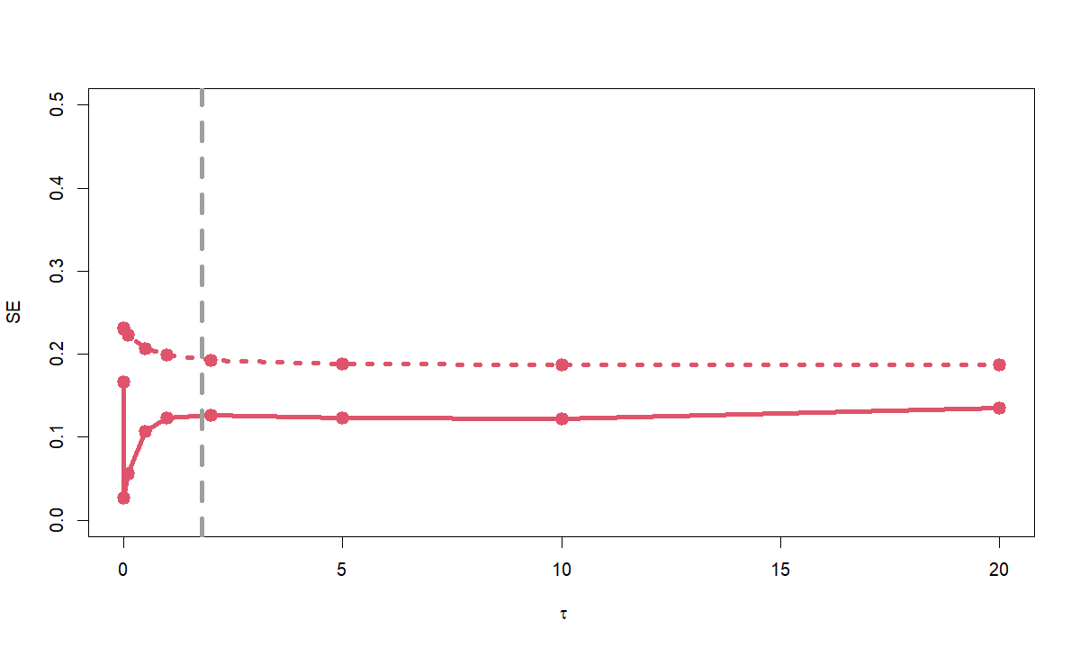
STACKLOSS: STANDARD ERRORS
air_flow
standard error
bootstrapping SE
likelihood SE
$$∞$$
$$τ$$
$$τ∈\left\{0, 0.01, 0.1, 1, 2, 5, 10,∞\right\}$$
lad
lm

Slide 56

SIMULATION: SE ESTIMATION
$y=β_{0}+1x_{1}+0.5x_{2}+0x_{3}+σε_{τ},$
$τ∈\left\{0.01, 0.1\right\}, x_{j}∼N\left(0,1\right), n∈\{100, 500, 1000, 5000\}$

Slide 57
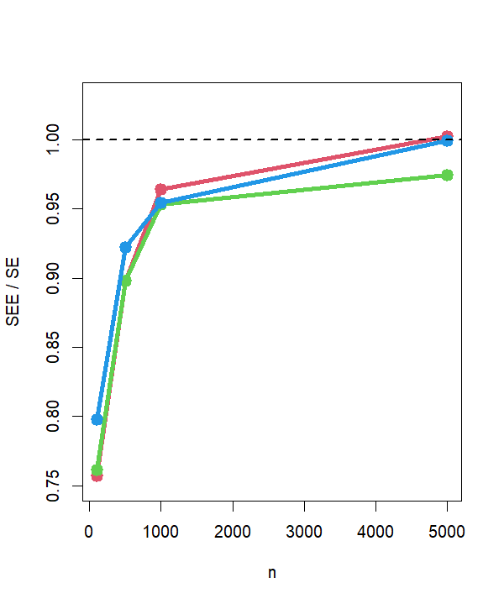

SIMULATION: SE ESTIMATION
$y=β_{0}+1x_{1}+0.5x_{2}+0x_{3}+σε_{τ},$
$τ∈\left\{0.01, 0.1\right\}, x_{j}∼N\left(0,1\right), n∈\{100, 500, 1000, 5000\}$
$$τ=0.01$$

Slide 58
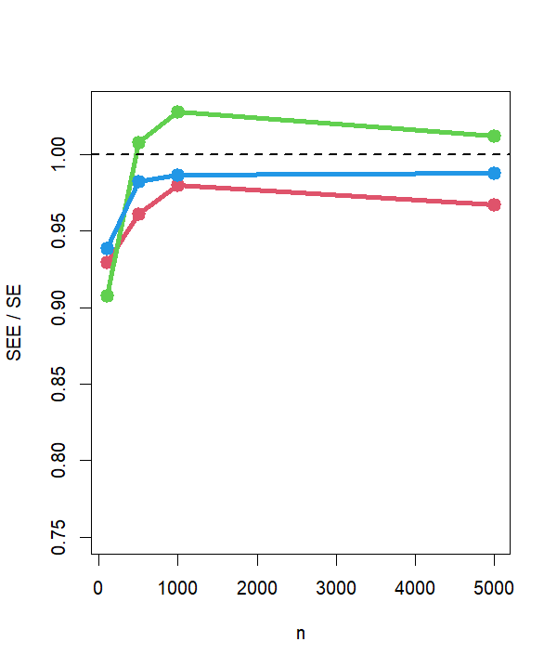

SIMULATION: SE ESTIMATION
$y=β_{0}+1x_{1}+0.5x_{2}+0x_{3}+σε_{τ},$
$τ∈\left\{0.01, 0.1\right\}, x_{j}∼N\left(0,1\right), n∈\{100, 500, 1000, 5000\}$
$$τ=0.01$$
$$τ=0.1$$

Slide 59
SIMULATION: 95% CI COVERAGE
$y=β_{0}+1x_{1}+0.5x_{2}+0x_{3}+σε_{τ},$
$τ∈\left\{0.01, 0.1\right\}, x_{j}∼N\left(0,1\right), n∈\{100, 500, 1000, 5000\}$

Slide 60
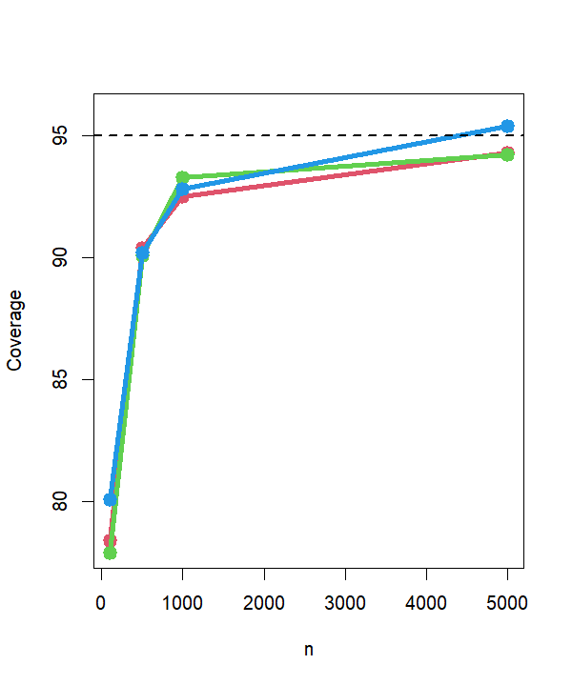
SIMULATION: 95% CI COVERAGE
$y=β_{0}+1x_{1}+0.5x_{2}+0x_{3}+σε_{τ},$
$τ∈\left\{0.01, 0.1\right\}, x_{j}∼N\left(0,1\right), n∈\{100, 500, 1000, 5000\}$
$$τ=0.01$$

Slide 61
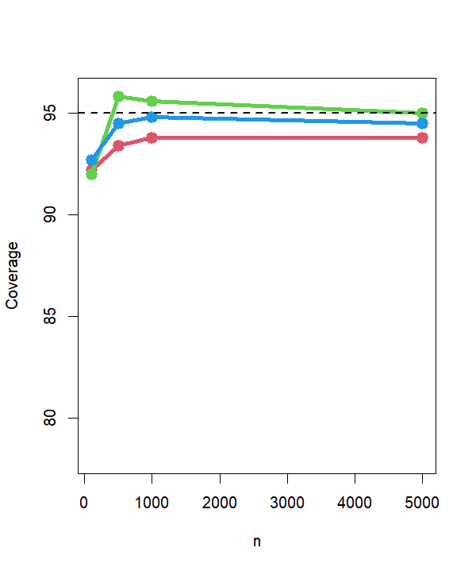
SIMULATION: 95% CI COVERAGE
$y=β_{0}+1x_{1}+0.5x_{2}+0x_{3}+σε_{τ},$
$τ∈\left\{0.01, 0.1\right\}, x_{j}∼N\left(0,1\right), n∈\{100, 500, 1000, 5000\}$
$$τ=0.01$$
$$τ=0.1$$

Slide 62
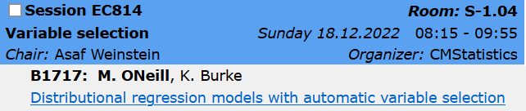
SUMMARY
New differentiable approximation to L1 regression / Laplace
Extension includes L2 regression / Gaussian
Smoothly joins two common regression approaches
SEs can be improved
References
O’Neill & Burke (2022). Robust Distributional Regression with Automatic Variable Selection. arXiv.
O’Neill & Burke (2021) Variable Selection Using a Smooth Information Criterion for Multi-Parameter Regression Models. arXiv.
Burke & Patilea (2021). A likelihood-based approach for cure regression models. TEST.
Jaouimaa, Ha, & Burke (2019). Penalized Variable Selection in Multi-Parameter Regression Survival Modelling. arXiv.
Also see: kevinburke.ie and arxiv.org/a/burke_k_1

