Slide 1



Agent-based null models for examining experimental social interaction networks
Kevin Burke | University of Limerick

Slide 2
My research
Distributional regression, variable selection, random effects models, neural networks, survival analysis
Psychology experiments, network science, opinion dynamics, agent-based modelling
https://kevinburke.ie/

Slide 3
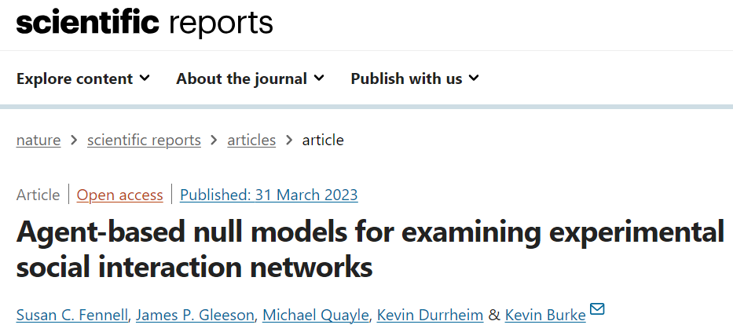



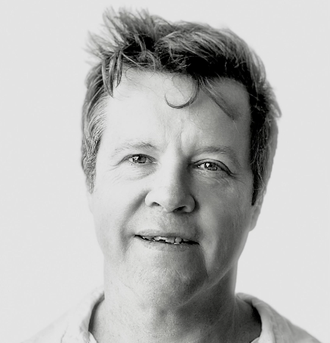

Agent based null models …

Slide 4
Experimental setup
Participants (“players”) are assigned randomly to one of two groups
They interact with each other over 40 rounds in a “token exchange” game
They see the results of each round
VIAPPL (Virtual Interaction Application)

Slide 5
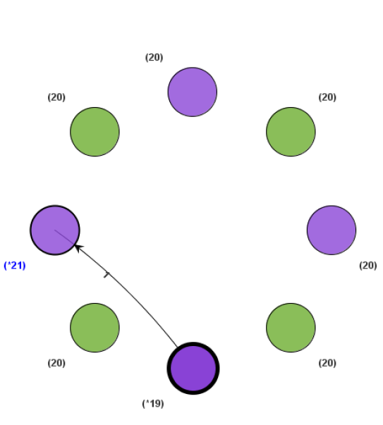
VIAPPL: Giving a token

Slide 6
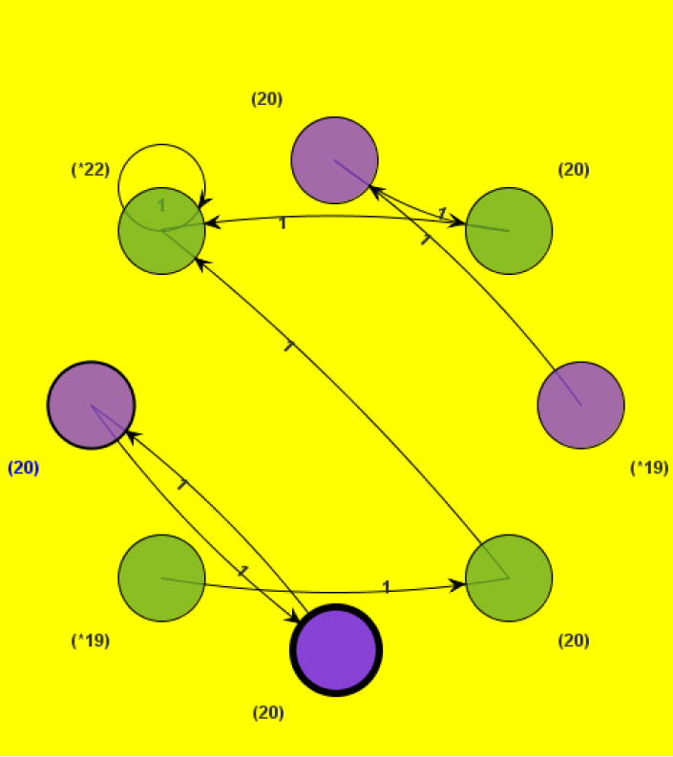
VIAPPL: End of round

Slide 7
VIAPPL: End of round
Social Norms
Reciprocation
Exchanges between pairs of players
Ingroup favouritism
Exchanges between players in the same group

Slide 8
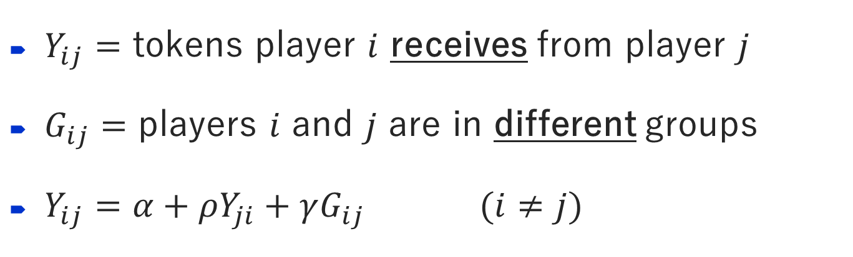
Linear regression model
$Y_{ij}=$ tokens player $i$ receives from player $j$
$G_{ij}=$ players $i$ and $j$ are in different groups
$Y_{ij}=α+ρY_{ji}+γG_{ij}$ $(i≠j)$

Slide 9
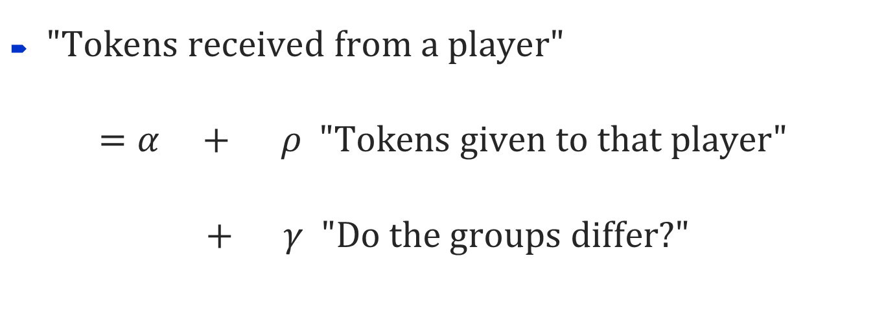
Linear regression model
$Y_{ij}=$ tokens player $i$ receives from player $j$
$G_{ij}=$ players $i$ and $j$ are in different groups
$Y_{ij}=α+ρY_{ji}+γG_{ij}$ $(i≠j)$
$\text{"}\text{Tokens} \text{received} \text{from} \text{a} \text{player}\text{"}$
$$=α + ρ \text{"}\text{Tokens} \text{given} \text{to} \text{that} \text{player}\text{"}$$
$$+ γ \text{"}\text{Do} \text{the} \text{groups} \text{differ}\text{?"}$$

Slide 10
Experimental results
4 games each spanning 40 rounds, 14 players per game, 20 tokens each

Slide 11
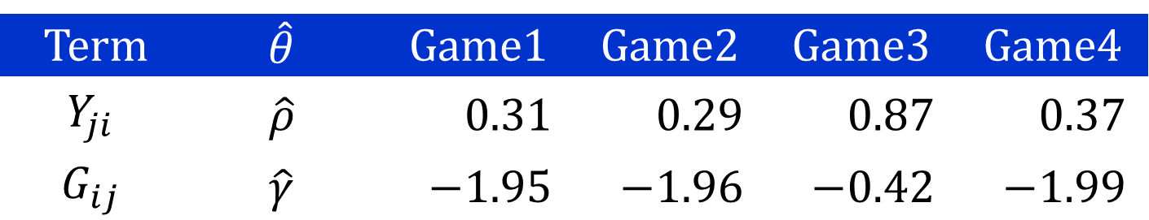
Experimental results
4 games each spanning 40 rounds, 14 players per game, 20 tokens each
Term | $$\hat{θ}$$ | Game1 | Game2 | Game3 | Game4
$$Y_{ji}$$ | $$\hat{ρ}$$ | $$0.31$$ | $$0.29$$ | $$0.87$$ | $$0.37$$
$$G_{ij}$$ | $$\hat{γ}$$ | $$−1.95$$ | $$−1.96$$ | $$−0.42$$ | $$−1.99$$

Slide 12
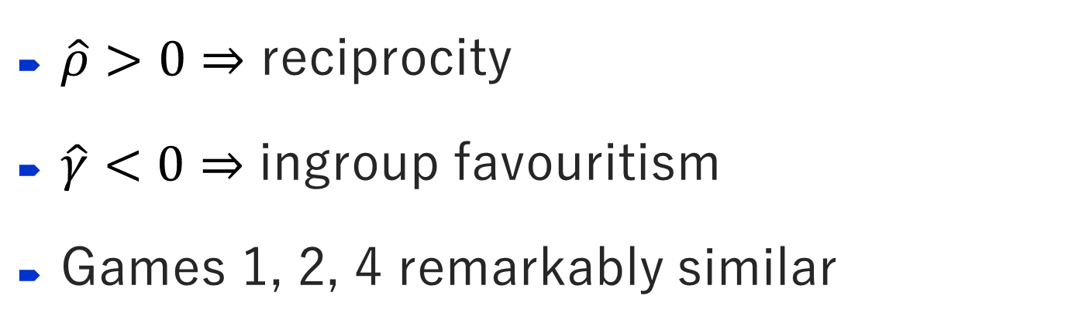
Experimental results
4 games each spanning 40 rounds, 14 players per game, 20 tokens each
Term | $$\hat{θ}$$ | Game1 | Game2 | Game3 | Game4
$$Y_{ji}$$ | $$\hat{ρ}$$ | $$0.31$$ | $$0.29$$ | $$0.87$$ | $$0.37$$
$$G_{ij}$$ | $$\hat{γ}$$ | $$−1.95$$ | $$−1.96$$ | $$−0.42$$ | $$−1.99$$
$\hat{ρ}>0⇒$ reciprocity
$\hat{γ}<0⇒$ ingroup favouritism
Games 1, 2, 4 remarkably similar

Slide 13
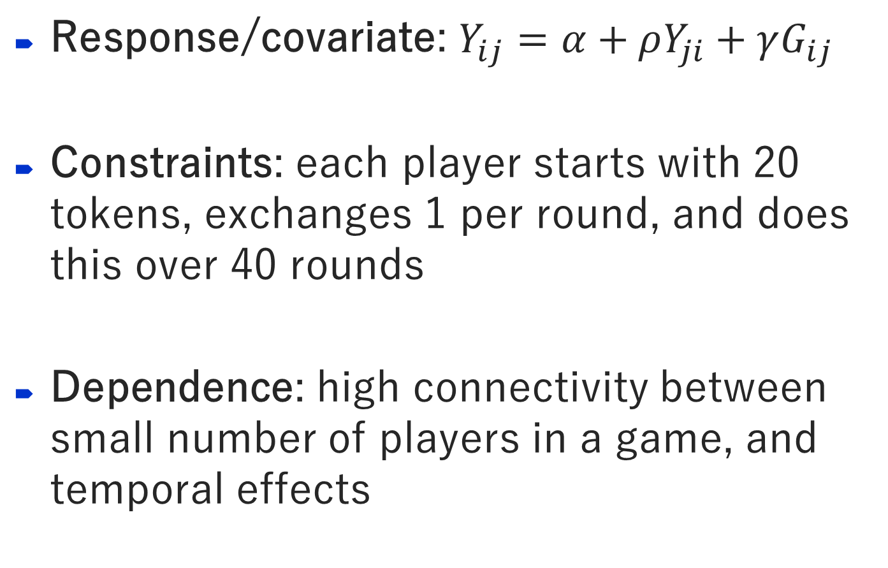
Statistical significance?
Response/covariate: $Y_{ij}=α+ρY_{ji}+γG_{ij}$
Constraints: each player starts with 20 tokens, exchanges 1 per round, and does this over 40 rounds
Dependence: high connectivity between small number of players in a game, and temporal effects

Slide 14
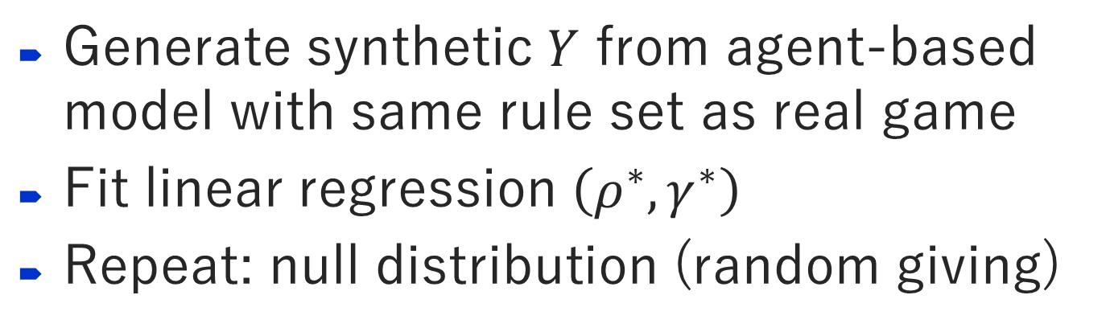
Agent-based null model
Generate synthetic $Y$ from agent-based model with same rule set as real game
Fit linear regression $\left(ρ^{∗},γ^{∗}\right)$
Repeat: null distribution (random giving)

Slide 15
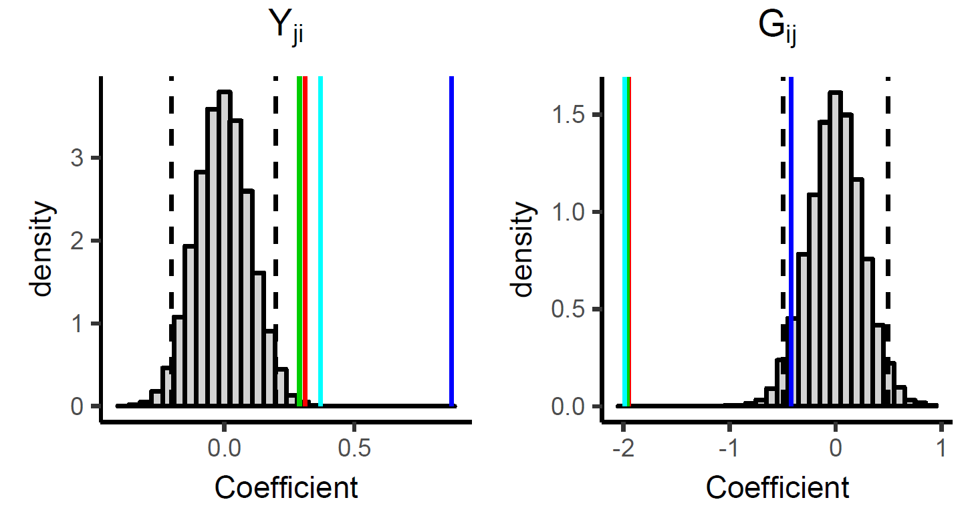
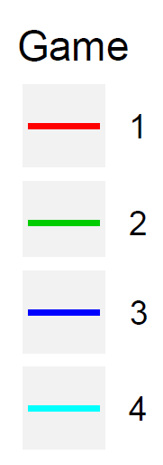


Agent-based null model
Generate synthetic $Y$ from agent-based model with same rule set as real game
Fit linear regression $\left(ρ^{∗},γ^{∗}\right)$
Repeat: null distribution (random giving)
$$ρ$$
$$γ$$

Slide 16
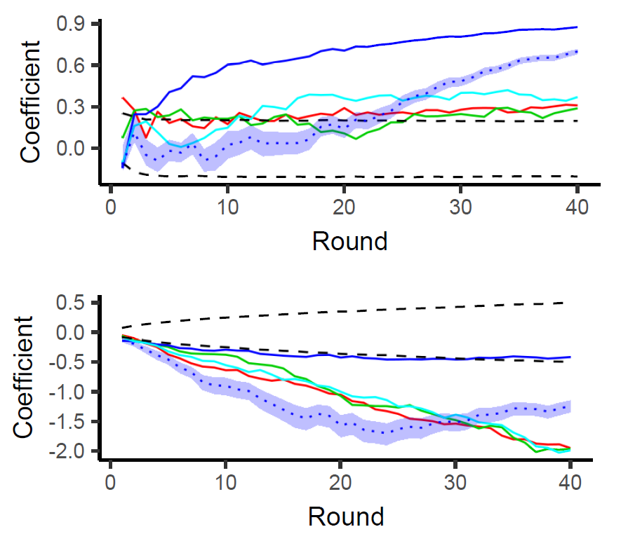


Coefficients in each round
$$ρ$$
$$γ$$

Slide 17
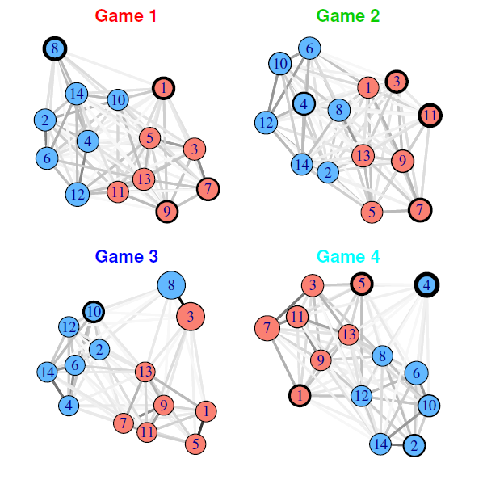
Network visualisation
Fruchterman-Reingold layout algorithm in the igraph package in R

Slide 18
Another VIAPPL experiment

Slide 19
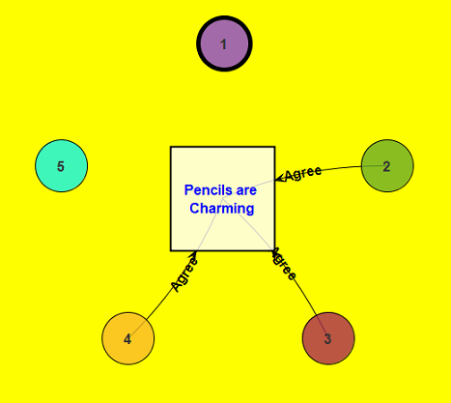
Another VIAPPL experiment
First, see who you agree with on 4 topics

Slide 20
Another VIAPPL experiment
First, see who you agree with on 4 topics
“Pencils are charming”
“The circle is a noble shape”
“Concrete blocks are problematic”
“Paper is trustworthy”

Slide 21
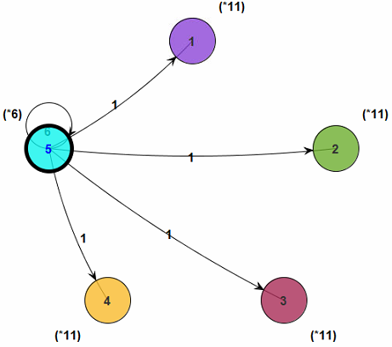
Another VIAPPL experiment
First, see who you agree with on 4 topics
Then, give tokens in one round
“Pencils are charming”
“The circle is a noble shape”
“Concrete blocks are problematic”
“Paper is trustworthy”

Slide 22
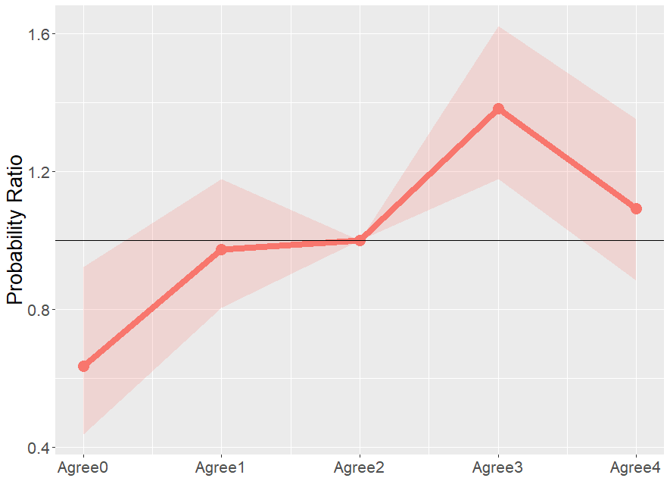
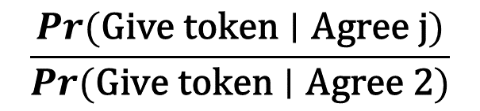
Another VIAPPL experiment: results
$$\frac{\operatorname{Pr}{(\text{Giv}\text{e} \text{token}∣\text{Agree} \text{j})}}{\operatorname{Pr}{(\text{Giv}\text{e} \text{token}∣\text{Agree}\text{ 2})}}$$
Output of multinomial regression model

Slide 23
Summary
Applied results
Players favour their group (and “similar” players)
Players reciprocate with each other
Modelling approach
Linear regression + agent-based null models
Network visualisation
Future
Directly fit agent-based model
Multinomial regression
Network models (Siena, ERGM)
Reference
Fennell, Gleeson, Quayle, Durrheim & Burke (2023). Agent-based null models for examining experimental social interaction networks. Scientific Reports.
Also see: kevinburke.ie and arxiv.org/a/burke_k_1

