Slide 1

SQL
2016 Database
Boot camp

Slide 2
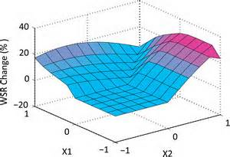
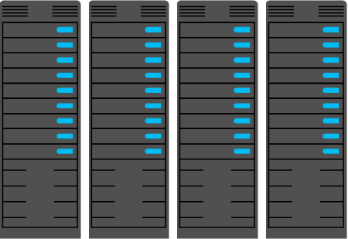
Azure Batch (HPC as a Service)
Hyperscale job execution over elastic pools of VMs
Cloud enable applications
Run the applications you use on workstations and clusters today
Run at scale
Batch starts a pool of compute VMs when you’re ready to run a job and turns them off when you’re done
Manage delivery
Manage who can access it, how many resources they can use, and ensure requirements such as encryption are met
Return results
Azure Batch
Manage
Data
Upload data
{REST API}
Submit job
Manage DAG
Usage and telemetry
BATCH PORTAL
Job Monitoring and Management
Usage reporting
Application management
Notes:
Hiya, so welcome to your summer of tech 2016 Databases. For starters I work for Microsoft on the Azure Batch team where we work on a product called Azure Batch. Where we enable large-scale parallel and high performance computing applications in the cloud. I have a design and computer science degree from VUW and managed to enter Microsoft through the Summer of Tech program. First I would like to ask the fun question who in the room has worked with any form of relational databases or SQL before? Yes I’m sure there are a few people in the room who know a bit about SQL, I’ll try and share some information you probably don’t know about databases.

Slide 3
Data access layer
Data access classes
Database
User facing portal
User
Entity classes
Notes:
I would say a majority of software of application uses some type of database. The most common storage mechanism would be a relational database or some type of flat storage database. When we say relational we normally talk about the big ones MySQL, PostgreSQL or microsoftSQL.
To describe a basic application we have a user or some type of input interacting with an application. That application records and responds to the user input based on the application. Events and information is recorded and processed. Those events or data is written somewhere.

Slide 4
Object-Relational Mapping
CREATE TABLE products (
id int(11) NOT NULL auto_increment,
name varchar(255),
PRIMARY KEY (id)
);
LearnEFEntities db = new LearnEFEntities();
Product p = new Product ();
p.Name = “some book”;
db.Products.AddObject(p);
db.SaveChanges();
class Product < ActiveRecord::Base
End p = Product.new
p.name = "Some Book"
puts p.name # save book
Notes:
Most of the big programming languages support using native SQL statements where you can write SQL statements and query the database that way. Or we can use an Object Relational Mapper or an ORM as they are often called. DotNet has the Entity Framework, Ruby on Rails has DataMapper or ActiveRecord. Basically an ORM is used for describing entities inside a table. You write a class such as Student and a student contains values such as ID, Name, Start year. That Object can be modified on the fly and then the object can get saved to a database when the appropriate time is called for. So we won’t be looking at ORMs today but I highly recommend finding out more about them. We’ll be covering the underlining language that is used for accessing, creating and dealing with databases Called SQL.

Slide 5

Column
ID | Student | Course | Mark
3001 | Frank | Comp102 | A
3001 | Frank | Comp103 | A
3001 | Frank | Swen102 | B
3002 | Sarah | Comp102 | A+
Row
CREATE TABLE STUDENTS(ID INT, STUDENT STRING,COURSE STRING,
MARK STRING, PRIMARY KEY(ID)));
Notes:
So for starters I would like to thank the father of relational database Edgar F. Codd. Around the 1970s when he was working for IBM came up with the concept of relational database because he was unhappy with the lack of searching
databases.
Basically he came up was this idea of a "relation" which was basically a set of tuples, like a collection of smaller arrays of related data, where those smaller collections all had a common set of attributes. Which is where we can start talking about foreign keys.
The example we're going to be using today is a grades database, records a student and a course and a grades.
So in a modern database the concept of the "set of values" sort of looks like this, which we call a table, and then in the table you have columns which define those attributes, then going across we have individual rows that represent sort of separate entity in this table in each row The key part of this table is the primary key. The concept of a primary key is very common across all types of storage mechanism. It basically says I can’t have another entity in my database that has the same primary key. We use also use primary key for doing look ups to if we wanted to ask the question “what did Frank get for Comp 102”.

Slide 6
ID | Name
3001 | Frank
3002 | Sarah
ID | Course | Mark
3001 | Comp102 | A
3001 | Comp103 | A
3001 | Swen102 | B
3002 | Comp102 | A+
Database normalization

Slide 7
ACID
Notes:
all relational models follow these principals called ACID which are basically some guarantees around how the database will behave in these sort of annoyingly wrinkly edge cases
A stands for Atomicity, Atom is considered to be smallest particle which can not be broken into further pieces.database transaction has to be atomic means either all steps of transaction completes or none of them.
C stands for Consistency, transaction must leave database in consistent state even if it succeed or rollback.
I is for Isolation
Two database transactions happening at same time should not affect each other and has consistent view of database. This is achieved by using isolation levels in database.
D stands for Durability
Data has to be persisted successfully in database once transaction completed successfully and it has to be saved from power outage or other threats. This is achieved by saving data related to transaction in more than one places along with database so it should be impossible for example for me to update a record in memory, have the system completely crash, then be unable to retrieve that updated row from the database when i restart
and so those four principles make some pretty strong assertions about the consistency of the database basically, and that helps us as developers of applications basically in knowing that our data we're working on is consistent.

Slide 8
Start transaction
start transaction
select balance from Account where Account_Number=‘T1';
select balance from Account where Account_Number=‘T2';
update Account set balance=balance-900 here Account_Number=’T1' ;
update Account set balance=balance+900 here Account_Number=’T2' ;
commit; //if all sql queries succed
rollback;
Verify account T1
Verify account T2
T1-900
T2+900
Commit

Slide 9
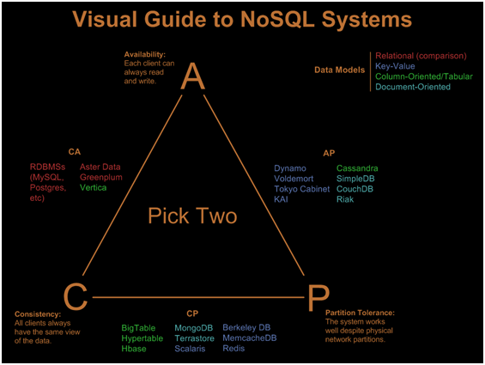

Slide 10

Sanitize your inputs!!
INSERT INTO Students (firstname) VALUES ('Robert');DROP TABLE Students;--');

