Slide 1
衛星多重任務及星系操作系統整合軟體
CONTRACT Number : NSPO-P-101080
CDRL Item Number : MCC-CDRL-001
Issue revision: 0001
E-M Pem
Shaowen Cheng
Gahong Tsai
Tom Cheng
ACS

Slide 2
Agenda
Present System Program Status
Demonstrate achievement of Rev.1 Acceptance Criteria
Design Document Review
Q & A

Slide 3
里程碑及日期(一)
項次 | 合約品項 | 審查會議時程 | 執行情況
1 | 階段 #1 系統設計 WSD+1M | 2013/1/5 | 12/12 Kick off meeting 12/26 TOFA功能討論 預計1月中由NSPO展示目前TOFA及MPSS系統以澄清系統需求
2 | 階段 #2關鍵設計 WSD+3M | 2013/3/5
3 | 階段 #3原型系統開發 WSD+10M | 2013/10/5
4 | 階段 #4更新系統開發及整合測試 WSD+15M | 2014/3/5
5 | 階段 #5更新系統開發及整合測試 WSD+20M | 2014/8/5

Slide 4
里程碑及日期(二)
項次 | 合約品項 | 審查會議時程 | 執行情況
6 | 階段 #6更新系統開發及整合測試 WSD+25M | 2015/1/5
7 | 階段 #7完成系統結案審查 WSD+30M | 2015/6/5

Slide 5
MCC主要功能規格及交付文件
系統設計審核報告
系統設計文件
介面控制文件
關鍵設計審核報告
PRM/TOFA/MPSS 操作規則文件
資料庫設計文件
原型系統開發測試審核報告
系統架構程式與功能說明文件
更新系統開發及整合測試審核報告
功能驗收與測試文件
完成系統結案審核報告
軟體保固證明書
完成訂單建置
完成可行性評估系統建置
完成任務規劃排程系統建置

Slide 6
本階段工作成果說明
舉辦開工會議及說明初步設計構想
開發工具評估，說明EUROPA排程軟體及系統軟體架構
完成系統設計文件(一)
完成系統控制界面文件(一)
完成系統設計審核報告

Slide 7
MCC Computer Software Configuration Items
MCC
CSCI
PRM Manager
CSC
TOFA Manager
CSC
Planning and
Scheduling
CSC
Activity/Resource
Management
CSC
Product Generation
CSC
Coordination
CSC
User Account
Management
CSU
User Account
Management
CSU
S/C Activity
Scheduling
CSU
Activity Definition
Database CSU
Command Load
Generator
CSU
Science Activity
Request
Processor CSU
Programming
Request
Management
CSU
Tasking Order
Management
CSU
Instrument Activity
Scheduling CSU
Resource
Definition
Database CSU
Real-Time Load
Generator
CSU
RTS Schedule
Processor CSU
Programming
Proposal
Management
CSU
Tasking Order
Feasibility
Assessment
CSU
Ground Equipment
Scheduling CSU
Activity Utilization
Prediction
CSU
Operation Report
Generator
CSU
IPS Schedule
Request
Processor CSU
Log File
Viewing
CSU
Tasking Order
List Management
CSU
Launch Planning
Contingency
Planning CSU
Resolved
Schedule
Announcement CSU
Programming
Proposal
Management
CSU
Gain Data
Management
CSU
Product Generation
CSU
External Product
Ingestion
CSU
Product and
Log File Viewing
CSU

Slide 8
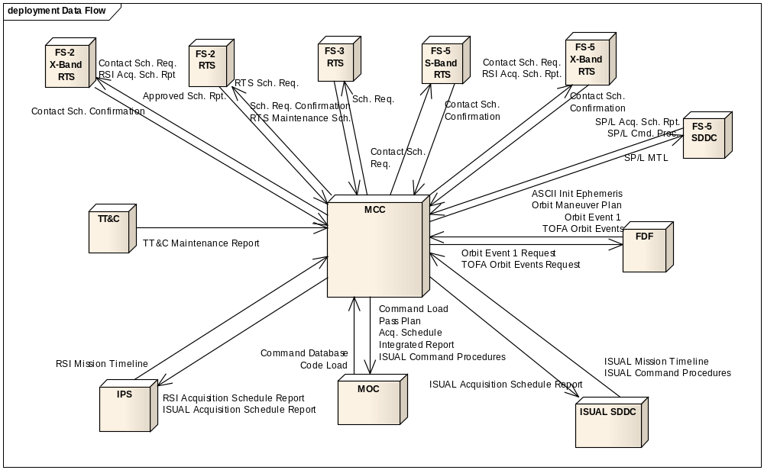
MCC Interface Requirements

Slide 9
MCC Receiving Products
Name | Source | Design Comments
Command Database | MOC | MCC reads directly from command database. (Read-Only access)
Code Load | MOC | ROCSAT-3 Data I/F filename for scheduling
Orbit Maneuver Plan | FDF | MCC pulls file from FDF (FTP)
Orbit Events I | FDF | OASYS parameter and event report. Contents stored within MPSS database for use during activity scheduling and report generation.
ASCII Init Ephemeris | FDF | MCC pulls file from FDF (FTP)
RSI Mission Timeline | PSS | imaging and maneuver requests. File FTP’d to MCC from PSS.
ISUAL Mission Timeline | ISUAL SDDC | Imaging and maneuver requests. File FTP’d to MCC from ISUAL SDDC
ISUAL Command Procedure | ISUAL SDDC | File FTP’d to MCC from ISUAL SDDC.
TT&C Maintenance Schedule | TT&C | Maintenance schedule manually entered into MPSS.
Approved Schedule Report | R-2 RTS | Request initiated by MCC. Report results manually entered into MPSS.
Schedule Request Confirmation | R-3 NMC/USN | ROCSAT-3 Data I/F
RTS Maintenance Schedule | R-3 NMC/USN | ROCSAT-3 Data I/F

Slide 10
MCC Sending Products
Name | Source | Design Comments
Command Load | MOC | Command loads will be FTP’d to the MOC. Command loads consist of: TTQ Load MPQ Load
Load Reports (as part of the Command Load data) | MOC | Load reports will be FTP’d to the MOC. Load reports consist of: TTQ Load Report MPQ Load Report
Pass Plan | MOC | Pass Plan will be FTP’d to MOC.
(Resolved) Acquisition Schedule | MOC | File will be FTP’d to MOC
Integrated (Acquisition Schedule) Report | MOC | File will be FTP’d to MOC
ISUAL Command Procedure | MOC | File will be FTP’d to MOC.
Command Load | MOC | ROCSAT-3 Data I/F
Orbit Events I Request | FDF | Request for orbit events for spacecraft during specified time period. MCC initiates OASYS to generate specified orbit events.
RSI Acq. Schedule Report (3.4.2) | PSS | Report will be FTP’d to PSS.
ISUAL Acq. Schedule Report | PSS | Report will be FTP’d to PSS.
ISUAL Acquisition Schedule Report | ISUAL SDDC | Report will be FTP’d to ISUAL SDDC.
RTS Schedule Request | R-2 RTS | RTS schedule request will be generated by MPSS and FTP’d to sites.
Schedule Request | R-3 NMC/USN | ROCSAT-3 Data I/F

Slide 11
MCC Functional Overview
The Functions of MCC are divided into the following parts:
  The Programming Request Manager (PRM) Client
  The Programming Request Manager (PRM) Server
  The Tasking Order Feasibility Assessor (TOFA)
  The Enhanced Mission Planning and Scheduling Subsystem (MPSS)

Slide 12
PRM Functional Overview
The PRM Client provides the following functionality
  Login securely to the PRM
  Managing Programming Requests (PRs)
  Managing Programming Proposals (PPs)
  Managing User Account Information
The PRM Server provides the following functionality
  Authentication of Users
  Communication with the PRM/TOFA Database
  Communication with the PRM client

Slide 13
TOFA Functional Overview
The TOFA allows the following functionality
  User Account Management
  Tasking Order Management
  Gain Data Management
  Cloud Cover Info.
  GIS Map Display
  Tasking Order Feasibility Assessment
  Managing Programming Proposals (PPs)
  Tasking Order List Management
  Generating Products
  Communication with External Processes/Entities

Slide 14
MPSS Functional Overview
The Mission Planning and Scheduling Subsystem
  Managing Satellite Resources & Constraints
  Managing Satellite Activities
  Exporting Resource Usage to TOFA
  Importing External Products
  Scheduling Satellite Activities
  Generating Satellite Operational Products
  Generating Satellite Operational Reports
  Exporting Satellite Products and Reports

Slide 15

MCC Data Flow
Customer
Planning & Scheduling Integrated System
Operation
PRM
Client
PRM
Server
TOFA
MPSS
MOC
PR Manager
Interface
RTS
SDDC
IPS
XAS
FDF
IQS
CWB
CSRSR
Products
PR/PP
TO
TO List
MTL
LOAD

Slide 16

PRM Data Flow
PRM
PRM Server
Authentication of User
Communicate with PRM client
Communicate with PRM/TOFA Database
TOFA
PRM
Client
Logs
Products
Program Request
Tasking Order
Program Proposal

Slide 17

TOFA Data Flow
TOFA
GIS Utility
MPSS
PRM
Feasibility Assessment
Planning Engine
Interface
MPSS
Database
Image Quality System
FDF
PP Generation
Logs
CWB
MTL Generation
Edit Gain
Program Request
Tasking Order
Mission Time Line
Program Proposal

Slide 18

MPSS Data Flow
MPSS
Management Resources and Constraints
FORMOSAT-series Satellites Activities Scheduling
Payload Activity Scheduling
Export of the Resource usage data to the TOFA
MOC
TOFA
Logs
Interface
RTS
SDDC
IPS
FDF
XAS
CSRSR
Mission Time Line
Load
Activities
Resource
Report

Slide 19
Key Requirements (1/2)
Requirement ID | Requirement Text | Verif. Meth.
MCC000.01.01 | The MCC shall have the capability to handle the image programming requests from customers which follow the OGC (Open Geospatial Consortium) format. | DEMO
MCC000.02.01 | The MCC shall have the capability to control and manage the mission plans and schedules for the FORMOSAT-5 satellite and the existing FORMOSAT-series satellites | DEMO
MCC000.03.01 | The MCC shall have the capability to assess the feasibility of the image tasking orders for the FORMOSAT-5 payload. | DEMO
PRM
MPSS
TOFA

Slide 20
Key Requirements (2/2)
Requirement ID | Requirement Text | Verif. Meth.
MCC000.04.01 | The MCC shall have the capability to generate programming proposals for customers | DEMO
MCC000.05.01 | The MCC shall use the information and data obtained from the science teams, the FDF, and the tasking list/mission timeline to generate short and long-range payload and spacecraft activity schedules and to define pass plans for multi-mission operations. | DEMO
MCC000.06.01 | The MCC shall provide schedules and plans which are free of conflict and do not jeopardize any mission. | DEMO
MCC000.07.01 | The PRM shall provide user account management for the website administrator | DEMO
MCC000.08.01 | The PRM shall provide user account management for the PR manager | DEMO
TOFA
MPSS
MPSS
PRM
PRM

Slide 21
Programming Request Manager
The Programming Request Manager (PRM) is a web based tool that allows customers to submit imaging requests ( Programming Requests) via the internet. The primary functions of the PRM are:
  User Account Management.
  Programming Request Management.
  Programming Proposal Management.
  Log File Viewing.

Slide 22
Programming Request Manager (1/6)
Requirement ID | Requirement Text | Verif. Meth.
MCC001.01.01 | The MCC shall allow the users to submit their PRs through the Internet. | DEMO
MCC001.02.01 | The MCC shall authenticate the users of the PRM and TOFA independently of each other. | DEMO
MCC001.03.01 | The PRM shall exchange information with the users via a web browser. | DEMO
MCC001.04.01 | The PRM shall use secure socket layer (SSL) protocol to ensure the security of all transactions on the Internet | DEMO
MCC001.05.01 | The PRM shall record all access information in a log file. | DEMO

Slide 23
Programming Request Manager (2/6)
Requirement ID | Requirement Text | Verif. Meth.
MCC001.06.01 | The PRM shall record all process information in a log file. | DEMO
MCC001.07.01 | The PRM shall provide user account management for the website administrator | DEMO
MCC001.08.01 | The PRM shall provide user account management for the PR manager | DEMO
MCC001.09.01 | The PRM shall provide user account management for the customer | DEMO
MCC001.10.01 | The PRM shall provide user account verification as part of user account management | DEMO

Slide 24
Programming Request Manager (3/6)
Requirement ID | Requirement Text | Verif. Meth.
MCC001.11.01 | The PRM shall provide user account deletion as part of user account management | DEMO
MCC001.12.01 | The PRM shall provide user account modification as part of user account management. | DEMO
MCC001.13.01 | The PRM shall provide user account maintenance as part of user account management. | DEMO
MCC001.14.01 | The PRM shall provide user account creation as part of user account management. | DEMO
MCC001.15.01 | The PRM shall provide a utility to let the customers enter their preferred application fields for a PR. | DEMO

Slide 25
Programming Request Manager (4/6)
Requirement ID | Requirement Text | Verif. Meth.
MCC001.16.01 | The PRM shall provide a utility to let the customers enter the optional service (standard, priority, urgent) for a PR. | DEMO
MCC001.17.01 | The PRM shall provide a utility to let the customers enter the survey period (taking the day as the unit) for a PR. | DEMO
MCC001.18.01 | The PRM shall provide a utility to let the customers enter the survey area (Area Of Interest, AOI) for a PR. | DEMO
MCC001.19.01 | The PRM shall provide a utility to let the customers enter the spectral mode for a PR. | DEMO
MCC001.20.01 | The PRM shall provide a utility to let the customers enter the survey method (viewing angle) for a PR. | DEMO

Slide 26
Programming Request Manager (5/6)
Requirement ID | Requirement Text | Verif. Meth.
MCC001.21.01 | The PRM shall provide a utility to let the customers enter the validation criteria (cloud cover/snow & ice/haze & sand wind) for a PR. | DEMO
MCC001.22.01 | The PRM shall provide a utility to the customers to allow the modification of their proposed PRs before the PRs are confirmed. | DEMO
MCC001.23.01 | The PRM shall provide a utility to the customers to allow the cancellation of their proposed PRs before the PRs are confirmed. | DEMO
MCC001.24.01 | The PRM shall provide a utility to allow the customers to accept the Programming Proposal for a PR after they have received the Programming Proposal generated from the TOFA | DEMO
MCC001.25.01 | The PRM shall provide a utility to allow the customers to reject a Programming Proposal for a PR after they have received the Programming Proposal generated from the TOFA. | DEMO

Slide 27
Programming Request Manager (6/6)
Requirement ID | Requirement Text | Verif. Meth.
MCC001.26.01 | The PRM shall provide the customer with statistical PR information including segment number and total imaging duration by week, month, quarter, season and year | DEMO
MCC001.27.01 | The PRM shall provide a utility for the PR managers to enter the customer’s Programming Request information into the PRM component if the customer proposes the PR by e-mail or FAX. | DEMO
MCC001.28.01 | The PRM shall provide a utility for the PR managers to accept a Programming Proposal for a PR after they receive the Programming Proposal generated from the TOFA, if the customer proposes the PR by e-mail or FAX. | DEMO

Slide 28
Tasking Order Feasibility Assessor (1/2)
The Tasking Order Feasibility Assessor (TOFA) is a stand alone application that is used to convert Programming Requests (PRs are entered through the PRM) into Tasking Orders (TOs) and assess the TO’s feasibility.
The TOFA also produces Programming Proposals (PPs) that are sent to the customers for approval.
Communication with the FDF, MPSS and CWB are performed to acquire the necessary information to assess TO feasibility.

Slide 29
Tasking Order Feasibility Assessor (2/2)
The primary functions of the TOFA are:
  User Account Management
  Tasking Order Management
  Tasking Order Feasibility Assessment
  Tasking Order List Management
  Programming Proposal Management
  Gain Data Management
  Product Generation
  External Product Ingestion
  Product and Log File Viewing

Slide 30
Tasking Order Feasibility Assessor (1/9)
Requirement ID | Requirement Text | Verif. Meth.
MCC002.01.01 | The TOFA shall have the capability for converting AOIs to several TOs . | DEMO
MCC002.02.01 | The TOFA shall have the feasibility assessment capability for TO while receiving the further assessment application proposed by the PR manager. | DEMO
MCC002.03.01 | The TOFA shall take into account the satellite constraints when determining TO feasibility. | DEMO
MCC002.04.01 | The TOFA shall take into account the validation criteria (cloud cover/ snow & ice/haze & sand wind) when determining TO feasibility. | DEMO
MCC002.05.01 | The TOFA shall take into account the TO List when determining TO feasibility. | DEMO

Slide 31
Tasking Order Feasibility Assessor (2/9)
Requirement ID | Requirement Text | Verif. Meth.
MCC002.06.01 | The TOFA shall take into account other limited resources when determining TO feasibility. | DEMO
MCC002.07.01 | The MCC shall authenticate the users of the PRM and TOFA independently of each other. | DEMO
MCC002.08.01 | The TOFA shall provide a utility for grid definition. | DEMO
MCC002.09.01 | The TOFA shall provide a utility for grid assessment. | DEMO
MCC002.10.01 | The TOFA shall provide a utility for segment definition | DEMO

Slide 32
Tasking Order Feasibility Assessor (3/9)
Requirement ID | Requirement Text | Verif. Meth.
MCC002.11.01 | The TOFA shall provide a utility for segment assessment. | DEMO
MCC002.12.01 | The TOFA shall allow two different units for the TOs,grids and segments. | DEMO
MCC002.13.01 | The TOFA shall provide GIS map machine database in order to facilitate the planning and assessment operation. | DEMO
MCC002.14.01 | The TOFA shall provide a utility for an AOI to be converted into TOs using the GIS map at the baseline. | DEMO
MCC002.15.01 | The TOFA shall provide the capability to convert the AOI to TOs. | DEMO

Slide 33
Tasking Order Feasibility Assessor (4/9)
Requirement ID | Requirement Text | Verif. Meth.
MCC002.16.01 | The TOFA shall maintain the relationship between the AOI and each TO. | DEMO
MCC002.17.01 | The TOFA shall provide the capability to assess the feasibility of TOs. | DEMO
MCC002.18.01 | The TOFA shall provide the capability to allow the TOFA managers to adjust the weight (inherit from the optional service of the PR) of the TOs. | DEMO
MCC002.19.01 | The TOFA shall provide the capability to allow the TOFA managers to adjust the survey periods of the TOs. | DEMO
MCC002.20.01 | The TOFA shall provide the capability to allow the TOFA managers to adjust the spectral mode of the TOs. | DEMO

Slide 34
Tasking Order Feasibility Assessor (5/9)
Requirement ID | Requirement Text | Verif. Meth.
MCC002.21.01 | The TOFA shall provide the capability to allow the TOFA managers to adjust the survey method (viewing angle) of the TOs. | DEMO
MCC002.22.01 | The TOFA shall provide the capability to allow the TOFA managers to adjust the validation criteria (cloud cover/ snow & ice/haze & sand wind) of the TOs. | DEMO
MCC002.23.01 | The TOFA shall provide the capability to allow the TOFA managers to adjust the preferred receiving station of the TOs. | DEMO
MCC002.24.01 | The TOFA shall allow the TOFA managers to properly assess the TOs after they have been modified | DEMO
MCC002.25.01 | The TOFA shall provide the capability to allow IQS (Imaging Quality Subsystem) team to update the status (open, closed,…) of the TOs on account of the results of the imaging quality. | DEMO

Slide 35
Tasking Order Feasibility Assessor (6/9)
Requirement ID | Requirement Text | Verif. Meth.
MCC002.26.01 | The TOFA shall provide the capability to assess the feasibility of TOs based on the current TO List | DEMO
MCC002.27.01 | The TOFA shall provide the capability to assess the feasibility of TOs based on the current satellite resources. | DEMO
MCC002.28.01 | The TOFA shall provide the capability to assess the feasibility of TOs based on the current ground station resources | DEMO
MCC002.29.01 | The TOFA shall provide the capability to simulate the entire on-orbit operations scenario including survey period to ensure satellite safety, image quality and prevent resource or schedule conflict. | DEMO
MCC002.30.01 | The TOFA shall provide the capability to simulate the entire on-orbit operations scenario including spectral mode to ensure satellite safety, image quality and prevent resource or schedule conflict. | DEMO

Slide 36
Tasking Order Feasibility Assessor (7/9)
Requirement ID | Requirement Text | Verif. Meth.
MCC002.31.01 | The TOFA shall provide the capability to simulate the entire on-orbit operations scenario including survey method to ensure satellite safety, image quality and prevent resource or schedule conflict. | DEMO
MCC002.32.01 | The TOFA shall provide the capability to simulate the entire on-orbit operations scenario including survey area to ensure satellite safety, image quality and prevent resource or schedule conflict | DEMO
MCC002.33.01 | The TOFA shall provide the capability to simulate the entire on-orbit operations scenario including validation criteria to ensure satellite safety, image quality and prevent resource or schedule conflict | DEMO
MCC002.34.01 | The TOFA shall provide the capability to simulate the entire on-orbit operations scenario including preferred receiving station to ensure satellite safety, image quality and prevent resource or schedule conflict. | DEMO
MCC002.35.01 | The TOFA shall provide the capability to simulate the entire on-orbit operations scenario including satellite position to ensure satellite safety, image quality and prevent resource or schedule conflict | DEMO

Slide 37
Tasking Order Feasibility Assessor (8/9)
Requirement ID | Requirement Text | Verif. Meth.
MCC002.36.01 | The TOFA shall provide the capability to simulate the entire on-orbit operations scenario including satellite attitude to ensure satellite safety, image quality and prevent resource or schedule conflict. | DEMO
MCC002.37.01 | The TOFA shall provide the capability to simulate the entire on-orbit operations scenario including data storage to ensure satellite safety, image quality and prevent resource or schedule conflict. | DEMO
MCC002.38.01 | The TOFA shall provide the capability to simulate the entire on-orbit operations scenario including power constraints to ensure satellite safety, image quality and prevent resource or schedule conflict. | DEMO
MCC002.39.01 | The TOFA shall provide the capability to simulate the entire on-orbit operations scenario including thermal constraints to ensure satellite safety, image quality and prevent resource or schedule conflict | DEMO
MCC002.40.01 | The TOFA shall provide the capability to simulate the entire on-orbit operations scenario including X-Band antenna switching to ensure satellite safety, image quality and prevent resource or schedule conflict. | DEMO

Slide 38
Tasking Order Feasibility Assessor (9/9)
Requirement ID | Requirement Text | Verif. Meth.
MCC002.41.01 | The TOFA shall incorporate and assess cloud cover information from CWB (Central Weather Bureau) or other weather prediction sources | DEMO
MCC002.42.01 | The TOFA shall provide the capability to import the feasible TOs into the TO List automatically after FA | DEMO
MCC002.43.01 | The TOFA shall provide the capability to allow the TOFA manager to delete TOs directly from the TO List. | DEMO
MCC002.44.01 | The TOFA shall provide the capability to generate Daily TO Reports from the TO List | DEMO
MCC002.45.01 | The TOFA shall provide the capability to generate Mission Timeline Reports from the TO List. | DEMO

Slide 39
MCC Capability Requirements
The major tasks of MCC are to perform and to conduct, at a minimum, the following:
  Planning and scheduling.
  Schedule Conflict Resolution.
  Data and Resource Management.
  Operations Product Generation.
  Coordination/Schedule Announcement.

Slide 40
Planning and Scheduling
The MCC shall use the MPSS to provide for the planning and scheduling of multi-mission operations. This shall include:
  Long-term and short-term planning and scheduling for normal mission operations.
  FORMOSAT-series satellites activity scheduling.
  Instrument activity scheduling.
  Launch planning.
  Contingency planning and scheduling.
  Rapid Replanning.

Slide 41
Planning and Scheduling (1/3)
Requirement ID | Requirement Text | Verif. Meth.
MCC003.01.01 | The MCC shall have the capability to provide scheduling of multi-mission operations and long-term mission planning including launch planning. | DEMO
MCC003.02.01 | The MCC shall have the capability to provide scheduling of multi-mission operations and long-term mission planning including FORMOSAT-5,FORMOSAT-2 and 3 activity scheduling | DEMO
MCC003.03.01 | The MCC shall have the capability to provide scheduling of multi-mission operations and long-term mission planning including instrument activity scheduling. | DEMO
MCC003.04.01 | The MCC shall have the capability to provide scheduling of multi-mission operations and long-term mission planning including contingency planning and scheduling for anomaly phenomena. | DEMO
MCC003.05.01 | The MCC shall have the capability to provide scheduling of multi-mission operations and long-term mission planning including long-term schedule for normal mission operations. | DEMO

Slide 42
Planning and Scheduling (2/3)
Requirement ID | Requirement Text | Verif. Meth.
MCC003.06.01 | The MCC shall have the capability to provide scheduling of multi-mission operations and long-term mission planning including scheduling rules definitions. | DEMO
MCC003.07.01 | The MCC shall have the capability to provide scheduling of multi-mission operations and long-term mission planning including activity definitions | DEMO
MCC003.08.01 | The MCC shall have the capability to provide scheduling of multi-mission operations and long-term mission planning including rescheduling strategies. | DEMO
MCC003.09.01 | The MCC shall have the capability to provide scheduling of multi-mission operations and long-term mission planning including operations constraints. | DEMO
MCC003.10.01 | The MCC shall have the capability to provide scheduling of multi-mission operations and long-term mission planning including rapid re-planning. | DEMO

Slide 43
Planning and Scheduling (3/3)
Requirement ID | Requirement Text | Verif. Meth.
MCC003.11.01 | The MCC shall use a SQL database . | DEMO
MCC003.12.01 | The MCC shall allow the users to modify or re-implement the corresponding activity definitions. | DEMO
MCC003.13.01 | The spacecraft specialists shall provide the operations constraints. | DEMO
MCC003.14.01 | The MCC shall generate schedules that have been validated to not have any operational rule violations. | DEMO

Slide 44
Schedule Conflict Resolution
The MPSS shall use the rules and constraints defined in the FORMOSAT-series MPSS Rules Document, the resources available, and the list of requested activities to generate a conflict-free schedule.
The MPSS will not generate a schedule that contains conflicts. If any activities could not be scheduled, due to conflicts of resources or rules, the MPSS will identify the unscheduled activities.
The MPSS provides tools to assist the planners in deciding how to proceed with rescheduling of the unscheduled activities.

Slide 45
Schedule Conflict Resolution (1/1)
Requirement ID | Requirement Text | Verif. Meth.
MCC003.15.01 | The MCC shall be capable of identifying schedule conflicts when there are overlapping resource allocations among multiple satellites. | DEMO
MCC003.16.01 | The MCC shall be capable of identifying schedule conflicts when there are operation rule violations. | DEMO
MCC003.17.01 | The MCC shall be capable of identifying schedule conflicts when there are scheduling rule violations. | DEMO
MCC003.18.01 | The MCC shall have the capability of merging individual event and activity schedules, analyzing schedule conflicts and resolving conflicts based on the rules and constraints defining priorities of satellite and ground activities. | DEMO
MCC003.19.01 | The MCC shall provide rescheduling tools to aid the users in resolving conflict. | DEMO
MCC003.20.01 | The MCC shall provide schedule editing tools to aid the users in resolving conflict. | DEMO

Slide 46
Resource Management
The MCC shall provide resource management of specific ground and spacecraft resources.
The resources to be managed are power/duty cycles, the Solid State Recorder (SSR) and the on-board TTQ/MPQ.
The resource management shall provide the capability to predict base on the real condition of these specific spacecraft resource within MCC planning software.

Slide 47
Resource Management (1/1)
Requirement ID | Requirement Text | Verif. Meth.
MCC003.21.01 | The MCC shall provide a resource database to manage all ground and satellite resources electronically to facilitate planning including ground site selection, on-board command sequence management | DEMO
MCC003.22.01 | The MCC shall provide a GUI tool to update and modify the resource definitions as the mission requires. | DEMO
MCC003.23.01 | The MCC shall provide the ability to predict resource utilization within MCC planning software. | DEMO

Slide 48
Operations Product Generation
The MCC will generate operational products for FORMOSAT-series. These products will assist in the automation of mission operations and facilitate mission coordination.
The products shall, at a minimum, include the following:
  Pass plan.
  Integrated report.
  Instrument operations plan (TBR).
  Executable files for MOC real-time operations.
  Executable files for ground equipment configuration setup.
  Command load ASCII and binary file.
  Branch Load ASCII and binary file.
  MPQ load ASCII and binary file.

Slide 49
Operations Product Generation (1/3)
Requirement ID | Requirement Text | Verif. Meth.
MCC003.24.01 | The MCC shall be capable of generating operations products including Pass Plans for the FORMOSAT-5 satellites and the existing FORMOSAT-series satellites to automate mission operations and facilitate mission coordination. | DEMO
MCC003.25.01 | The MCC shall be capable of generating operations products including Integrated Reports for the FORMOSAT-5 satellites and the existing FORMOSAT-series satellites to automate mission operations and facilitate mission coordination. | DEMO
MCC003.26.01 | The MCC shall be capable of generating operations products including Instrument Operation Plans for the FORMOSAT-5 satellites and the existing FORMOSAT-series satellites to automate mission operations and facilitate mission coordination. | DEMO
MCC003.27.01 | The MCC shall be capable of generating operations products including executable files for MOC real-time operations for the FORMOSAT-5 satellites and the existing FORMOSAT-series satellites to automate mission operations and facilitate mission coordination. | DEMO
MCC003.28.01 | The MCC shall be capable of generating operations products including executable files for ground equipment configuration setup for the FORMOSAT-5 satellites and the existing FORMOSAT-series satellites to automate mission operations and facilitate mission coordination | DEMO

Slide 50
Operations Product Generation (2/3)
Requirement ID | Requirement Text | Verif. Meth.
MCC003.29.01 | The MCC shall be capable of generating operations products including ASCII command loads for the FORMOSAT-5 satellites and the existing FORMOSAT-series satellites to automate mission operations and facilitate mission coordination. | DEMO
MCC003.30.01 | The MCC shall be capable of generating operations products including binary command loads (including FORMOSAT-5 payload command files) for the FORMOSAT-5 satellites and the existing FORMOSAT-series satellites to automate mission operations and facilitate mission coordination | DEMO
MCC003.31.01 | The MCC shall be capable of generating operations products including ACSII patch loads for the FORMOSAT-5 satellites and the existing FORMOSAT-series satellites to automate mission operations and facilitate mission coordination. | DEMO
MCC003.32.01 | The MCC shall be capable of generating operations products including binary patch loads for the FORMOSAT-5 satellites and the existing FORMOSAT-series satellites to automate mission operations and facilitate mission coordination. | DEMO
MCC003.33.01 | The MCC shall generate executable files for MOC real-time operations that are completely compatible (i.e.once the files are generated, no more post processing or conversion will be necessary for MOC normal operations) with the MOC EPOCH system. | DEMO

Slide 51
Operations Product Generation (3/3)
Requirement ID | Requirement Text | Verif. Meth.
MCC003.34.01 | The MCC shall generate executable files for ground equipment configuration setup that are completely compatible (i.e. once the files are generated, no more post processing or conversion will be necessary for MOC normal operations) with the MOC EPOCH system. | DEMO
MCC003.35.01 | The MCC shall be capable of generating operations products including binary MPQ loads (including FORMOSAT-5 payload command files) for the FORMOSAT-5 satellites and the existing FORMOSAT-series satellites to automate mission operations and facilitate mission coordination | DEMO
MCC003.36.01 | The MCC shall be capable of generating operations products including ASCII MPQ loads (including FORMOSAT-5 payload command files) for the FORMOSAT-5 satellites and the existing FORMOSAT-series satellites to automate mission operations and facilitate mission coordination | DEMO

Slide 52
Coordination/Schedule Announcement
The MCC shall provide an interface to FDF, MOC, RTS, CSRSR, PSS, and ISUAL SDDC via GCN for gathering and disseminating information or data needed for conducting mission activities.

Slide 53
Coordination/Schedule Announcement (1/2)
Requirement ID | Requirement Text | Verif. Meth.
MCC003.37.01 | The MCC shall provide interface to FDF to gather information or data for coordination of conducting mission activities. | DEMO
MCC003.38.01 | The MCC shall provide interface to MOC to gather information or data for coordination of conducting mission activities | DEMO
MCC003.39.01 | The MCC shall provide interface to IPS (Image Processing System) to gather information or data for coordination of conducting mission activities. | DEMO
MCC003.40.01 | The MCC shall provide interface to CSRSR (Center for Space and Remote Sensing Research National Central University) to gather information or data for coordination of conducting mission activities. | DEMO
MCC003.41.01 | The MCC shall provide interface to SDDCs (Science Data Distribution Centers) to gather information or data for coordination of conducting mission activities. | DEMO

Slide 54
Coordination/Schedule Announcement (2/2)
Requirement ID | Requirement Text | Verif. Meth.
MCC003.42.01 | The MCC shall provide interface to RTS (Remote Tracking Station) sites scheduling office to gather information or data for coordination of conducting mission activities. | DEMO
MCC003.43.01 | The MCC shall provide the capability of receiving and automatically processing SDDC’s instrument schedule requests for the FORMOSAT-5 satellite and the existing FORMOSAT-series satellites. | DEMO
MCC003.44.01 | The MCC shall return the final integrated schedules to the SDDC. | DEMO
MCC003.45.01 | The MCC shall provide the capability to gather data detailed in operational products listed above that are required for NSPO to analyze in coordination of science communities and engineers to perform mission operations. | DEMO
MCC003.46.01 | The MCC shall have the capability to export operations reports in HTML format to selective websites once the schedule is approved, to announce the planned activity to the operations team and all concerned parties. | DEMO
MCC003.47.01 | The MCC shall have the capability to export operations reports in ASCII format to selective FTP sites once the schedule is approved, to announce the planned activity to the operations team and all concerned parties. | DEMO

Slide 55
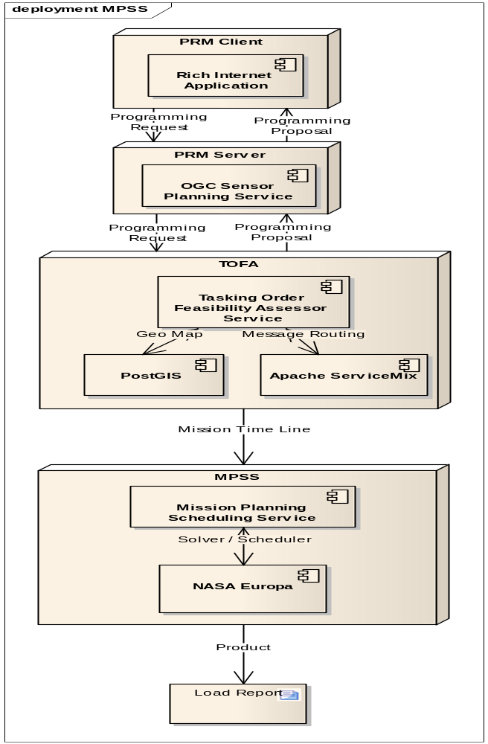
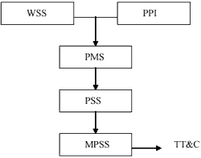
Overall Software Architecture
PRM (web)
OGC SPS
TOFA
C++ -> Java
iLog -> EUROPA

Slide 56
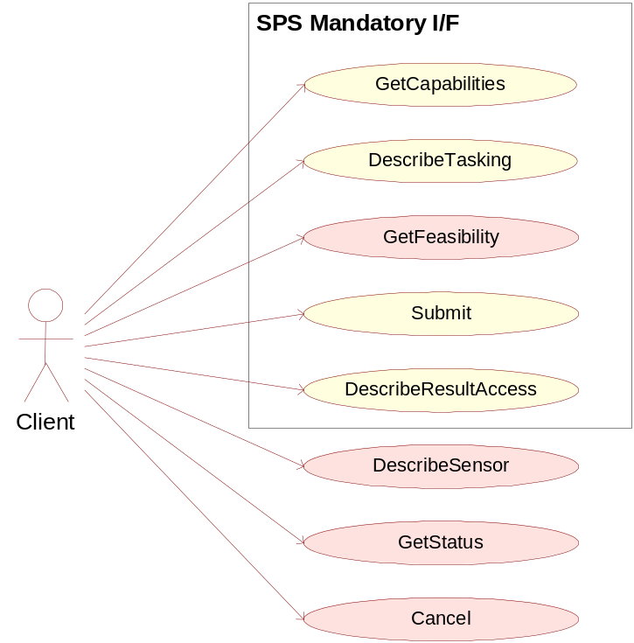
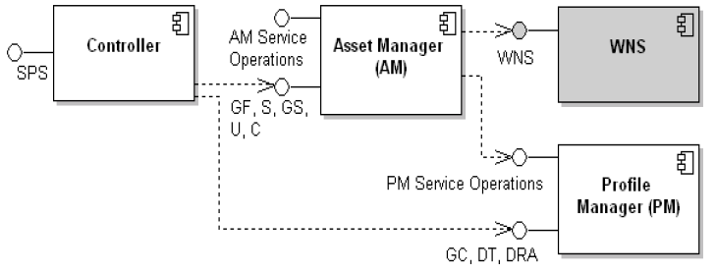
PRM - Programming Request Manager
OGC Sensor Planning Service
Backend Implementation
TOFA

Slide 57
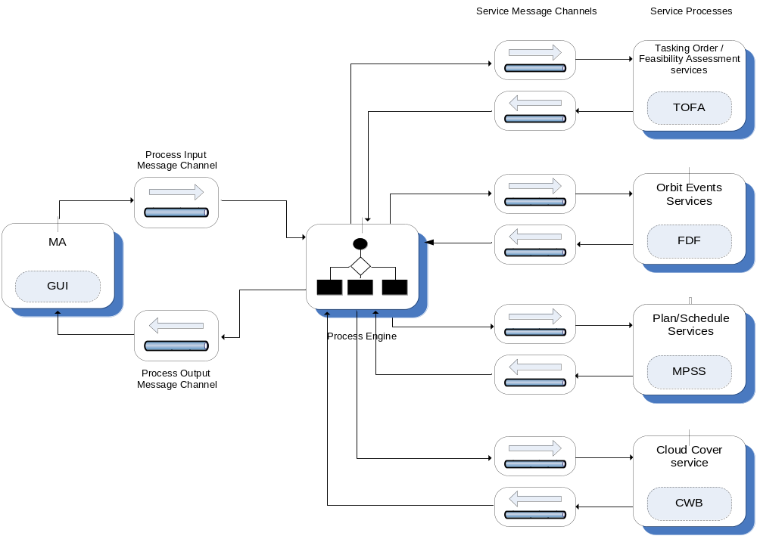
TOFA - Tasking Order Feasibility Assessor
Service Oriented Architecture
on top of Apache ServiceMix

Slide 58
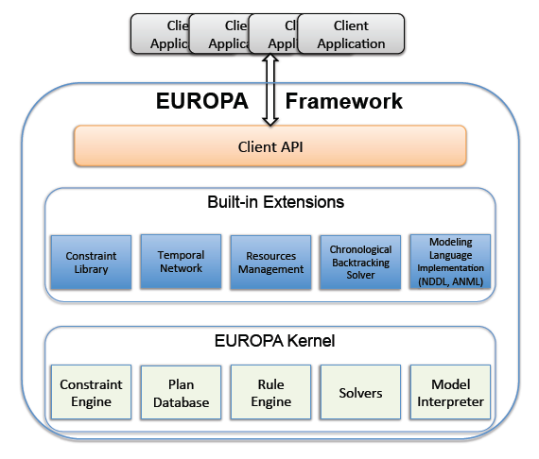
MPSS- Mission Planning & Scheduling System
MPSS
Similar to iLog Solver/Scheduler
NDDL can be built by MA himself

Slide 59
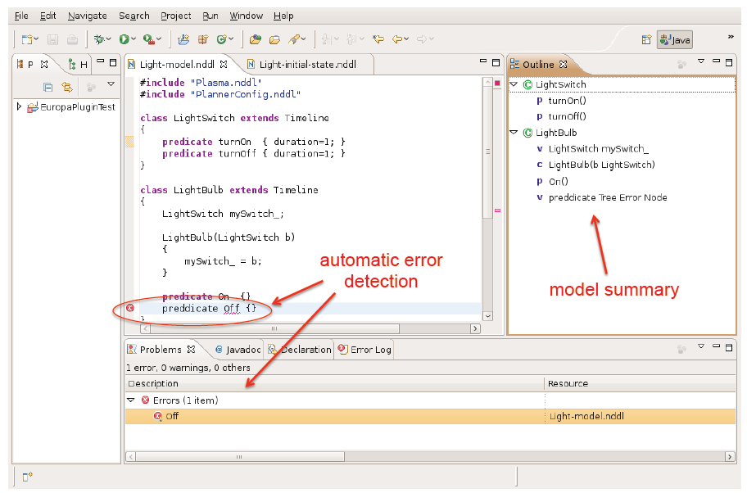
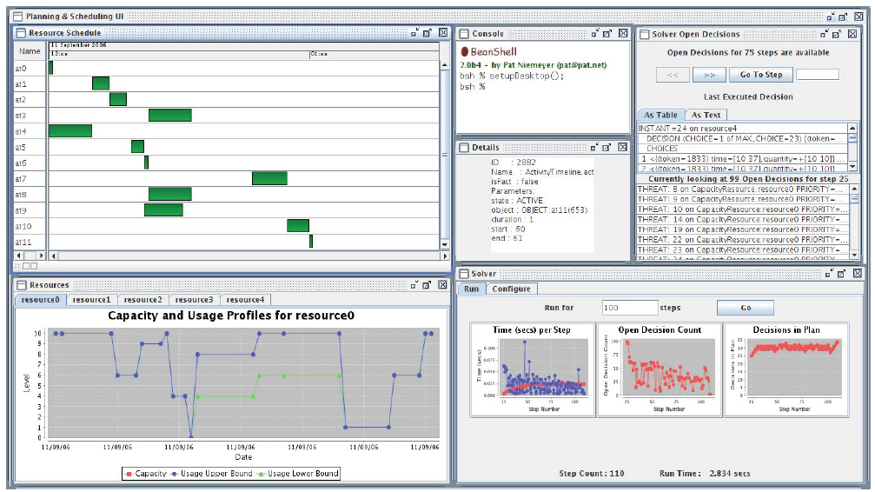
EUROPA - Toolkits
Eclipse Plugin - NDDL Graphical Model Editor
PS Desktop

Slide 60
Constraint Engine
Domains
  int,float,bool,string,object
  Enumeration, Range
Variables
  Have base and current domain
Constraints
  Built-in constraint library (42 constraints, see EUROPA portal)‏
Constraint Propagation
  Each constraint has a propagator
  Constraint Engine allows propagators to perform domain reduction
NDDL
// Domains
typedef int [0 8] Queen;
typedef double [0.0 100.0] myRange;
// Variables
Queen q1,q2, ... , q8;
// Constraints
neq(q1,q2);
allDiff(q1,q2, ... , q8);

Slide 61
Plan Database
Classes
  Inheritance
  Constructor
Objects
  Contain Tokens, Variables, other objects
Tokens
  Object-scoped
  Temporal entities (start, end, duration). Typically represent activities or states.
Variables
  Object attribute
  Token parameter
  Global variable
NDDL
class LightSwitch extends Timeline
{
predicate turnOn { duration=1; }
predicate turnOff { duration=1; }
}
class LightBulb extends Timeline
{
LightSwitch mySwitch_;
LightBulb(LightSwitch b) { mySwitch_ = b; }
predicate On {}
predicate Off {}
}

Slide 62
Rules Engine
Subgoals
  Token Master-Slave relationships
Allen Relations
  before, after, meets,met_by,equals, contains, contained_by, paralleled_by, parallels, starts, ends, ends_after, ends_before, ends_after_start, starts_before_end, starts_during, contains_start, ends_during, contains_end, starts_after, starts_before, any
Token Activate-Merge-Reject mechanisms
NDDL
LightBulb::On
{
// Bulb must be Off to be turned On
met_by(object.Off);
met_by(object.mySwitch_.turnOn);
}
LightBulb::Off
{
// Bulb must be On to be turned Off
met_by(object.On);
// Must be turned off through the switch
met_by(object.mySwitch_.turnOff);
}
goal(LightBulb.Off g1);
eq(g1.start,10);

Slide 63
Temporal Network
Temporal Constraints are mirrored in Distance Graph
  temporalDistance, precedes, concurrent
Negative cycle detection provides earlier conflict detection
NDDL
activity4.start, [ -inf 25 ], activity9.start );
temporalDistance(
activity10.start, [ 5 +inf ], activity11.start );
precedes(0,activity0.start);
precedes(activity0.end,maxDuration);
precedes(0,activity1.start);
precedes(activity1.end,maxDuration);
temporalDistance(

Slide 64
Resources
NDDL
class Allocation {
int m_actId; float m_qty; Reusable m_resource;
Allocation( Reusable r, int id, float qty) {
m_actId = id; m_resource = r; m_qty = qty;
}
}
class ProblemInstance {
predicate Activity { int m_actId; }
}
ProblemInstance::Activity
{
Allocation allocations;
eq( allocations.m_actId, m_actId );
foreach( a in allocations ) {
equals( a.m_resource.uses u );
eq( u.quantity, a.m_qty );
}
}
Multiple Resource types
  Reservoirs : Independent produce/consume
  Reusables : Matching produce/consume
  Unary : Reusable specialization
Profile Envelope Computation
  Resource Profile internally transformed into flow network representation. Efficient Max Flow computation provides earlier conflict detection

Slide 65
Built-in Solver
Flaws
  Open Condition
  Unbound Variable
  Threat
XML-Configuration
  Flaw Managers
  Flaw Filters
  Priorities
This is just one kind of solver that can be built using EUROPA
Chronological Backtracking algorithm
Rplan(PlanDatabase db, FlawManagers fms) {
if(!isConsistent(db)) return INITIALLY_INCONSISTENT;
Stack s = {};
DecisionPoint dp = selectDecisionPoint(db, fms); // Uses priorities, filters.
while(dp != NULL) {
while(dp.hasNext()) {
dp.tryNext();
if (!isConsistent(db)) dp.undo();
}
if (!isConsistent(db)) { // Exhausted choices
if(s.isEmpty() return SEARCH_EXHAUSTED;
else dp = backtrack (s);
}
else {
s.push(dp);
dp = selectDecisionPoint(db, fms);
}
}
return PLAN_FOUND;
}

Slide 66

Q & A

Slide 67

報告完畢
敬請指教

