Slide 1
衛星多重任務及星系操作系統整合軟體
CONTRACT Number : NSPO-P-101080
CDRL Item Number : MCC-CDRL-007
Issue revision: 0001
E-M Pem
Shaowen Cheng
Gahong Tsai
Tom Cheng
ACS

Slide 2
Agenda
專案進度
系統架構程式與功能說明
雛型展示
下階段工作說明
Q & A

Slide 3
里程碑及日期
項次 | 合約品項 | 審查會議時程 | 執行情況
1 | 階段 #1 系統設計 WSD+1M | 2013/1/5 | 12/12 Kick off meeting 12/26 TOFA功能討論 預計1月中由NSPO展示目前TOFA及MPSS系統以澄清系統需求
2 | 階段 #2關鍵設計 WSD+3M | 2013/3/5 | 1/10工程範圍討論 1/30 EUROPA功能介紹及展示
3 | 階段 #3原型系統開發 WSD+10M | 2013/10/5 | 完成UI主要功能 完成Orbit Event & MTL匯入展現初步排程結果
4 | 階段 #4更新系統開發及整合測試 WSD+15M | 2014/3/5

Slide 4
目前工作進度說明
文件交付
  原型系統開發測試審核報告
  功能驗收與測試文件
  系統架構程式與功能說明文件
排程活動產生
  Activities Generation
  正進行MPSS和EUROPA整合及驗證
原型系統主要操作功能
  Planning
    Orbital Events, Resource Configuration, Activity Request List Editor, Session Management, RTS Schedule Request Generation.
  Scheduling
    Cold Scheduling, External Activity Request Scheduler, Gantt Chart.

Slide 5
MPSS Operational Processes
Transfer
Data
Resource
Configuration
Orbit
Events
RTS
Request
Scheduler
Session
Manager
- Import ASCII
ephemeris
from FDF
- Import
RSI/ISUAL
MTL (mission
timeline) from
Gateway-PC
- Make sure the
Global and
the Parameter
Set resource
configuration
- Orbit events
generation
using OASYS
- Orbit events
ingestion into
MPSS DB
- Generate the
RTS schedule
request files
for transfer to
the RTS sites
- Define a session
including time
period, resource
PS, satellites and
sites
Planning
Cold
Scheduler
EARS
Gantt Chart
Scheduling
Schedule
Validation
Report
Generation
Product
Generation
Product/
Report
Transfer
- Perform the
initial
scheduling
of a session
- External
Activity
Request
Scheduler
- Ingest and
schedule
external files
(MTL)
- Display the
scheduled
session
- provide fine
tuning, rapid
re-planning
and hot
scheduling
- Validate the
scheduled
session
based on
resource
allocation
and
scheduling
rules
- Generate
reports for
scheduling
results
- Acquisition
schedule
report
- DIS report
- SSR
utilization
report
- Generate
operation
products for
uplink
- MPQ/TTQ
loads
- Interface
with EPOCH
DB
- Transfer load
files to MOC
- Transfer
reports to
FTP for
CSRSR/ISUAL
SDDC/IPS/RTS
Scheduling
Product

Slide 6
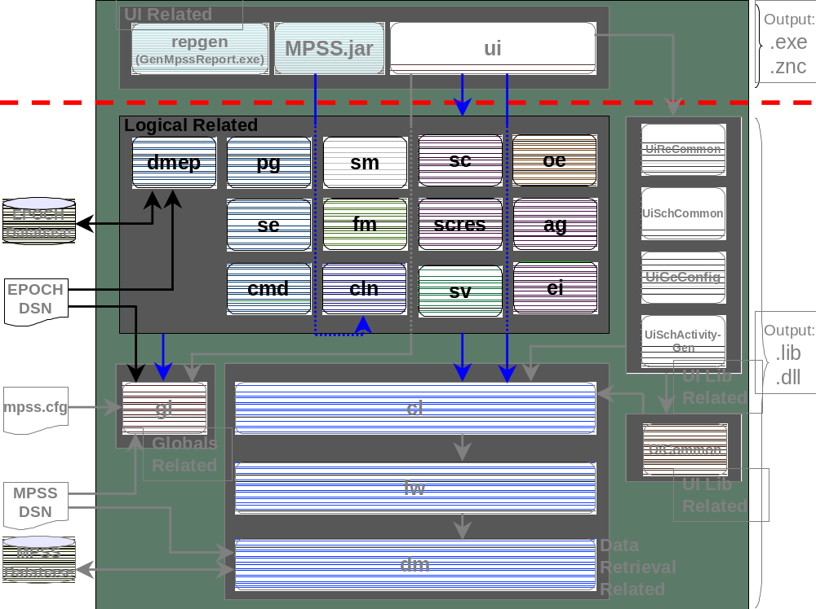
MPSS Modules

Slide 7
MPSS: From Request to Schedule
Activity Request List
Activity
(Time Line)
Constraints
Timing
We are here
iLog /EUROPA Activity
定義排程問題
Solver
Schedule

Slide 8
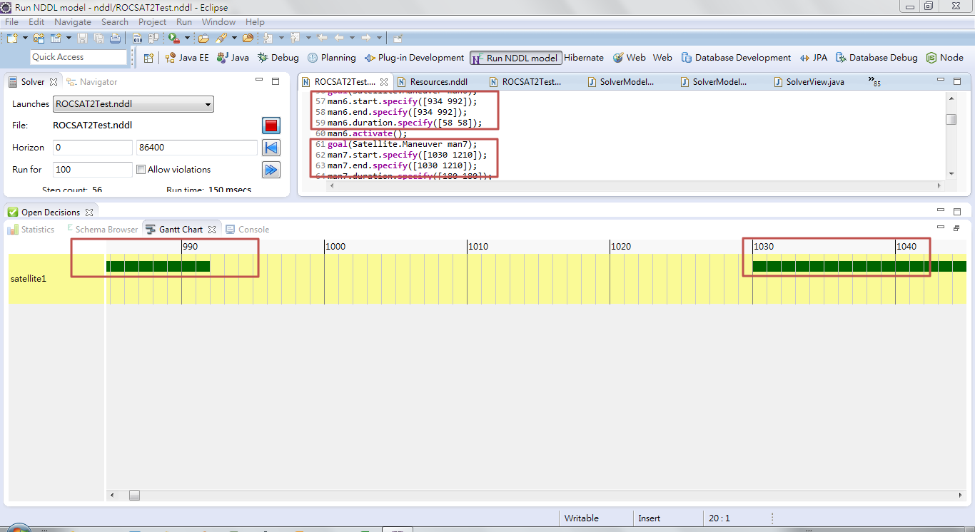
MPSS: From Request to Schedule
Development & Testing Undergoing

Slide 9
Product Generation
It generate spacecraft loads, ground directives, real-time scripts, and schedule reports.
Product Generation
Resolved Acquisition Schedule Reports
(RASR)
Scheduled MPSS Events
Ground Pass Initialization Procedures
Command Loads
Event Templates
Command Load Reports
Miscellaneous Procedures
Integrated Report
ISUAL Command Procedures
Pass Plans

Slide 10
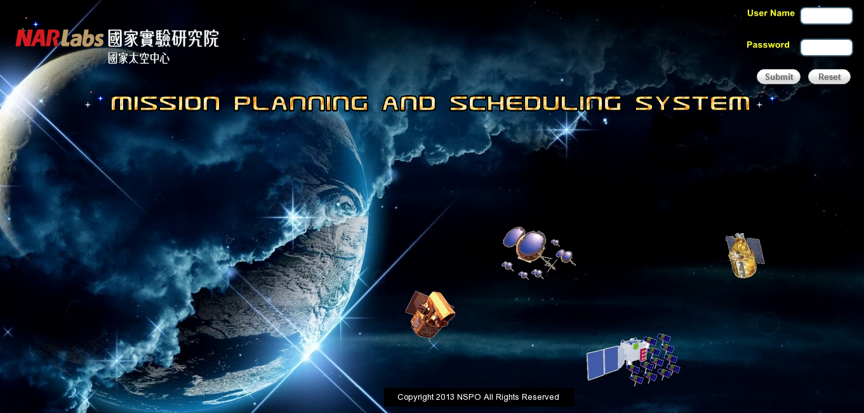
UI 模型展示
Home Page

Slide 11

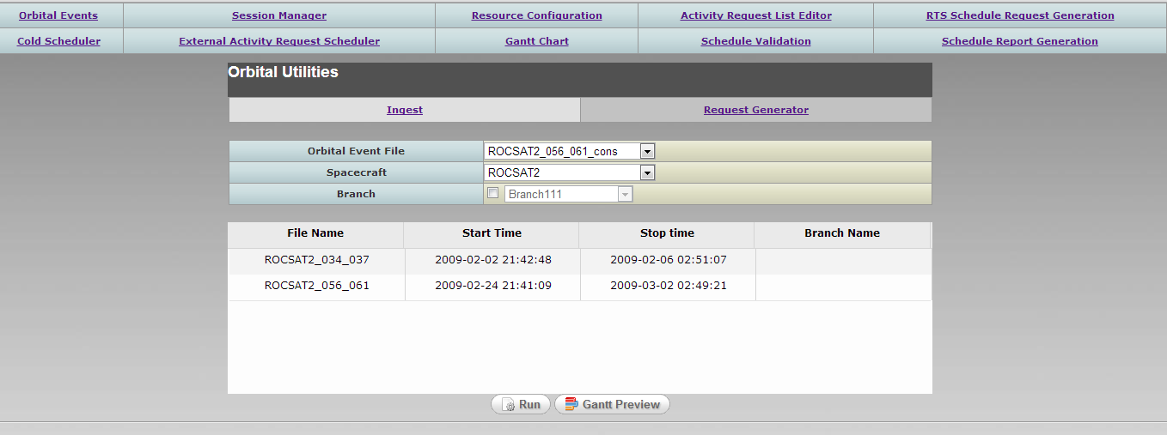
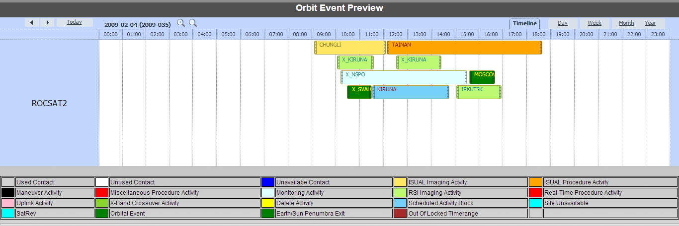
Orbit Events

Slide 12
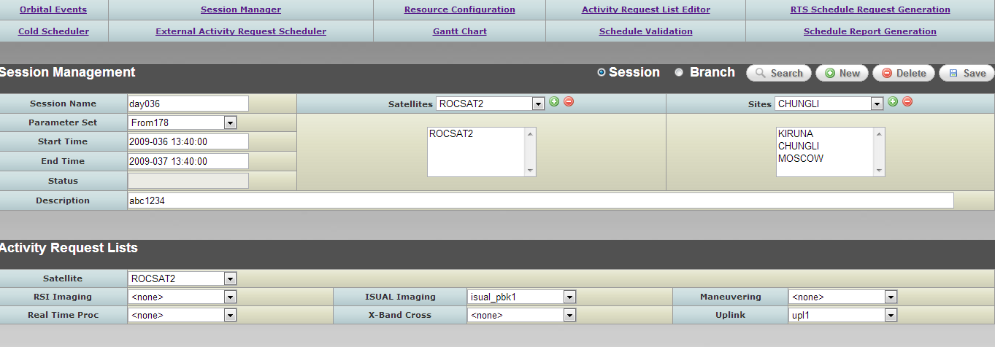
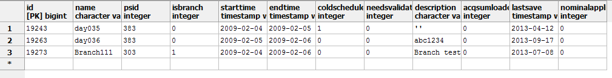

Session Management
與DB連結， 可作查詢、新增、刪除、修改
DB

Slide 13
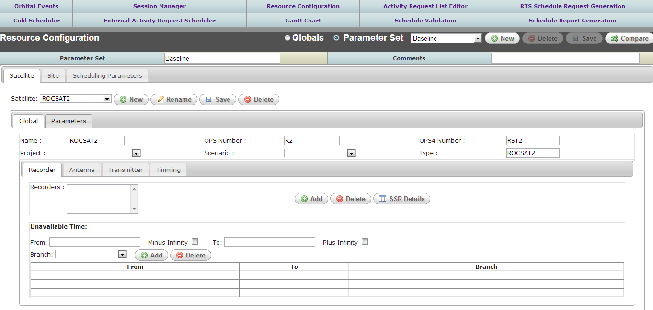
Resource Configuration

Slide 14
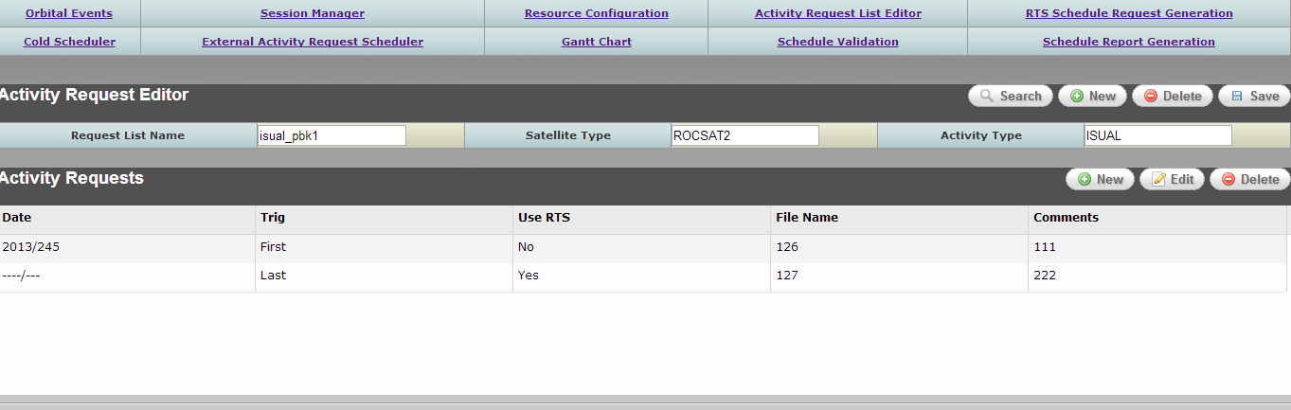
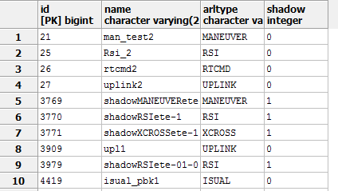

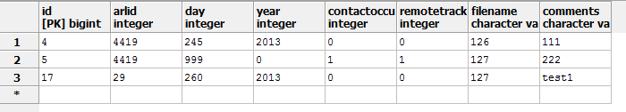
Activity Request List Editor
與DB連結， 可作查詢、新增、刪除、修改
DB

Slide 15
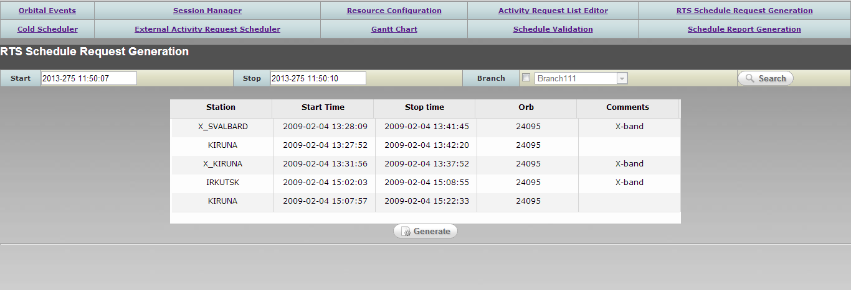
RTS Schedule Request Generation
與DB連結， 可作查詢、新增、刪除、修改

Slide 16
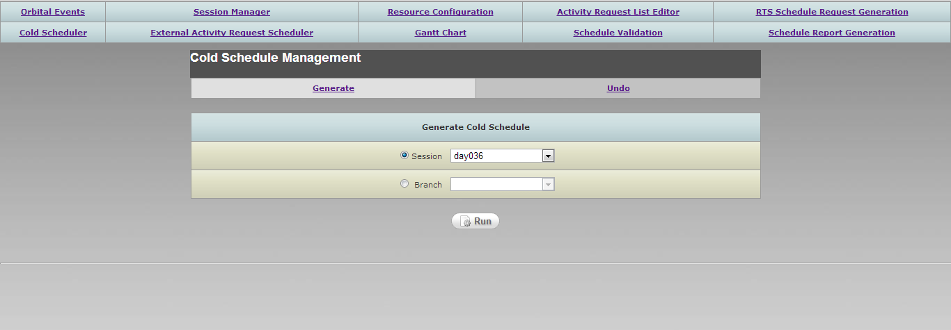
Cold Schedule Management

Slide 17
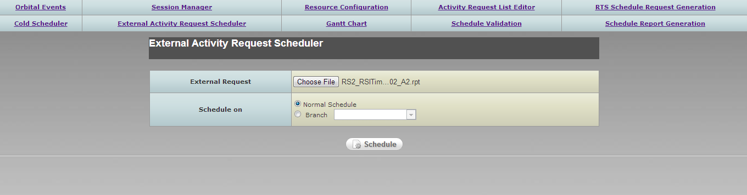
External Activity Request Scheduler

Slide 18
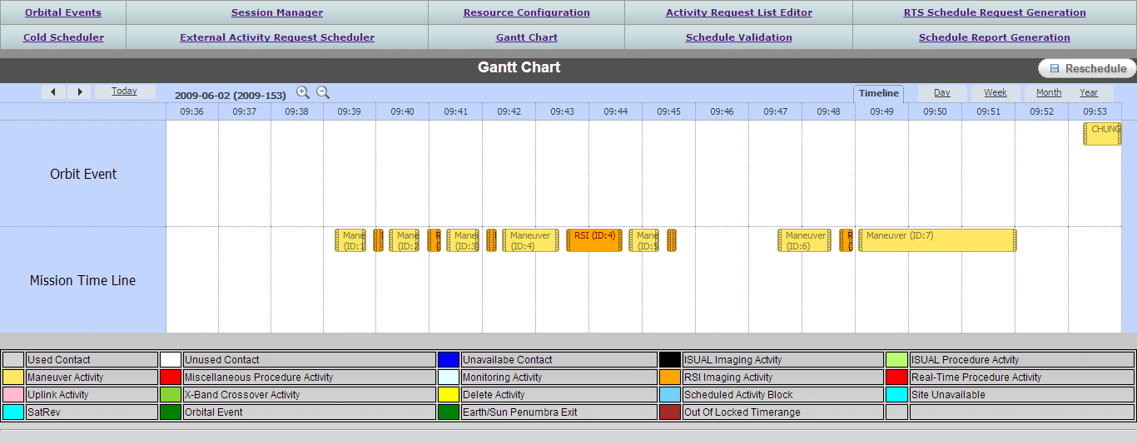
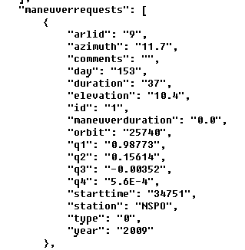
Gantt Chart(Activities)
讀取Mission Timeline 檔案畫出Gantt Chart

Slide 19
Test Report Review
項目 | 功能說明 | 測試內容說明
C3.1 | Planning and Scheduling
MCC003.01.01 | The MCC shall have the capability to provide scheduling of multi-mission operations and long-term mission planning including launch planning. | 由Orbit Events及MTL彙入MPSS資料庫產生初步排程
MCC003.02.01 | The MCC shall have the capability to provide scheduling of multi-mission operations and long-term mission planning including FORMOSAT-5,FORMOSAT-2 and 3 activity scheduling . | 由Orbit Events及MTL彙入MPSS資料庫產生初步排程
MCC003.03.01 | The MCC shall have the capability to provide scheduling of multi-mission operations and long-term mission planning including instrument activity scheduling. | 由Orbit Events及MTL彙入MPSS資料庫產生初步排程
MCC003.04.01 | The MCC shall have the capability to provide scheduling of multi-mission operations and long-term mission planning including contingency planning and scheduling for anomaly phenomena. | 由Orbit Events及MTL彙入MPSS資料庫產生初步排程

Slide 20
項目 | 功能說明 | 測試內容說明
MCC003.05.01 | The MCC shall have the capability to provide scheduling of multi-mission operations and long-term mission planning including long-term schedule for normal mission operations. | 由Orbit Events及MTL彙入MPSS資料庫產生初步排程
MCC003.06.01 | The MCC shall have the capability to provide scheduling of multi-mission operations and long-term mission planning including scheduling rules definitions. | 由Orbit Events及MTL彙入MPSS資料庫產生初步排程
MCC003.07.01 | The MCC shall have the capability to provide scheduling of multi-mission operations and long-term mission planning including activity definitions | Activity Request List Editor
MCC003.08.01 | The MCC shall have the capability to provide scheduling of multi-mission operations and long-term mission planning including rescheduling strategies. | 由Orbit Events及MTL彙入MPSS資料庫產生初步排程
MCC003.09.01 | The MCC shall have the capability to provide scheduling of multi-mission operations and long-term mission planning including operations constraints. | Resource Configuration
MCC003.10.01 | The MCC shall have the capability to provide scheduling of multi-mission operations and long-term mission planning including rapid re-planning. | Session Management

Slide 21
項目 | 功能說明 | 測試內容說明
MCC003.11.01 | The MCC shall use a SQL database . | PostgreSQL Database
MCC003.12.01 | The MCC shall allow the users to modify or re-implement the corresponding activity definitions. | Activity Request List Editor
MCC003.13.01 | The spacecraft specialists shall provide the operations constraints. | Resource Configuration
MCC003.14.01 | The MCC shall generate schedules that have been validated to not have any operational rule violations. | Undergoing
C3.2 | Schedule Conflict Resolution
MCC003.15.01 | The MCC shall be capable of identifying schedule conflicts when there are overlapping resource allocations among multiple satellites. | Not yet
MCC003.16.01 | The MCC shall be capable of identifying schedule conflicts when there are operation rule violations. | Not yet

Slide 22
項目 | 功能說明 | 測試內容說明
MCC003.17.01 | The MCC shall be capable of identifying schedule conflicts when there are scheduling rule violations. | Not yet
MCC003.18.01 | The MCC shall have the capability of merging individual event and activity schedules, analyzing schedule conflicts and resolving conflicts based on the rules and constraints defining priorities of satellite and ground activities. | Not yet
MCC003.19.01 | The MCC shall provide rescheduling tools to aid the users in resolving conflict. | EUROPA
MCC003.20.01 | The MCC shall provide schedule editing tools to aid the users in resolving conflict. | Gantt Chart Editor UI
C3.3 | Data and Resource Management
MCC003.21.01 | The MCC shall provide a resource database to manage all ground and satellite resources electronically to facilitate planning including ground site selection, on-board command sequence management . | Resource Configuration
MCC003.22.01 | The MCC shall provide a GUI tool to update and modify the resource definitions as the mission requires. | Resource Configuration

Slide 23
項目 | 功能說明 | 測試項目說明
MCC003.23.01 | The MCC shall provide the ability to predict resource utilization within MCC planning software. | Resource Configuration
C3.4 | Operations Product Generation
MCC003.24.01 | The MCC shall be capable of generating operations products including Pass Plans for the FORMOSAT-5 satellites and the existing FORMOSAT-series satellites to automate mission operations and facilitate mission coordination. | Not yet
MCC003.25.01 | The MCC shall be capable of generating operations products including Integrated Reports for the FORMOSAT-5 satellites and the existing FORMOSAT-series satellites to automate mission operations and facilitate mission coordination. | Not yet
MCC003.26.01 | The MCC shall be capable of generating operations products including Instrument Operation Plans for the FORMOSAT-5 satellites and the existing FORMOSAT-series satellites to automate mission operations and facilitate mission coordination. | Not yet

Slide 24
項目 | 功能說明 | 測試項目說明
MCC003.27.01 | The MCC shall be capable of generating operations products including executable files for MOC real-time operations for the FORMOSAT-5 satellites and the existing FORMOSAT-series satellites to automate mission operations and facilitate mission coordination. | Not yet
MCC003.28.01 | The MCC shall be capable of generating operations products including executable files for ground equipment configuration setup for the FORMOSAT-5 satellites and the existing FORMOSAT-series satellites to automate mission operations and facilitate mission coordination . | Not yet
MCC003.29.01 | The MCC shall be capable of generating operations products including ASCII command loads for the FORMOSAT-5 satellites and the existing FORMOSAT-series satellites to automate mission operations and facilitate mission coordination. | Not yet
MCC003.30.01 | The MCC shall be capable of generating operations products including binary command loads (including FORMOSAT-5 payload command files) for the FORMOSAT-5 satellites and the existing FORMOSAT-series satellites to automate mission operations and facilitate mission coordination . | Not yet

Slide 25
項目 | 功能說明 | 測試項目說明
MCC003.31.01 | The MCC shall be capable of generating operations products including ACSII patch loads for the FORMOSAT-5 satellites and the existing FORMOSAT-series satellites to automate mission operations and facilitate mission coordination. | Not yet
MCC003.32.01 | The MCC shall be capable of generating operations products including binary patch loads for the FORMOSAT-5 satellites and the existing FORMOSAT-series satellites to automate mission operations and facilitate mission coordination. | Not yet
MCC003.33.01 | The MCC shall generate executable files for MOC real-time operations that are completely compatible (i.e.once the files are generated, no more post processing or conversion will be necessary for MOC normal operations) with the MOC EPOCH system. | Not yet
MCC003.34.01 | The MCC shall generate executable files for ground equipment configuration setup that are completely compatible (i.e. once the files are generated, no more post processing or conversion will be necessary for MOC normal operations) with the MOC EPOCH system. | Not yet

Slide 26
項目 | 功能說明 | 測試項目說明
MCC003.35.01 | The MCC shall be capable of generating operations products including binary MPQ loads (including FORMOSAT-5 payload command files) for the FORMOSAT-5 satellites and the existing FORMOSAT-series satellites to automate mission operations and facilitate mission coordination . | Not yet
MCC003.36.01 | The MCC shall be capable of generating operations products including ASCII MPQ loads (including FORMOSAT-5 payload command files) for the FORMOSAT-5 satellites and the existing FORMOSAT-series satellites to automate mission operations and facilitate mission coordination . | Not yet
C3.5 | Coordination/Schedule Announcement
MCC003.37.01 | The MCC shall provide interface to FDF to gather information or data for coordination of conducting mission activities. | Not yet
MCC003.38.01 | The MCC shall provide interface to MOC to gather information or data for coordination of conducting mission activities . | Not yet

Slide 27
項目 | 功能說明 | 測試項目說明
MCC003.39.01 | The MCC shall provide interface to IPS (Image Processing System) to gather information or data for coordination of conducting mission activities. | Not yet
MCC003.40.01 | The MCC shall provide interface to CSRSR (Center for Space and Remote Sensing Research National Central University) to gather information or data for coordination of conducting mission activities. | Not yet
MCC003.41.01 | The MCC shall provide interface to SDDCs (Science Data Distribution Centers) to gather information or data for coordination of conducting mission activities. | Not yet
MCC003.42.01 | The MCC shall provide interface to RTS (Remote Tracking Station) sites scheduling office to gather information or data for coordination of conducting mission activities. | Not yet
MCC003.43.01 | The MCC shall provide the capability of receiving and automatically processing SDDC’s instrument schedule requests for the FORMOSAT-5 satellite and the existing FORMOSAT-series satellites. | Not yet

Slide 28
項目 | 功能說明 | 測試項目說明
MCC003.44.01 | The MCC shall return the final integrated schedules to the SDDC. | Not yet
MCC003.45.01 | The MCC shall provide the capability to gather data detailed in operational products listed above that are required for NSPO to analyze in coordination of science communities and engineers to perform mission operations. | Not yet
MCC003.46.01 | The MCC shall have the capability to export operations reports in HTML format to selective websites once the schedule is approved, to announce the planned activity to the operations team and all concerned parties. | Not yet
MCC003.47.01 | The MCC shall have the capability to export operations reports in ASCII format to selective FTP sites once the schedule is approved, to announce the planned activity to the operations team and all concerned parties. | Not yet

Slide 29
下階段工作說明
整合EUROPA排程功能及性能評估
完成Planning、Scheduling、Products操作畫面所有功能

Slide 30
Q & A

