Slide 1
UCB - CS189 Introduction to Machine Learning Fall 2015 Lecture 2: Linear Classifiers
Isabelle Guyon
ChaLearn

Slide 2

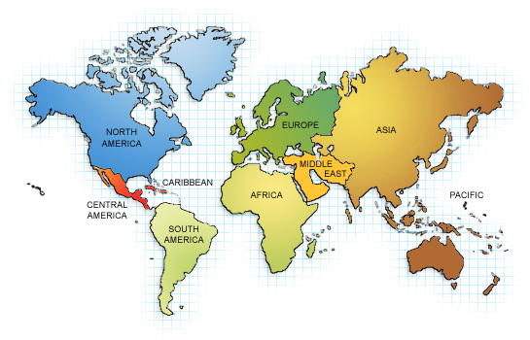





Isabelle Guyon

Slide 3
The DREAM
AutoML
black box
Trained
model
TRAINING
DATA
Answer y
?
Query x
http://codalab.org/AutoML

Slide 4

The REALITY
Hyper-parameter tuning
Trained
model
TRAINING
DATA
Answer y
?
Query x
http://codalab.org/AutoML

Slide 5
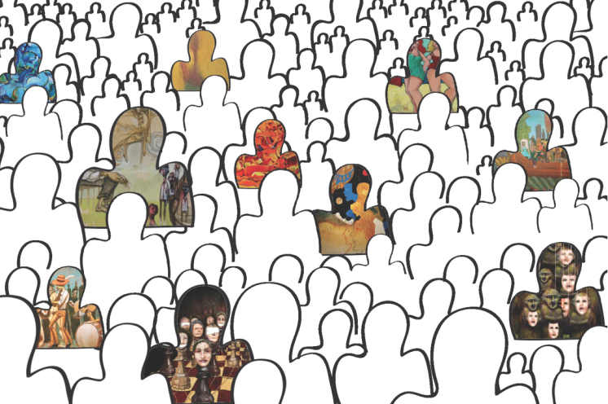
ChaLearn ML challenges
Trained
model
Crowd
TRAINING
DATA
Answer y
?
Query x
http://codalab.org/AutoML

Slide 6

AutoML challenge
AutoML
black box
Trained
model
Crowd
TRAINING
DATA
Answer y
?
Query x
http://codalab.org/AutoML

Slide 7

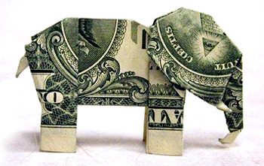



Why would the crowd do that?
$30000
Learning
Fame
Fun
Workshop
http://codalab.org/AutoML
Dream

Slide 8
Come to my office hours… Wed 2:30-4:30 Soda 329
$30000
Learning
Fame
Fun
Workshop
http://codalab.org/AutoML
Dream

Slide 9
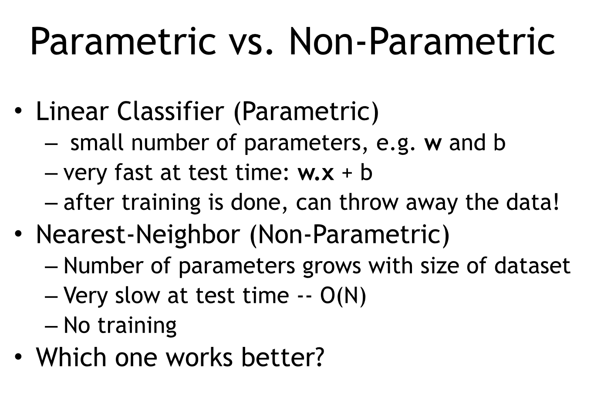
Come to my office hours… Wed 2:30-4:30 Soda 329
Last time

Slide 10
Come to my office hours… Wed 2:30-4:30 Soda 329
Today
Parametric ≡ Non-Parametric
DUAL representations
via the
“kernel trick”

Slide 11
Math prerequisites
Vector
Dot product (scalar product)
Euclidean norm
Normalizing a vector
Cosine between two vectors
Standardizing a vector
Correlation between two vectors
Linearity
Hyperplane

Slide 12
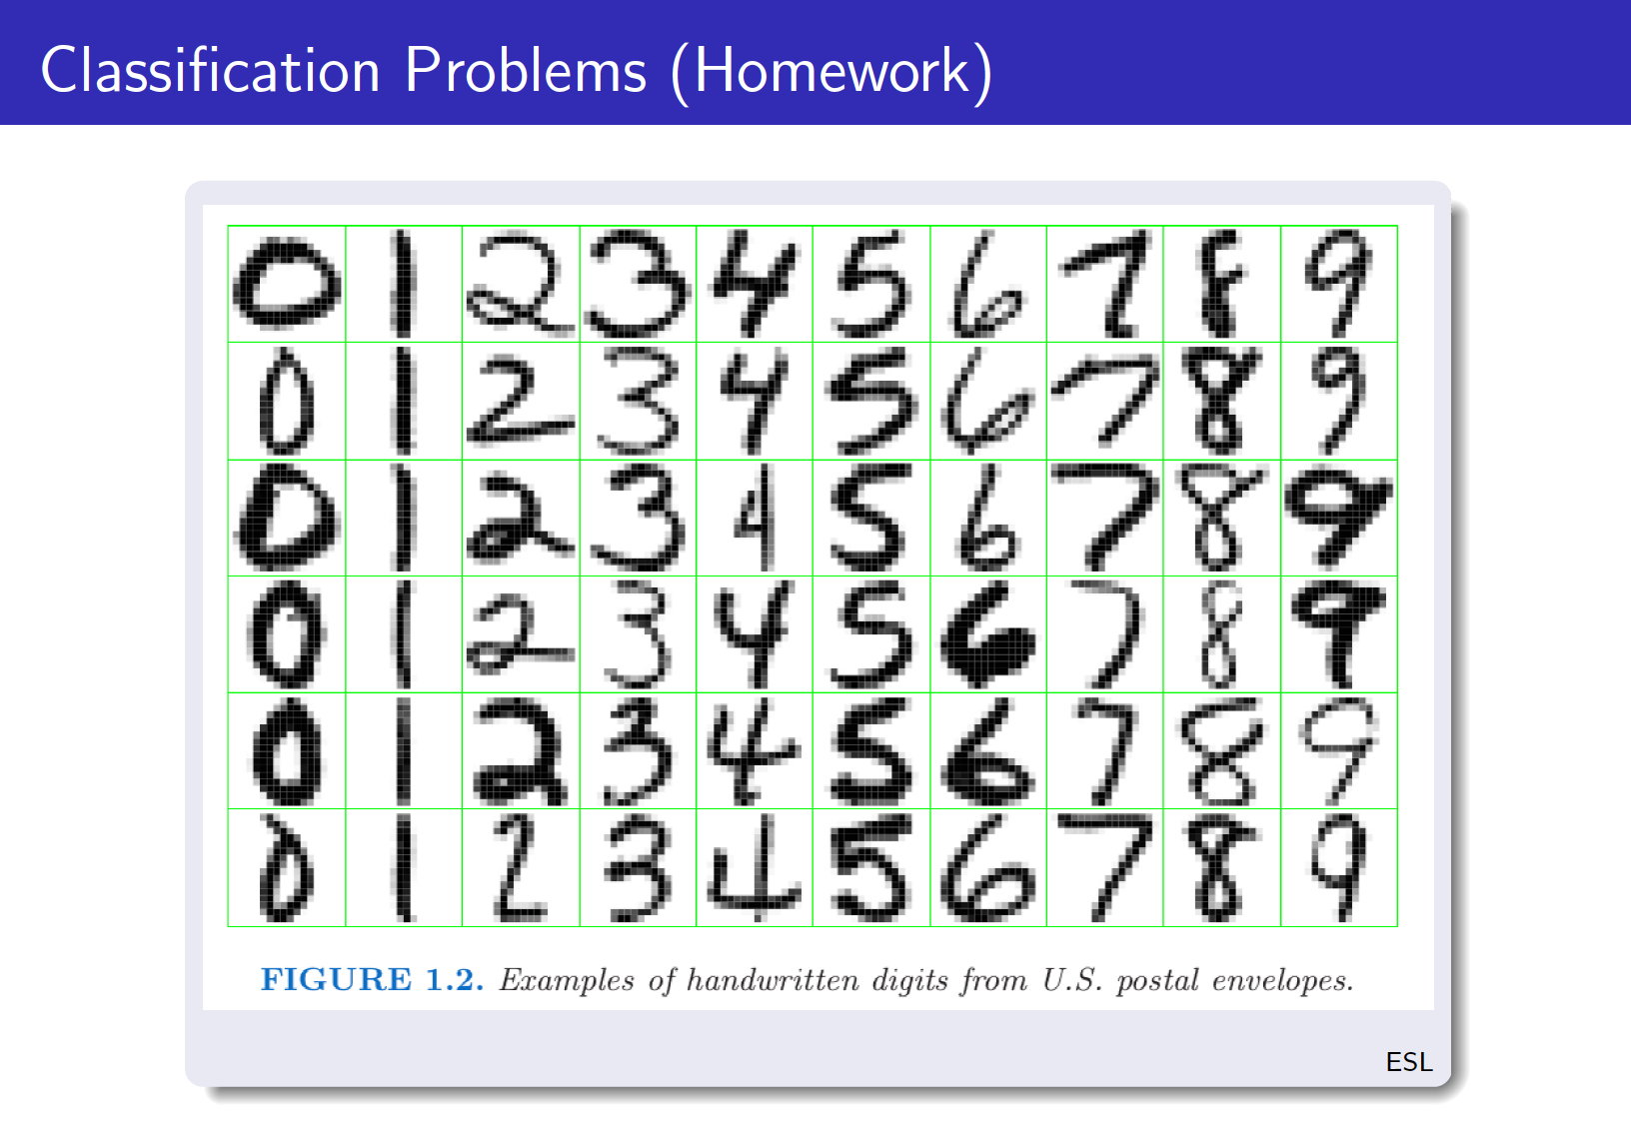
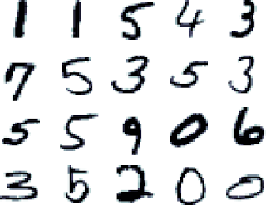
MNIST data

Slide 13
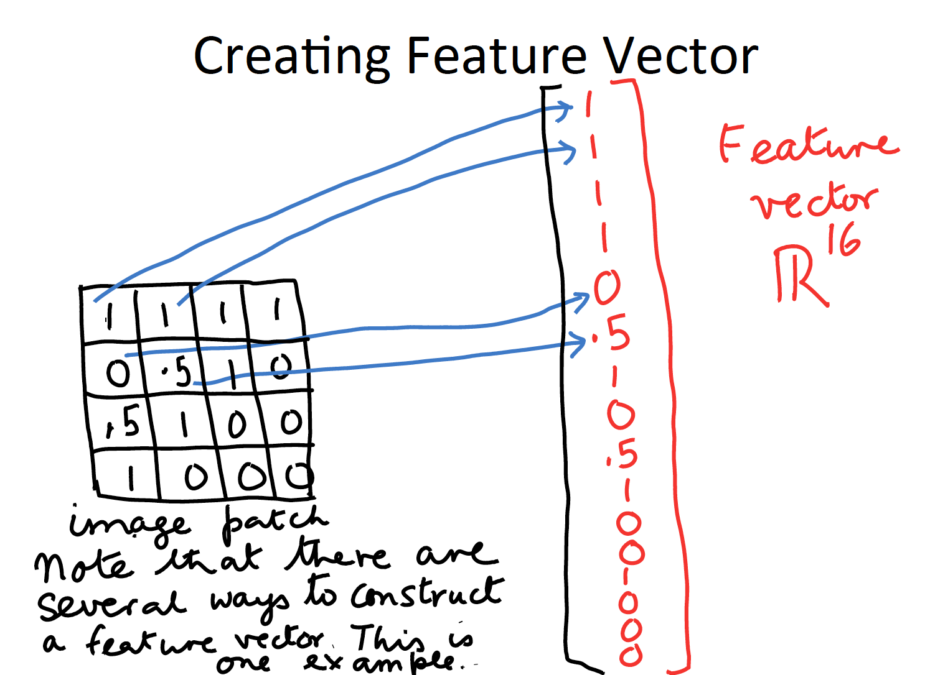
Reminder:

Slide 14
Reminder:

Slide 15
Reminder:
Another example, extract features: x = [amount_ink, shape_elongation]

Slide 16
Separate “0” and “1” in 2 dimensions
x₂ = shape_elongation
x₁ = amount_ink
0
Each example is represented by a little vector x = [ x_{1 ,} x₂ ]

Slide 17









Separate “0” and “1” in 2 dimensions
x₂ = shape_elongation
x₁ = amount_ink
0
The zeros are written with more ink and are less elongated. The ones are written with less ink and are more elongated.

Slide 18
Separate “0” and “1” matrix representation
ink elongation
X = [ -0.8147 0.6576
-0.6058 0.5706
-0.7270 0.8572
-0.8134 0.5854
-0.4324 0.4003
0.4975 -0.1419
0.2785 -0.4218
0.5469 -0.7157
0.7575 -0.7922
0.8649 -0.8595 ]
y= [ 1
1
1
1
1
-1
-1
-1
-1
-1 ]

Slide 19
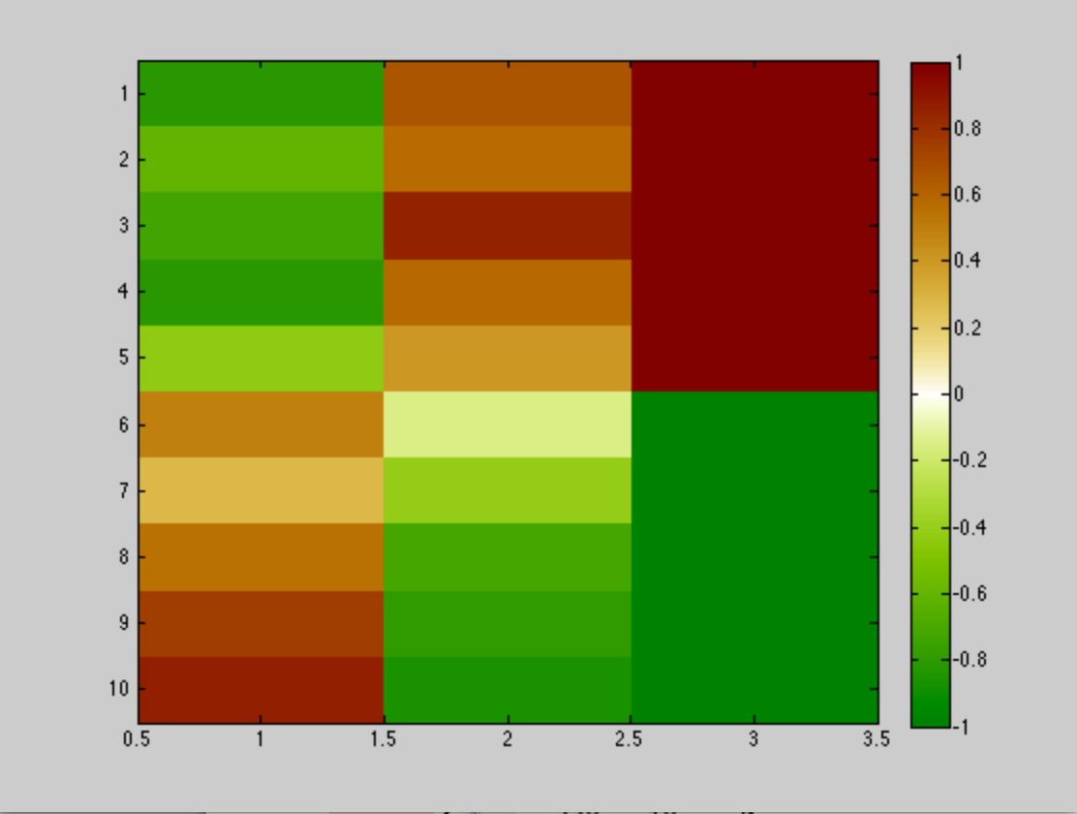
Heat map
ink elongation Y

Slide 20
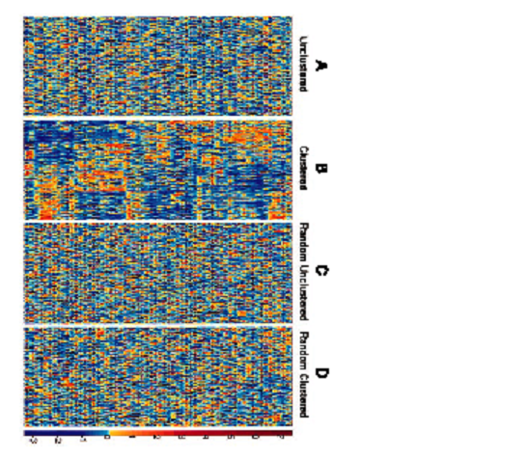
Learning problem
Data matrix: X
N lines = patterns (data points, examples): samples, patients, documents, images, …
d columns = features: (attributes, input variables): genes, proteins, words, pixels, …
Unsupervised learning
Is there structure in data?
Supervised learning
Predict an outcome y.
Colon cancer, Alon et al 1999

Slide 21
Conventions
d
X={x^{k}_{i}}
y ={y^{k}}
x^{k}
N
α
w

Slide 22
Separate “0” and “1” How to build your first linear classifier?
x₂ = shape_elongation
x₁ = amount_ink
0

Slide 23
Separate “0” and “1” How to build your first linear classifier?
x₂ = shape_elongation
x₁ = amount_ink
0

Slide 24
Separate “0” and “1” 1) Find the class “centroids”
x₂ = shape_elongation
x₁ = amount_ink
0
Just average the vectors of each class.

Slide 25


Separate “0” and “1” 1) Find the class “centroids”
x₂ = shape_elongation
w^{[1]}
x₁ = amount_ink
0
w^{[0]}
You get vectors representing average shapes.

Slide 26
Separate “0” and “1” 2) Subtract w^{[0]} from w^{[1]}
x₂ = shape_elongation
-w^{[0]}
w^{[1]}
x₁ = amount_ink
0

Slide 27
Separate “0” and “1” 2) Subtract w^{[0]} from w^{[1]}
w^{[1]} - w^{[0]}
x₂ = shape_elongation
x₁ = amount_ink
0
You get w = w^{[1]} - w^{[0]} as your weight vector.

Slide 28
Separate “0” and “1” 3) Get the separaring “hyperplane”
w=w^{[1]}-w^{[0]}
x₂ = shape_elongation
f(x) < 0
x₁ = amount_ink
0
f(x) > 0
f(x) = w.x = 0

Slide 29
Separate “0” and “1” 4) ALL the “math”
Input vector x = [x₁, x₂]
x₁ = amount_ink
x₂ = shape_elongation
Target value y = ± 1
+1 = “one”; -1 = “zero”
Training examples:
{ (x¹, y¹), (x², y²), … , (x^{N}, y^{N}) }
Class centroids:
w^{[0]} ~ ∑_{{y}k_{==-1}} x^{k} (~ means “proportional”, omitting to divide by class cardinality)
w^{[1]} ~ ∑_{{y}k_{==+1}} x^{k}
Weight vector:
w = w^{[1]} - w^{[0]} ~ ∑_{k} y^{k} x^{k} (for “balanced” classes)

Slide 30
Separate “0” and “1” 4) ALL the “math” (continued)
Decision function:
f(x) = w . x
f(x) > 0, decide that this is a “one”
f(x) < 0, decide that this is a “zero”
Dot product:
w . x = w₁ x₁ + w₂ x₂ This is a weighted sum.
Equivalent “centroid” method:
f(x) = w^{[1]} . x - w^{[0]} . x This is because w = w^{[1]} - w^{[0]}.
Decide “one” if w^{[1]} . x > w^{[0]} . x and “zero” otherwise
A dot product is a similarity measure.
Equivalent “kernel” method: This is because w = ∑_{k} y^{k} x^{k}
f(x) = ∑_{k} y^{k} x^{k} . x = ∑_{k} α^{k} k(x^{k}, x) (in the case of identical number of examples for the two classes)

Slide 31
Centroid methods don’t always work…
0

Slide 32
Centroid methods don’t always work…
0

Slide 33
Centroid methods don’t always work…
0

Slide 34
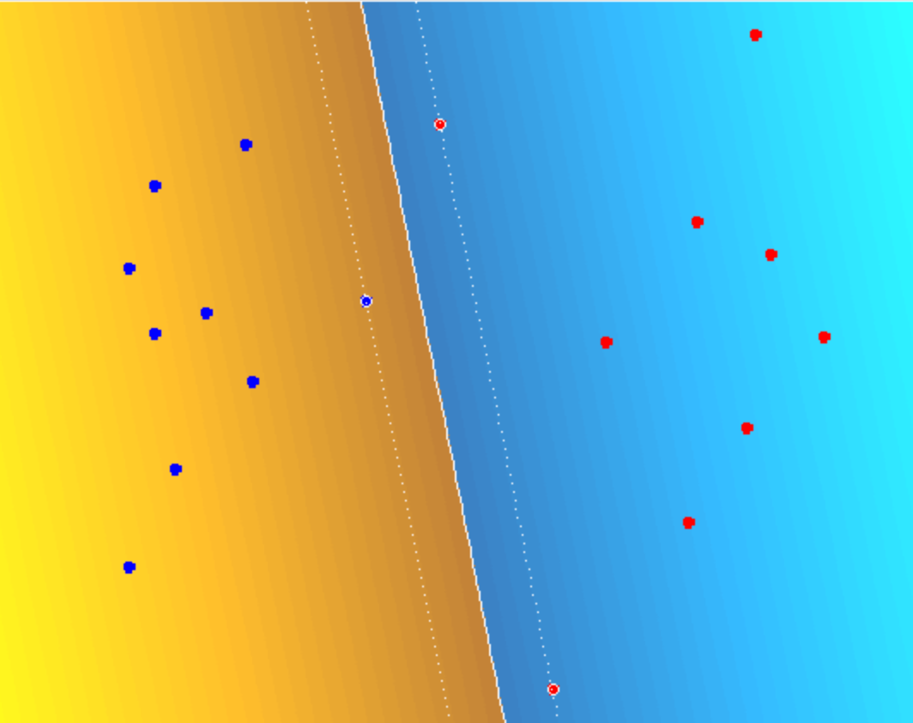
Demo of SVM (downloadable from bCourses)

Slide 35
Linear Models
“Regular” linear models, linear in their inputs and parameters
f(x) = w • x +b = Σ_{i=1:d} w_{i} x_{i} +b
Models linear in their parameters, NOT in their inputs.
f(x) = w • Φ(x) +b = Σ_{i} w_{i} φ_{i}(x) +b (Perceptron)
f(x) = Σ_{k=1:N} α_{k} k(x^{k}, x) +b (Kernel method)

Slide 36
Linear Models
“Regular” linear models, linear in their inputs and parameters
f(x) = w • x +b = Σ_{i=1:d} w_{i} x_{i} +b
Models linear in their parameters, NOT in their inputs.
f(x) = w • Φ(x) +b = Σ_{i} w_{i} φ_{i}(x) +b (Perceptron)
f(x) = Σ_{k=1:N} α_{k} k(x^{k}, x) +b (Kernel method)

Slide 37
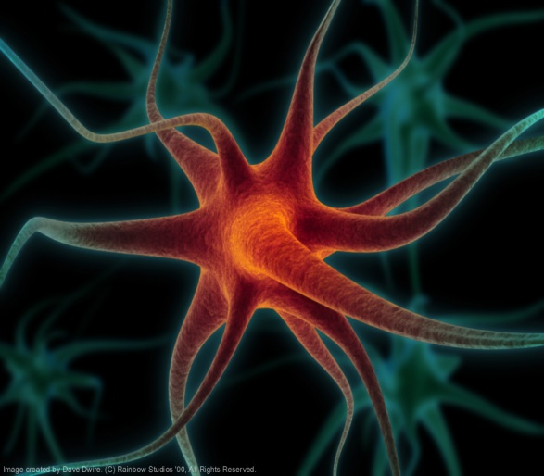
Artificial Neurons
Cell potential
x₁
w₁
x₂
w₂
Σ
f(x)
Axon
w_{d}
Activation of other neurons
x_{d}
b
Activation function
1
Dendrites
Synapses
McCulloch and Pitts, 1943
f(x) = w • x + b

Slide 38
Linear decision boundary
hyperplane
x₂
f(x) > 0
f(x) = w • x + b = 0
f(x) > 0
x₃
f(x) < 0
f(x) < 0
f(x) = w • x + b = 0
x₁
x₂
x₁

Slide 39
Perceptron
Rosenblatt, 1957
x₁
φ₁(x)
w₁
x₂
φ₂(x)
w₂
Σ
f(x)
w_{D}
x_{d}
φ_{D}(x)
b
f(x) = w • Φ(x) + b
1

Slide 40
Non-linear decision boundary
x₂
f(x) > 0
f(x) = 0
x₃
f(x) < 0
x₂
x₁
x₁

Slide 41
Linear decision boundary in Φ-space
Φ(x)
x₂
φ₂(x)
x₁
φ₁(x)

Slide 42
Summary
We represent patterns as vectors x in a space of d dimensions.
A “discriminant function” f(x) is a function such that f(x) > 0 for one class and f(x) < 0 for the other. f(x)=0 is the equation of the decision boundary.
Given a weight vector w, f(x)=w.x is a linear discriminant function. The corresponding decision boundary w.x=0 is a hyperplane (a subspace of dimension (d-1)).
Feature transforms x -> Φ(x) permit to built non-linear decision boundaries, while using discriminant linear in w (NOT in x).

Slide 43
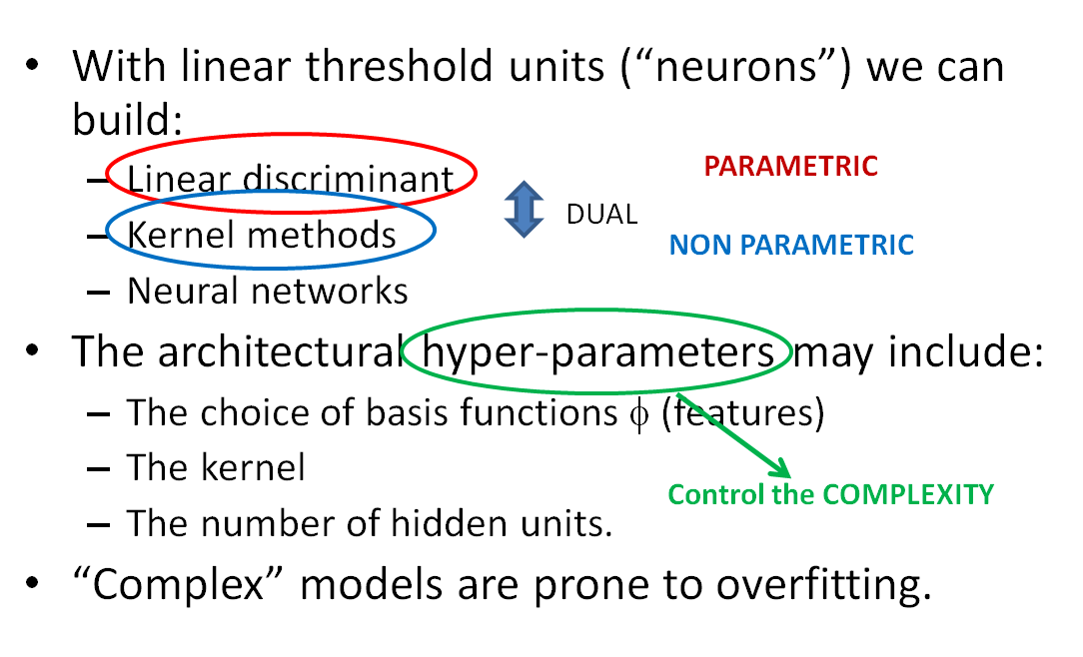
Come to my office hours… Wed 2:30-4:30 Soda 329
Next time

