Slide 1
UCB - CS189 Introduction to Machine Learning Fall 2015 Lecture 3: Support Vector Machines
Isabelle Guyon
ChaLearn

Slide 2
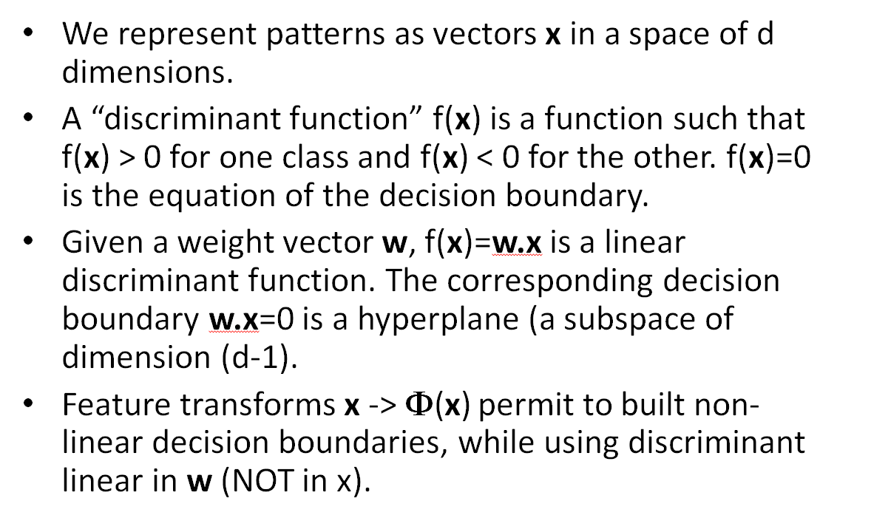
Come to my office hours… Wed 2:30-4:30 Soda 329
Last time

Slide 3
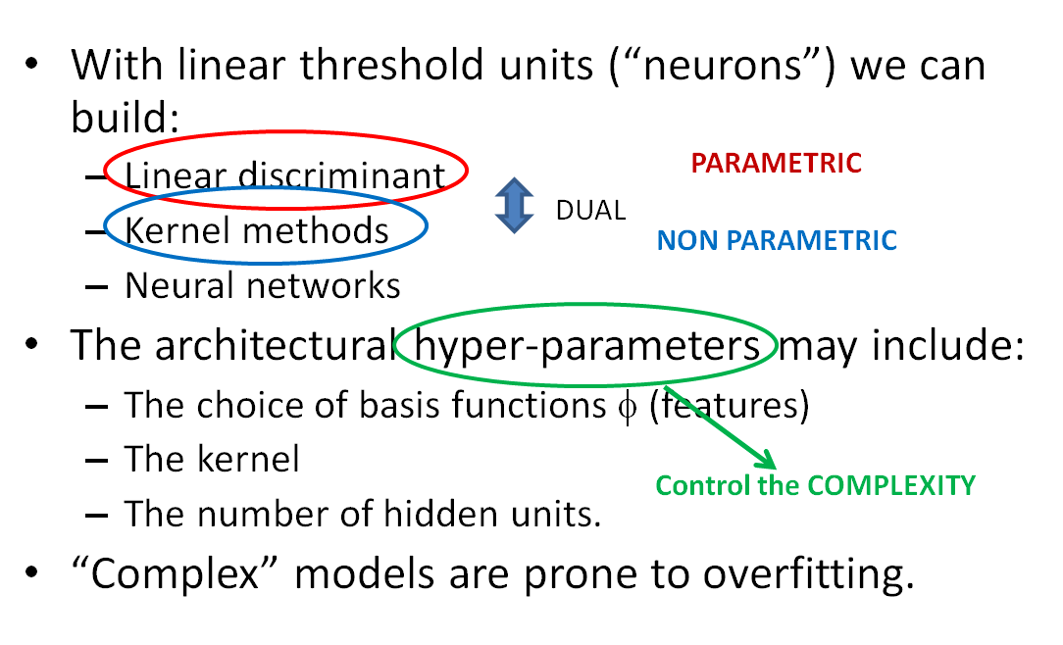
Come to my office hours… Wed 2:30-4:30 Soda 329
Today

Slide 4









Separating hyperplane
LAST TIME
f(x) < 0
x₂
w
f(x) > 0
f(x) = w.x = 0
x₁

Slide 5
Separating hyperplane
LAST TIME
?

Slide 6


Centroid method
LAST TIME
w

Slide 7
The centroid methods can fail!
LAST TIME
Even when the samples are linearly separable

Slide 8
The Perceptron algorithm
PREVIEW
Always find ONE separating hyperplane if the samples are linearly separable

Slide 9
But which one is best?
PREVIEW
?

Slide 10
Safety margin
PREVIEW

Slide 11
Support Vector Classifier
PREVIEW

Slide 12















New test examples
PREVIEW

Slide 13
More “robust” solution
PREVIEW

Slide 14
Better “fit”
PREVIEW

Slide 15
The “robust” solution has training errors
PREVIEW

Slide 16
Fit vs. Robustness tradeoff
PREVIEW
Best fit: Zero training error. Based on “marginal” possibly “atypical” examples. Could be outliers.
Best robustness: Based on typical examples or average examples (centroids).

Slide 17
Compromise
PREVIEW
Good fit: Allow a few training errors.
Good robustness: Maximize the margin.

Slide 18
“Soft” margin
PREVIEW

Slide 19
Soft Margin Compromise
PREVIEW
Minimize
(1/Margin) + C Training error
Good robustness
Good fit

Slide 20
Hyper-parameter Selection
PREVIEW
X
y
Learning = adjusting:
parameters (w vector).
hyper-parameter (C).
Cross-validation with K-folds:
For various values of C:
- Adjust w on a fraction (K-1)/K of training examples e.g. 9/10th.
- Test on 1/K remaining examples e.g. 1/10th.
- Rotate examples and average test results (CV error).
- Select C to minimize CV error.
- Re-compute w on all training examples using optimal C.
Training data: Make K folds
Test data
Prospective study / “real” validation

Slide 21
Hyper-parameter Selection
PREVIEW
X
y
Learning = adjusting:
parameters (w vector).
hyper-parameter (C).
Cross-validation with K-folds:
For various values of C:
- Adjust w on a fraction (K-1)/K of training examples e.g. 9/10th.
- Test on 1/K remaining examples e.g. 1/10th.
- Rotate examples and average test results (CV error).
- Select C to minimize CV error.
- Re-compute w on all training examples using optimal C.
Training data: Make K folds
Test data
PRIVATE
Prospective study / “real” validation
PUBLIC

Slide 22
Non-linear decision boundary
x₂
f(x) > 0
f(x) = 0
x₃
f(x) < 0
x₂
x₁
x₁

Slide 23
Linear decision boundary in Φ-space
Φ(x)
x₂
φ₁(x)
x₁
φ₂(x)

Slide 24
Perceptron
Rosenblatt, 1957
x₁
φ₁(x)
w₁
x₂
φ₂(x)
w₂
Σ
f(x)
w_{D}
x_{d}
φ_{D}(x)
b
f(x) = w • Φ(x) + b
1

Slide 25
What can Φ features be?
Hand crafted features (lines, crosses, corners).
Randomly generated functions (sums, products).
“Dictionary” features (little pieces of images).
Basis functions of transforms (Fourier, Wavelet)

Slide 26
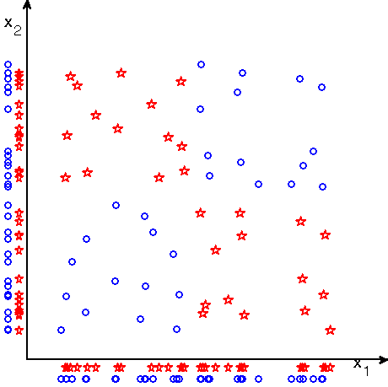
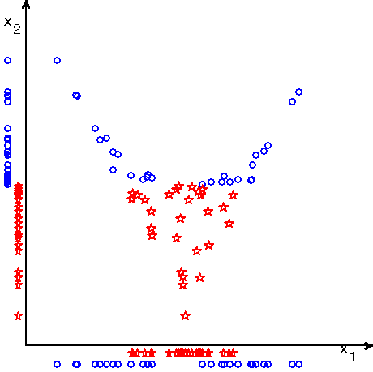
Chessboard problem
Φ(x)
φ₁(x) = x₁ x₂
0
φ₂(x) = x₁+x₂

Slide 27
Kernel Method
Potential functions, Aizerman et al 1964
x₁
k(x¹,x)
α₁
x₂
k(x²,x)
α₂
Σ
α_{N}
x_{n}
k(x^{N},x)
b
f(x) = Σ_{k} α_{k} k(x^{k}, x) + b
1
k(. ,. ) is a similarity measure or “kernel”.

Slide 28
Radial basis functions
f(x) = Σ_{k} α_{k} k(x^{k}, x) + b
x₂
x₂
x₁
x₁

Slide 29
What is a Kernel?
A kernel is:
a similarity measure
a dot product in some feature space:
k(s, t) = Φ(s) • Φ(t)
But we do not need to know the Φ representation.
k(s, t) = exp(-ǁs-tǁ²/σ²) Gaussian kernel
k(s, t) = 1/ǁs-tǁ Potential function
k(s, t) = (s • t)^{q} Polynomial kernel
([s₁,s₂]•[t₁,t₂])² = [s₁²,s₂²,√2s₁s₂] .[t₁²,t₂²,√2t₁t₂]
k(s, t)
Φ(s)
Φ(t)

Slide 30
What is a Kernel?
A kernel is:
a similarity measure
a dot product in some feature space:
k(s, t) = Φ(s) • Φ(t)
But we do not need to know the Φ representation.
k(s, t) = exp(-ǁs-tǁ²/σ²) Gaussian kernel
k(s, t) = 1/ǁs-tǁ Potential function
k(s, t) = (s • t)^{q} Polynomial kernel
([s₁,s₂]•[t₁,t₂])² = [s₁²,s₂²,√2s₁s₂] .[t₁²,t₂²,√2t₁t₂]
k(s, t)
Φ(s)
Φ(t)

Slide 31
What is a Kernel?
A kernel is:
a similarity measure
a dot product in some feature space:
k(s, t) = Φ(s) • Φ(t)
But we do not need to know the Φ representation.
k(s, t) = exp(-ǁs-tǁ²/σ²) Gaussian kernel
k(s, t) = 1/ǁs-tǁ Potential function
k(s, t) = (s • t)^{q} Polynomial kernel
([s₁,s₂]•[t₁,t₂])² = [s₁²,s₂²,√2s₁s₂] .[t₁²,t₂²,√2t₁t₂]
k(s, t)
Φ(s)
Φ(t)

Slide 32
What is a Kernel?
A kernel is:
a similarity measure
a dot product in some feature space:
k(s, t) = Φ(s) • Φ(t)
But we do not need to know the Φ representation.
k(s, t) = exp(-ǁs-tǁ²/σ²) Gaussian kernel
k(s, t) = 1/ǁs-tǁ Potential function
k(s, t) = (s • t + 1)^{q} Polynomial kernel
([s₁,s₂]•[t₁,t₂])² = [s₁²,s₂²,√2s₁s₂] .[t₁²,t₂²,√2t₁t₂]
k(s, t)
Φ(s)
Φ(t)

Slide 33
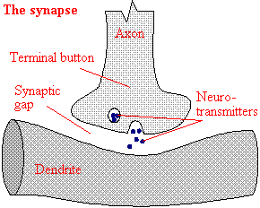
Hebb’s Rule
D. Hebb, 1949
w_{i} ← w_{i} + y^{k} x^{k}_{i}
Activation of another neuron
x_{i}
w_{i}
y
Σ
Axon
Dendrite
Synapse

Slide 34
Hebb’s Rule
D. Hebb, 1949
w ← w + y^{k} x^{k}
Activation of another neuron
x_{i}
w_{i}
y
Σ
Axon
Dendrite
Synapse

Slide 35
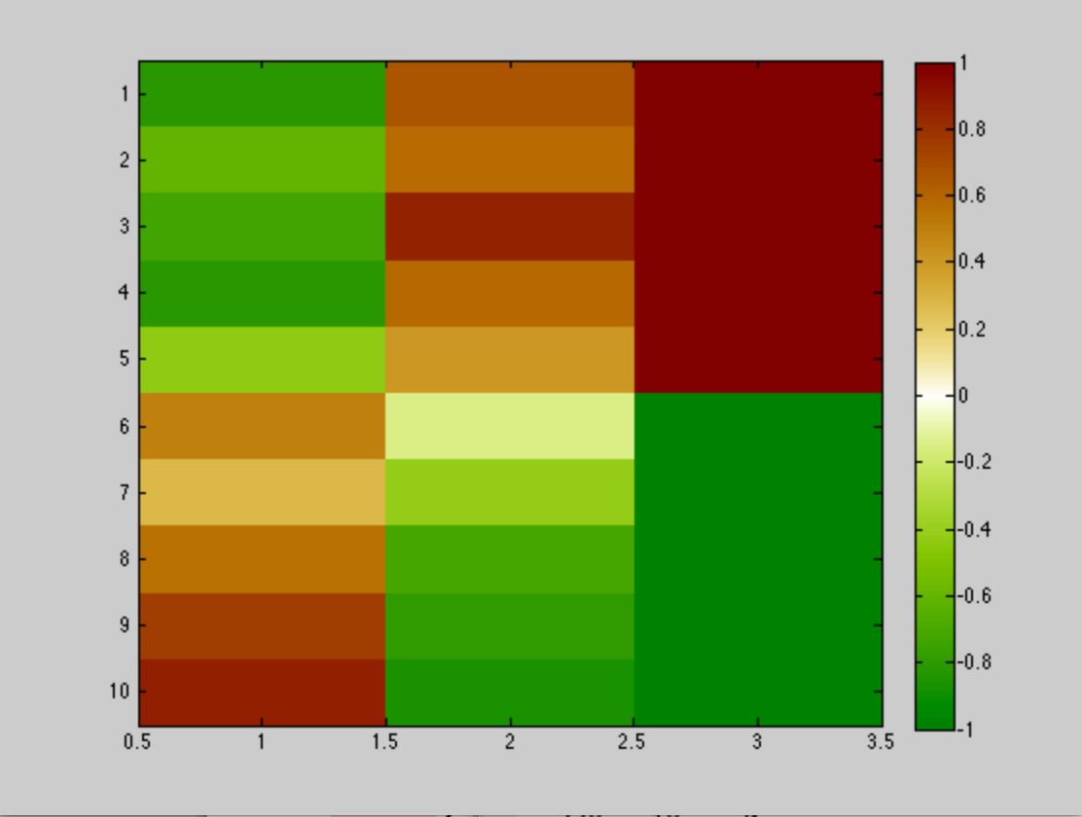





Hebb’s rule
ink elongation Y
w_{i} ← w_{i} + y^{k} x^{k}_{i}
w_{i} = Σ_{k} y^{k} x^{k}_{i} = y • x_{i}
w = Σ_{k} y^{k} x^{k}
f(x) = w • x
= Σ_{i} w_{i} x_{i}
= Σ_{k} y^{k} x^{k}• x
~ w^{[1]} • x - w^{[0]} • x
w_{ink}
w_{elongation}

Slide 36
Hebb’s rule
ink elongation Y
w_{i} ← w_{i} + y^{k} x^{k}_{i}
w_{i} = Σ_{k} y^{k} x^{k}_{i} = y • x_{i}
w = Σ_{k} y^{k} x^{k}
f(x) = w • x
= Σ_{i} w_{i} x_{i}
= Σ_{k} y^{k} x^{k}• x
~ w^{[1]} • x - w^{[0]} • x
PARAMETRIC
NON
PARAMETRIC
w_{ink}
w_{elongation}

Slide 37
Kernel “Trick” (for Hebb’s rule)
w = Σ_{k} y^{k} x^{k}
Hebb’s rule for the Perceptron:
w = Σ_{k} y^{k} Φ(x_{k})
f(x) = w • Φ(x) = Σ_{k} y^{k} Φ(x_{k}) • Φ(x)
Define a dot product:
k(x_{i}, x) = Φ(x_{i}) • Φ(x)
f(x) = Σ_{i} y_{i} k(x_{i}, x)

Slide 38
Kernel “Trick” (for Hebb’s rule)
w = Σ_{k} y^{k} x^{k}
Hebb’s rule for the Perceptron:
w = Σ_{k} y^{k} Φ(x_{k})
f(x) = w • Φ(x) = Σ_{k} y^{k} Φ(x_{k}) • Φ(x)
Define a dot product:
k(x_{i}, x) = Φ(x_{i}) • Φ(x)
f(x) = Σ_{i} y_{i} k(x_{i}, x)
PARAMETRIC
NON
PARAMETRIC

Slide 39
Kernel “Trick” (general)
f(x) = Σ_{k} α_{k} k(x^{k}, x)
k(x^{k}, x) = Φ(x^{k}) • Φ(x)
f(x) = w • Φ(x)
w = Σ_{k} α_{k} Φ(x^{k})
NON
PARAMETRIC
Dual forms
PARAMETRIC

Slide 40
Dual learning machines
PARAMETRIC
NON PARAMETRIC
f(x) = Σ α_{k} k(x^{k}, x)
k(x^{k}, x) = Φ(x^{k}).Φ(x)
Dual Hebb’s rule
α_{k} ← α_{k} + y_{k}
Potential Function algorithm
α_{k} ← α_{k} + y_{k} if y_{k}f(x^{k})<0
(Aizerman et al 1964)
Dual minover
α_{k} ← α_{k}+ y^{k} for min y_{k}f(x^{k})
f(x) = w • Φ(x)
Hebb’s rule
w ← w + y_{k} Φ(x^{k})
(Hebb 1949)
Perceptron algorithm
w ← w + y_{k} Φ(x^{k}) if y_{k}f(x^{k})<0
(Rosenblatt 1958)
Minover (optimum margin)
w ← w + y_{k} Φ(x^{k}) for min y^{k}f(x^{k})
(Krauth-Mézard 1987)
w = Σ α_{k} Φ(x^{k})
k
k
(ancestor of SVM)

Slide 41
Fit / Robustness Tradeoff
x₂
x₂
x₁
x₁
Notes:
Which one is best : linear or non-linear
The decision comes when we see new data
Very often the simplest model is better
This principle is implemented in Learning Theory

Slide 42
Fit / Robustness Tradeoff
x₂
x₂
x₁
x₁
Notes:
Which one is best : linear or non-linear
The decision comes when we see new data
Very often the simplest model is better
This principle is implemented in Learning Theory

Slide 43
Summary
With linear threshold units (“neurons”) we can build:
Linear discriminant
Kernel methods
Neural networks
The architectural hyper-parameters may include:
The choice of basis functions φ (features)
The kernel
The number of hidden units.
“Complex” models are prone to overfitting.
DUAL

Slide 44
Summary
With linear threshold units (“neurons”) we can build:
Linear discriminant
Kernel methods
Neural networks
The architectural hyper-parameters may include:
The choice of basis functions φ (features)
The kernel
The number of hidden units.
“Complex” models are prone to overfitting.
PARAMETRIC
DUAL
NON PARAMETRIC

Slide 45
Summary
With linear threshold units (“neurons”) we can build:
Linear discriminant
Kernel methods
Neural networks
The architectural hyper-parameters may include:
The choice of basis functions φ (features)
The kernel
The number of hidden units.
“Complex” models are prone to overfitting.
PARAMETRIC
DUAL
NON PARAMETRIC

Slide 46
Summary
With linear threshold units (“neurons”) we can build:
Linear discriminant
Kernel methods
Neural networks
The architectural hyper-parameters may include:
The choice of basis functions φ (features)
The kernel
The number of hidden units.
“Complex” models are prone to overfitting.
PARAMETRIC
DUAL
NON PARAMETRIC
Control the COMPLEXITY

Slide 47
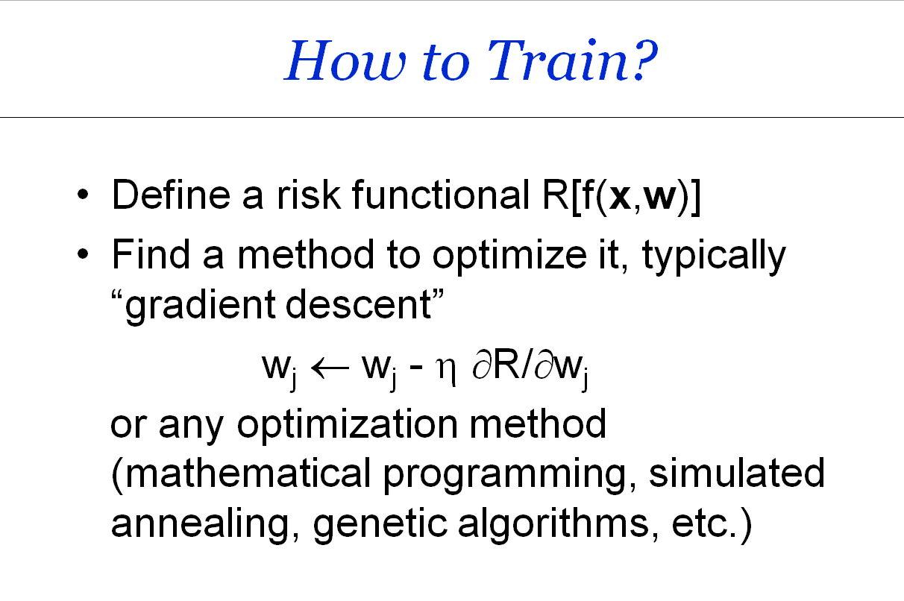
Come to my office hours… Wed 2:30-4:30 Soda 329
Next time

