Slide 1
LSTM

Slide 2
Shap
Import shap
explainer = shap.DeepExplainer(model, X_train)
shap_values = explainer.shap_values(X_test)
shap.initjs()
shap.force_plot(explainer.expected_value[0], shap_values[0][0], features)

Slide 3
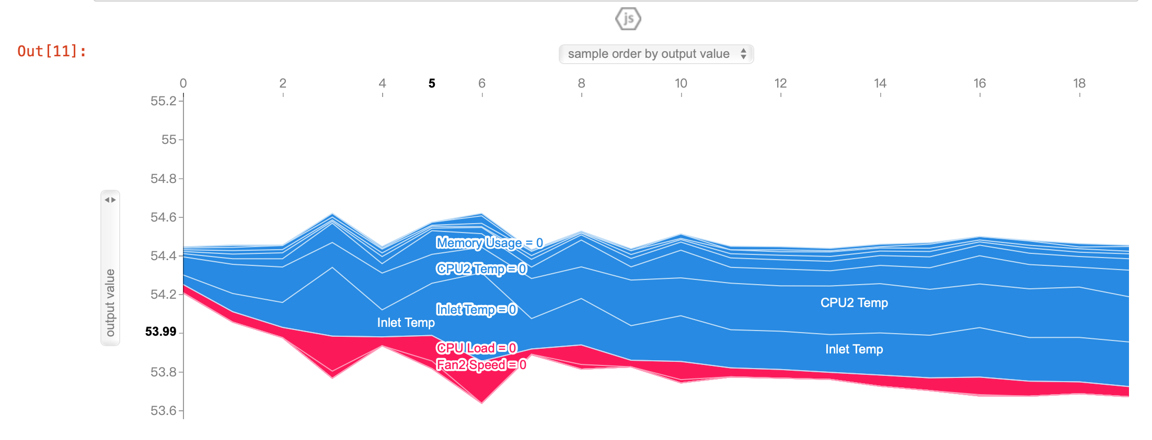
SHAP value

Slide 4
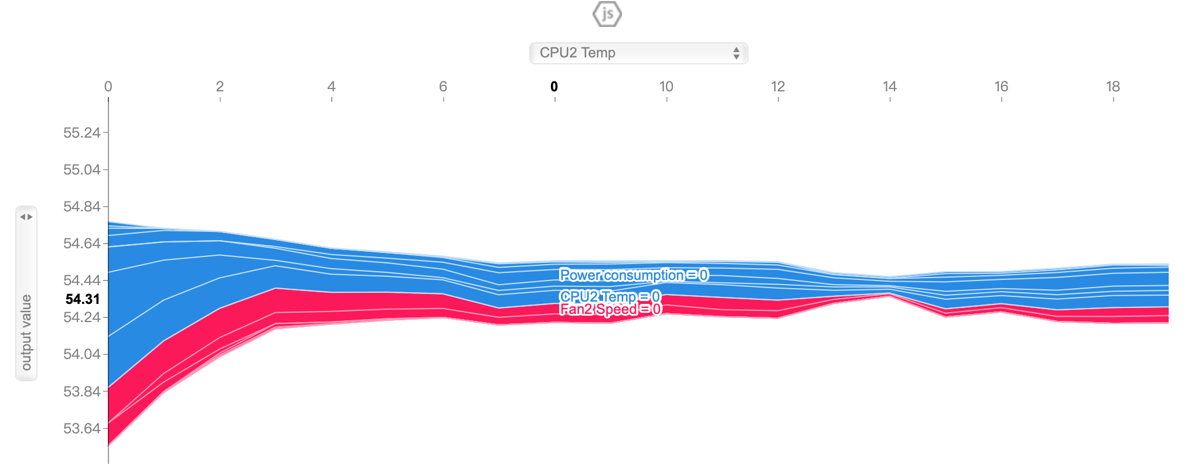
SHAP value

Slide 5
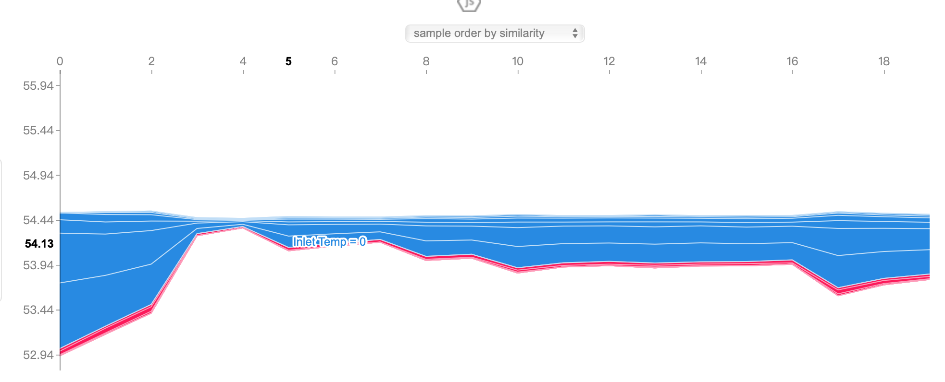
SHAP value

Slide 6
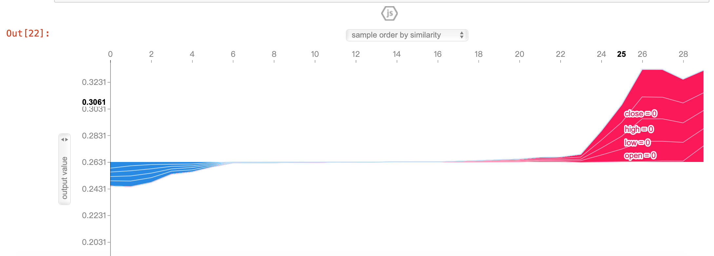
SHAP fin

Slide 7
try
https://blog.csdn.net/Li_yi_chao/article/details/105577642
https://github.com/heytitle/thesis-designing-recurrent-neural-networks-for-explainability

