Slide 1
Wafer map classification

Slide 2
Outline
Resize all photo without data augmentation
Resize all photo with data augmentation

Slide 3
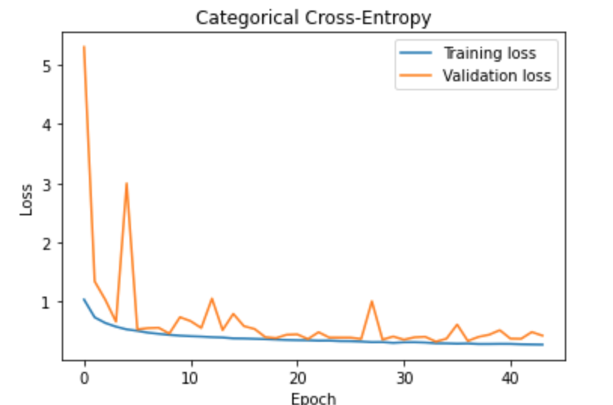
Resize all photo without data augmentation loss
loss: 0.2777 - accuracy: 0.8951 - val_loss: 0.4301 - val_accuracy: 0.8572

Slide 4
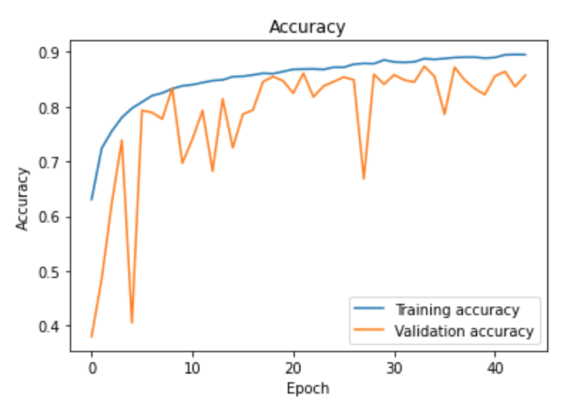
Acc

Slide 5
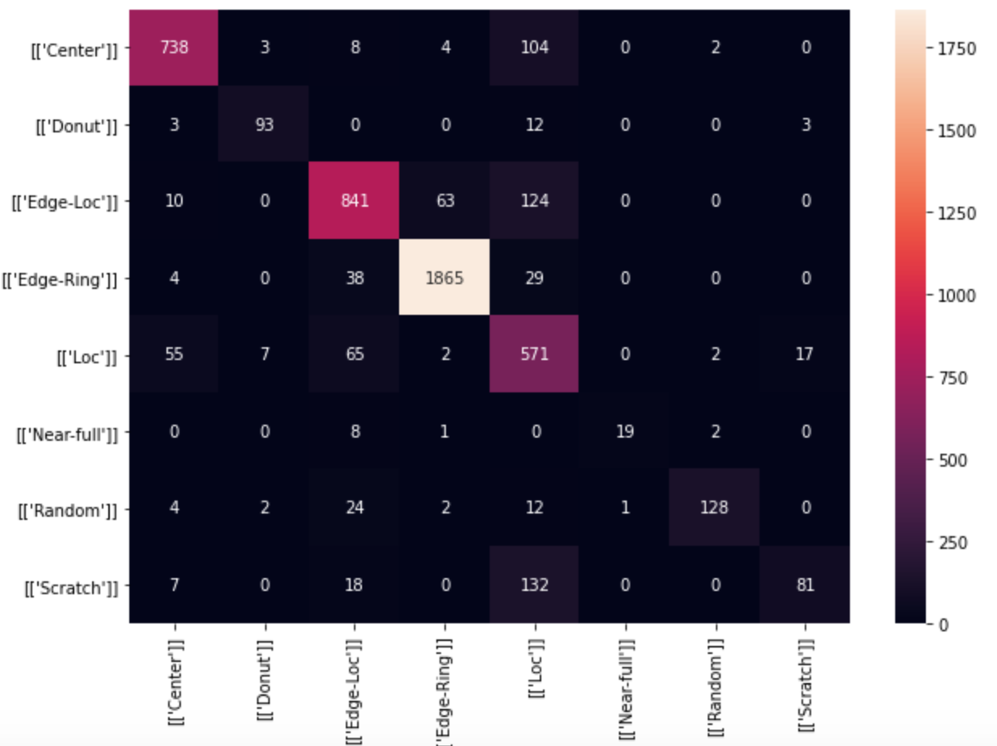
Test,CM 0.84

Slide 6
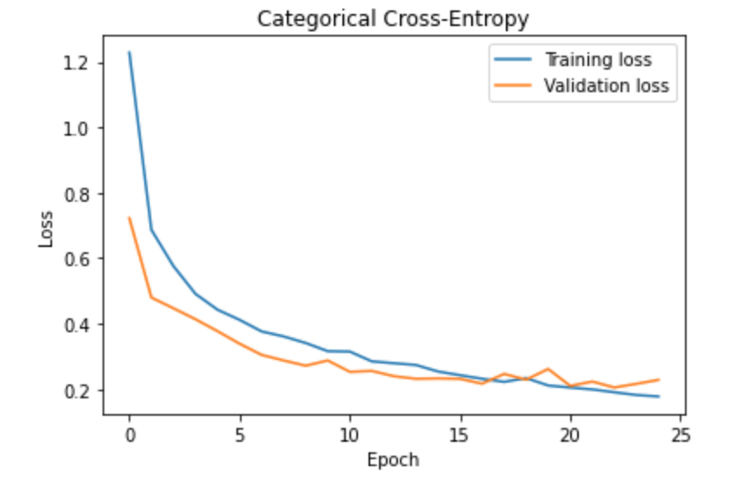
Resize all photo with data augmentation Loss (test 0.2 vali 0.2)

Slide 7
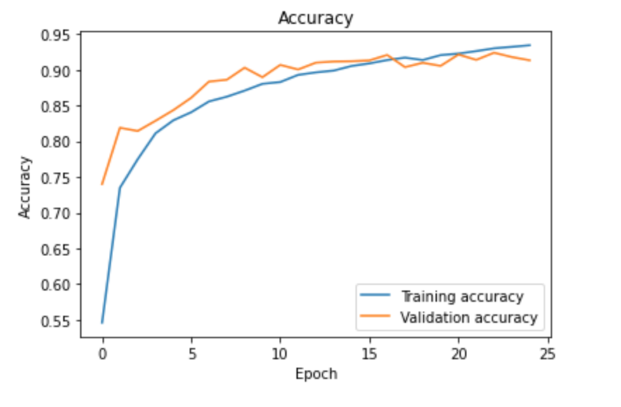
Acc

Slide 8
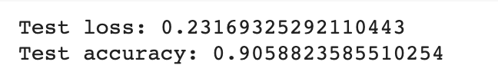
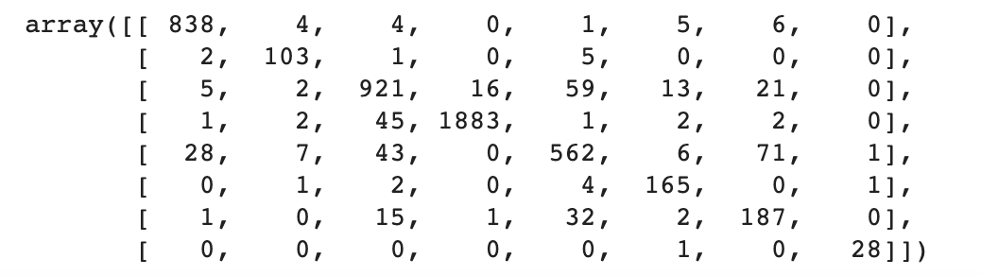
Test,CM 0.90

Slide 9
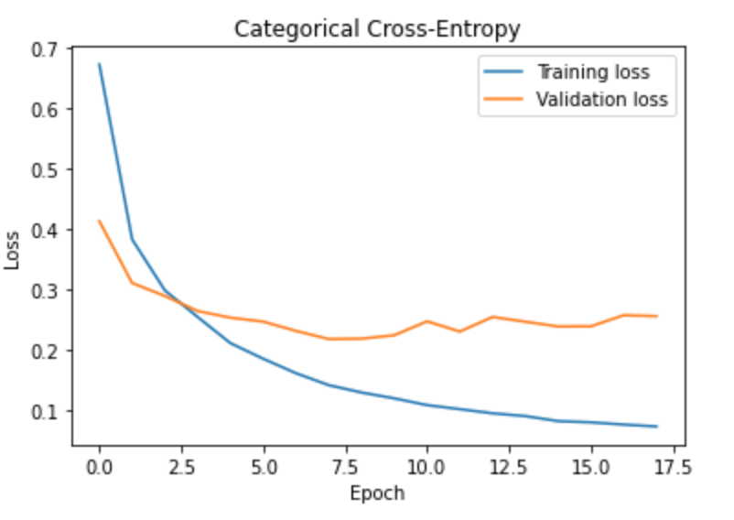
Resize all photo with data augmentation Loss (test 0.25 vali 0.15)

Slide 10
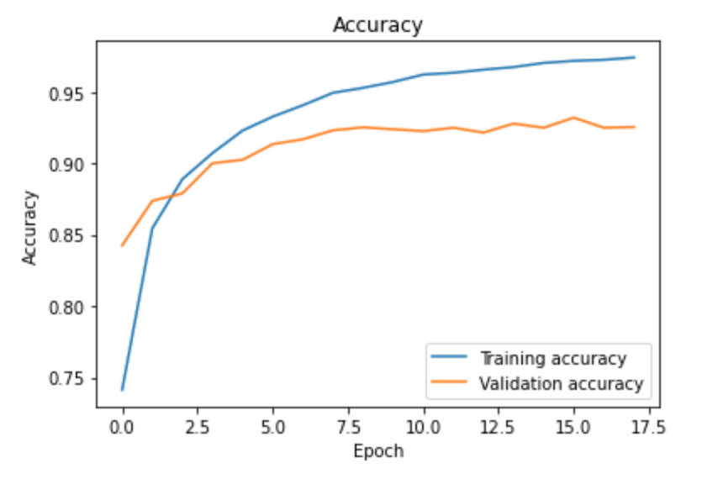
ACC

Slide 11
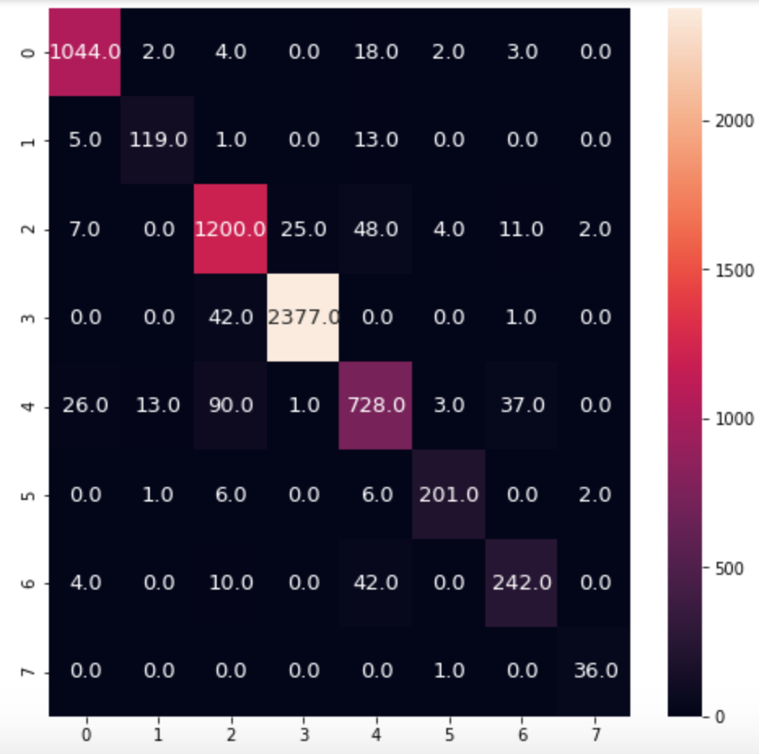

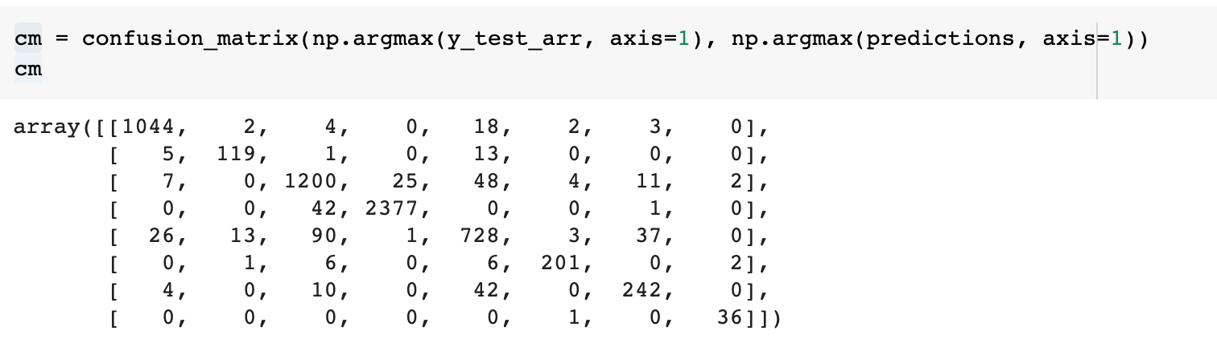
Test

Slide 12
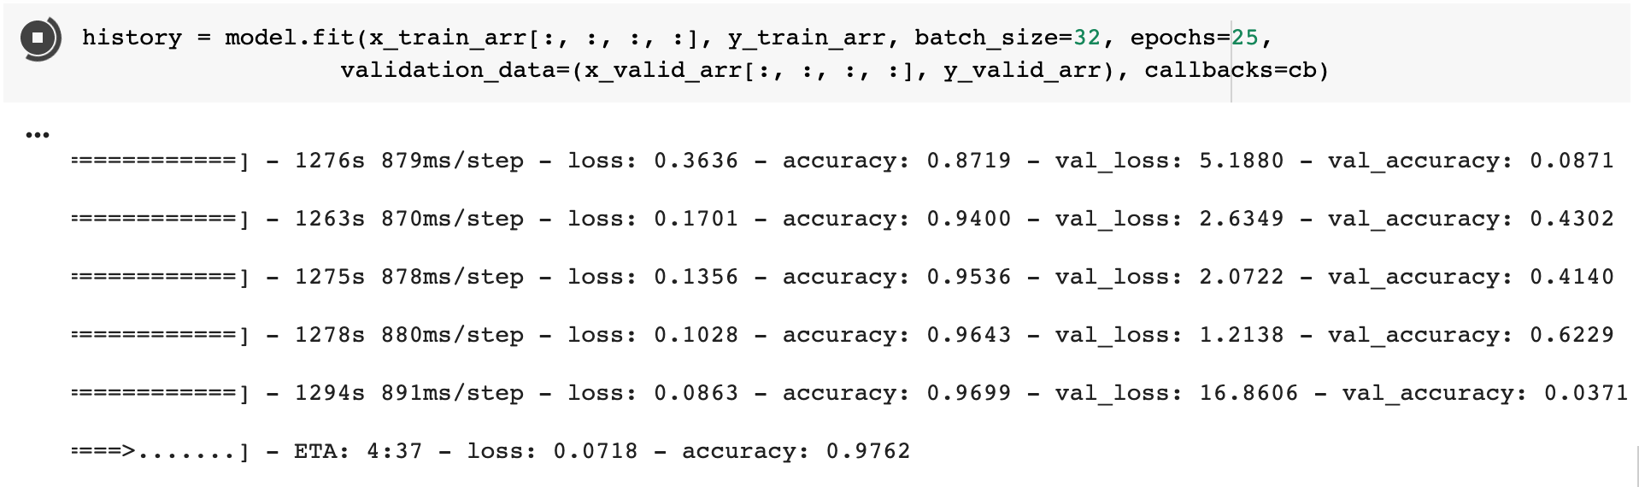
EfficientNet
GPU只跑的動這個size而且由於圖片過小跑太深的模型反而overfitting

Slide 13
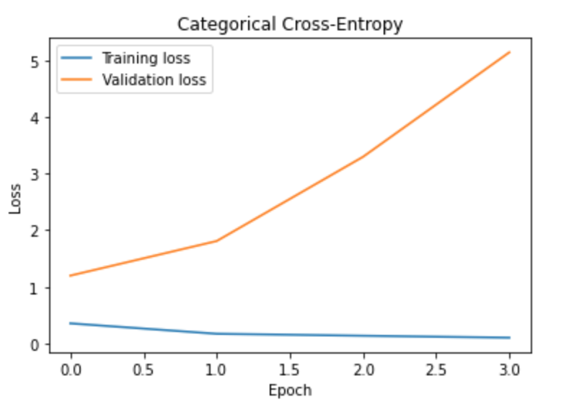
EfficientNet

Slide 14
問題
Small image
Super resolution
Data augmentation
By pattern generate

