Slide 1
ggplot2 Introduction
Notes:
Hi everyone, so today I am going to show you some basic concepts about ggplot2 and I will pick up some section to demonstrate the plots as well.
I also made a markdown which I uploaded yesterday in the discussion. If you are interested in the packages, I highly recommend you to go through the codes and even make some changes to it.
So let’s get started.

Slide 2
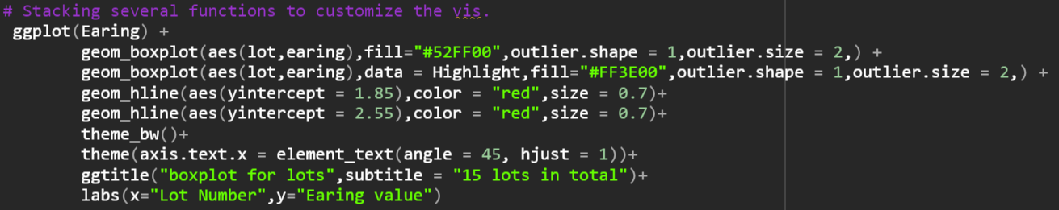
ggplot2 - Background
an open-source data visualization package for R
an implementation of Leland Wilkinson’s Grammar of Graphics
which breaks up graphs into semantic components such as scales and layers.
It’s the foundation of Tableau and Vega-Lite.
Coding woulde be like:
Notes:
Ggplot 2 is actually an inplemetation of a book called grammar of graphics which divides a graph into several elements such as data, scale, coordinate .
With that being said, the coding would be like stacking different layers together
Just like code I paste here. You can add the elements you want piece by piece.
Ggplot2 is also the foundation of tableau and vega-lite which are both powerful tools when it comes to data visualization.

Slide 3
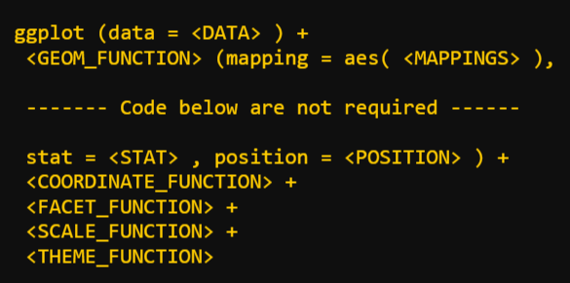
ggplot2 - Components
Required
Data
Mapping(Aesthetic)
Geometries
Not required
Statistic
Scale
Facets
Coordinates
Theme
Notes:
To create a chart, the essential elements include data frame, mapping variables and geometry.
Data is the DF you’re going to use,
and the mapping, also called aesthetic, usually indicates the x and y axis, it can also used to control the color, shape and the size. We will talk about it later.
And for the geometry it’s about the type of graphics you are going to visualize. Like scatter plot or histogram
And the elements below are not required to produce a basic chart, but with those functions, you can make your chart more elegant and easier to analyze.

Slide 4
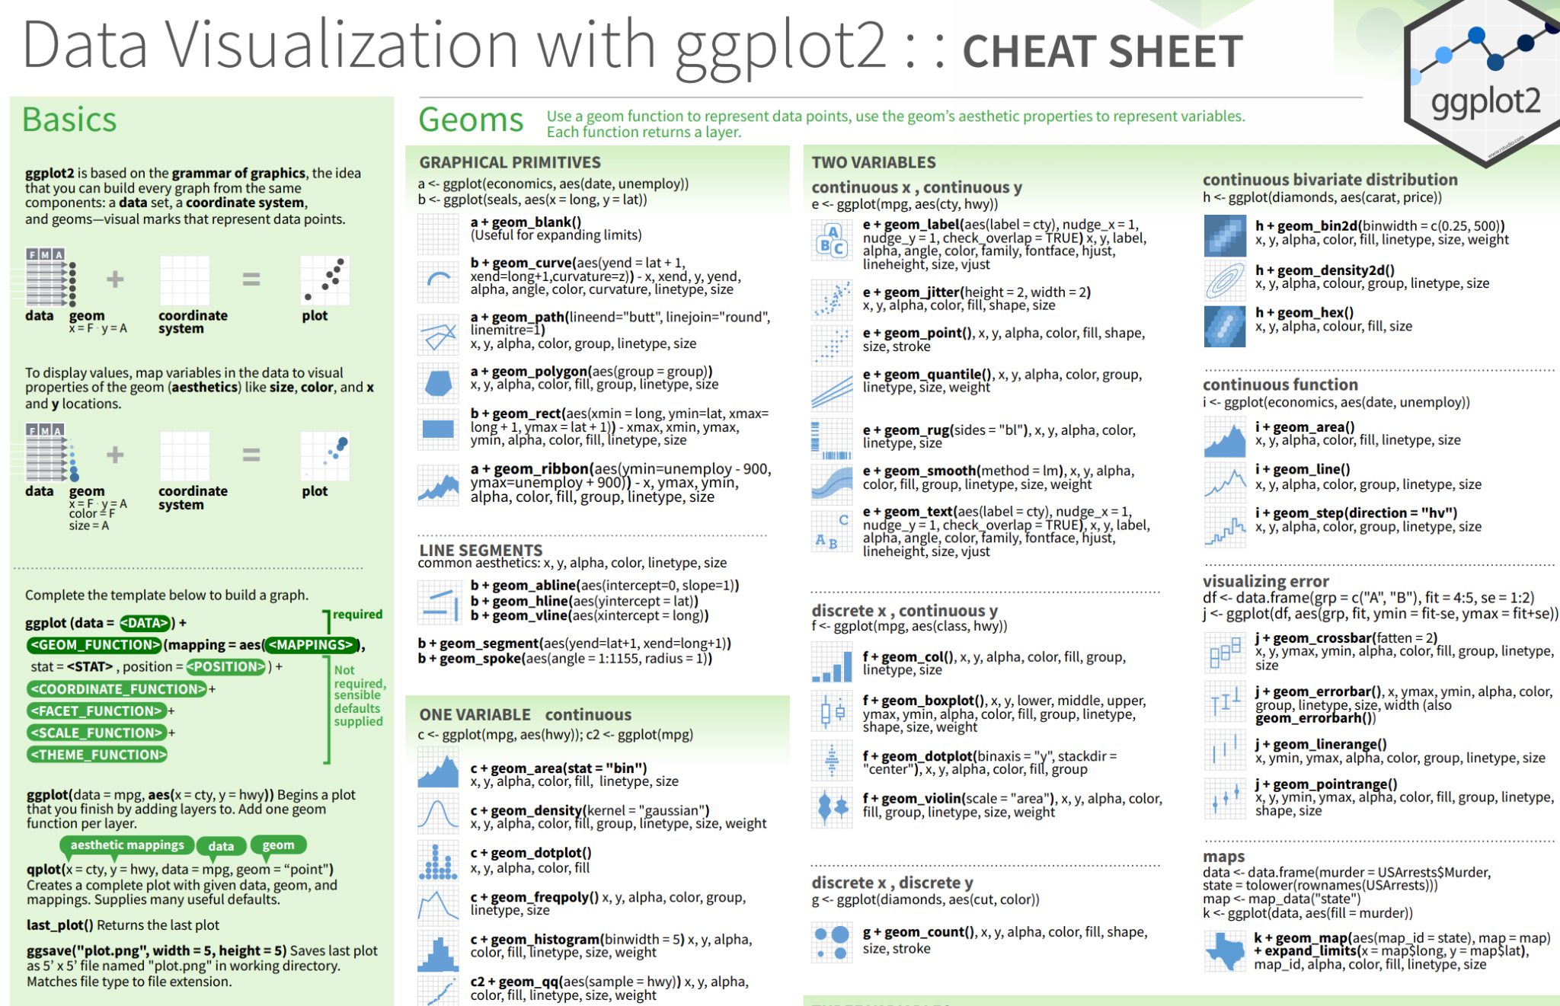
ggplot2 - Cheatsheet
RStudio Cheatsheets - RStudio
Include some basic command
Choose geometry according to the data type.
Notes:
Before we really make our hands dirty, I would like to introduce the cheatsheet to you, which you can find it on this website.
It contains most common used function in the package, and it also shows the type of geometries as well.
What I would usually do is to first define the type of the variable, and come back to sheet to find the most proper graphic to use.

Slide 5
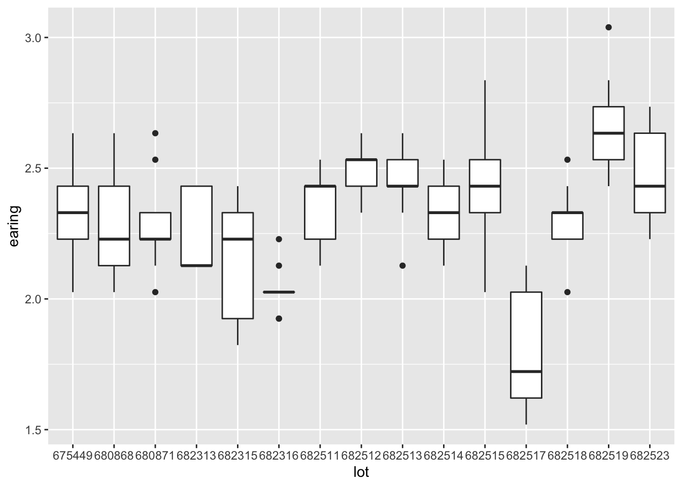
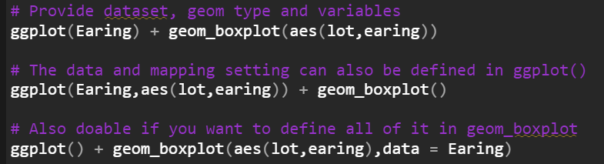
Basic plot - Histogram/Boxplot/Point/Jitter
Data set: Jellybeans.dat, Earing.dat
Always start with ggplot() - It will initialize the package.
It will be global if you define df and mapping in ggplot()
Notes:
In the following
I will start with some basic geometries with the data set we used in the previous homeworks.
Like I said, you only need to provide 3 elements to get a chart. So you can see that the code give me a boxplot after I put the argument in there
And btw you will always have to start with this ggplot() function which will initialize the package first.
You can put the argument in gglot() or the geometry function.
But the parameter will be global if you put it in the ggplot(), you won’t need to provide arguments again in the following layers.

Slide 6
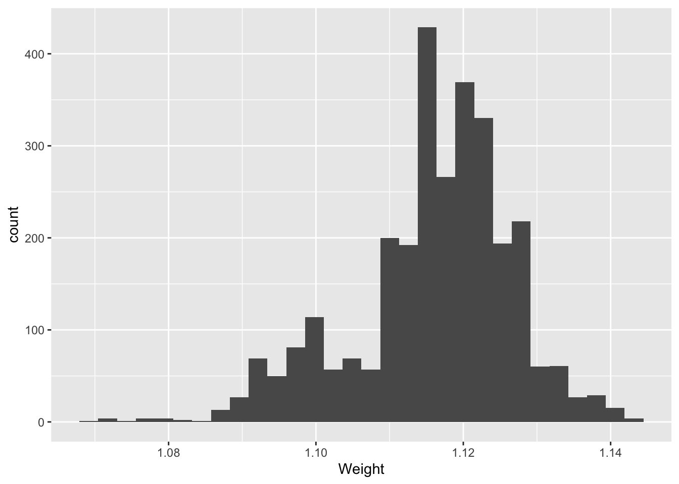
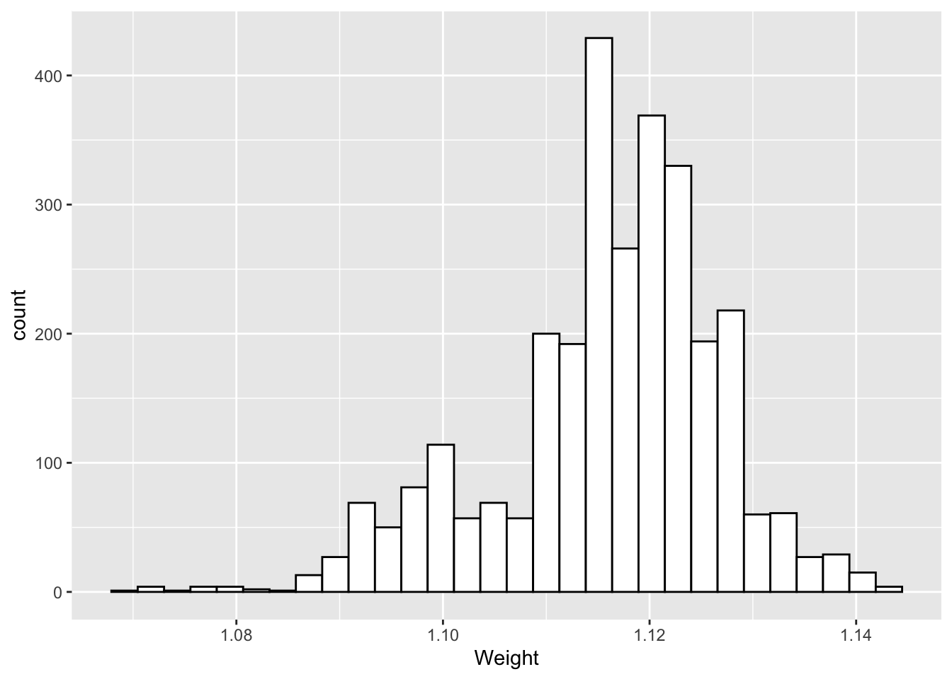
Basic plot - Histogram/Boxplot/Point/Jitter
Notes:
So this one is the example of making histogram, the default is dark grey, and I adjust the color to make it look prettier on the right .

Slide 7

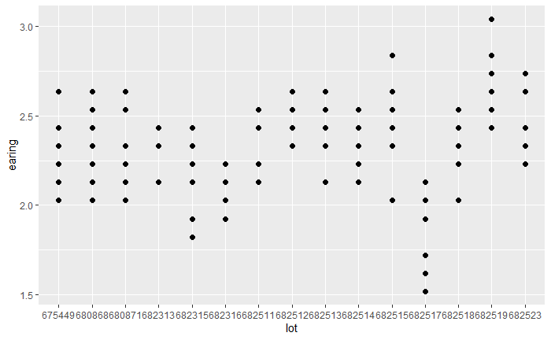
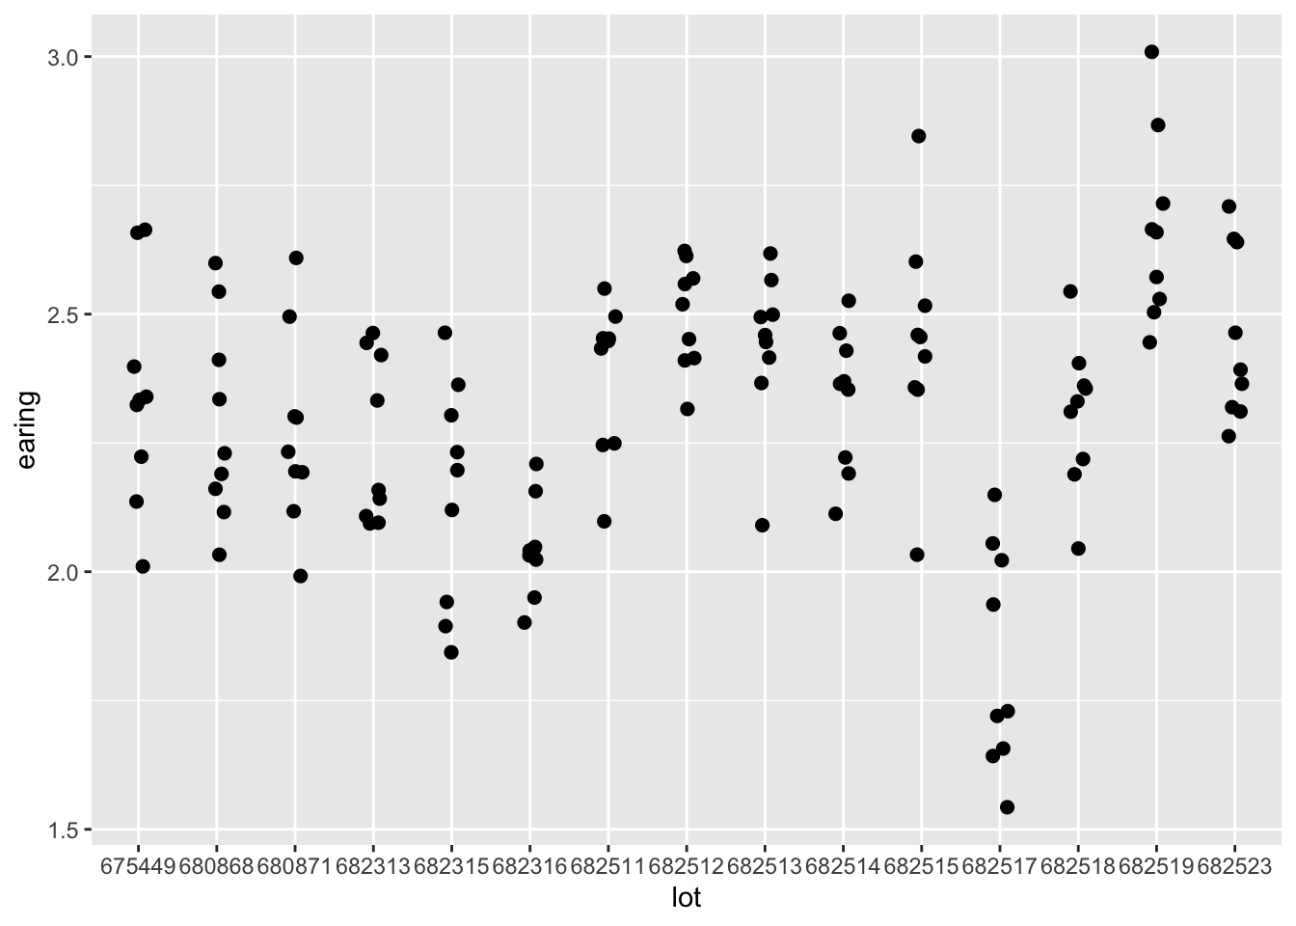
Basic plot - Histogram/Boxplot/Point/Jitter
Notes:
Pretty much the same for this one, the point and the jitter plot.
I actually like the jitter plot more when I am dealing with distribution problems., since the overlayed point would not hide, and you can see the distribution clearly.

Slide 8
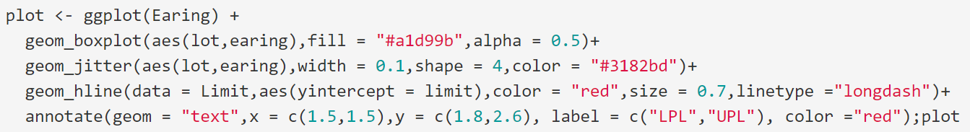
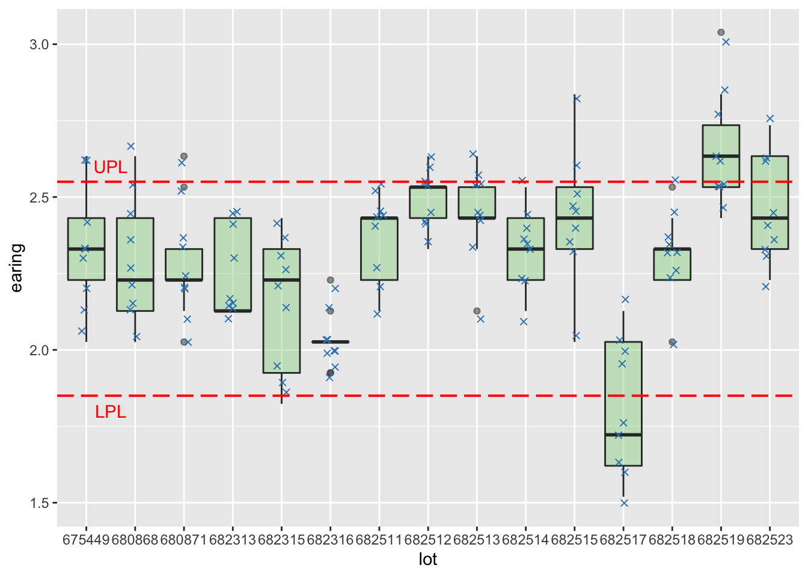
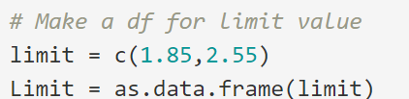
Add one plot to another with some lines and annotations
Notes:
After we get these simple charts, we can add some extra stuff to make the chart contains more information, just like we would add the UPL and LPL before.
As you can see, I stack two different geometries first and then add the limit line and annotation on the field as well.
There are a few ways to add the extra lines or annotations, you can add them one by one, or you can create a data frame which have the value of the limits and produce them at the same time.
And it’s the same with annotate function as well.

Slide 9
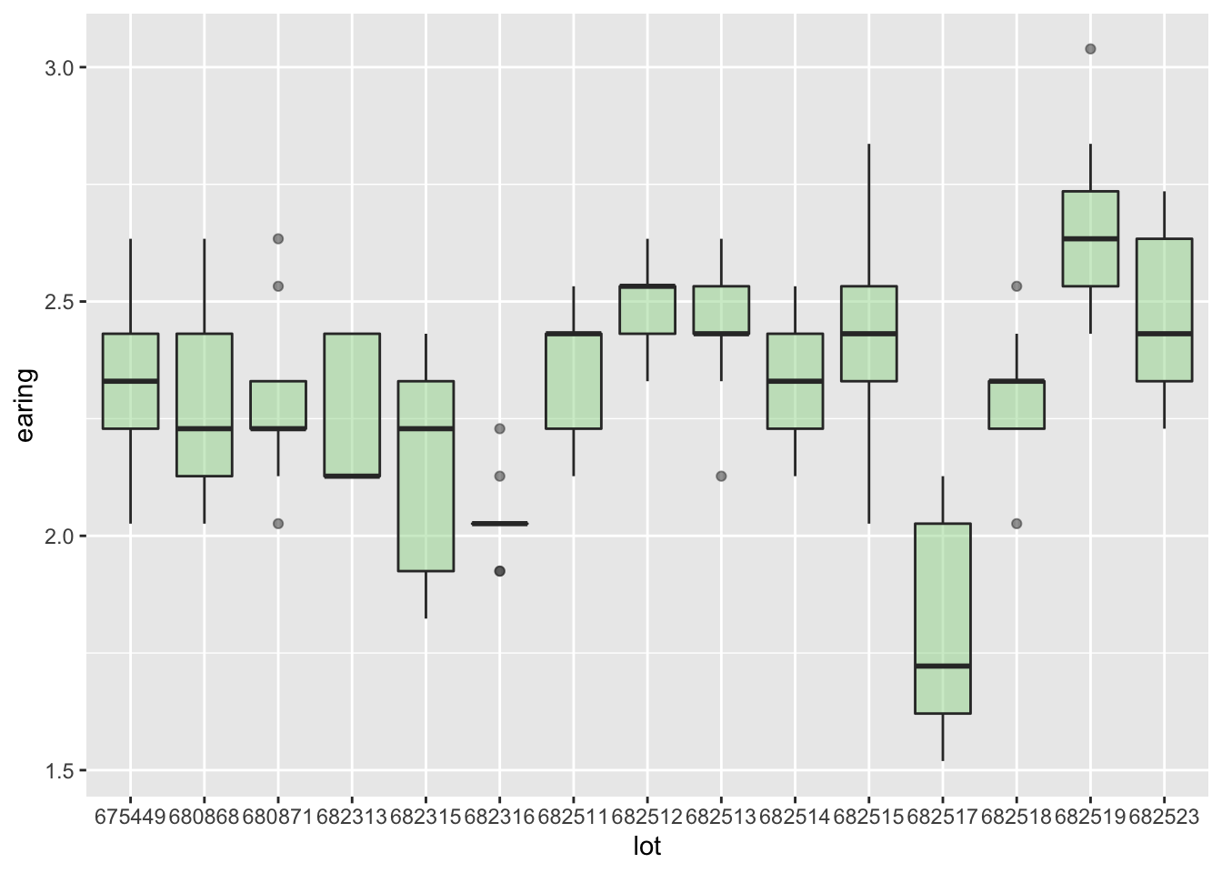
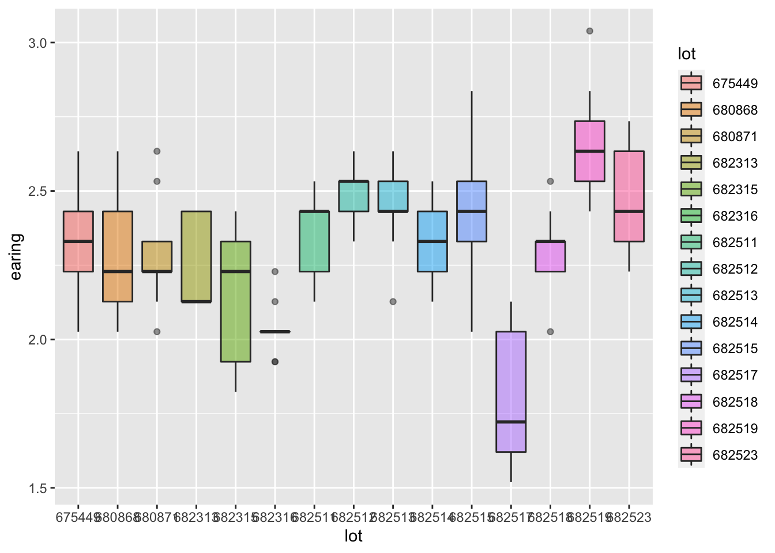
Color & Scale
ColorBrewer: Color Advice for Maps (colorbrewer2.org)
To Fill color:
Input argument in geom_func(aes(), fill = “red”)
Mapping data in aes(fill = <Variable>)
alpha controls opacity
Notes:
For the next part, we will talk about the color and the scale
And here is a website that provides lots of color sets. You can choose the palette according to your data and export the color code array and input them into code.
If you want to have color in the chart, there are two ways to do so,
The first one is to fill the color outside the aesthetic function, and another is that you can map a data within the aesthetic function.
Like these 2 examples I have here, if you input a fill outside the aesthetic function, the boxes would be all green,
But if you map a variable to fill in aesthetic function,
ggplot2 will automatically choose the color for those data. Since they are discrete data, there would be 15 colors in this case

Slide 10
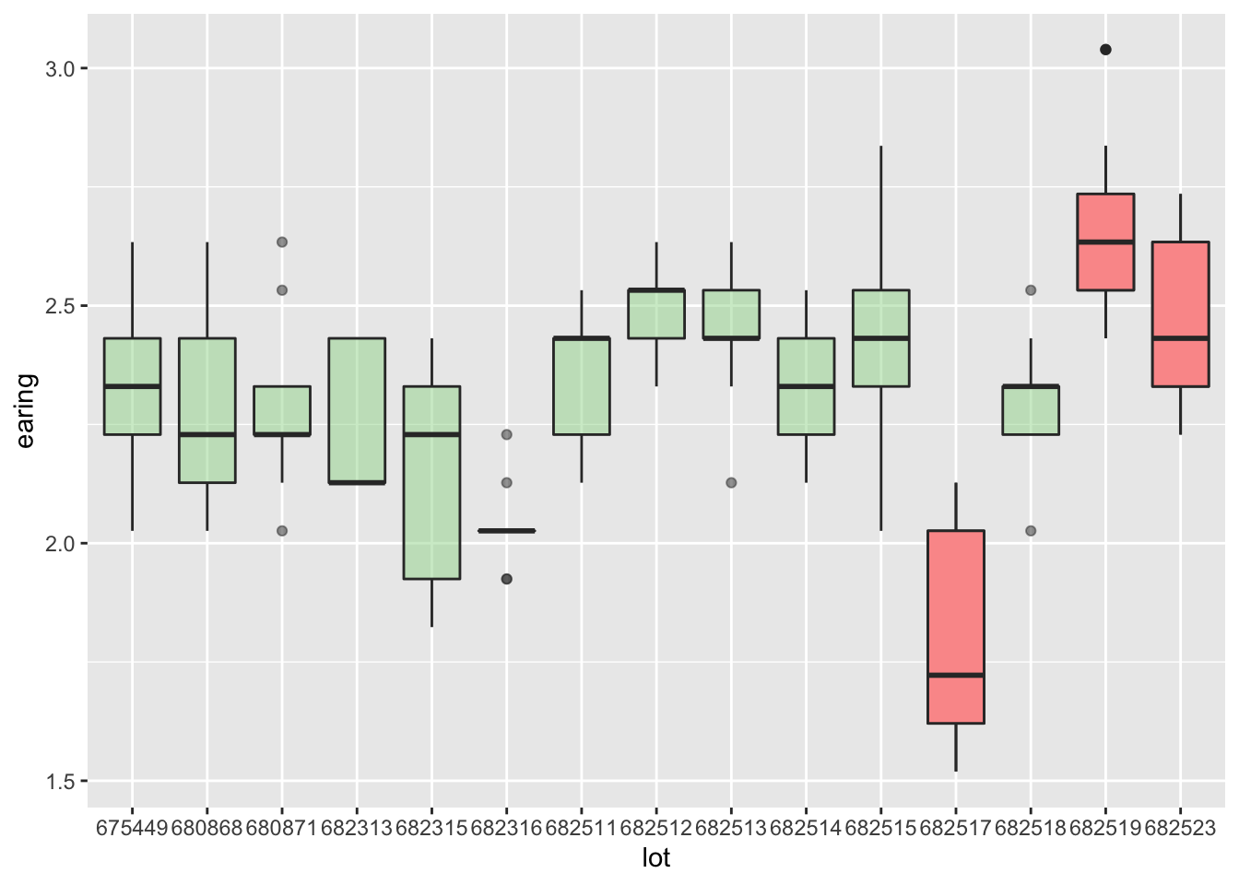
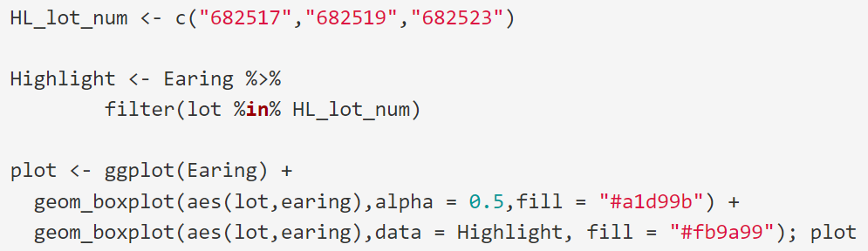
Color & Scale
Highlight with colors
Notes:
You can also use colors to highlight specific items.
What I did here is to create a new data frame of the highlight group and produce a new box plot over the old one.
And I think it’s pretty useful when you have to mark the oos items.

Slide 11
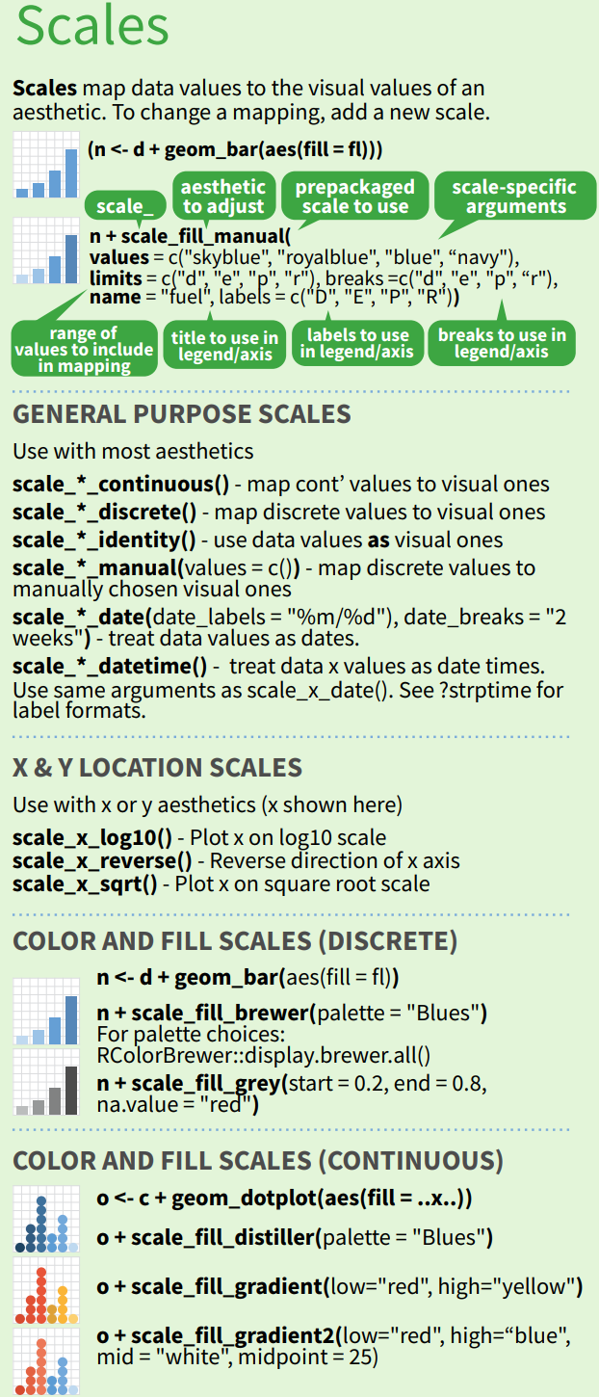
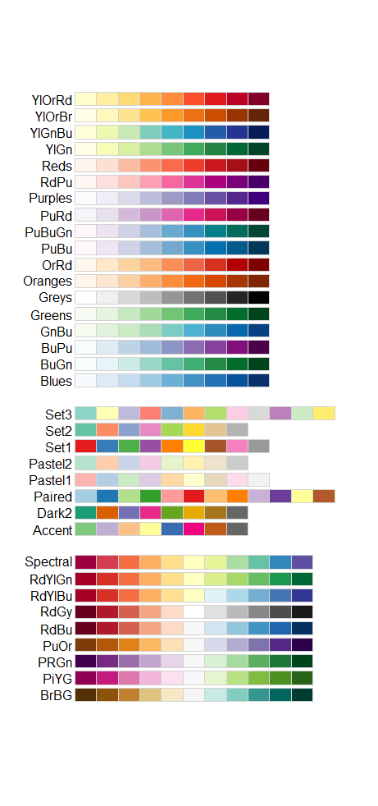
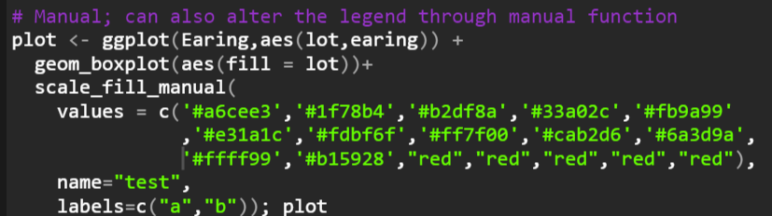
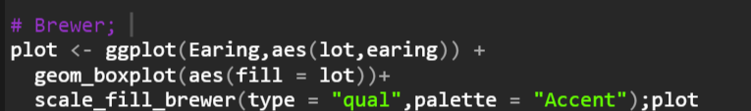
Color & Scale
Use scale_fill_brewer (palette includes in ggplot2) / scale_fill_manual to change color scale.
Notes:
Beside the methods we mentioned, we can also use scale function to alter the color and the legend as well.
scale function is usually used to add a new scale for the chart, no matter it’s color or x-y location, like you can convert your x axis into a exponential scale.
But I usually use this function to adjust the color in this class
There are many scale functions to change the color, But I will only introduce two here.
The first is scale_fill_brewer which you can use the patlette that inlcuded in ggplor2,
And another is scale_fill_manual, which you can alter the color to whatever you like, and you can also modify the name of the legend.

Slide 12
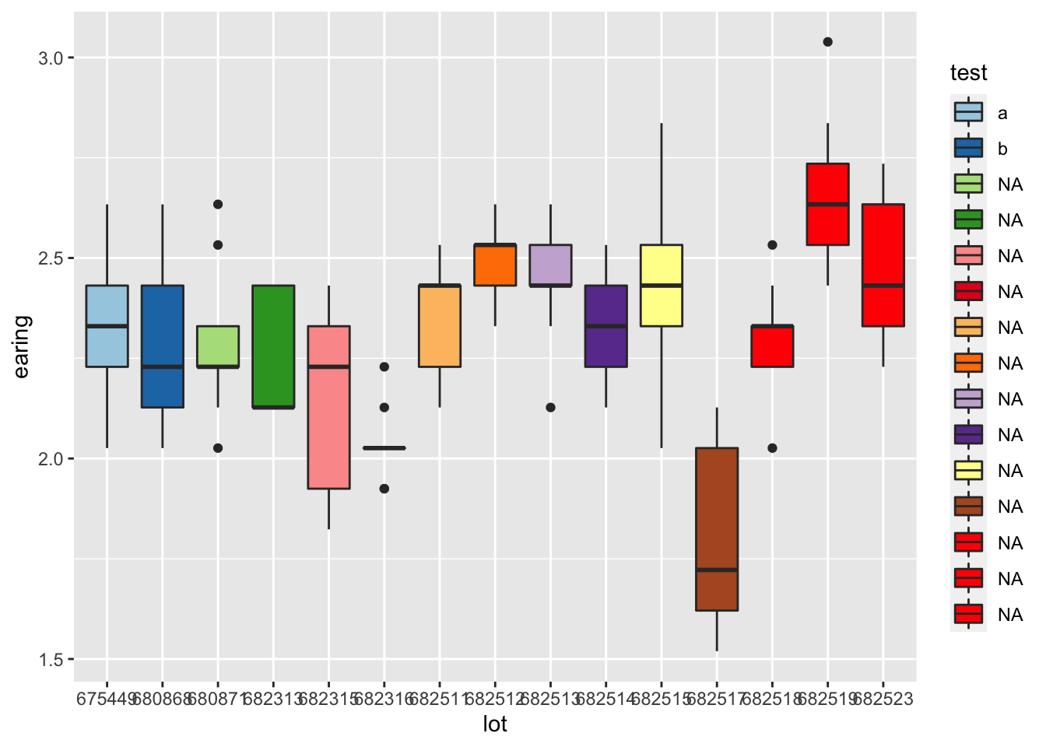
Notes:
Here I used the manual function,
so the color is exactly what I put in the function
and the name of legend and labels also changed too.

Slide 13
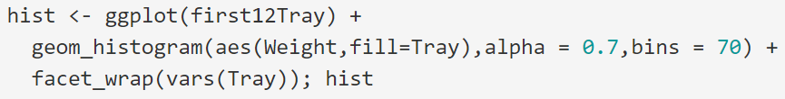
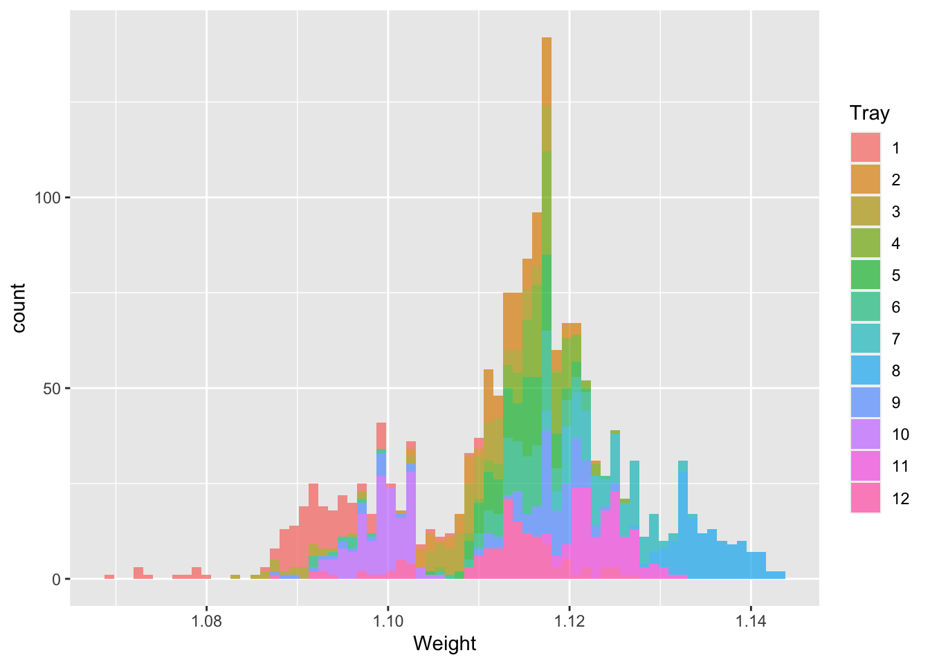
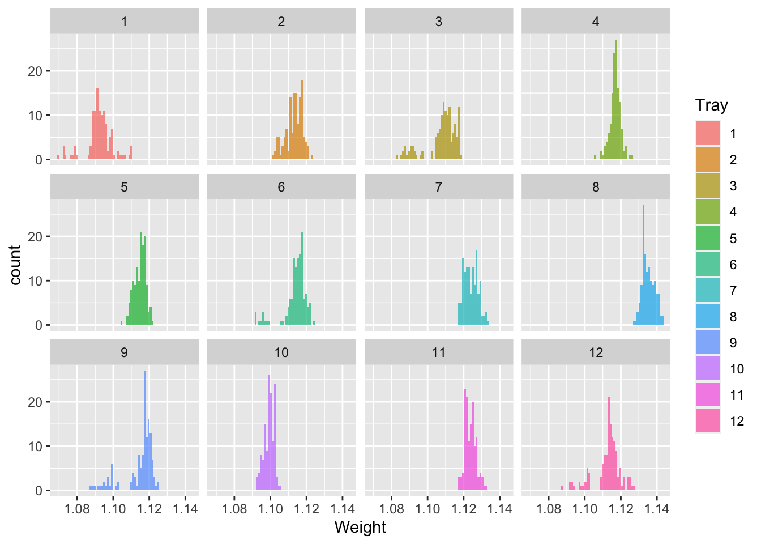
Faceting
Facets divide a plot into subplots based on the values of one or more discrete variables.
Notes:
Next we have faceting, which would divide the plot into subplots on the values of variables.
The data is from jellybeans, I filter the first 12 trays and create two plots according.
The first is the histogram that has color mapping with the Tray,
and in the second one, I used the faceting to make the histogram into 12 subplots.
Well, imo, I would say that the second one would be better if u want to compare the distribution between groups.

Slide 14
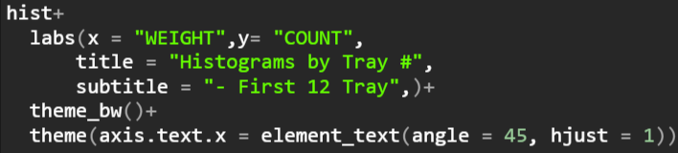
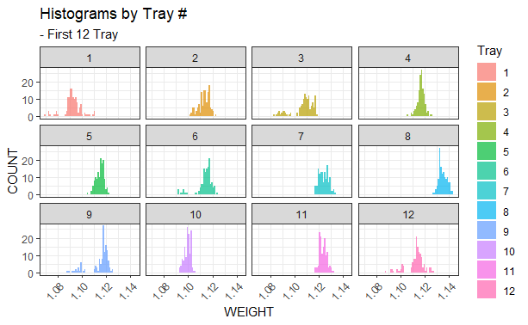
Title/Label/Theme
Notes:
The last part here for ggplot2 is some customization you can make.
Labs() function can alter the name of the axis ,and add title, subtile, and caption.
The theme function can change the background of the chart, as well as some basic setting such as the font size and type, and here I rotate the x-axis labels by 45 degrees.

Slide 15
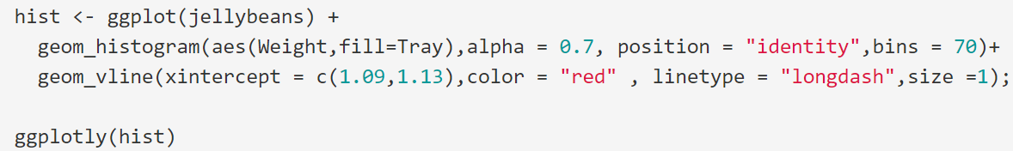
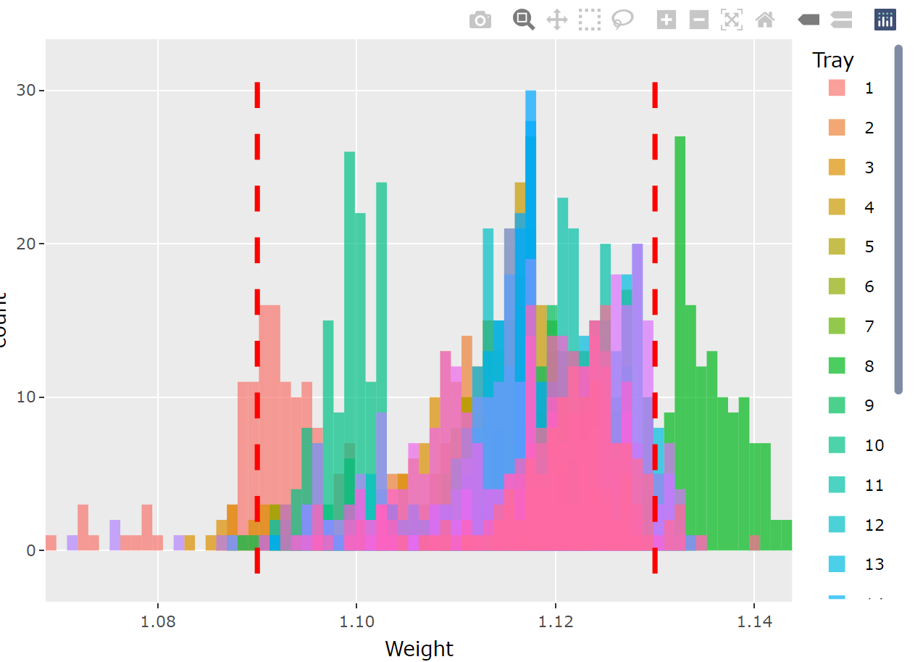
Extension packages - plotly
Add some interaction features to the plot

Slide 16
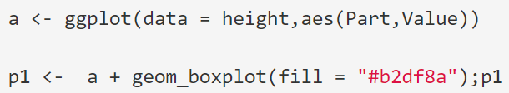
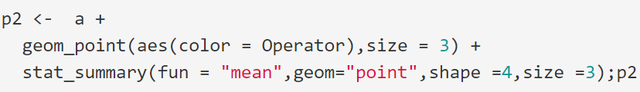
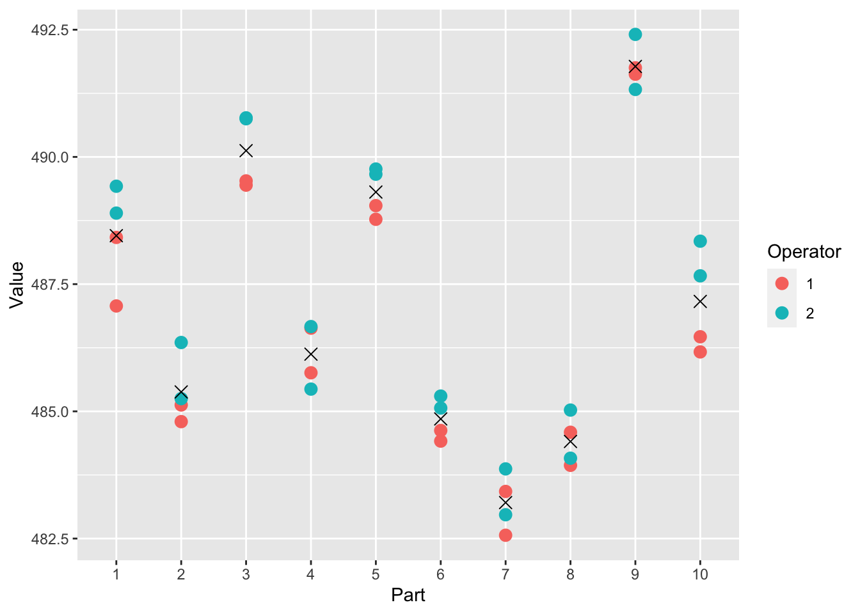

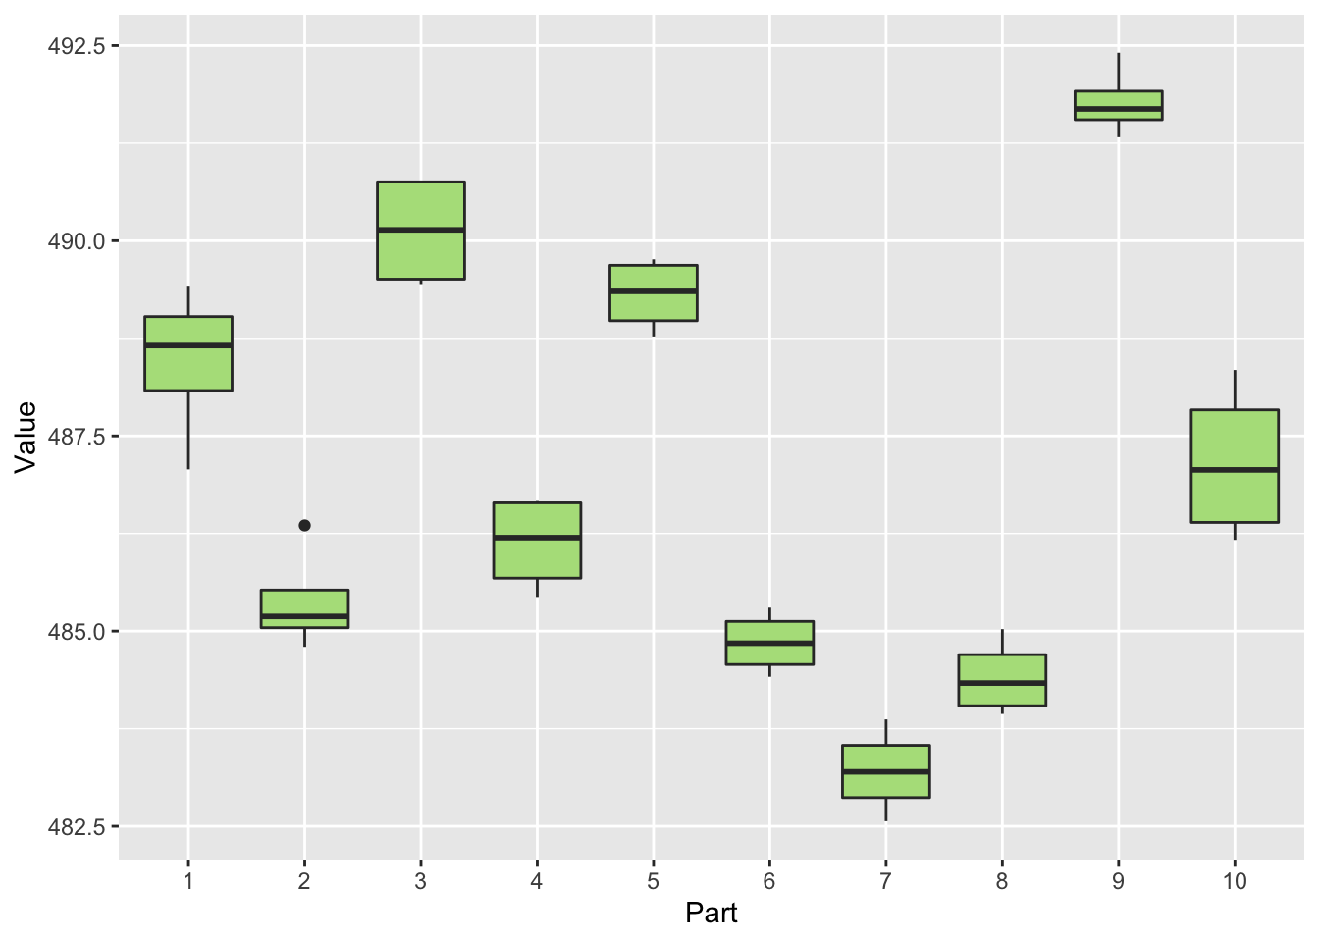
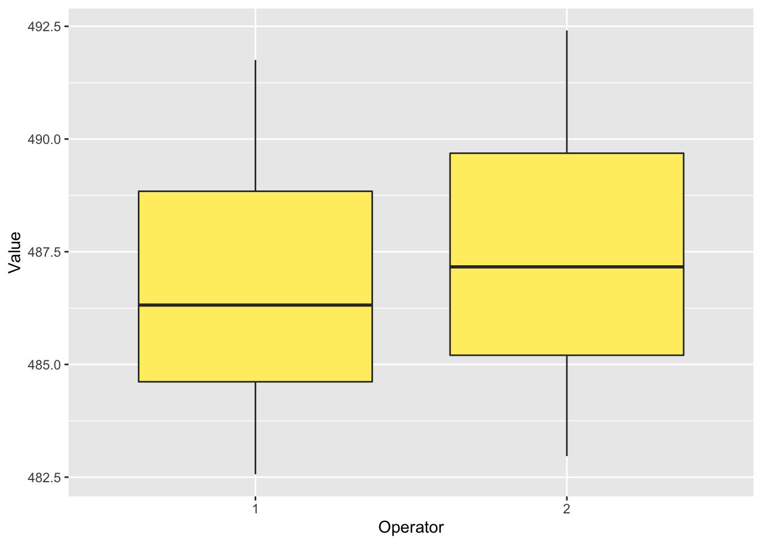
Extension packages - patchwork
Plots composition
Take visualization in Hw10 as example.
Notes:
For the last one, it’s called patchwork, which allow you to do plots compositions

Slide 17
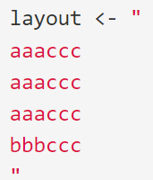

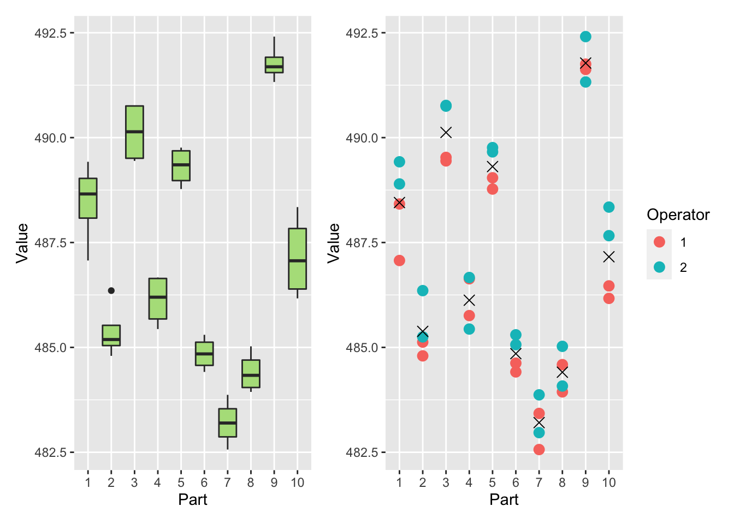
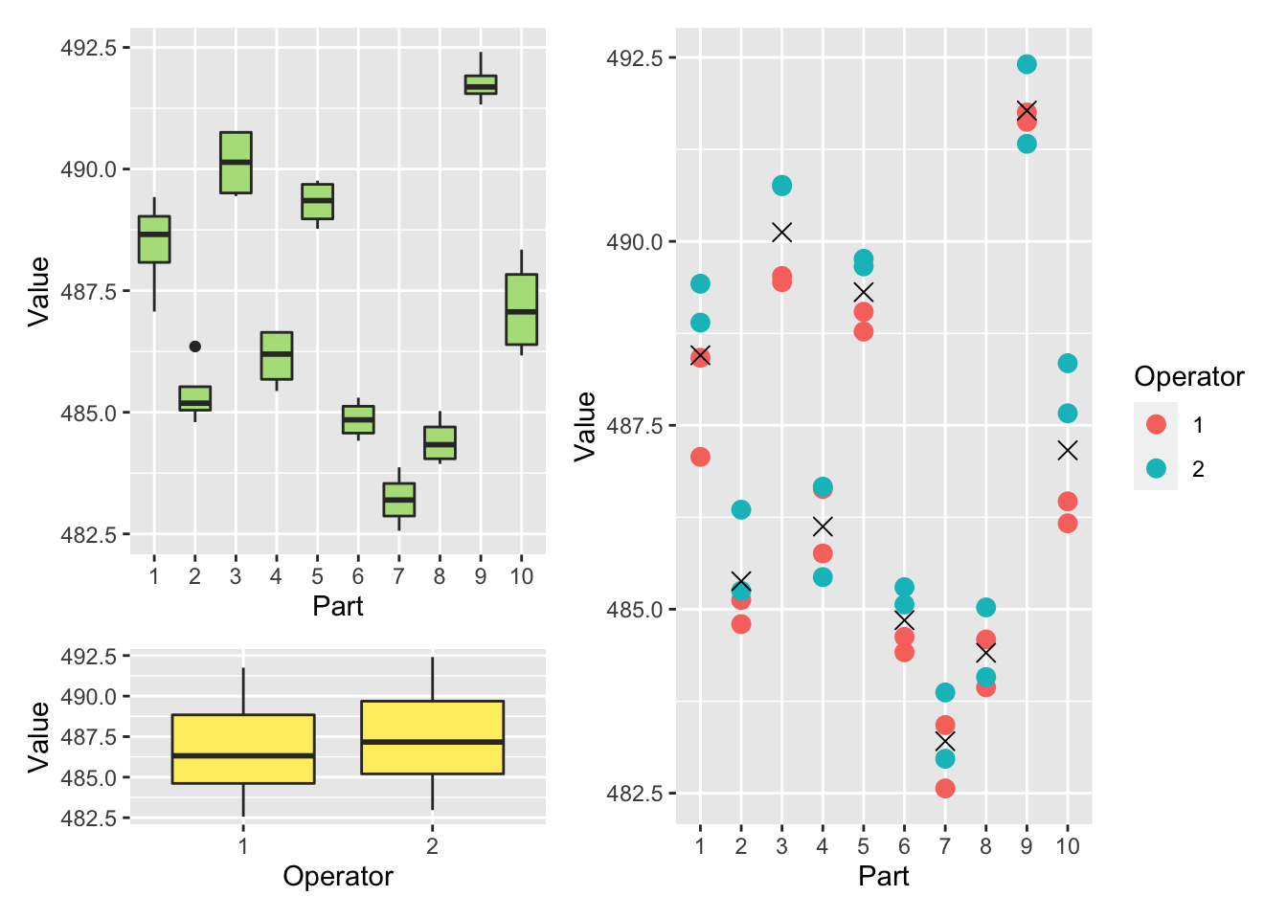
Extension packages - patchwork

