Slide 2
Overall Satisfaction | Class Pace
Academic Support | Apply Learning Outside Class
Instructor Engagement | Instructor Clarity
Instructor Knowledge | Homework Feedback Rating

Slide 3
Self-Reported Outcome in Healthcare
Customer Insight/Satisfaction
Product Preference in Market Research
Voting Intentions
Exercise Routine
Net Promoter Score

Slide 4
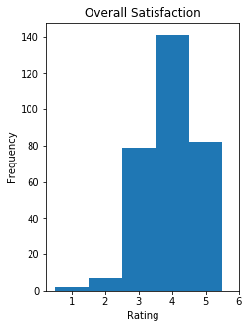
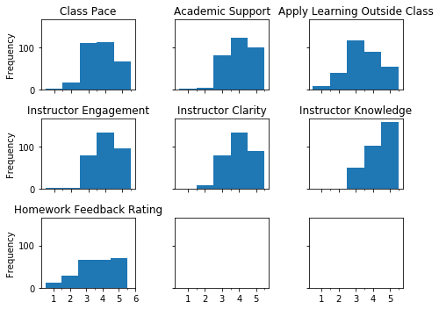

Slide 5
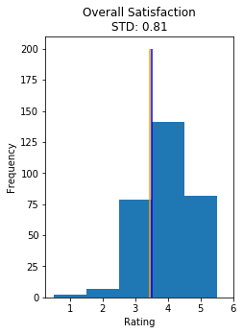
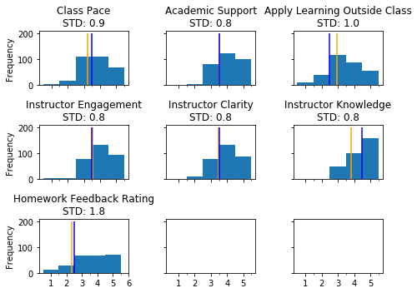

Slide 6
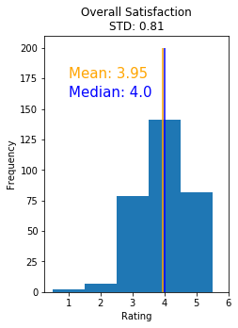


Slide 7
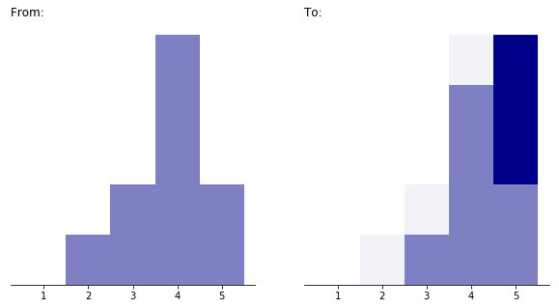

Taking a Closer Look at Rating Scales
Frequency
Satisfaction Rating Before
Satisfaction Rating After

Slide 8

Taking a Closer Look at Rating Scales
How Do You Feel About Your Experience?
Not Satisfied
1
Satisfied
5
2
3
4

Slide 9
How Do You Feel About Your Experience?
Ordinal
Not Satisfied
Somewhat Not Satisfied
Neutral
Somewhat Satisfied
Satisfied
not the same distance
Interval
- Implies Choices Are Equidistant
Not Satisfied
1
Satisfied
5
2
3
4
same distance

Slide 10
How Do You Feel About Your Experience?
Not Satisfied
Somewhat Not Satisfied
Neutral
Somewhat Satisfied
Satisfied
not the same distance
Not Satisfied
1
2
3
4
Satisfied
5
same distance

Slide 11
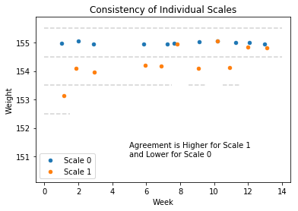
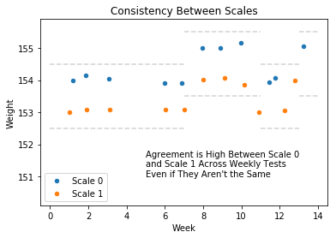

Slide 12
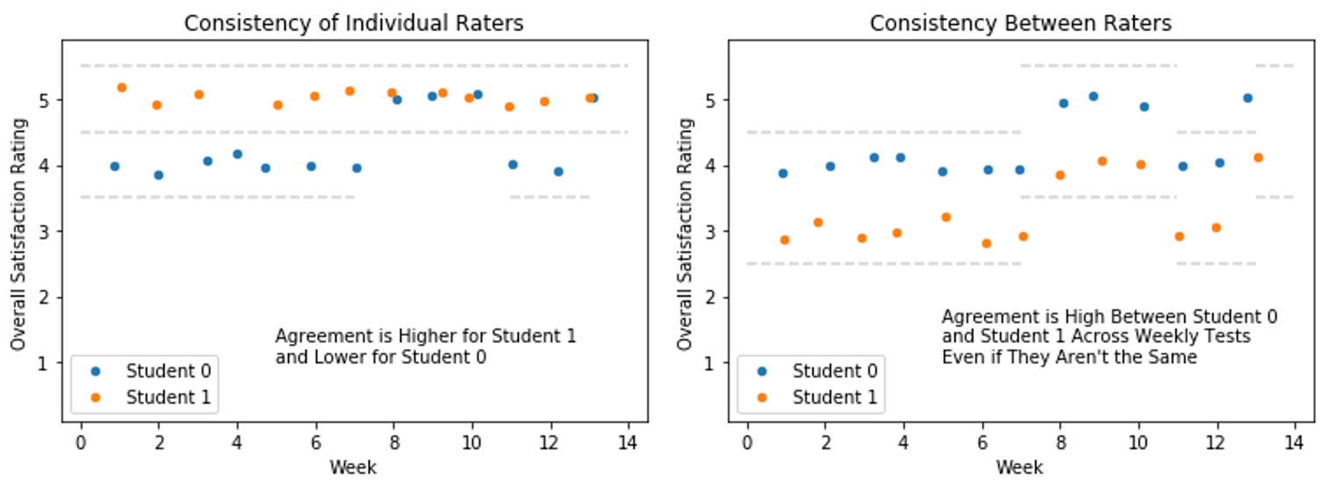

Slide 14
Question: How Do You Feel About Your Experience with Class?
Type | Description and Example
Nominal | Choices are labelled but has no order
Ordinal | Choices are in a specific order but not equidistant
Interval | Choices are ordered and equidistant
Ratio | Choices are ordered, equidistant, and accommodate 0 as starting point
It was confusing
It was rushed
It was ok
I look forward to more
I learned a lot
Not Satisfied
Somewhat Not Satisfied
Neutral
Somewhat Satisfied
Satisfied
Not Satisfied
1
Satisfied
5
2
3
4
Provides actual numbers in place of/in addition to word anchors – the implication is that the intervals between numbers may be considered equal since they appear to be mapped to a number line
0
100

Slide 15
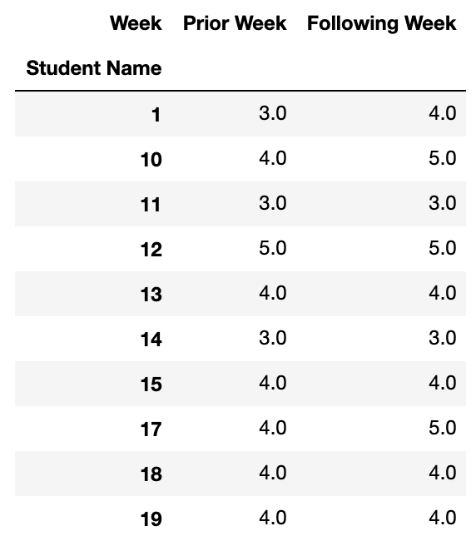
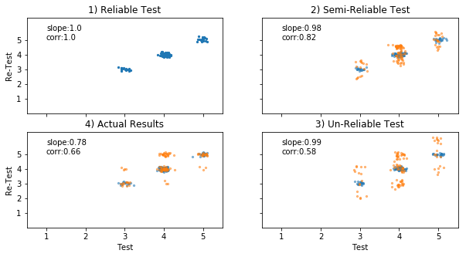
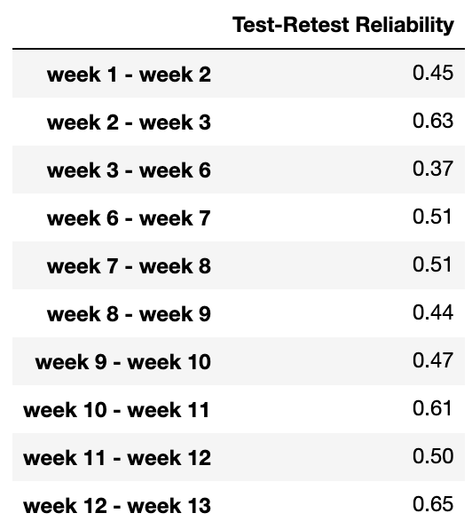
A) Data Transformation
B) Scatter Plots
C) Correlation by Week

Slide 16
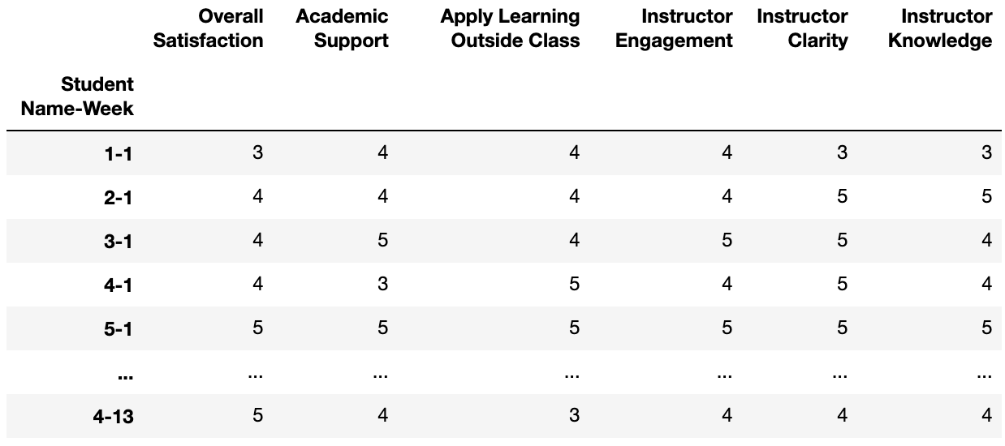
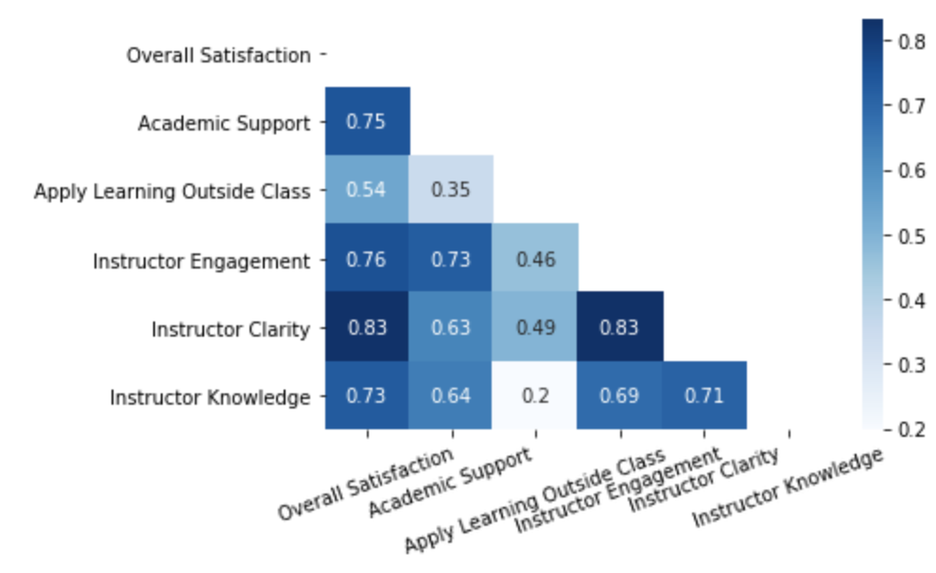
A) Data Transformation
B) Correlation Heatmap

Slide 17
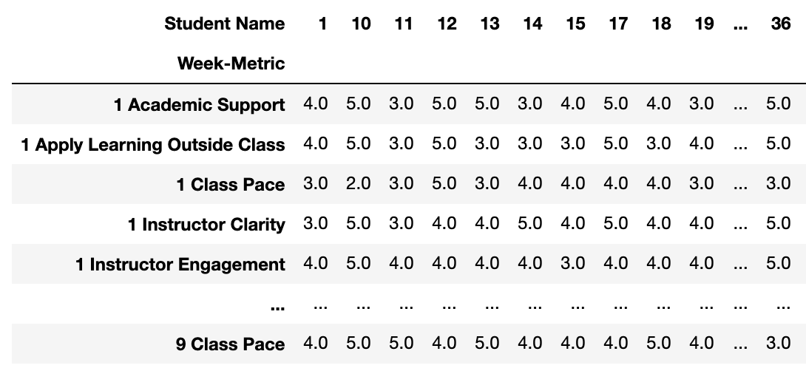
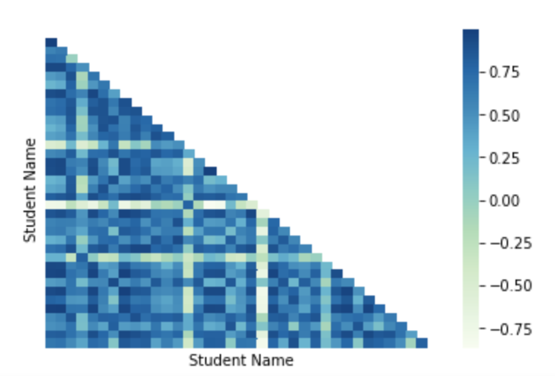
A) Data Transformation
B) Correlation Heatmap

Slide 18
Type | Source | Mitigation
Social Bias | Occurs when respondents are inclined to portray themselves in a favorable light | Make responses anonymous or avoid framing questions/choices in a socially desirable way
Acquiesce Bias | Occurs when questions stir respondents towards a direction or to agree with the statement as presented | Formulate instructions, questions, statements, and choice labels in a clear and objective way. Avoid having an even number of choices as it eliminates a neutral option
Central tendency Bias | Occurs when respondents are likely to choose the middle of a Rating Scale if the stakes are too high | Avoid using extreme response categories
Sampling Bias | Occurs when results only represent the opinions of those inclined to submit responses | Make responses easy but mandatory to complete
Question Order Bias (Order Effect Bias) | Occurs when respondents react differently to questions based on the order in which questions appear in a survey | Mix the order in which questions are arranged in the survey

Slide 19
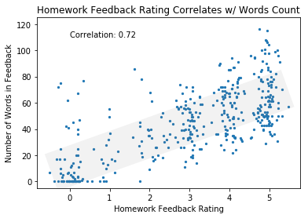
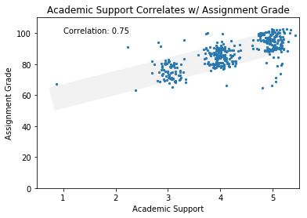

Slide 20
