Slide 2
Overall Satisfaction | Class Pace
Academic Support | Apply Learning Outside Class
Instructor Engagement | Instructor Clarity
Instructor Knowledge | Homework Feedback Rating

Slide 3
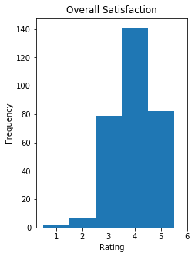
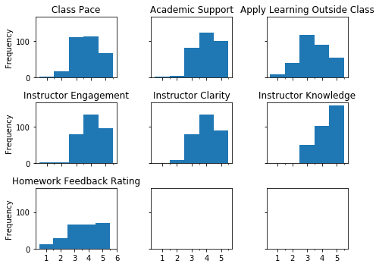

Slide 4
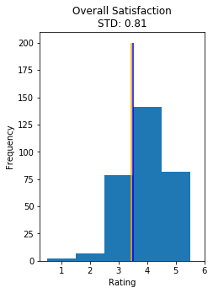
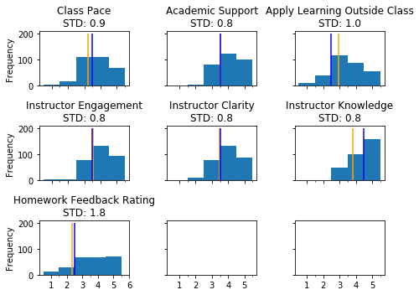

Slide 5
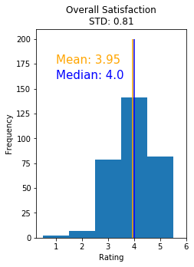


Slide 6
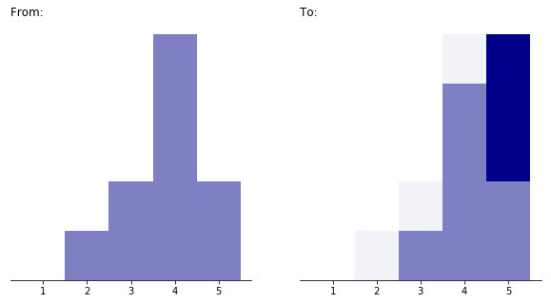
Improve
Customer
Rating

Slide 7
How Do You Feel About Your Experience?
Ordinal
Not Satisfied
Somewhat Not Satisfied
Neutral
Somewhat Satisfied
Satisfied
not the same distance
Interval
- Implies Choices Are Equidistant
Not Satisfied
1
Satisfied
5
2
3
4
same distance

