Slide 2
Overall Satisfaction | Class Pace
Academic Support | Apply Learning Outside Class
Instructor Engagement | Instructor Clarity
Instructor Knowledge | Homework Feedback Rating

Slide 3
Self-Reported Outcome in Healthcare
Customer Insight/Satisfaction
Product Preference in Market Research
Voting Intentions
Exercise Routine
Net Promoter Score

Slide 4
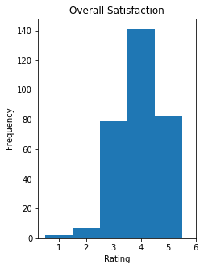
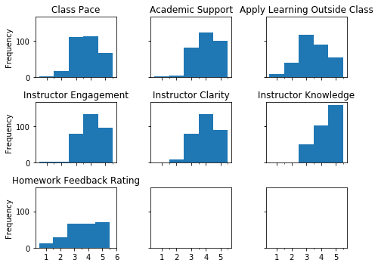

Slide 5
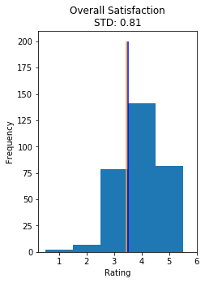
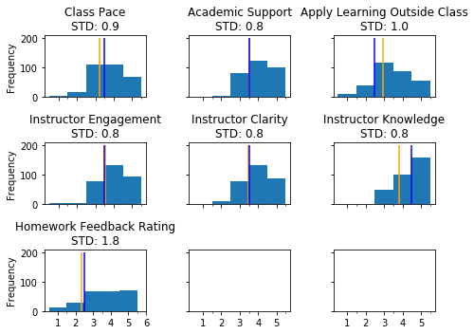

Slide 6
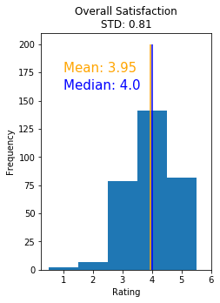


Slide 7
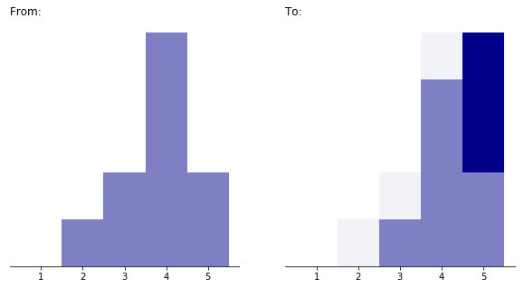
Improve
Customer
Rating

Slide 8
How Do You Feel About Your Experience?
Ordinal
Not Satisfied
Somewhat Not Satisfied
Neutral
Somewhat Satisfied
Satisfied
not the same distance
Interval
- Implies Choices Are Equidistant
Not Satisfied
1
Satisfied
5
2
3
4
same distance

Slide 9
How Do You Feel About Your Experience?
Not Satisfied
Somewhat Not Satisfied
Neutral
Somewhat Satisfied
Satisfied
not the same distance
Not Satisfied
1
2
3
4
Satisfied
5
same distance

Slide 10
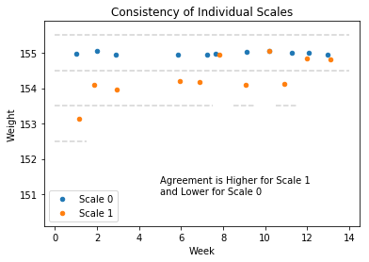
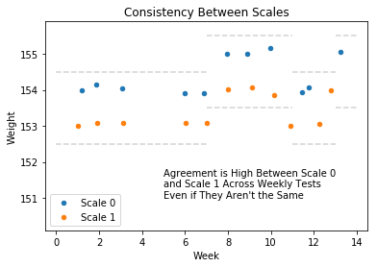

Slide 11
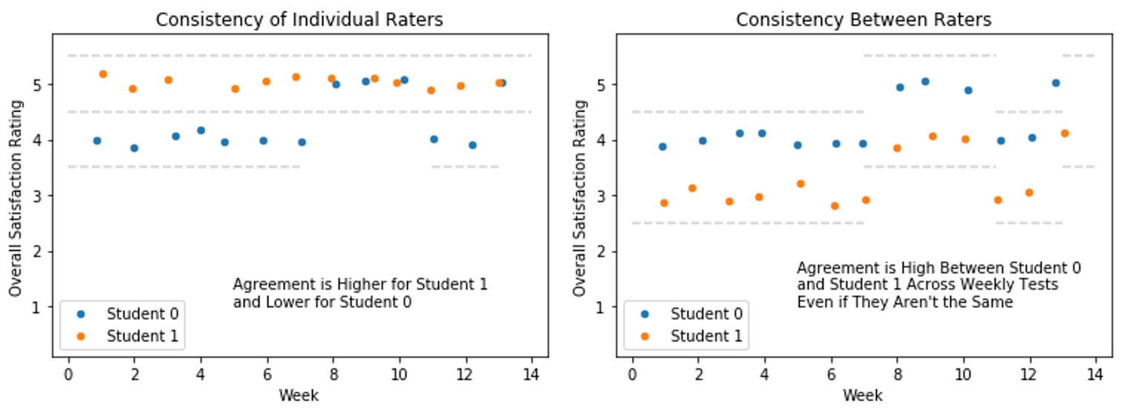

Slide 13
Question: How Do You Feel About Your Experience with Class?
Type | Description and Example
Nominal | Choices are labelled but has no order
Ordinal | Choices are in a specific order but not equidistant
Interval | Choices are ordered and equidistant
Ratio | Choices are ordered, equidistant, and accommodate 0 as starting point
It was confusing
It was rushed
It was ok
I look forward to more
I learned a lot
Not Satisfied
Somewhat Not Satisfied
Neutral
Somewhat Satisfied
Satisfied
Not Satisfied
1
Satisfied
5
2
3
4
Provides actual numbers in place of/in addition to word anchors – the implication is that the intervals between numbers may be considered equal since they appear to be mapped to a number line
0
100

Slide 14
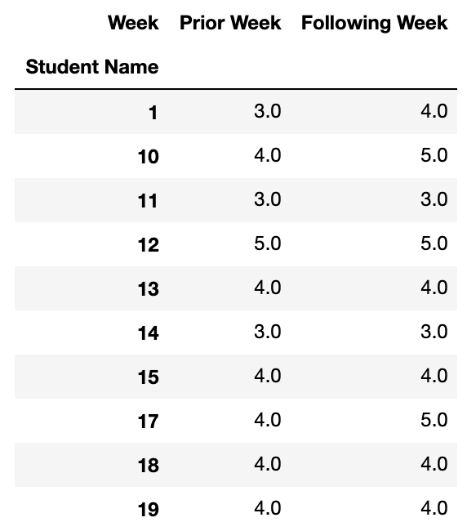
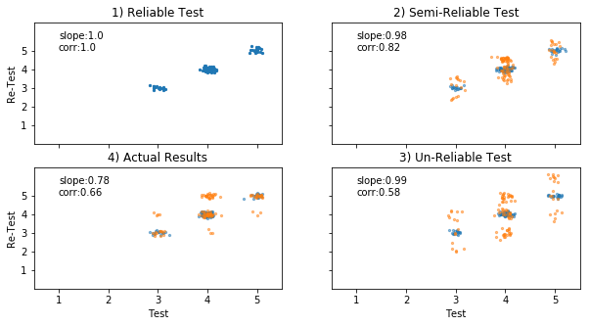
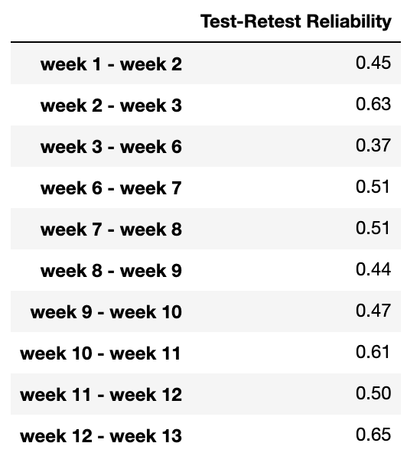
A) Data Transformation
B) Scatter Plots
C) Correlation by Week

Slide 15
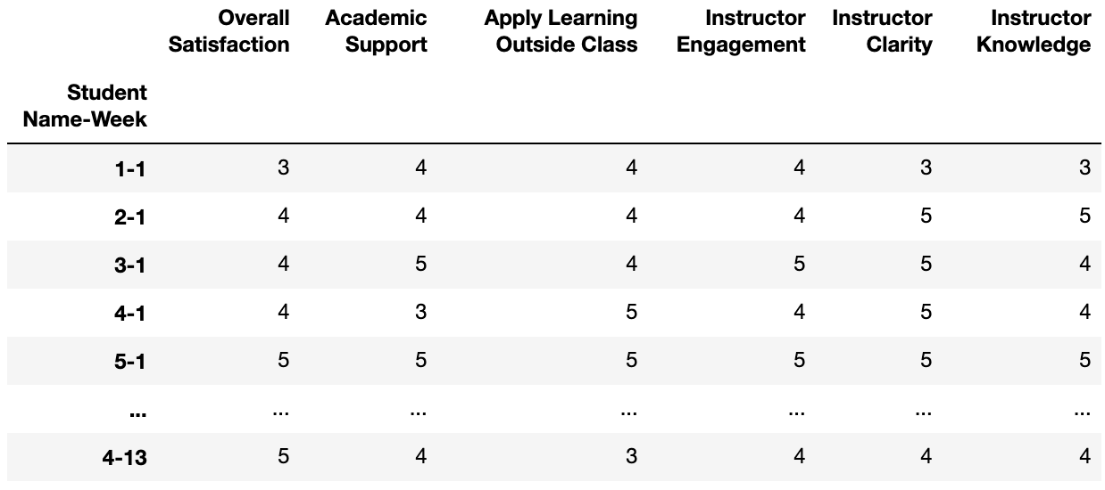
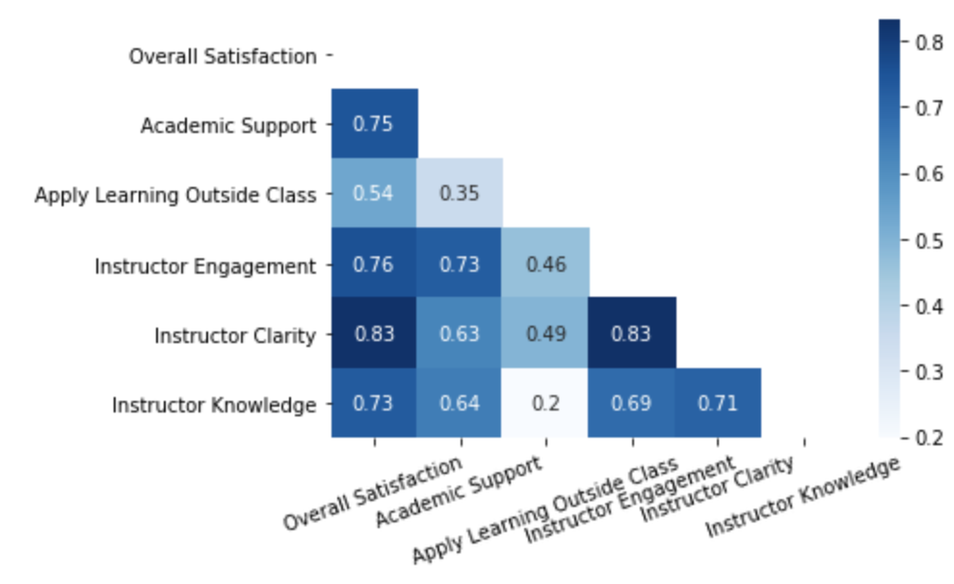
A) Data Transformation
B) Correlation Heatmap

Slide 16
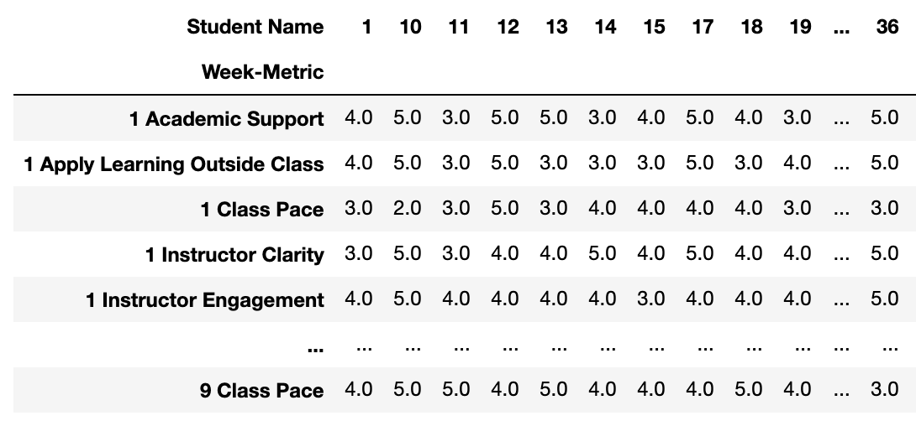
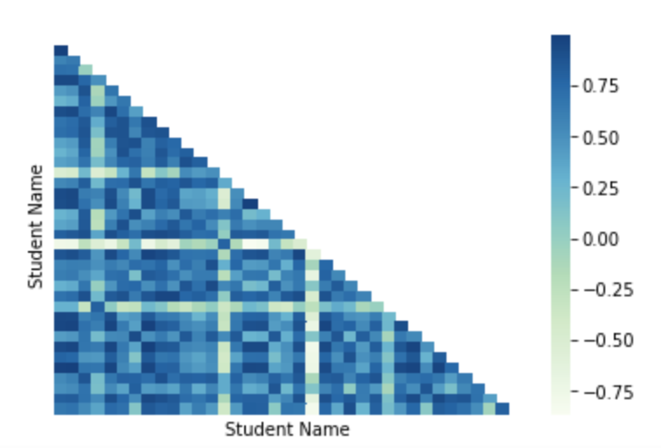
A) Data Transformation
B) Correlation Heatmap

