Slide 2





Scissors
beats paper
Rock
beats scissors
Paper
beats rock

Slide 3
player_1 | player_2 | result
p | p | Tie
s | p | Player 1 Win
s | r | Player 1 Lose
s | r | Player 1 Lose
r | r | Tie
s | s | Tie
p | s | Player 1 Lose
s | p | Player 1 Win
p | r | Player 1 Win
… | … | …

Slide 4
player_1 | player_2 | time_1 | time_2 | difference | result
p | p | 01:08.0 | 01:08.3 | .3 | Tie
r | s | 17:06.7 | 17:07.4 | .7 | Player 1 Win
r | s | 49:24.3 | 49:24.5 | .2 | Player 1 Win
p | p | 50:34.8 | 50:35.1 | .3 | Tie
p | r | 23:04.8 | 23:05.1 | .3 | Player 1 Win
r | s | 53:37.7 | 53:37.9 | .2 | Player 1 Win
s | r | 38:24.9 | 38:25.5 | .6 | Player 1 Lose
p | r | 46:35.8 | 46:36.5 | .7 | Player 1 Win
r | s | 00:45.0 | 00:45.7 | .7 | Player 1 Win
… | … | … | … | … | …

Slide 5
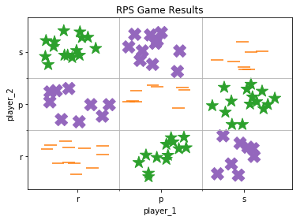
Start
Rock
Rock
Paper
Paper
Scissors
Start
Feature:
Player 1 Choice
Feature:
Player 2 Choice
Scissors
Scissors
Rock
Paper
Rock
Paper
Scissors
Target:
Result
Tie
Player 1 Lose
Player 1 Win
Player 1 Win
Tie
Player 1 Lose
Player 1 Lose
Player 1 Win
Tie
12
12
9
9
36
15
15
13
13
100
33
9
9
11
11
31
8
8
15
15
8
8

Slide 6
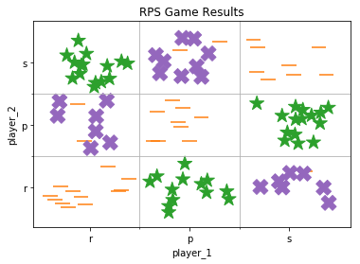
Start
<=0.8
Rock
Paper
>0.8
Rock
Start
Feature: Delay
Feature:
Player 1 Choice
Rock
Tie
Paper
Player 1 Lose
Scissors
Player 1 Win
Rock
Player 1 Win
Paper
Tie
Scissors
Player 1 Lose
Scissors
Rock
Player 1 Lose
Paper
Player 1 Win
Scissors
Tie
Not Scissors
Target:
Result
Feature:
Player 2 Choice
Tie
Scissors
Player 1 Win
Paper
Rock
Player 1 Win
Not Rock
Tie
Scissors
Not Paper
Tie
Paper
Player 1 Win
8
8
8
8
30
14
14
11
11
27
8
8
89
8
8
27
8
8
13
13
100
6
6
3
3
11
4
1
1
3
1
1
2
2
4
2
2
2
2

Slide 7
Rules-Based System | Machine Learning
Good when the incoming data is relatively stable | Have lower accuracy without enough labelled data
Can be thought of as a filter | Predicts the probable answer from within that filtered library
Immediate application if rules are simple | Can handle complex logics with great speed
Little flexibility once deployed | Automatically adapts as data evolves
Logic is coded by humans | Logic is embedded in the algorithm
Requires rules to be descriptive but are easy to understand | Complex interactions of the logics can be difficult to grasp

Slide 8
Rules-Based | Rules + Data -> Results
Machine Learning | Results + Data -> Rules

