Slide 2

CPU | GPU
Central Processing Unit | Graphics Processing Unit
4-8 Cores | 100s or 1000s of Cores
Low Latency | High Throughput
Good for Serial Processing | Good for Parallel Processing
Quickly Process Tasks That Require Interactivity | Breaks Jobs Into Separate Tasks To Process Simultaneously
Traditional Programming Are Written For CPU Sequential Execution | Requires Additional Software To Convert CPU Functions to GPU Functions for Parallel Execution

Slide 3
Easy
Slow
API – Numpy, Pandas, Etc.
Python
C++
Hardware
Complex
Fast

Slide 4
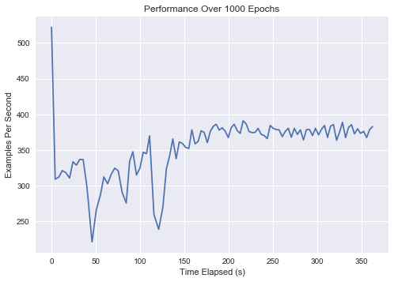
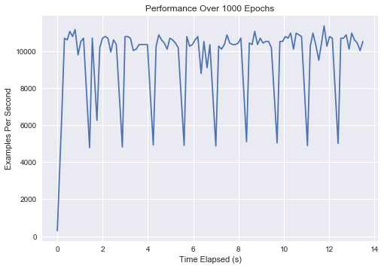
 | With GPU | W/O GPU
Total Training Time (s) | 134.9 | 3628.40 (~1 hour)
Average EPS | 9805 | 355

