Slide 2
Chart | Variable Type | Stratification
Pie Chart | Categorical | -
Bar Chart | Categorical | Across Categories
Histogram | Categorical/Numerical | Across Categories
Density Plot | Numerical | Ridge Plot
Box Plot | Numerical | Across Categories

Slide 3

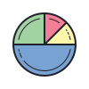

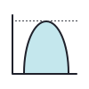

Heat Map | Pie Chart | Bar Chart | Histogram/Density Plot | Box Plot
Categorical | Categorical | Categorical | Numerical | Numerical

Slide 4
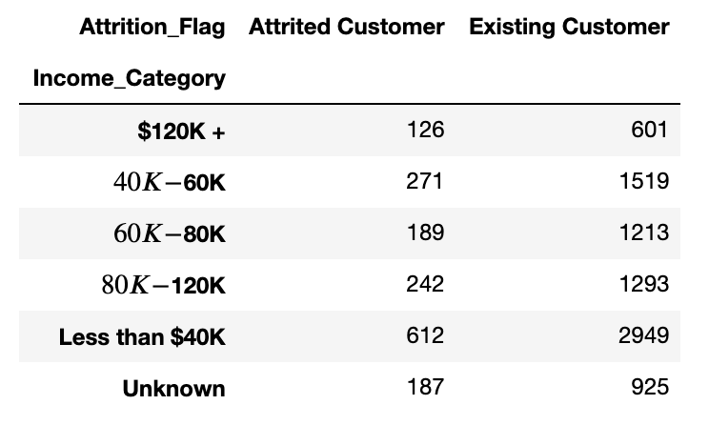
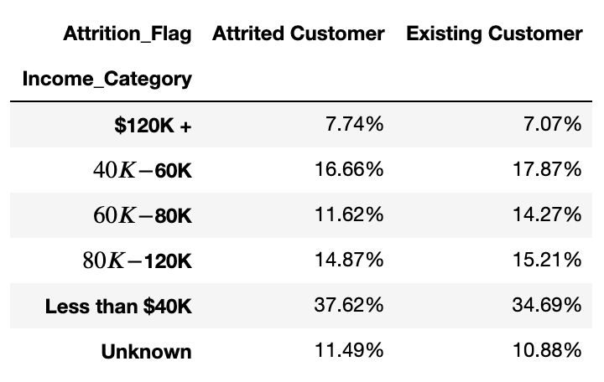
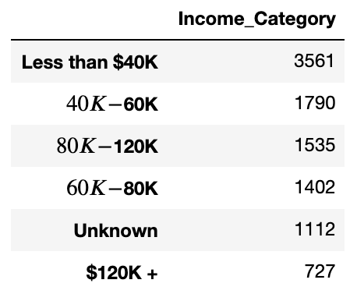

Slide 5
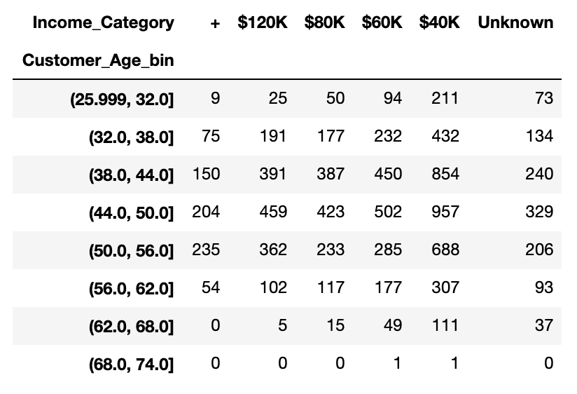
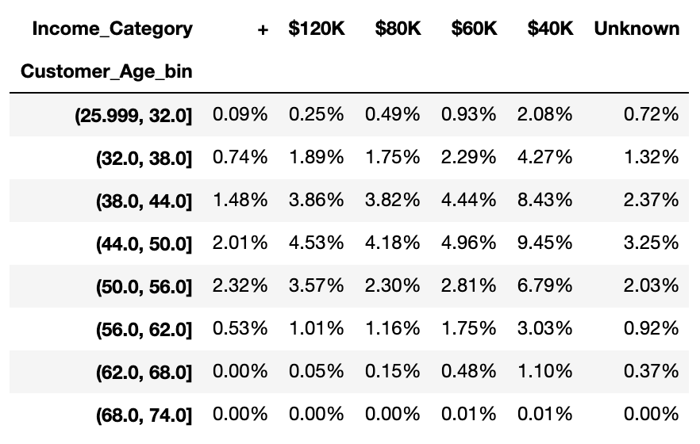
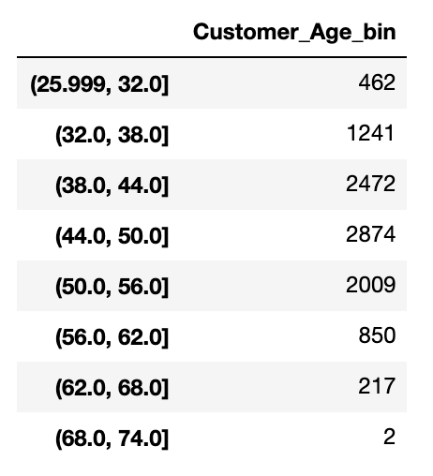

Slide 6
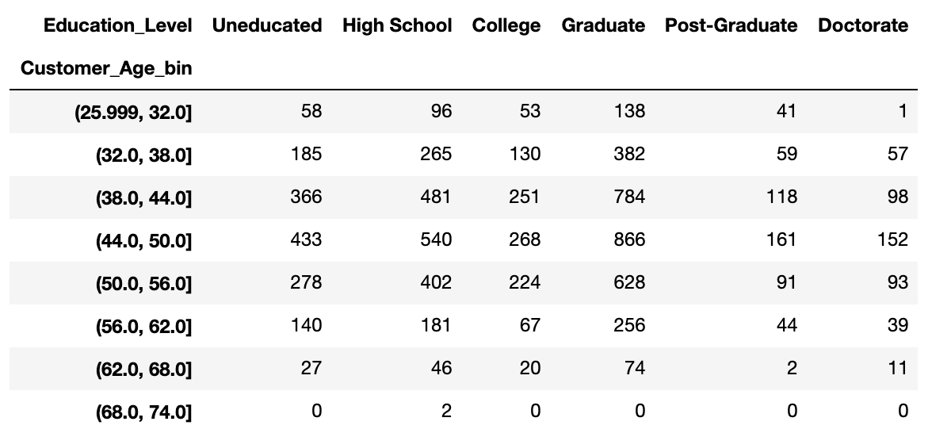

Slide 7
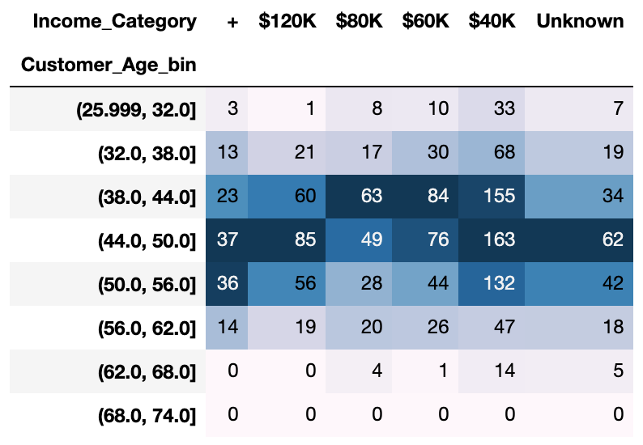
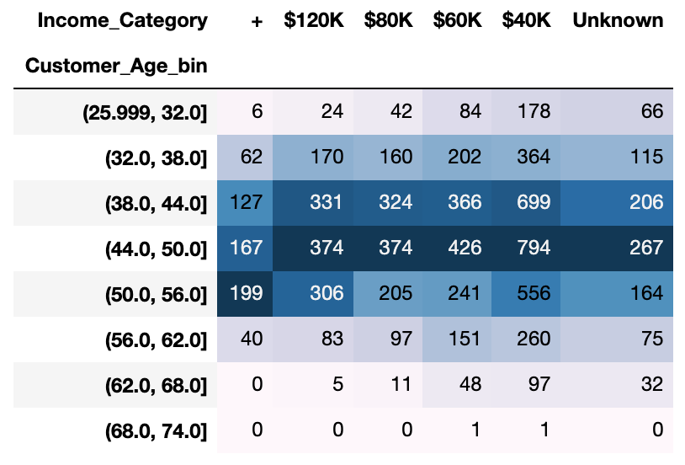
Attrited Customer
Existing Customer

