Slide 2

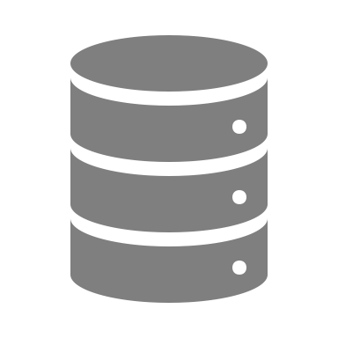



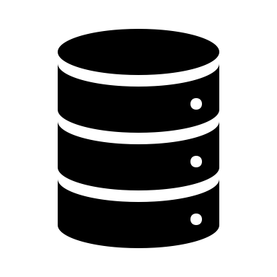








LOCAL
Building A RESTful API and Analytics Tool
Anyone with a network connection should be able to make a request to the API. Most consumers of data do not take in data in the raw form. They consume data after it has been processed and analyzed, which is why Dashboards are very popular. Even so, having a robust API is an important foundation for any organization with a digital presence.
Flask App Python Script
HTML
Other Assets
The Flask App and Database are developed and tested offline before it is deployed. By using the @app.route decorator, Flask enables different functionality through each defined endpoint. Flask can be programmed to map to static as well as dynamic urls that include variables.
Database
connect to DB
@app.route(‘/’)
def home():
return (‘Welcome’)
@app.route(‘/fetch/<query_string>’)
def fetch(query_string=None):
retrieve data from DB
filter based on query_string
return jsonify(results) to JS
CSS
JavaScript
PUSH/PUBLISH
REMOTE – ONE OR MORE HOSTS
Database
API
Website
Files and Data are Loaded, Analyzed, and Displayed in Browser
Return Query Results
Data passed via Response
Flask App Executes Query Based on Endpoint
Browser Initiate GET Request at URL via JavaScript
Anyone with Network Connection Can Access Website

Slide 3


Flask Demo
assets | data | breweries.csv
app.py | images | breweries.sqlite
 |  | csv_to_sqlite.py

Slide 4

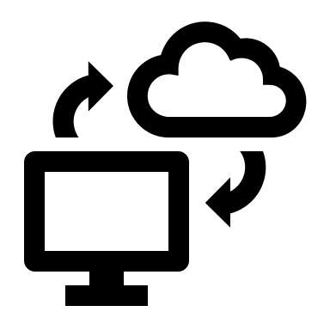











Find Data Source | Develop App and Database | Add a Scheduler | Host on Heroku | Monitor App
Find Data Source | Develop Data Collection Script | Add a Scheduler | Host on Heroku | Monitor App

Slide 5
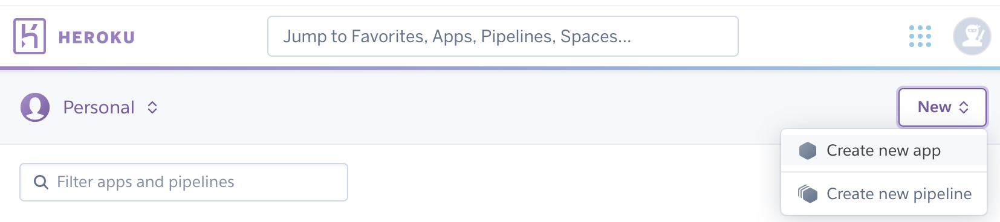
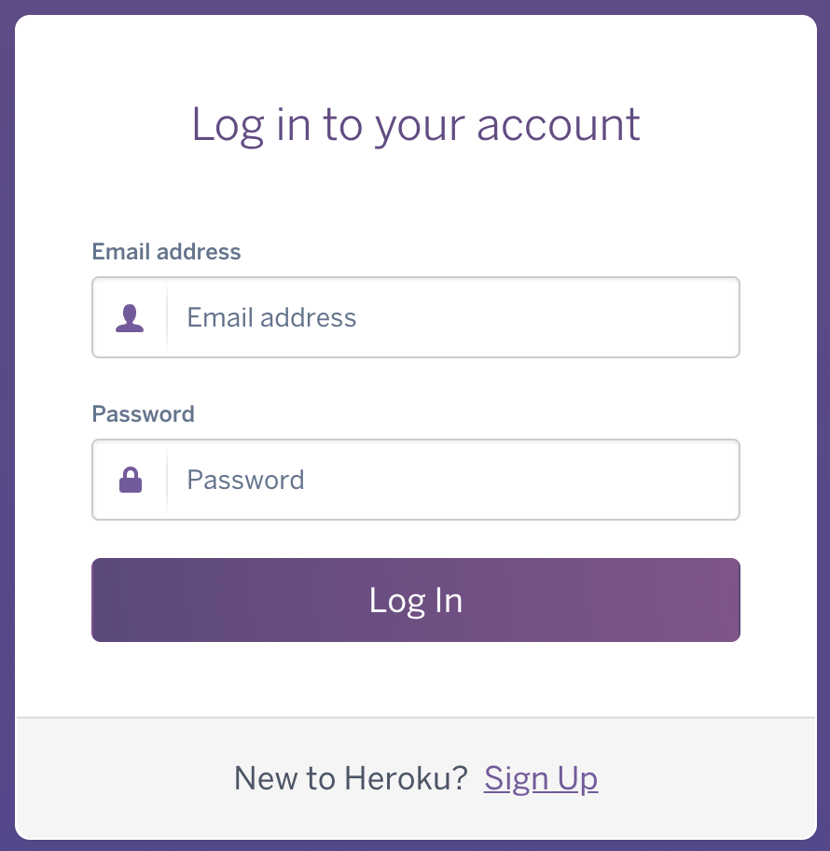
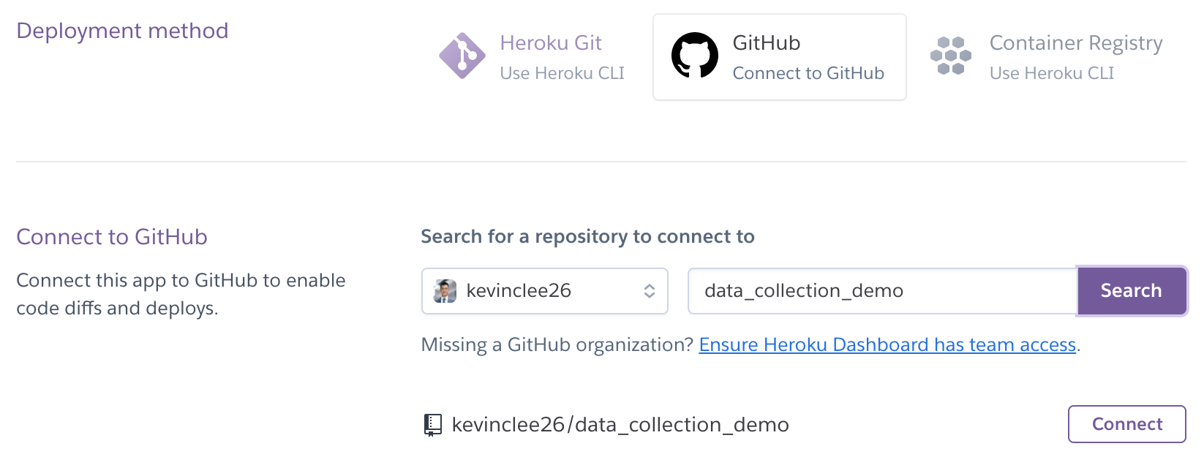
2
3
4
5
1
6
7
8

Slide 6
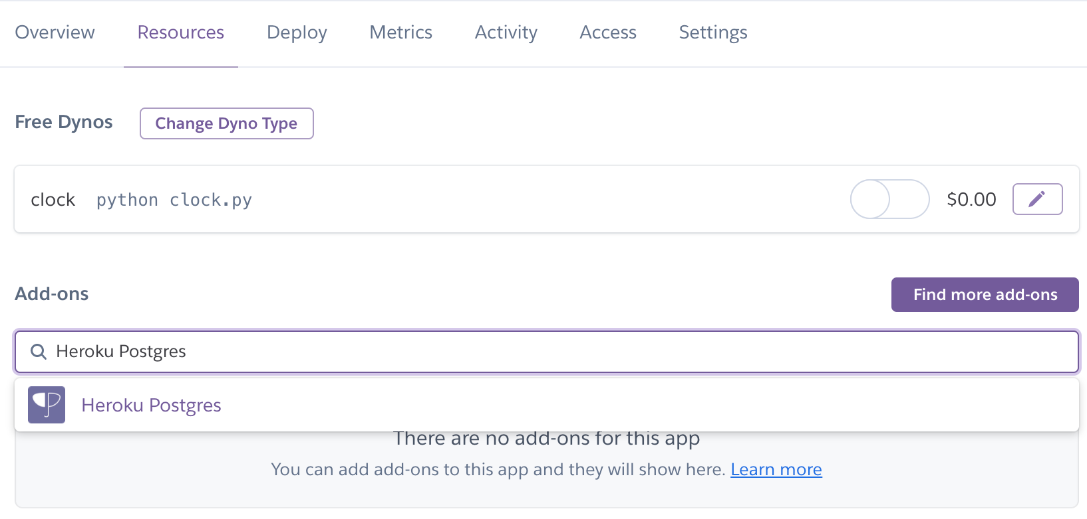
1
2
3

Slide 7

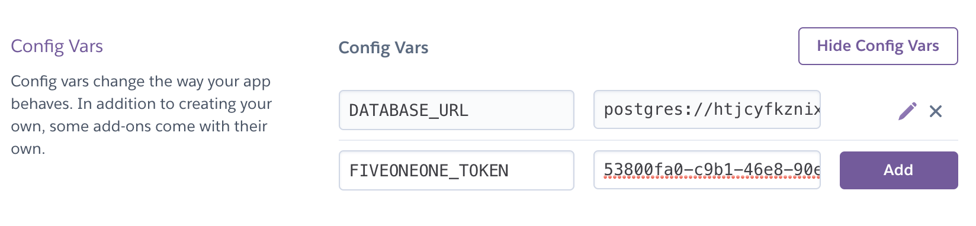
1
2
postgresql
3
5
4

Slide 8
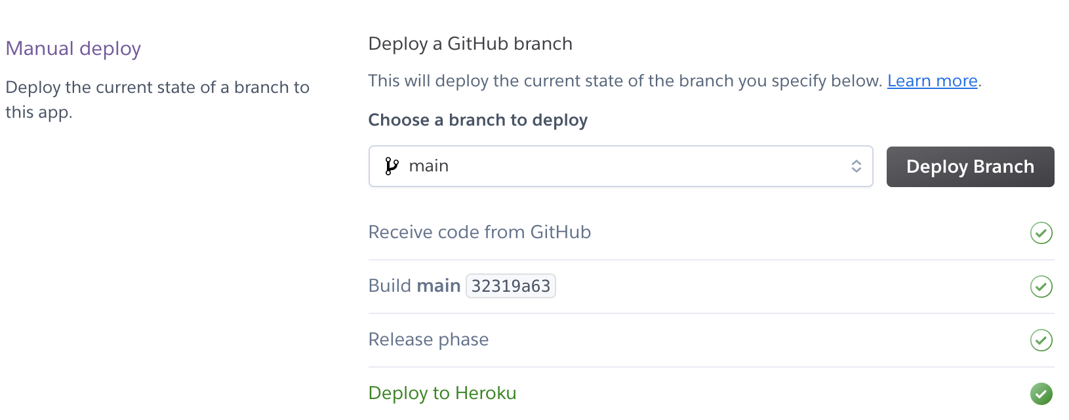
1
2
3
4

Slide 9
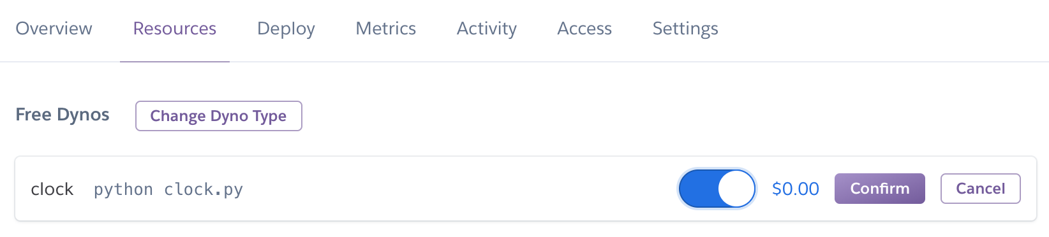

1
2
3
4

Slide 10



Data Collection Script
Scheduler

Slide 11


Manually Set Environment Variables
Add Environment Variables at Runtime
Keys Should Never Be Pushed to GitHub
Keys Are Added To the OS’s Environment Variables
Push
Deployment
Development Environment on Local Machine
GitHub
Production Environment at Host

