Slide 2
Approach | Custom Machine Learning Models |  | Lexicon & Rule-Based Tool
Approach | Naive Bayes DTM | Word Embedding + LSTM Deep Learning | VADER
Training Effort | Supervised Machine Learning requires labeled data, which can be difficult to acquire |  | Pre-trained models are easy and quick to implement
 | Model is fast to train | Resource intensive and takes time | Pre-trained model
Interpretability | Outputs are reasonably understandable | Difficult to interpret model outputs | Results are easy to understand
Strength | Custom models capture context of the text and are useful for domain-specific NLP tasks |  | Does not require model training
 | Computation is fast Widely used for large-scale sentiment analysis Retains context to a degree | Has the potential to produce the most accurate results Retains context of the text/corpus Less effort for feature engineering when neural networks can learn important features | Less resource and computationally intensive Doesn’t suffer severely from a speed-performance tradeoff VADER contains linguistic rules that go beyond what is captured in a typical document-term-matrix model
Weakness | Custom models require sufficient training data and feature extraction |  | Lexicon is difficult to create and validate
Weakness | Naïve Bayes models rely on complete and representative data set Strong independence assumption in the model | Most expensive to train and operate | Susceptible to misspellings, nomenclatures, sarcasm, irony, jargons, and grammatical mistakes as they are not recognized by the lexicon Ignores context of the text Suitability issues across domains

Slide 3
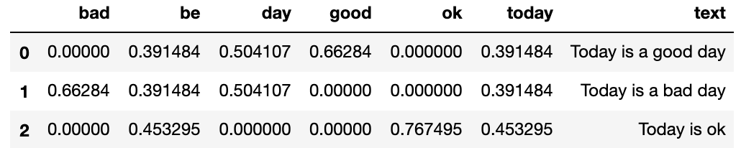
Naïve Bayes
Convert Case
Tokenize
Lemmatize
Stop Words Removal
TD-IDF
cleaning
vectorizing

Slide 4
Text | Today | Is | Good | Day | Bad | Ok | Not Good
Today is good day | 1 | 1 | 1 | 1 | 0 | 0 | 0
Today is bad day | 1 | 1 | 0 | 1 | 1 | 0 | 0
Today is ok | 1 | 1 | 0 | 0 | 0 | 1
Today is not good |  |  | 1 |  | 0 |  | 1
Label
Positive
Negative
Neutral
Negative

Slide 5
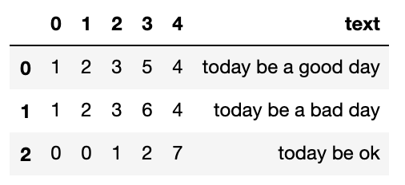
LSTM
Convert Case
Tokenize
Lemmatize
Texts to Sequence
Word Embedding
cleaning
vectorizing

Slide 6







Training
Machine Learning Algorithm
Tags
Texts
Features
Feature Extraction
Prediction
Texts
Features
Classifier Model
Tags
Feature Extraction

Slide 7
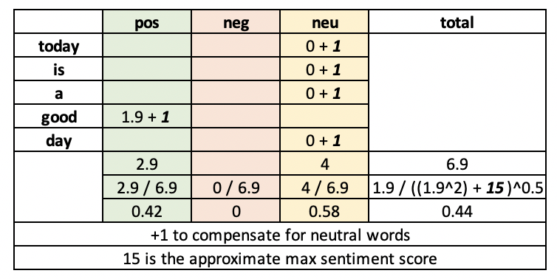
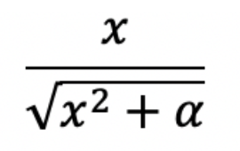
normalizing function:

