Slide 2
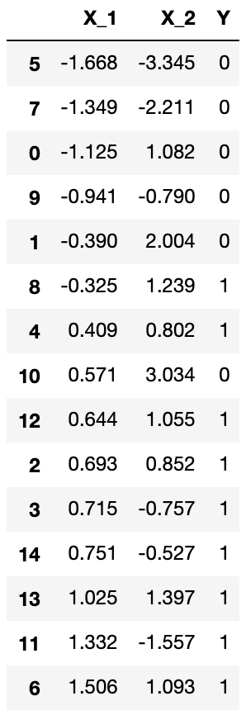
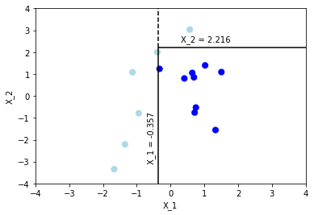
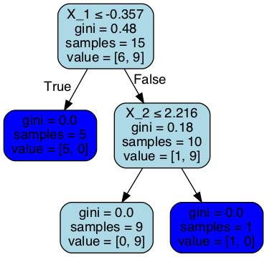
Training Set
Treemap
Decision Tree
0
Decision 1
Decision 2
0
1

Slide 3
Decision Tree
Prone to overfitting
Pruning
Removes nodes that are not informative
Optimizes the size of tree
Bagging
Reduces variance through collaboration of multiple trees
Random Forest
Boosting
Gradient Boosting
Can handle high dimensionality
Combines weaker learners to improve model performance
Model trains sequentially based on residuals of prior outcome
Early Stopping
Prevents the model from learning patterns that are too specific
Reduces overfitting
Identifies significant variables
Requires less data preparation
Each tree is trained on a subset of features
Intuitive and easy to understand
Longer time to train multiple trees
Longer time to develop as models are trained sequentially
Ensemble Learning

Slide 4
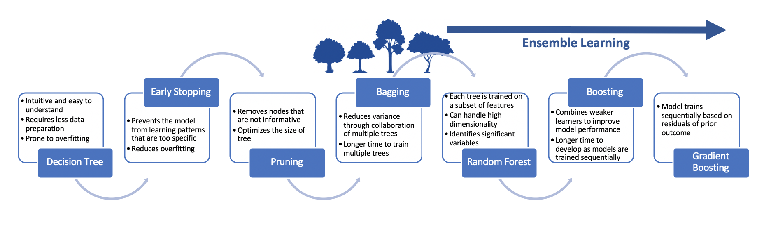

Slide 5
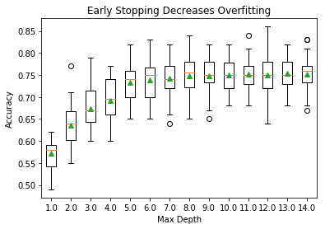
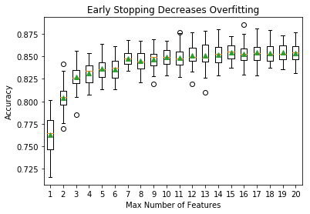
Limiting Depth Reduces Overfitting
Limiting Features Reduces Overfitting

Slide 6
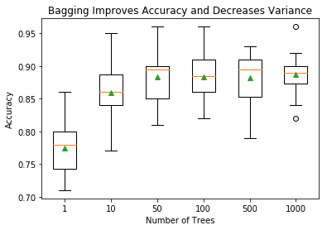
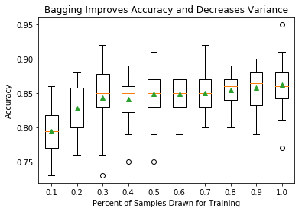
Collaboration of Multiple Trees Reduces Variance
Sub-Sampling Increases Reduces Variance

Slide 7


Bagging
Parallel
Boosting
Sequential

Slide 8


