Slide 1
Margin Working Group Updates Outbrief
Chris Bennett
5/1/2019

Slide 2
Margin Working Group Brief Overview
The Margin Working Groups (MWG) will be assessing, documenting, and improving how the MSL team uses margins for the various vehicle resources such as energy, downlink data volume, onboard data volume, and activity durations. [Began October 2017]
The goal is to understand the margin practices from an end to end system perspective, thereby reducing the silos, inefficiencies, and inconsistencies that exist between the MSL teams. The margin working group will progress through 4 phases for each resource:
Phase 1: Document Existing Margin Practices
Phase 2: Discuss and Establish Project Risk Stance for Each Resource Margin
Phase 3: Establish and Allocate Margin Best-Practices
Phase 4: Implement Proposed Margining Updates

Slide 3
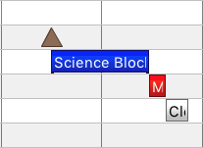
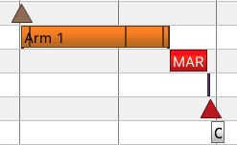
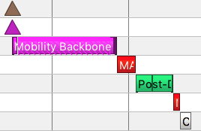
Current Focus: Tactical Activity Plan Explicit Margins
Currently focused on durations of explicit “Margin” blocks in tactical activity plan on submaster blocks: science blocks, arm backbones, and drive backbones
Assessed tactical activity plans beginning on Sol 1000 through today
Assessment focused on ‘modern’ sols to stay true to current practices
Some data points were removed from assessment:
Strategic planning sols (long holidays, conjunction)
Submasters where the associated margin could not be found
Planning data is user-defined and thus not perfect
Submasters where no as-runs were found (failed execution, etc.)
Implemented a recommended solution on sol 2170

Slide 4


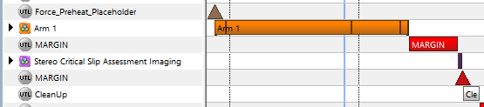
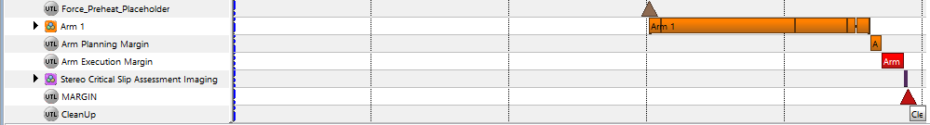
Implemented Solution
SBs
Propose to cut the rule of thumb in half:
5 min of margin/hour of SB time
No less than 1 min for a SB
Was: 10 min/hr
Is: 5 min/hr
Arm
Add a planning margin (5min/hr) that will shrink as the planning day progresses
This duration is given to RPs first (ie not a negotiable in SOWG)
As RPs gain confidence in their duration as the day progresses they can reduce this or trade it for backbone duration
The intention is that by APAM, the remaining planning margin should either disappear, or become part of the arm bb (if the RPs need it)
However, we expect that there will be days RPs will still need to keep that margin through APAM. This is ok
Additionally have an execution margin (static 5min + 5min/hr)
Is: 5 min/hr Planning Margin
5min/hr + 5 min Ex. margin
Was: 15 min/hr

Slide 5
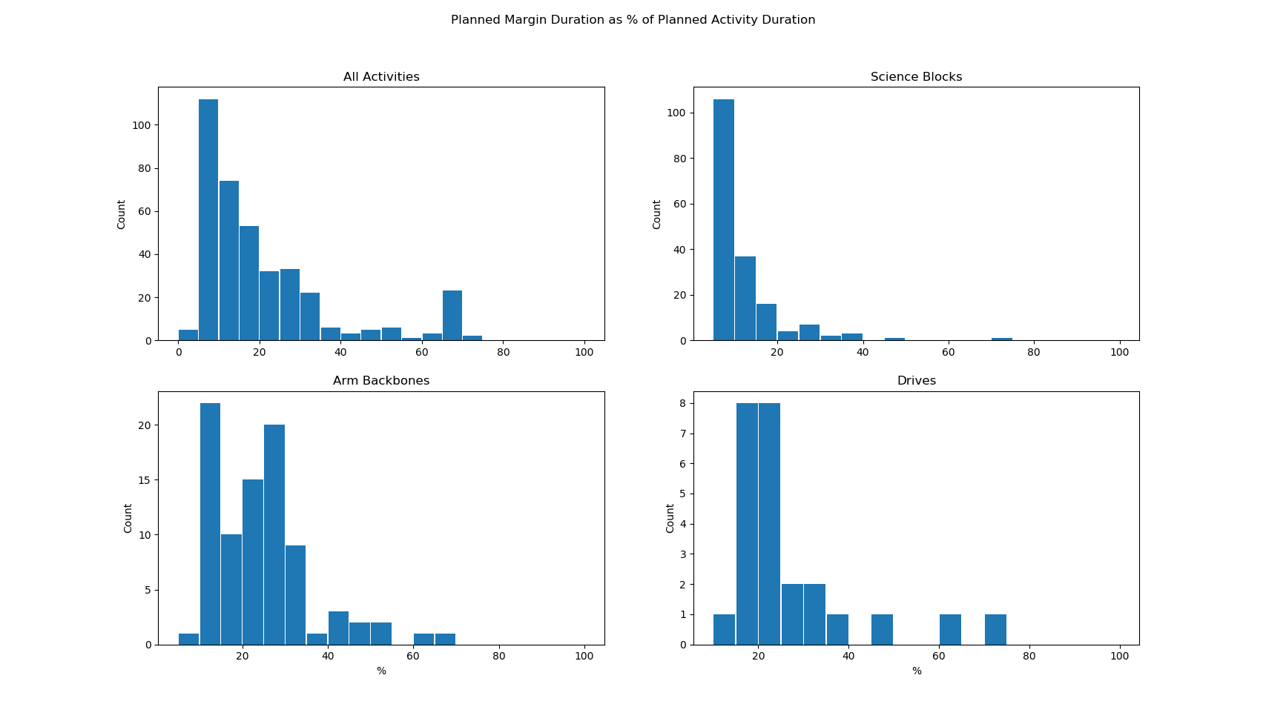
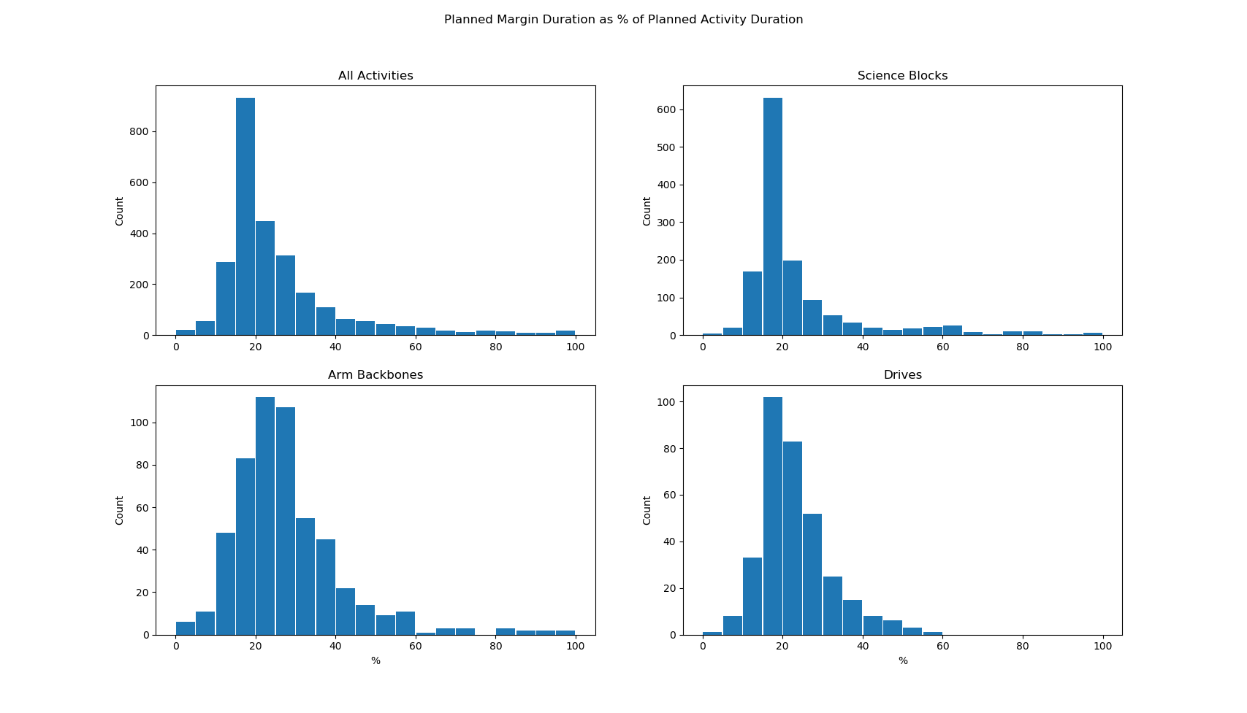
Are we doing what we said we would?
10min/hour = ~16.6%
15 min/hour = 25%
Median = 25%
Pre-Update
What are these?
Post-Update
Median = 23.9%
5min/hour = ~8.3%
10 min/hour (for 1 hr Arm) = 16.6%
7.5 min/hour (for 2 hr Arm) = 12.5%

Slide 6
Figure of Merit Definition – Vehicle Idle Time
From MSLICE Database:
We have the planned duration of each submaster (includes margin)
Planned Duration
Submaster
SB or Arm BB
Margin
Cleanup
From SPAZZ:
We have the execution duration of each submaster
Sub_xxxxx duration
Actual Duration
Vehicle Idle Time
Vehicle Idle time = Planned Duration – Actual Duration

Slide 7
Results!
Pre-Update Vehicle Idle Time (min)
Activity Type | 25th percentile | 50th percentile | 75th percentile | 95th percentile | 99th percentile
All | 8.3 | 17.0 | 28.6 | 52.5 | 98.3
SB | 8.6 | 15.7 | 22.9 | 36.0 | 55.0
Arm | 11.5 | 20.3 | 32.4 | 63.3 | 182.0
Drive | 30.9 | 38.7 | 47.1 | 79.6 | 114.0
Post-Update Vehicle Idle Time (min)
Activity Type | 25th percentile | 50th percentile | 75th percentile | 95th percentile | 99th percentile
All | 3.9 | 9.5 | 16.2 | 44.4 | 120.8
SB | 6.3 | 10.1 | 14.5 | 20.7 | 29.3
Arm | 8.6 | 13.7 | 25.0 | 58.0 | 174.3
Drive | 34.1 | 40.6 | 48.4 | 56.6 | 87.8

Slide 8
Results!
Science Blocks (using median values)
Idle Time Reduction per SB: 5.6 min
35% improvement
Average SBs per Sol: 1.24
Average Idle Time Reduction per Sol: 6.9 min
Arm BB
Idle Time Reduction per Arm BB: 6.6 min
33% improvement
Average Arm BBs per Sol: 0.61
Average Idle Time Reduction per Sol: 4 min
Average Idle Time Reduction per Sol: 10.9 min
Approximately 1% SOC per Sol
Including awake time rule of thumb of 1.2% SOC/20min
There is also a benefit of less heating for those activities ~0.5%
Also the benefit of this time can be directly used by science

Slide 9
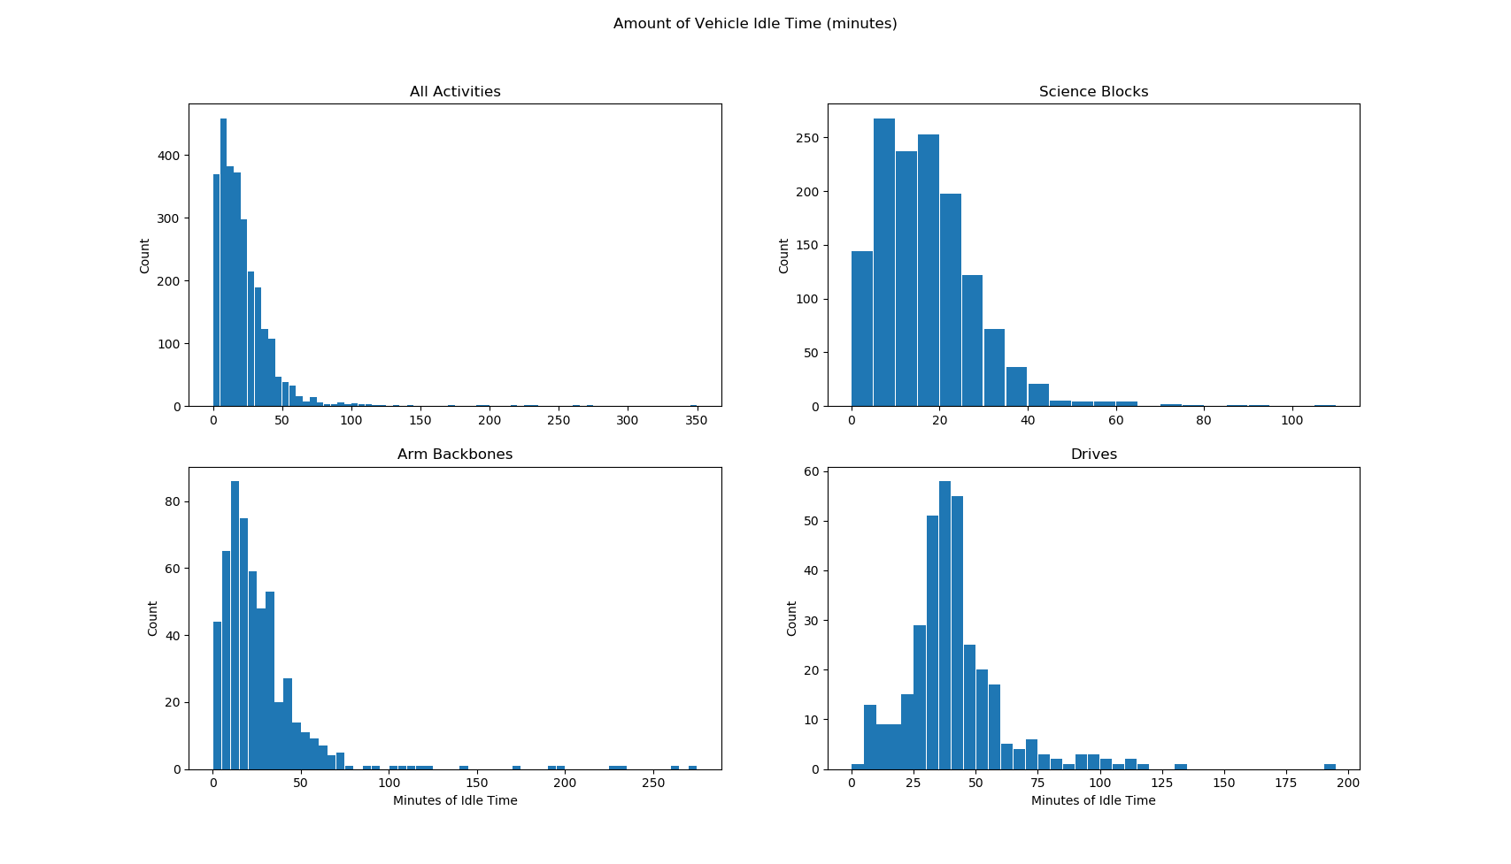
Pre-Update Idle Time

Slide 10
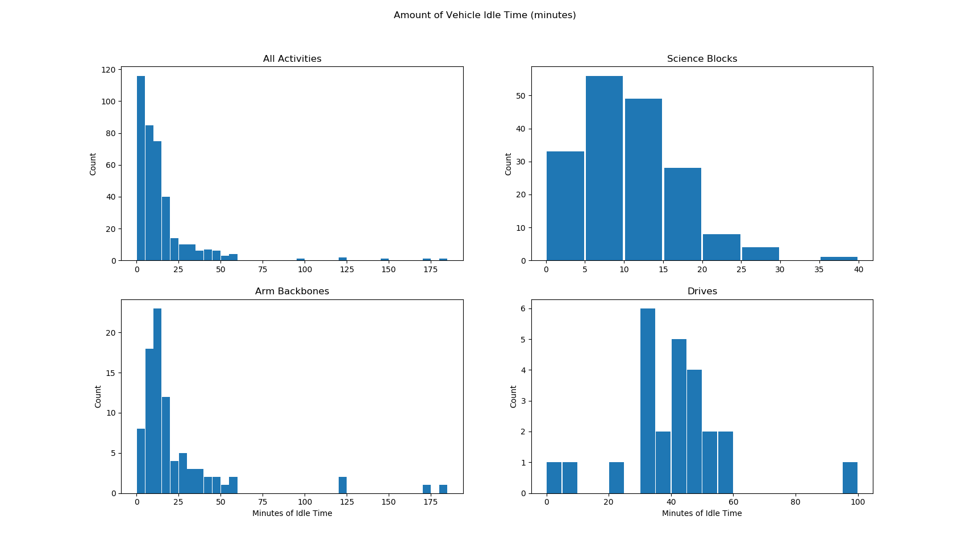
Post-Update Vehicle Idle Time

