Slide 1


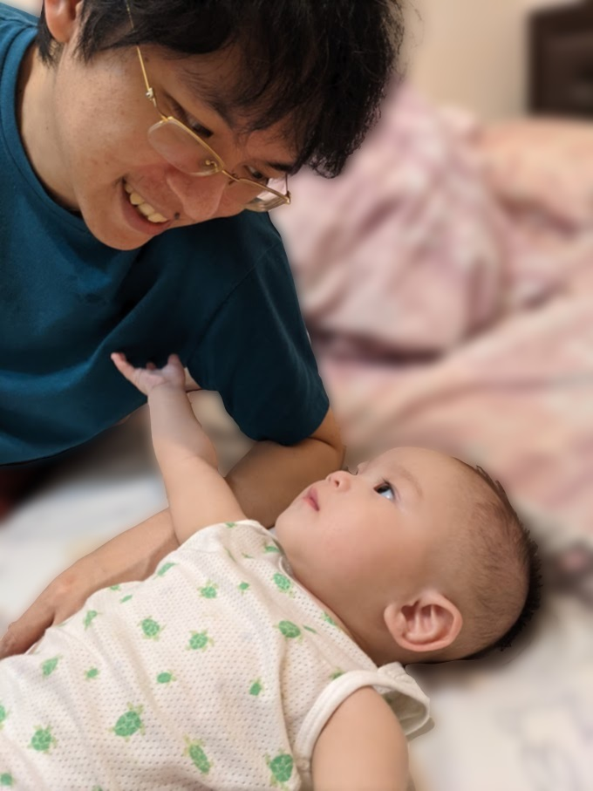





MediaTek
Yu-Ting Wu (吳昱霆)
Ph.D. in CS:
NTU
(2009/09 - 2014/06)
Master in CS:
NCTU
(2007/09 - 2009/06)
Bachelor in CS:
NCTU
(2003/09 - 2007/06)
Postdoc, NTU
(2020/02 - 2021/07)
Sr. Engineer, Toppano Inc.
(2018/05 - 2020/02)
Pr. Engineer, HTC Inc.
(2014/09 - 2018/05)
September 28th, 2021

Slide 2
About the Presenter
About the Presenter
Working Experience:
Research Interests: computer graphics, image processing, computational photography, VR/AR/MR, AI, GPU
October 1st, 2021

