Slide 1
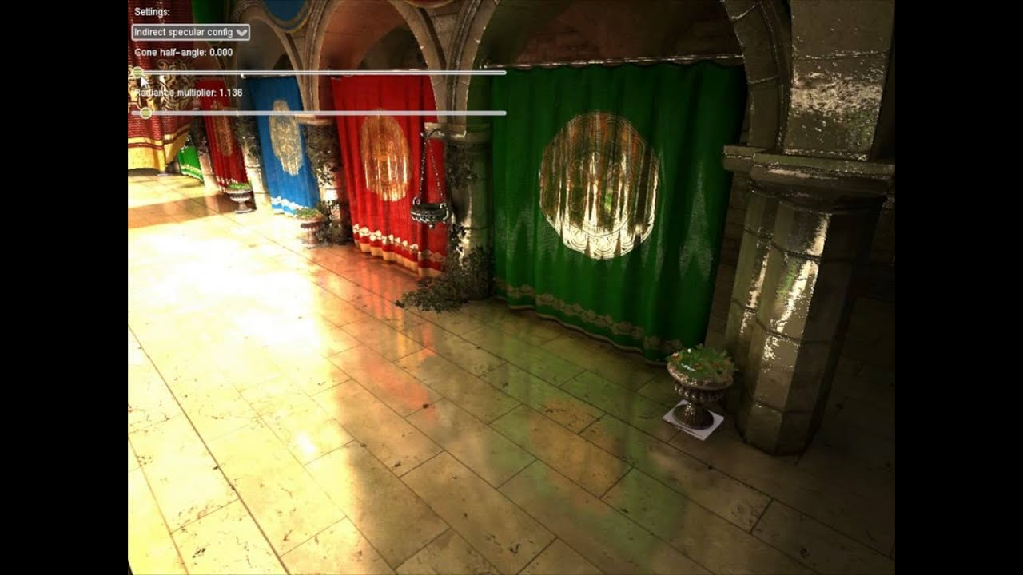
For games in the near future: Hybrid Rendering
Rasterization is relatively mature
Ray tracing is hot, but noise (affordable rays) and memory are difficult to overcome
Use ray tracing for specific light paths only (ex: glossy reflection, perfect specular reflection and refraction)
Most can be done with rasterization
Exception: glossy surface + image-based lighting (env. map)
Direct Illumination:
Diffuse: rasterization
Glossy: ray tracing + approximated geometry + denoising
Specular: ray tracing
Global Illumination:
Ambient Occlusion: rasterization & ray tracing (with approximated geometry)

Slide 2
Important Topics for MTK
Rasterization
Software rasterization
Tiler-friendly rendering algorithms
Visibility buffer (memory bandwidth friendly)
Shadows (scalability and bandwidth issue for open-world games)
Ray tracing
Approximated geometry (voxel, SDF, …)
Spatio-temporal denoising
Volumes
General topics
VRS
MEMC

