Slide 1
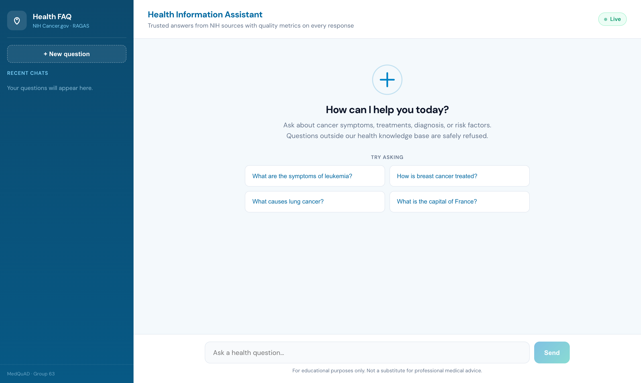

Health FAQ RAG Chatbot
WIL PROJECT · TEST-DRIVEN RAG
Trusted cancer answers grounded in NIH Cancer.gov, built step by step from V1 to V4 with LangChain
Presented by
Kevin Costner
October 2026
Notes:
Introduce yourself (Kevin Costner) and the project: a retrieval-augmented chatbot that answers general cancer questions using only NIH Cancer.gov content, with sources and safe refusals. The screenshot is the live React app.

Slide 2


Problem statement and proposed solution
The problem
Proposed solution
Cancer information online is scattered across many sites and varies in quality
General chatbots can invent medical facts and give no sources to check
Patients and carers cannot tell which answers to trust
Off-topic or risky questions (e.g. drug dosages) get answered anyway
A RAG chatbot that answers only from NIH Cancer.gov content (MedQuAD)
Every answer cites the NIH pages it came from
Questions outside the knowledge base get a safe refusal
Built in four LangChain versions (V1 to V4), each one measured
729
98
6,452
Patients · carers · public
NIH question-answer pairs
cancer topics
searchable text chunks
target users
Notes:
Problem: unreliable, scattered cancer information and chatbots that hallucinate without sources. Solution: ground every answer in NIH Cancer.gov (MedQuAD CancerGov subset: 729 Q-A pairs, 98 topics, 6,452 chunks), show sources, refuse out-of-scope questions.

Slide 3




V1: LangChain basics with no retrieval
The question goes straight to the LLM. LangChain handles the prompt, the model call and a structured output (answer, key points, disclaimer), but the model answers from its own training memory.
User question
clean_input
(Runnable)
ChatPrompt
Template
ChatGroq
gpt-oss-120b
Pydantic
parser
HealthAnswer
Disadvantages
No grounding
No sources
Weak scope control
Cannot be updated
Answers come from training memory, so facts can be outdated or invented.
Nothing to cite, so the user cannot verify an answer.
Answered 2 of 5 off-topic questions, including an ibuprofen dosage.
New NIH content would need a new model, not just a re-index.
Notes:
V1 shows the LangChain building blocks: LCEL chain, RunnableLambda input cleaning, ChatPromptTemplate, ChatGroq, PydanticOutputParser. In evaluation V1 scored 82% answer accuracy and refused only 3 of 5 out-of-scope questions.

Slide 4






RAG components
Retrieval-Augmented Generation looks up the most relevant NIH passages first, then lets the LLM answer only from them.
INDEXING · built once
QUERY TIME · every question
1
2
3
4
5
6
Document loader
Text splitter
Embeddings
Vector store
Retriever
Prompt + LLM
MedQuADLoader
RecursiveCharacter TextSplitter
all-MiniLM-L6-v2
FAISS (V2) / ChromaDB (V3-V4)
ScoredRetriever
Groq gpt-oss-120b
729 NIH Q-A pairs with URL and topic
500 characters, 75 overlap: 6,452 chunks
Each chunk becomes a 384-number vector
Cosine-similarity search
Top 5 chunks; below 0.45 similarity it refuses
Answers only from context and cites sources
Notes:
Indexing (offline): load NIH Q-A pairs, split into 500-character chunks with 75 overlap, embed with MiniLM, store in a vector store. Query time: the retriever returns the top 5 chunks above a 0.45 cosine threshold (otherwise refuse), and the LLM answers from those chunks only.

Slide 5


V2: basic RAG with FAISS
V2 adds retrieval. Chunks are embedded into a FAISS index; each question pulls the 5 closest NIH chunks, and the LLM answers from them with sources.
Loader
Splitter
MiniLM
embeddings
FAISS index
Retriever
top 5
Prompt +
LLM
V1 vs V2
Disadvantages
 | V1: LLM only | V2: FAISS RAG
Knowledge | Training memory | 6,452 NIH chunks
Sources shown | None | Top 5 NIH URLs
Off-topic refused | 3 / 5 | 5 / 5
Answer accuracy | 82% | 86%
Median response | 1.00 s | 1.29 s
A library, not a database
Vectors sit in memory and are saved as files. Metadata lives in a separate pickled docstore, so no metadata filtering.
Hard to update
No single-record update or delete. New documents mean rebuilding the index or appending in code.
Notes:
Difference from V1: answers are grounded in retrieved NIH text, sources are shown, and all 5 off-topic questions are refused thanks to the similarity threshold. Accuracy rose from 82% to 86% for about 0.3 s more latency. Downsides: FAISS is only a similarity-search library and is awkward to update.

Slide 6
V3: ChromaDB vector database with metadata
V2 (FAISS) vs V3 (ChromaDB)
What is a vector database?
 | FAISS | ChromaDB
Type | Search library | Vector database
Storage | Memory + files | Persistent on disk
Metadata | Separate pickle | Stored with vector
Metadata filters | No | Yes (doc_type=…)
Add / delete one record | No | Yes
Hit@5 / MRR | 96% / 0.820 | 96% / 0.820
It stores each chunk as an embedding (a list of numbers that captures meaning) together with its text and metadata, and finds the nearest vectors to a question.
1
Text chunk
"Laryngeal cancer may be treated with surgery…"
2
Embedding
[0.12, -0.48, 0.07, …] 384 numbers
3
Stored with metadata
source URL · doc_type · topic · page
Metadata stored on every chunk
source
page
doc_type
4
Search
Nearest vectors by cosine similarity
topic
question
qid
Same search quality as FAISS. Chroma's gain is managing the data, not speed.
Notes:
V3 swaps FAISS for ChromaDB. Retrieval scores are identical (hit@5 96%, MRR 0.820) because embeddings and chunks are the same. The difference is data management: persistent storage, metadata kept with each vector, metadata filters such as doc_type='treatment', and single-record updates and deletes.

Slide 7


V4: advanced RAG with cross-encoder reranking
User question
ChromaDB
top 20
Cross-encoder
reranker
Best 5
chunks
Prompt +
LLM
Answer +
sources
Why it counts as advanced RAG
Bi-encoder (stage 1)
0.919 → 0.988
MRR on the 40-question dev set: the best chunk moves to the top
The question and each chunk are embedded separately, so the search only compares two summaries. Fast enough for all 6,452 chunks.
53% → 56%
precision@5 on the test set: more relevant chunks in context
Cross-encoder (stage 2)
0
wrong answers (V2 and V3 had 1)
ms-marco-MiniLM-L-6-v2 reads the question and the chunk together and scores how well that chunk answers it. Too slow for everything, so it only reorders the top 20.
~57 ms
extra time for reranking
Notes:
V4 is two-stage retrieval: a fast bi-encoder search narrows to 20 candidates, then a cross-encoder rereads question and chunk together and keeps the best 5. On the dev set MRR rose from 0.919 to 0.988. On the 22-question test set precision@5 improved from 53% to 56% and there were no wrong answers, although test-set MRR dropped (0.820 to 0.744), so we report both. V4 powers the deployed app.

Slide 8
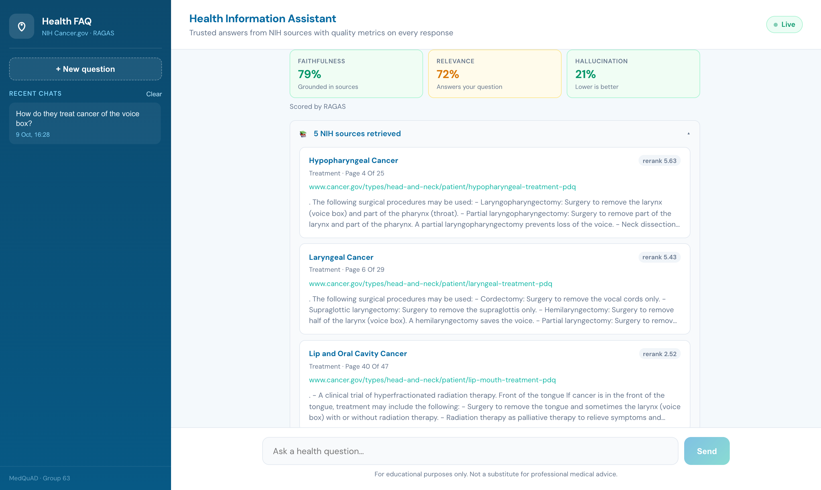






V4: metadata, guardrails and grounded answers
Two-stage retrieval
Metadata on every chunk
Retrieve 20, rerank, keep the best 5
Source URL, doc_type, topic and page drive the citation cards
Metadata filtering
Relevance guardrail
Chroma can filter by field, e.g. doc_type = "treatment"
Below 0.45 cosine similarity the bot gives a safe refusal
Live V4 answer: RAGAS scores, then 5 reranked NIH sources with topic, doc_type, page and URL
Grounded prompt
Quality on every answer
Answer only from context, cite each claim, add a disclaimer
RAGAS faithfulness, relevance and hallucination scores
Notes:
The metadata stored in Chroma (source, doc_type, topic, page) is what the UI shows on each source card, and Chroma supports filtering on it, for example doc_type='treatment'. The relevance threshold is the guardrail that produces safe refusals.

Slide 9





Deployment: how the app runs
ChromaDB
chroma_lc on disk
React UI
Vite · localhost:5173
FastAPI backend
/api/chat · /api/history
V4 RAG chain
LangChain LCEL
Cross-encoder
runs locally on CPU
Groq API
gpt-oss-120b
SQLite history
data/chat_history.db
Run it in three commands
1
run.py setup
2
run.py api
3
run.py web
+
Config
Creates .venv, installs packages, builds the Chroma index and test sets
Starts FastAPI with uvicorn on port 8000
Starts the React app; /api calls go to the backend
GROQ_API_KEY in .env (never committed). Streamlit demo: run.py streamlit
Notes:
The React front end calls the FastAPI backend. The backend runs the V4 chain: Chroma retrieval, local cross-encoder reranking, and generation on Groq. Every chat with its scores is stored in SQLite. Setup is one command; then the API and web app run in two terminals.

Slide 10
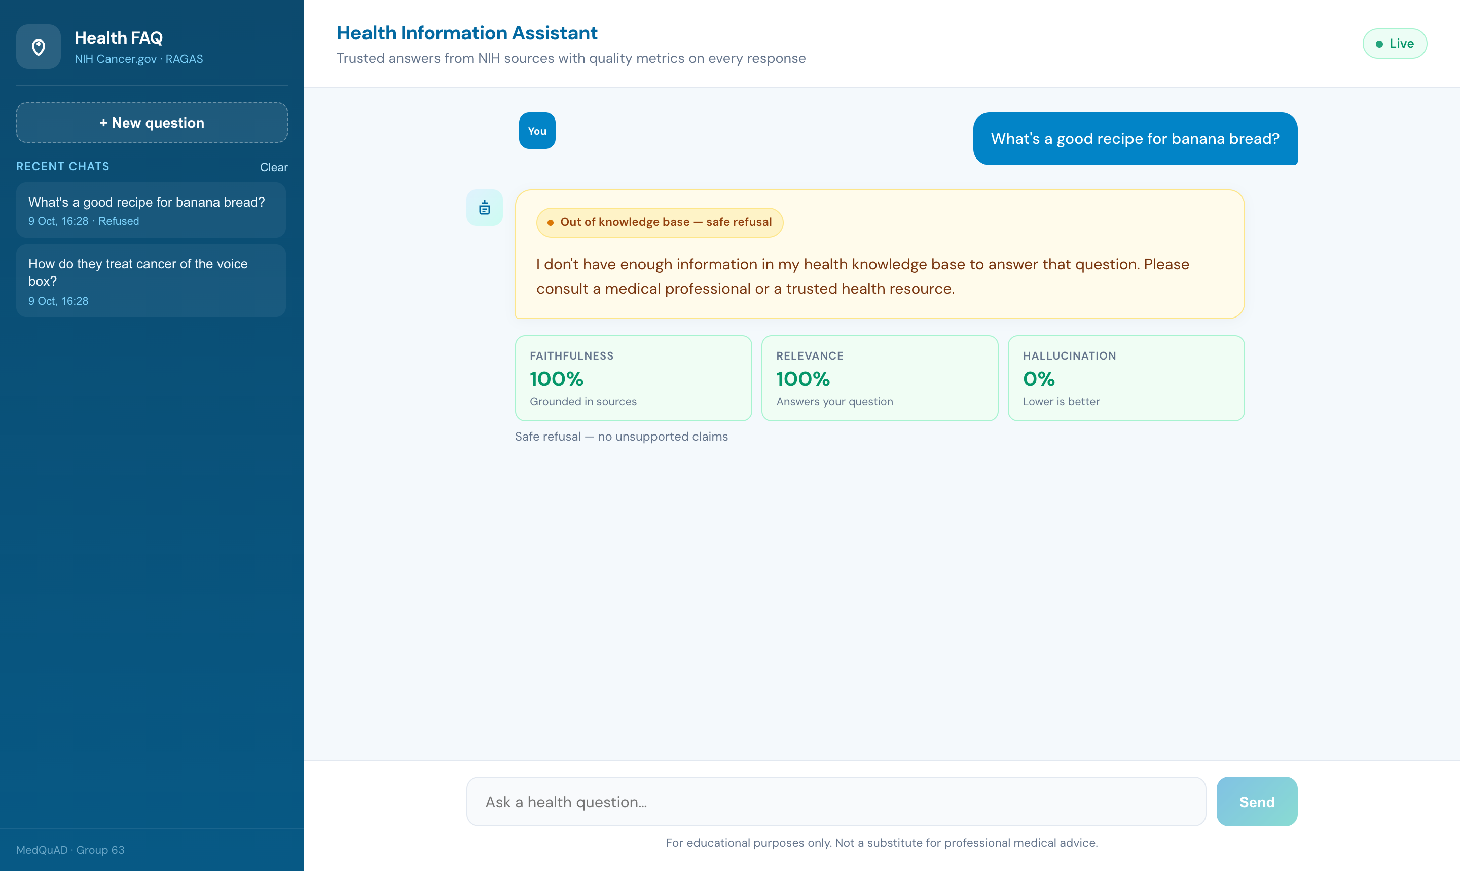


Monitoring
RAGAS on every answer
Faithfulness, relevance and hallucination (1 − faithfulness) shown under each reply. Falls back to word overlap if Groq rate-limits.
Chat history in SQLite
Question, answer, sources and scores saved; served by /api/history.
LangSmith tracing
With LANGSMITH_TRACING on, each run logs retriever, reranker, prompt, LLM, tokens and latency.
Every answer, including refusals, is scored and saved to the Recent Chats history
Stage timings
Median: retrieval ~61 ms, rerank ~57 ms, LLM ~1.3 s.
Notes:
Monitoring has four layers: live RAGAS scores per answer, persistent chat history in SQLite, optional LangSmith tracing of every chain step, and per-stage timings returned with each response.

Slide 11
Evaluation metrics
27 test questions: 22 cancer questions phrased the way users ask, each linked to its NIH answer, plus 5 off-topic questions.
Retrieval
Hit@5: right chunk in the top 5. MRR: how high it ranks. Precision@5: share of relevant chunks.
Metric | V1 | V2 | V3 | V4
Hit@5 | – | 96% | 96% | 96%
MRR | – | 0.820 | 0.820 | 0.744
Precision@5 | – | 53% | 53% | 56%
Answer accuracy | 82% | 86% | 86% | 84%
Wrong answers | 0 | 1 | 1 | 0
BERTScore F1 | 0.816 | 0.825 | 0.827 | 0.829
Off-topic refused | 3/5 | 5/5 | 5/5 | 5/5
Median response | 1.00 s | 1.29 s | 1.25 s | 1.41 s
Answer quality
LLM judge grades correct / partial / wrong against the NIH answer; BERTScore F1 for meaning overlap.
Safety
Off-topic questions correctly refused; in-scope questions wrongly refused.
Live (RAGAS)
Faithfulness, answer relevance, hallucination = 1 − faithfulness.
Notes:
Retrieval adds sources and safe refusals (5/5 vs 3/5) and lifts accuracy. V4 has the best precision and BERTScore and no wrong answers; V2/V3 edge it on judge accuracy (86% vs 84%) and MRR on this small test set. Response times include the Groq API call.

Slide 12


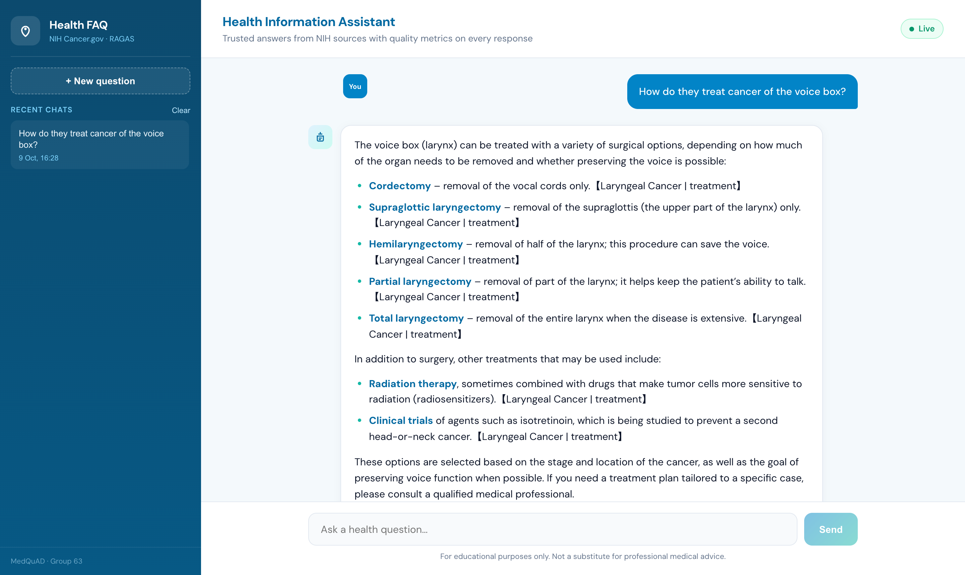



Real-time work and future scope
Future scope
Working today
Hybrid search Combine keyword (BM25) and vector search
Intent-based filters Detect "treatment" or "symptoms" and filter by doc_type
Cloud deployment Docker, managed hosting, HTTPS and login
Wider knowledge base All of MedQuAD beyond cancer, more languages
Follow-up questions Conversation memory across turns
Live web app answers in ~1.4 s with 5 NIH citations
Safe refusal for off-topic questions; RAGAS scores and history on every chat
Feedback loop User ratings and a larger test set
Notes:
Today: a working V4 app with grounded answers, citations, refusals, live RAGAS scores and history. Next: hybrid search, intent-driven metadata filters, cloud deployment, a wider knowledge base, conversation memory and a user feedback loop.

