Slide 1
Syntax Models and Syntactic Parsing
Daniel Marcu
http://www.isi.edu/~marcu/

Slide 2
Overview
Syntax
  I understand don’t words the come that of out mouth your.
Parsing
  Generative Models
    Models
    Decoding/Parsing
    Building Efficient Parsers
  Discriminative Models
  History-based Models
    Models
    Decoding/Parsing
Syntax-Based Language Models

Slide 3
Why Syntax? A linguist’s answer.
Lexical items (words) tell us the concepts.
Syntax tells how the concepts fit together to form more complex concepts and sentences that make sense.
Syntax studies the rules for forming admissible sentences

Slide 4
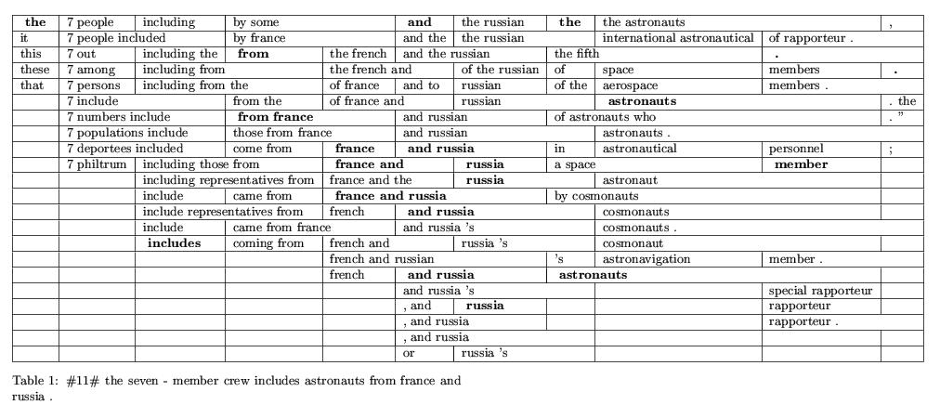
Why syntax? An MT researcher’s answer.
c1 c2 c3 c4 c5 c6 c7 c8 c9 c10 c11
Monotonic translation: the 7 include from france and russia astronauts .

Slide 5
Why syntax? An MT researcher’s answer.
The 7 include from france and russia astronauts . [include COMPL]
The 7 astronauts include from france and russia .
The include 7 astronauts from france and russia . [the NOUN]
The 7 include astronauts from france and russia . [ok]
The 7 include astronauts and france from russia . [ok syntactically, not-ok semantically]
The 7 include men and women from russia . [ok]

Slide 6
Different words and word classes have different acceptable behaviors
he enjoys to music listening: he enjoys what
enjoys he listening to music: enjoys he???
he listening to music enjoys: he listening??
he enjoys what?
he enjoys listening to music ok
S
NP
VP
PRO
VBZ
NP
he
enjoys
SBAR
VBG
VP
listening
P
NP
to
music

Slide 7
Parts of Speech Classes – Good abstractions for characterizing “local” constraints.
Noun (NN, NNS): singular and plural; “The _____ is ...”
Verb (VB, VBP, VBZ, VBD, VBN, VBG):
go, go, goes, went, gone, going; “_____-ing”
Adjective (JJ, JJR, JJS): good, better, best; “The ____ thing is ...”
Adverb (RB, RBR, RBS): rapidly, faster, fastest; often “____-ly”
Pronoun (PP): I, you, he, she, it, we, they, ...
Determiner (DT): a, the, ...
Preposition, subordinate conjunction (IN): of, in, to, during, if, before, ...
Particles (RT): out, up, ...
Coordinating conjunction (CC): and, or, but, so
OPEN CLASS
CLOSED CLASS
Slide from Jerry Hobbs (CS544)

Slide 8
Syntactic constituents: good abstractions for characterizing global constraints.
A sentence usually consists of a noun phrase (NP) followed by a verb phrase (VP).
A VP consists of a verb (VB) followed by a noun phrase (NP)
A noun phrase (NP) consists of a determiner (DT), adjective (ADJ), noun (NN) and relative clause (S-REL).

Slide 9
Basic Clause Structure
Subject
Abstract these rules:
Add argument on left.
Add argument on right.
PP --> P NP (in California)
S --> NP VP John [likes Mary]
VP --> V NP likes Mary
Object / Complement
Head
S
NP
VP
(S1 (S (NP (NNP John)
(VP (VPZ likes)
(NP (NNP Mary))))
(. .))
V
NP
John likes Mary
Slide from Jerry Hobbs (CS544)

Slide 10
The Structure of the VP
More than just VP --> V NP
There are lots of possible complements: 1st Compl 2nd Compl
Bond prices soared. ---
He sponsors terrorism. NP
She gave John the book. NP NP
They rely on the U.S. PP[p=on]
He gave up. RP[p=up]
Figure out the solution / Figure it out. RP[p=out] NP
He cut a deal with the devil. NP PP
He shouted that he was right. (that) S
He told me that he was right. NP (that) S
He tends to amuse us. VP[vform=inf]
Let us know if you need it. PP[p=if]
Different verbs subcategorize for different complements.
Slide from Jerry Hobbs (CS544)

Slide 11
The Structure of the NP
the three tall government buildings in Chicago that I saw
left modifiers
head noun
right modifiers, noun complements
noun group
the three tall gray U.S. government buildings
determiners,
numbers,
quantifiers
prenominal
nouns
adjectives
head noun
In this order.
Slide from Jerry Hobbs (CS544)

Slide 12
Want to quickly learn more about syntax?
See Jerry Hobbs’s CS544 Lecture Notes
(http://www.isi.edu/natural-language/teaching/cs544/2004.html)
  The syntax of the clause
  The syntax of the noun phrase
  Other issues in syntax: adjuncts, conjunction, comparatives.

Slide 13
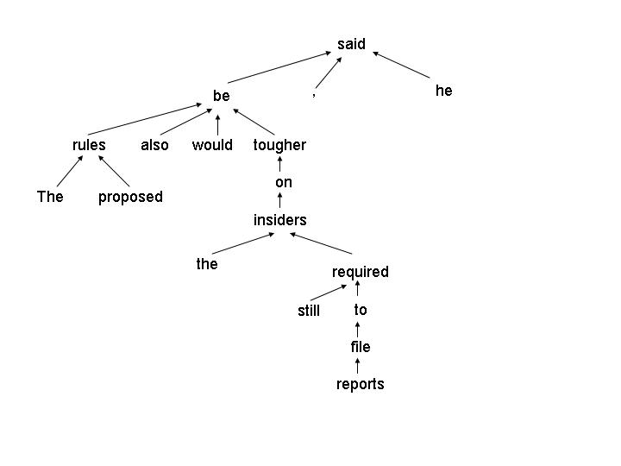
Disclaimer
Penn Treebank style phrase-structure representations are consistent with only one of the many syntactic theories around…
  Dependency grammars
  Functional/systemic grammars
  Categorial grammars
  …
Note: large annotated corpora have had a significant impact on our field [Marcus et al., 1993]

Slide 14
Parsing

Slide 15
Treasury Secretary Nicholas Brady said that Congress should grant the Securities and Exchange Commission the power to close the stock markets in periods of crisis.
( (S
(NP-SBJ (NNP Treasury) (NNP Secretary) (NNP Nicholas) (NNP Brady) )
(VP (VBD said)
(SBAR (IN that)
(S
(NP-SBJ (NNP Congress) )
(VP (MD should)
(VP (VB grant)
(NP (DT the) (NNPS Securities)
(CC and)
(NNP Exchange) (NNP Commission) )
(NP (DT the) (NN power)
(S
(NP-SBJ (-NONE- *) )
(VP (TO to)
(VP (VB close)
(NP (DT the) (NN stock) (NNS markets) )
(PP-TMP (IN in)
(NP
(NP (NNS periods) )
(PP (IN of)
(NP (NN crisis) )))))))))))))
(. .) ))

Slide 16
“This raises questions whether futures and equity margin requirements are consistent at these levels and whether future margins are adequate,” Mr. Brady said.
( (S
(S-TPC-1 (`` ``)
(NP-SBJ (DT This) )
(VP (VBZ raises)
(NP (NNS questions)
(SBAR
(SBAR (IN whether)
(S
(NP-SBJ (NNS futures)
(CC and)
(NN equity) (NN margin) (NNS requirements) )
(VP (VBP are)
(ADJP-PRD (JJ consistent) )
(PP-LOC (IN at)
(NP (DT these) (NNS levels) )))))
(CC and)
(SBAR (IN whether)
(S
(NP-SBJ (NNS futures) (NNS margins) )
(VP (VBP are)
(ADJP-PRD (JJ adequate) )))))))
(, ,) ('' '') )
(NP-SBJ (NNP Mr.) (NNP Brady) )
(VP (VBD said)
(S (-NONE- *T*-1) ))
(. .) ))

Slide 17
Evaluation
Labeled recall/precision against a gold standard
  Section 23, Penn Treebank

Slide 18
How can we build a parser
Write grammar rules by hand and develop parsing algorithms that given a sentence and a set of rules produce all parse trees of that sentence.
  Potential problems:
    How do we choose between different parse trees?
      “For each plant give the ratio of 1973 to 1972 figures for each type of production cost and overhead cost.”
      This sentence has 692 parse trees. (PP attachment is highly ambiguous)

Slide 19
How can we build a parser
Write grammar rules by hand…
Potential problems:
  How can we ensure that we write complete-enough grammars?
    Penn Treebank – 43,000 sentences
    Sections 2-21 yield 12,409 grammar rules
# of rules occurrences | # of rules | Percent | # of rules occurrences | # of rules | Percent
> 100 times | 439 | 3.54 | 5 times | 329 | 2.65
51..100 times | 204 | 1.64 | 4 times | 457 | 3.68
21..50 times | 501 | 4.04 | 3 times | 695 | 5.60
11...20 times | 496 | 4.00 | 2 times | 1688 | 13.60
6..10 times | 835 | 6.73 | 1 time | 6765 | 54.52

Slide 20
Generative Models for Parsing

Slide 21
Generative models: P(T,S)
Estimate the probability of generating a sentence S that has a parse tree T.
T and S are generated incrementally, by applying a sequence of stochastic steps.
TOP
S
NP NP VP
N
N
VB NP
N
Yesterday
IBM
bought
Lotus

Slide 22
The PCFG Model: Generative Process
Estimate the probability of generating a sentence S that has a parse tree T.
T and S are generated incrementally, by applying a sequence of stochastic steps.
TOP
P(T,S) =
P(TOP → S | TOP) x
S
P(S → NP NP VP | S) x
NP NP VP
P(NP → N | NP) x
P(N → Yesterday | N) x …
N
N
VB NP
N
P(VP → VB NP | VP) x …
Yesterday
IBM
bought
Lotus

Slide 23
GO TO PCFG HANDOUT!!!

Slide 24
The PCFG Model: Parameter estimation
Given a Corpus, what is the PCFG grammar G for which
P(Corpus | Parameters of the G)
is maximal?
What are the values of the parameters P(α →β | α) that maximize the likelihood of the corpus?
Count(α →β)
P(α →β | α) =
Count(α)
See [Michael Collins, PhD Thesis, 1999]
Performance: ~70/74% labeled recall/precision [Charniak, 1997].

Slide 25
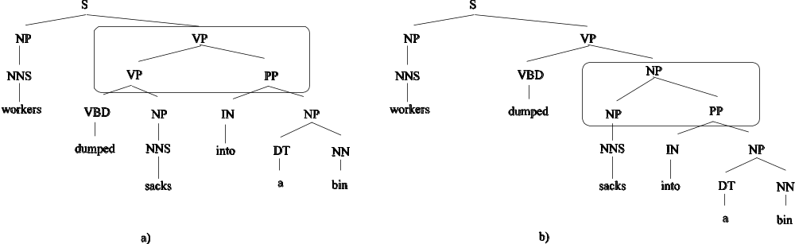
Problem with PCFG: Lack of sensitivity to lexical context
In the Penn Treebank, 52% of the PP attachments are noun attachments.
In all cases, parses of type (b) have higher probability.
And the solution is…

Slide 26
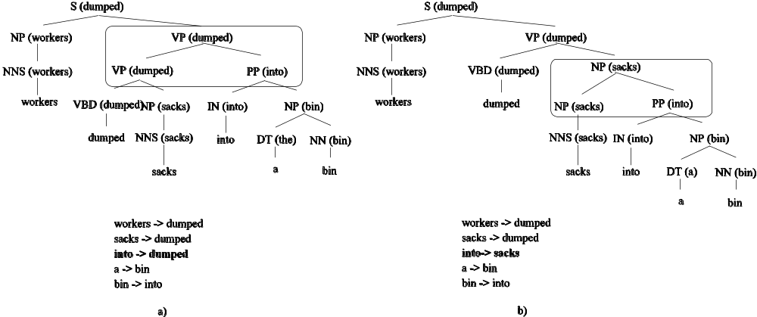
Lexicalized models of syntax
P(VP(dumped) → VP(dumped) PP(into)) > P(NP(sacks) → NP(sacks) PP(into))
Problem: Lexicalized rules are too fine grained;
would need billions of examples to train.

Slide 27
Collins’ Model
TOP
S(bought,VBD)
NP(Yesterday,NN)
NP(IBM,NNP)
VP(bought,VBD)
NN(Yesterday,NN)
NNP(IBM,NNP)
VBD(bought,VBD)
NP(Lotus,NNP)
Yesterday
IBM
bought
NNP(Lotus,NNP)
Lotus

Slide 28
Collins’ Model 1: Horizontal Grammar Markovization
TOP
S(bought,VBD)
NP(Yesterday,NN)
NP(IBM,NNP)
VP(bought,VBD)
NN(Yesterday,NN)
NNP(IBM,NNP)
VBD(bought,VBD)
NP(Lotus,NNP)
Yesterday
IBM
bought
NNP(Lotus,NNP)
Lotus
P_{TOP}(S(bought,VBD) | TOP) x
P_{l}(STOP | S,bought,VBD,VP) x
Pr(STOP | S,bought,VBD,VP) x
P_{h}(VP | S,bought,VBD) x
P_{l}(NP(IBM) | S,bought,VBD,VP) x
P_{l}(NP(Yesterday) | S,bought,VBD,VP) x

Slide 29
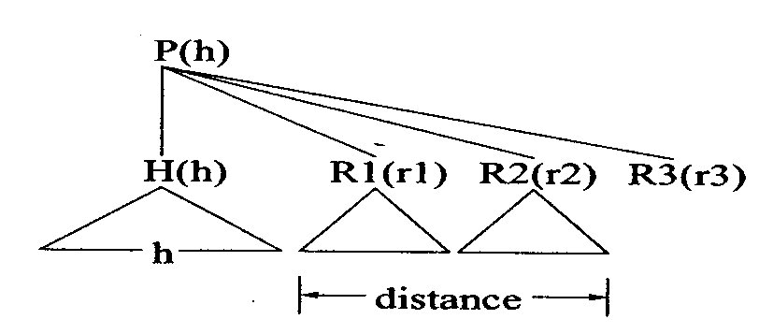
Collins’ Model 2
Model 1: P_{l}(L_{i}(l_{i}) | H,P,h,L₁(l₁)...L_{i-1}(l_{i-1})) ~ P_{l}(L_{i}(l_{i}) | H,P,h)
English has a right branching structure (preference for dependencies between adjacent words)
  P_{l}(L_{i}(l_{i}) | H,P,h,L₁(l₁)...L_{i-1}(l_{i-1})) ~ P_{l}(L_{i}(l_{i}) | H,P,h, distance_{l}(i -1))
  P_{r}(R_{i}(r_{i}) | H,P,h,R₁(r₁)...R_{i-1}(r_{i-1})) ~ P_{r}(R_{i}(r_{i}) | H,P,h, distance_{r}(i -1))
  distance_{l,r} are functions of the surface string below the previous modifiers
    Does the string have length 0?
    Does the string contain a verb?

Slide 30
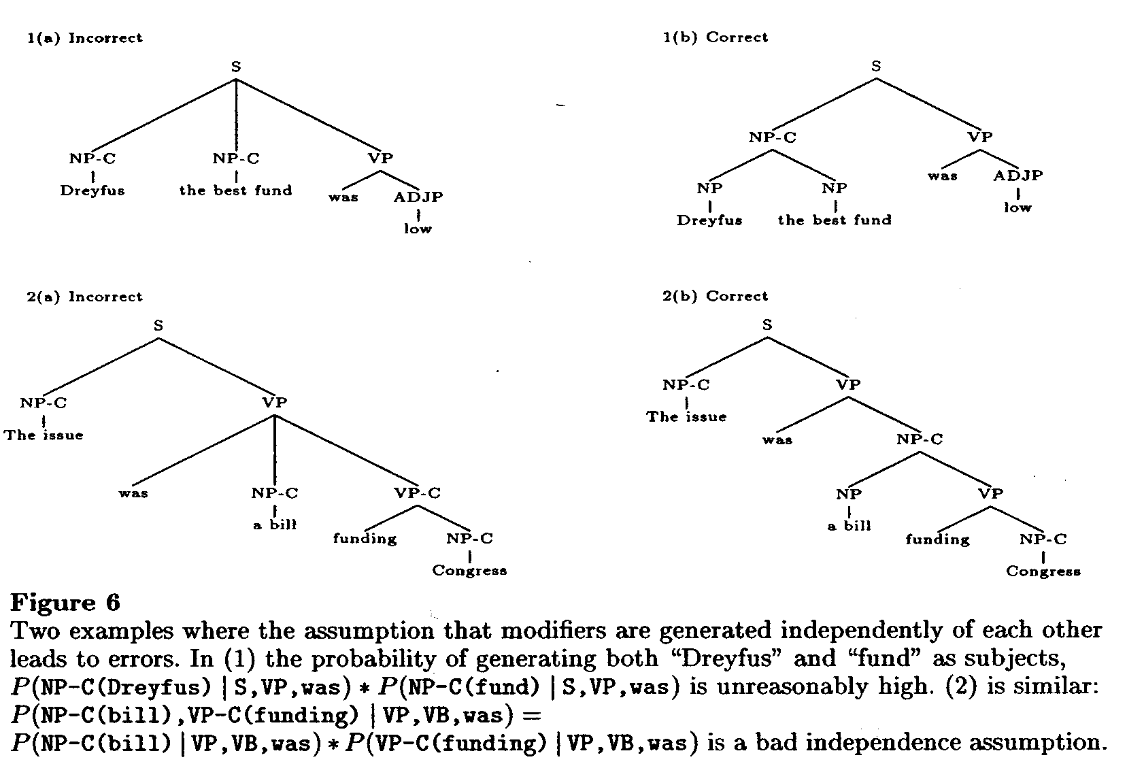
Collins Model 2:Subcategorization frames

Slide 31
Modified generative story (incomplete).
1. Choose a head H with probability P_{h}(H | P, h).
2. Choose left and right subcat frames, LC and RC, with probabilities
P_{lc}(LC | P, H, h) and P_{rc}(RC | P, H, h). Each subcat frame is a multi-set
specifying the complements that the head requires in its left or right modifiers.
3. Generate the left and right modifiers with probabilities
P_{l}(Li(li) | H,P,h, distance_{l}(i -1),LC) and
P_{r}(R_{i}(r_{i}) | H,P,h,distance_{r}(i - 1), RC) respectively.
As complements are generated they are removed from the appropriate subcat
multi-set.
S(bought) → NP(Yesterday) NP-C(IBM) VP(bought)
P_{h}(VP | S, bought) x P_{lc}( {NP-C} | S,VP,bought) x P_{rc}({} | S,VP,bought) x
P_{l}(NP-C(IBM) | S,VP,bought,{NP-C}) x P_{l}(NP(Yesterday) | S,VP,bought,{}) x
P_{l}(STOP | S,VP,bought, {}) x P_{r}(STOP | S,VP,bought, {})

Slide 32
Collins’s Model
See Collins’ 2003 Computational Linguistics Paper for the entire generative story
(http://www.ai.mit.edu/people/mcollins/publications.html)
[Bikel, 2003] Tech Report – Intricacies of Collins’ Parsing Model.
Parameter Estimation: maximum likelihood estimation from the Penn Treebank, with heavy reliance on smoothing (3 levels of smoothing).
Performance: 88.0/88.3% (88.6/88.7%) labeled recall/precision on sentences < 100 words (40 words).

Slide 33
Discriminative models
Use a generative model to produce n-best lists of parse trees
Use a direct model with a much more sophisticated set of features to re-rank the trees in the n-best list.
  [Michael Collins, ICML-2000]
  [Michael Collins and Nigel Duffy, ACL-2002]
  [Charniak and Johnson, 2005]
Performance: 89.6/89.5% (90.1/90.1%) labeled recall/precision on sentences < 100 words (40 words).

Slide 34
How important is lexicalization?
[Klein and Manning, 2003]
PCF rules read off the Penn Treebank are inadequate
  Category symbols are too coarse: NP subjects are 8.7 more likely than NP objects to expand into pronouns
    Solution: have separate symbols for subject/object NPs; rewrite NPs with S parents (subjects) as NP^S and NPs with VP parents as NP^VP [Johnson, 1998]
  Many rules have been seen only once
    Solution: Markovize the grammar horizontally (Collins) and vertically (Johnson).
  Parent annotations: capture constituent-external constraints
  Lexical annotations: capture constituent-internal constraints
Vertical Markovization increases the performance from ~72.5% labeled recall/precision to ~79%.

Slide 35
Klein and Manning, 2003 (cont)
Take the corpus rewriting task seriously
  Mark unary rules with a special symbol: Unary-DT, Unary-RB (as well vs. also)
  Exploit additional annotations in the Treebank (Gapped-S)
  Annotate constituents to distinguish between different external environments (possessive, base NPs)
  Annotate constituents to better capture long-distance attachment preferences
Performance: 85.1/86.3% (85.7/86.9) labeled recall/precision on sentences that are <100 (<40) words long.
The generative story is non-lexicalized PCFG – just use more non-terminal symbols.

Slide 36
Matsuzaki et al. (2005) – How important is human analysis? (Parsing with latent variables)
TOP
TOP
S₁
S
NP₄ NP₂ VP₅
NP NP VP
N₂
N₁
VB₂ NP₁
N
N
VB NP
N₇
N
Yesterday
IBM
bought
Yesterday
IBM
bought
Lotus
Lotus
Assume there are n types for each category (16 max.)
The types are hidden, but the probability of grammar rules with
  hidden types can be learned via EM
Yields good performance: 86.0/86.1% (86.7/86.6) labeled
recall/precision on sentences that are <100 (<40) words long

Slide 37
Petrov et al. (2006) – How important is human analysis? (Parsing with non-fixed # of latent variables)
Assume there are up to n types for each category (16 max.)
The types are hidden, but the probability of grammar rules with
  hidden types can be learned via EM and a combination of hierarchical splitting and merging of categories.
  EM training is efficient for both Matsuzaki and Petrov because the structure is fixed.
Yields good performance: 89.6/89.8% (90.0/90.3) labeled recall/precision on sentences that are <100 (<40) words long

Slide 38
The Directed Oriented Parsing Model
[Bod et al., 2003]
TOP
S
NP NP VP
N
N
VB NP
N
Yesterday
IBM
bought
Lotus

Slide 39
“Generative story” for the DOP “model”
TOP
The same linguistic
representation can be
generated by several
different combinations
of fragments.
S
NP NP VP
N
N
VB NP
N
Yesterday
IBM
bought
Lotus
P(TOP → S | TOP)
P(N → Lotus | N)
P(S → (S (NP
NP
(VP (VB bought)
(NP N))) | S)
P(NP → (NP (N IBM)) | NP)
P(NP → (NP (N Yesterday)) | NP)

Slide 40
The DOP “model”
P(t₁ º t₂ º … º t_{n}) = ∏_{i} P(t_{i})
P(T) = ∑_{d} ∏_{i} P(t _{id})
| t |
P(t) =
∑ _{t’ : r(t’) = r(t)} | t’ |
The original DOP estimator is biased and inconsistent [Johnson, 2002]
  As the corpus size increases, the corresponding sequence of probability distributions estimated by the DOP model does not converge to the true distribution that generated the training data.
Other estimators for the DOP model exist [Bonnema et al., 1999; Bod, 2000].
Performance: 90.7/90.8% labeled recall/precision on sentences < 100 words long [Bod, EACL2003].

Slide 41
Summary Results Generative Models
Who/When | Method | Labeled Recall | Labeled Precision
Charniak, 1997 | Lexicalized PCFG | 86.7 | 86.6
Collins, 1999 | Markovized, head-driven, history based | 88.1 | 88.3
Henderson and Brill, 2000 | [Collins, 1999] + bagging | 89.5 | 88.8
Charniak, 2000 | Markovized, Head-driven + maximum entropy | 89.6 | 89.5
Collins, 2000 | [Collins, 1999] + reranking | 89.6 | 89.9
Charniak and Johnson, 2005 | [Charniak, 2000] + reranking | 89.6 | 89.5
Klein and Manning, 2003 | Unlexicalized PCFG – manual assignment of categories | 85.1 | 86.3
Matsuzaki et al., 2005 | Unlexicalized PCFG with fixed number of latent variables | 86.0 | 86.1
Petrov et al., 2006 | Unlexicalized PCFG with variable number of latent variables | 89.6 | 89.8

Slide 42
Decoding/Parsing
argmax _{T} P(T | S)
= argmax _{T} P(T,S) / P(S)
= argmax _{T} P(T,S)

Slide 43
Bottom-up parsing
CNF grammar: k → k1 k2, k → w_{i}
p[i,j,k] – max prob of constituent k spanning words i..j
b[i,j,k] = {m,k1,k2} – backpointer to rule used to derive k
for i = 1..n // base case
for k = 1..G
if k → w_{i} ∊ G then p[i,i,k] = P(k → w_{i} | k)
for s = 2..n // bottom up
for i = 1..(n-s+1)
j = i + s – 1;
for m = i..(j – 1)
for k = 1..G
if(k → k1 k2 ∊ G ∧ p[i,m,k1] > 0 ∧ p[m+1,j,k2] > 0)
prob = p[i,m,k1] × p[m+1,j,k2] × p(k → k1 k2 | k)
if(prob > p[i,j,k])
p[i,j,k]) = prob
b[i,j,k] = {m,k1,k2}
end all for loops
O(n³ |G| )

Slide 44
Faster parsing using PCFG-like models
The chart: a data structure that contains completely parsed constituents that may appear in the final parse tree. Initially, the chart is empty.
The agenda: a data structure that contains a list of constituents that have not been combined yet with other constituents. Initially, the agenda contains the terminal symbols (POS tags).
Algorithm:
  While (complete parse tree not found)
  · remove constituent c from agenda and add c to chart
  · use the rules of the grammar to combine c with other constituents in the chart and add new constituents (edges) to the agenda.
  Note: The bottom-up algorithm used no agenda.

Slide 45
The art of parsing is
The art of choosing the agenda constituents that need to be explored first
  Keep constituents in the agenda sorted according to a Figure of Merit, which reflects the likelihood that a constituent will end up in the final parse tree.
The art of not adding to the agenda/chart constituents that are unlikely to be useful
  Use a Beam: add constituents only when they are not very bad, i.e., when P(new_c) > P(best_c)/B.

Slide 46
Figures of Merit
[Caraballo and Charniak, CL1998]
Ordering agenda constituents according to their inside probability β(N^{i}_{j,k}) = p(N^{i}_{j,k} | t_{0..n}) is a bad idea (non-terminal of type N^{i} spanning positions j to k over the input sequence t_{0..n})
  “Small” non-terminals are always preferred over “large” non-terminals.
Solutions
  Normalized β: β(N^{i}_{j,k}) ^{1/(k-j)}
  Trigram estimate (prob of a constituent to subsume a certain tag sequence)
    p(N^{i}_{j,k} | t_{0..n}) = p(N^{i}) × β(N^{i}_{j,k}) / p(t_{j,k} | t_{j-2}, t_{j-1})
  Prefix estimate (prob of a constituent to appear in the context of the preceding tags)
    p(N^{i}_{j,k} | t_{0..n}) ≈ p(N^{i}_{j,k}, t_{0,j}) × β(N^{i}_{j,k}) / p(t_{0,k})

Slide 47
Figures of merit and PCFG binarization [Charniak et al., 1998]
p(N^{i}_{j,k} | t_{j-1}) β(N^{i}_{j,k}) p(t_{k} | N^{i}_{j,k})
p(N^{i}_{j,k} | t_{0..n}) ≈
p(t_{j,k} | t_{j-1}) p(t_{k} | t_{k-1})
  p(N^{i}_{j,k} | t_{j-1}) and p(t_{k} | N^{i}_{j,k}) can be directly estimated during training
  P(t_{j,k} | t_{j-1}) ≈ ∏_{i=j,k} p(t_{i} | t_{i-1})
  β(N^{i}_{j,k}) is approximated with the prob of the best parse tree (not the sum of all parses)
  Scale down the bitag probabilities (n-gram probs are typically lower than PCFG probs).
Binarize the grammar
  VP → V NP NP PP : 0.7
    VP → V-NP-NP* PP : 0.7
    V-NP-NP* → V-NP* PP : 1.0
    V-NP* → V NP : 1.0

Slide 48
Other means to speed up parsing [Goodman,1997]
Local beam thresholding:
  Keep only constituents for which P(new_c) > P(best_c)/B
    Use P(N^{i}) β(N^{i}_{j,k}) instead of β(N^{i}_{j,k}) to compute P(c)
    P(N^{i}) approximates the outside probability
Global beam thresholding
  Keep only non-terminals that are part of a sequence of reasonably probable non-terminals covering the whole sentence
  Keep only constituents for which P(L_{new_c}) > P(L)/B
    P(L_{new_c}) ~ the prob of the most probable sequence that contains L_{new_c}
    P(L) ~ the prob of the most probable sequence
  Global beam thresholding can eliminate bad cells/non-terminals altogether.
  The algorithm for computing the global beam thresholds is O(n³), so the end-to-end parsing algorithm is still O(n³ |G|),
Multiple-pass parsing

Slide 49
Parsing with admissible heuristics
[Klein and Manning, 2003]
The use of FOM and Beam pruning does not guarantee that parsers find the optimal parse trees.
A* search uses admissible heuristics to estimate future costs. A heuristic a is admissible if
  It does not underestimate the cost of completing a parse tree (a > α)
  It is monotonic (β + a never increases as the tree is built)
Klein and Manning propose a set of pre-computable, admissible heuristics
Parsing as before but sort edges in the agenda according to β + a (not FOM(edge)).

Slide 50
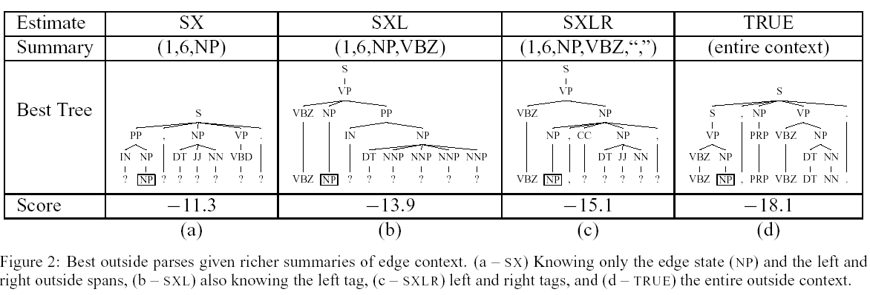
A* Parsing
Estimate types
  Estimates on G (see above)
  Estimates on projections of G (multi-pass parsing).
The admissible heuristics lead to 90% reduction in the number of edges required to produce an optimal parse tree.

Slide 51
State of the art
Best/fastest parsers use
  Figures of merit
  Beam thresholds
  Binarized grammars
These parsers are several orders of magnitude faster than straightforward parser implementations.

Slide 52
Parsing with lexicalized grammars
Charniak
  Multi-pass parsing
    Use fast, binarized PCF parsing with FOM heuristics to over-generate PCF-like structures
    Re-score these structures using a lexicalized model
Collins
  Modify chart parsing algorithm to enable it to handle the horizontal Markovization the model employs

Slide 53
Parsing in Collins’ Model
Edges: contain all needed structural/lexical information
  Type (terminal/nonterminal); Label; Head label; Head word; Start, end position; Left and right context (adjacency and verb flags); Stop – true if edge complete; Probability; Children (linked list).
Operations on edges:
  Join_2_edges_follow(e1,e2) → e3(e1.head) = e1.e2
  Join_2_edges_precede(e1,e2) → e3(e2.head) = e1.e2
  Add_singles(e) – add to chart all possible edges containing a unary rule with e as the head child
  Add_stops(e) – close edge

Slide 54
Algorithm
initialize() //add stopped and non-stopped edges for all POS tags
for span = 2 to n
for start = 1 to n – span + 1
end = start + span – 1;
complete(start, end);
X = edge in chart[1,n,TOP] with highest probability
complete(start,end)
for split = start to end – 1
foreach e1 in chart[start,split] such that e1.stop = false
foreach e2 in chart[split+1,end] such that e2.stop == true
join_2_edges_follow(e1,e2)
foreach e1 in chart[start,split] such that e1.stop = true
foreach e2 in chart[split+1,end] such that e2.stop == false
join_2_edges_precede(e1,e2)
add_singles_stops(start,end)
Figures of Merit and Beam Search are used by Collins too.

Slide 55
Parsing with the DOP model
[Bod,1992-2002]
Method 1
  Each subtree t is converted into a CFG rule r
    (S (NP NP (VP (VB bought) (NP N))))
    S → NP NP bought N
  Each rule is stored in a DB and accessed via an index
  DOP parsing is PCFG parsing with tree reconstruction via DB access
  A large sample of parse trees is constructed via multiple derivations D. Each derivation d ∊D has a probability p(d)
  Best parse is the one that maximizes ∑_{d ∊ D} p(d)
  Speed: 200 sec/WSJ sentence.

Slide 56
Parsing with the DOP model
[Goodman,1996,2002; Bod,2003]
Given a corpus, Goodman gives a method for producing a PCFG grammar G that has the following properties:
  G generates the same strings with the same probabilities as DOP.
  G generates the same trees with the same probabilities as DOP (one still has to sum over several PCFG trees)
  G is O(n) in the size of the corpus: it contains at most 8 PCFG rules for each node in the corpus.
Parsing in DOP
  PCFG Parsing to generate top 10,000 most probable derivations.
  Each derivation d has a probability p(d)
  Best parse is the one that maximizes ∑_{d ∊ D} p(d)
  Speed: 3.6 sec/WSJ sentence [Bod, EACL-2003].

Slide 57
History-based models

Slide 58
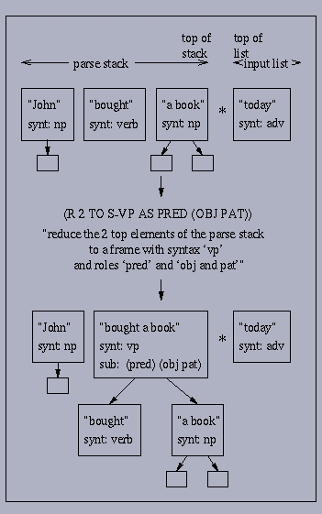
Decision-based parsing
Modeling
  P(T | S) = P(d₁, d₂, …, d_{n,}| s)
= ∏_{i=1,n} P(d_{i} | d₁ … d_{i-1} ,s)
Parsing
  P(T | s) = argmax_{D} (P(D | s))
  ~ argmax(∏_{i=1,n} P(d_{i} | Φ(d₁ … d_{i-1},s))
Data points
  [Magerman, 1995]: decision trees learning; stack-based search over many trees.
  [Hermjakob and Mooney, 1997]: C4.5 learning, one pass, one tree.
  [Ratnaparkhi,1997]: ME-based learning with 3 passes: POS tagging, CHUNKing, tree building; top-k trees explored.
  [Hopkins and Kuhn, 2006]: generic framework; decouples framework from learning; branch and bound search leads to very fast parsing algorithm.

Slide 59
Syntax-Based Language Models

Slide 60
Basic Idea
What we want:
  P(S) = ∑_{T} P(T,S)
What we use:
  P(S) = argmax _{T} P(T | S)
ASR in retrospective
  It took ASR researchers 25 years to benefit from syntax-based LMs [Chelba and Jelinek, 1998]
  SBLMs are still used only in research systems because the cost does not justify the gain (computationally expensive)
  Using SBLMs in ASR is hard due to left-to-right processing constraint: P_{SBLM} (w _{i} | w₁ … w_{i-1})
  See the papers by Chelba, Roark, Charniak.

Slide 61
MT Story
The good
  We can work with full sentences (left-to-right constraint is not a factor)
  Time is not a major concern – this summer!!!
  Intuitively, SBLMs give us a means to tackle the word-reordering problem.
The bad
  Short sentences are preferred.
  Incorporating SBLMs within SMT systems is hard.
The ugly
  SBLMs were developed for parsing (everything we process is good English!!!) [Och et al., 2003]
  Loose SBLMs lead to structures that do not look at all like parse trees [Thayer, 2003-2004].
  Tight SBLMs lead to grammatical outputs with possibly incorrect semantics [Charniak, Knight, Yamada, 2003].

Slide 62
References (http://acl.ldc.upenn.edu/)
Bikel, 2003. Intricacies of Collins’ Parsing Model. Computational Linguistics, 20 (4), pp. 479-511. (http://www.cis.upenn.edu/~dbikel/papers/collins-intricacies.pdf)
Bod, 2003. An Efficient Implementation of a New DOP Model, EACL-2003. (http://turing.wins.uva.nl/~rens/)
Bod et al., 2003. Data-Oriented Parsing. CSLI Publications, University of Chicago Press.
Caraballo and Charniak, 1998. New figures of merit for best-first probabilistic chart parsing. Computational Linguistics , 1998. (http://www.cs.brown.edu/people/ec/#publications)
Charniak, 1997. Statistical parsing with a context-free grammar and word statistics, AAAI-1997 (http://www.cs.brown.edu/people/ec/#publications)
Charniak et al., 1998. Edge-based best-first chart parsing, VLC-1998.
Charniak 2000. A Maximum-Entropy-Inspired Parser. ACL-2000.
Charniak, 2001. Immediate-Head Parsing for Language Models. ACL-2001.
Charniak et al.,2003. Syntax-based Language Models for Machine Translation, MT Summit-2003.
Charniak and Johnson, 2005. Coarse-to-fine n-best parsing and maxent discriminative reranking. In ACL’2005, pp. 173-298.
Chelba, 2000. Structured Language Modeling Computer Speech and Language (2000), 14 (http://research.microsoft.com/~chelba/publications/publications.html)
Collins, 1999. Head-Driven Statistical Models for Natural Language Parsing. PhD Dissertation, University of Pennsylvania, 1999. (http://www.ai.mit.edu/people/mcollins/publications.html)

Slide 63
References
Collins, 2000. Discriminative Reranking for Natural Language Parsing. ICML-2000.
Collins and Duffy, 2002. New Ranking Algorithms for Parsing and Tagging: Kernels over Discrete Structures, and the Voted Perceptron. ACL-2002.
Collins, 2003. Head-Driven Statistical Models for Natural Language Parsing. Computational Linguistics, 2003.
Goodman, 1997. Global thresholding and multiple-pass parsing, EMNLP-1997. (http://research.microsoft.com/~joshuago/publications.htm)
Goodman, 2002 (1996). Efficient Parsing of DOP with PCFG-reductions in Data Oriented Parsing, Rens Bod, Khalil Sima'an, and Remko Scha, editors, CSLI, 2002.
Hermjakob and Mooney, 1997. Learning Parse and Translation Decisions from Examples with Rich Context, ACL-1997. (http://www.isi.edu/~ulf/diss_abstract.html)
Hobbs, 2004. CS544 Lecture Notes.
(http://www.isi.edu/natural-language/teaching/cs544/2004.html).
Hopkins and Kuhn (2006). Exploiting the Potential of Intractable Parsers. ACL-2006.
Johnson, 2002. The DOP estimation method is biased and inconsistent. Computational Linguistics 28(1), pages 71-76. (http://www.cog.brown.edu/~mj/Publications.htm)
Klein and Manning, 2003. Accurate Unlexicalized Parsing, ACL-2003. (http://www.stanford.edu/~danklein/#Publications)
Klein and Manning, 2003. A* Parsing: Fast Exact Viterbi Parse Selection. HLT-NAACL03.
Magerman, 1995. Statistical Decision-Tree Models for Parsing, ACL-1995. (http://www-cs-students.stanford.edu/~magerman/pubs.html)

Slide 64
References
Marcus et al., 1993. Building a large annotated corpus of English: the Penn Treebank.'' Computational Linguistics, Vol.19, 1993.
Matsuzaki et al., 2005. Probabilistic CFG with latent annotations. ACL’05, pp.75-82.
Petrov et al., 2006. Learning Accurate, Compact, Interpretable Tree Annotation. ACL’06, pp. 433-440.
Ratnaparkhi, 1997. A Linear Observed Time Statistical Parser Based on Maximum Entropy Models. EMNLP-97. (http://www.cis.upenn.edu/~adwait/statnlp.html)
Roark. 2001. Probabilistic top-down parsing and language modeling. In Computational Linguistics, 27(http://www.research.att.com/~roark/papers_cv.html)

