Slide 1
Location, Location, Location

Slide 2

This expression is common, but how much stock should you put into it?
Let's use about 1000 venues in the New York area to find out.

Slide 3


Who is interested?
Any business owner looking into relocating

Slide 4

The Data
Venue locations and ratings pulled from Foursquare's API

Slide 5
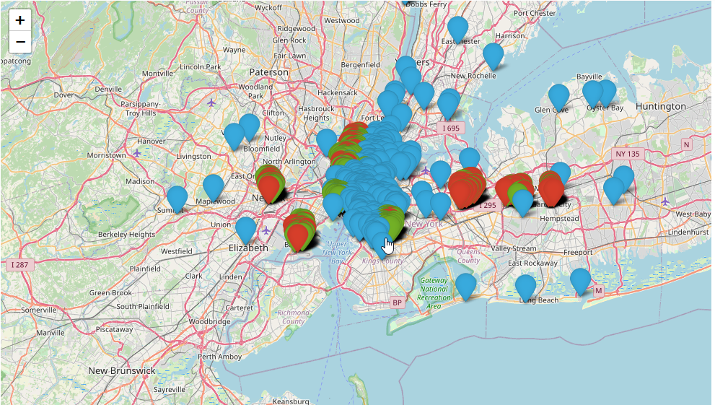
Methodology
Map of venues by rating quality

Slide 6
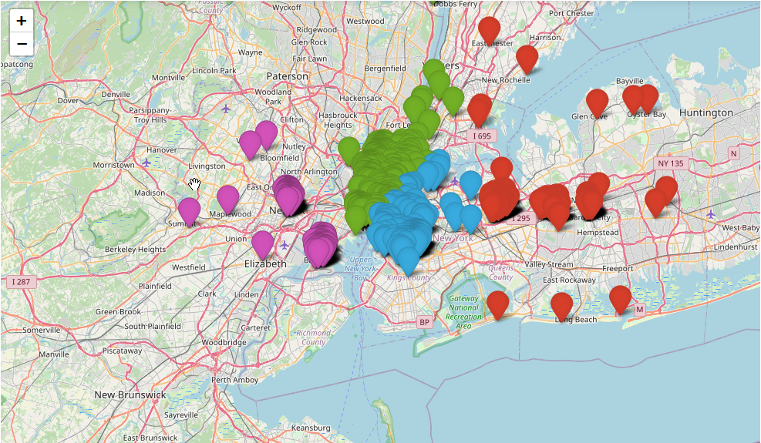
Map of venues clustered by location ONLY

Slide 7

How location is scored
A statistic that will be called Location Pull, a multiplier that is added to the expected number of venues of a certain quality
Formula for Location Pull in an above average cluster:
True number of venues - (total number of venues * .25)

Slide 8

Final Results
Over the four clusters, the average Location Pull is 15.87%
This is not as much as first thought when starting the project

Slide 9

Discussion/Conclusions
Imperfect data may have soured results
The process is intact and may even be used to assess the quality of specific locations.
While this does not accomplish initial goal, it does generate something that is immediately applicable to real-life situations.

