Slide 1

2017 Operating Report

Slide 2
2017 Summary
This data has been processed to remove:
Trips taken by staff for service and inspection
Trips that are taken to or from any “test” stations
Trips less than 60 seconds in length (potentially false starts or users trying to re-dock a bike to ensure it's secure)
Total Rides | 16,364,660
Total Ride Time | 516 years
Total Bikes | 14,204
% of Rides by Subscribers | 89%
% of Rides by Customers | 11%

Slide 3
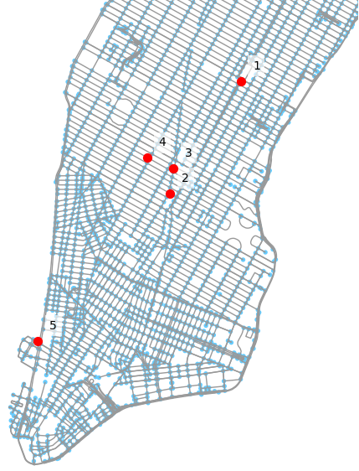
Top 5 Stations
Most popular stations are in popular areas or parks. The top 5 stations represent 3.5% of total rides
Rank | Station Area | Station Address | Count
1 | Grand Central | Pershing Square North | 162,716
2 | Union Square | E 17 St & Broadway | 112,218
3 | Madison Square | Broadway & E 22 St | 108,590
4 |  | W 21 St & 6 Ave | 107,133
5 | Hudson Greenway | West St & Chambers St | 105,610

Slide 4
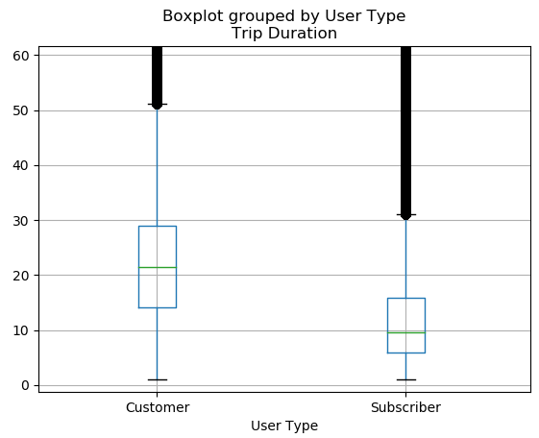
Trip Duration by User
89% of rides are from subscribers, who average shorter rides. Both sets contain many extreme outliers
 | Customer | Subscriber
Count | 1,769,423 | 14,579,325
Mean | 42 min | 14 min
STD | 667 min | 166 min
Min | 1 min | 1 min
25% | 14 min | 6 min
50% | 21 min | 10 min
75% | 29 min | 16 min
Max | 111 days | 113 days
Trip Duration (min)

Slide 5
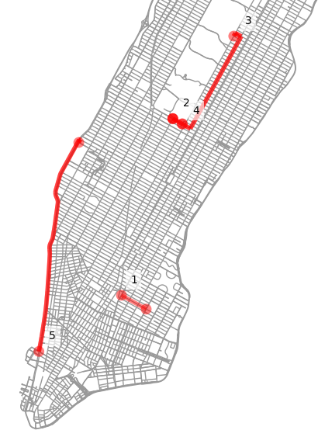
Most Popular Trips
Most popular trips are in parks, except for 1. Potentially riding to subway?
Rank | Area | Start Address | End Address | Count
1 | East Village | E 7 St & Avenue A | Cooper Square & E 7 St | 7994
2 | Central Park | Central Park S & 6 Ave | Central Park S & 6 Ave | 7169
3 | Central Park | Central Park S & 6 Ave | 5 Ave & E 88 St | 6318
4 | Central Park | Grand Army Plaza & Central Park S | Grand Army Plaza & Central Park S | 5670
5 | Hudson Greenway | 12 Ave & W 40 St | West St & Chambers St | 5403

Slide 6
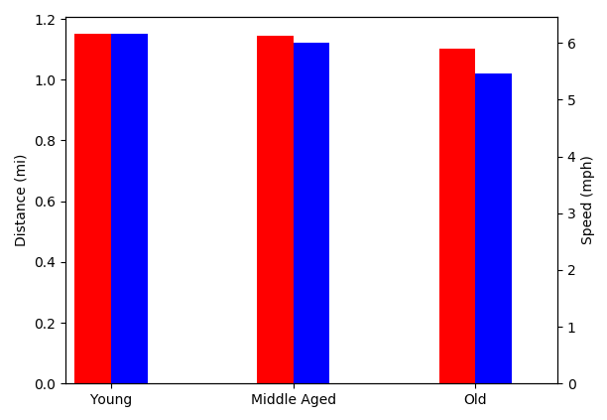
Rider Performance
Both metrics decrease with age, with speed decreasing more drastically
Metric | Young | Middle Aged | Old
Distance (mi) | 1.15 | 1.14 | 1.10
Speed (mph) | 6.16 | 6.00 | 5.46
distance
speed

Slide 7
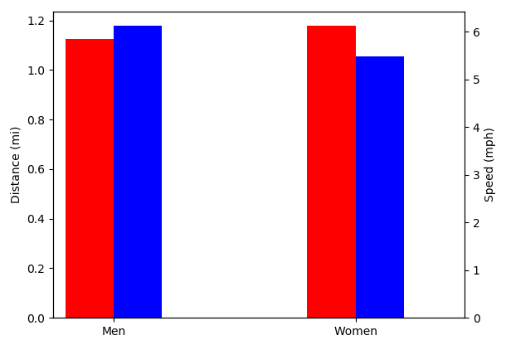
Rider Performance cont.
Men travel about the same distance, but do so at a faster speed
Metric | Men | Women
Distance (mi) | 1.13 | 1.18
Speed (mph) | 6.12 | 5.49
distance
speed

Slide 8
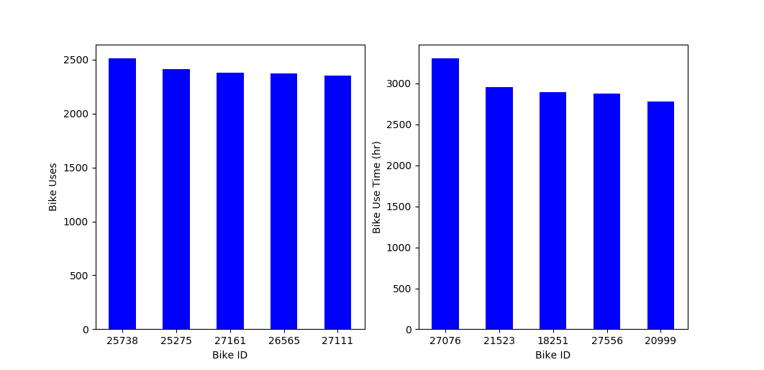
Busiest Bike
Busiest bike was ridden about 2500 times
Rank | Bike ID | Uses
1 | 25738 | 2514
2 | 25275 | 2409
3 | 27161 | 2376
4 | 26565 | 2370
5 | 27111 | 2349

Slide 9
Busiest Bike cont.
Busiest bike by time was used for over 3000 hours
Rank | Bike ID | Time in Use (hr)
1 | 27076 | 3310
2 | 21523 | 2958
3 | 18251 | 2893
4 | 27556 | 2880
5 | 20999 | 2782

Slide 10
Feasibility Study – Travel Time
Goal
Predict a biker’s travel time using Citi Bike and historic NYC weather data given starting station and destination
Method
Clean and prepare data
Extreme outliers (trips longer than 1.5hrs) are removed
Incorporate only relevant variables
Correlation testing is done between the target variable (Trip Duration) and candidate predictor variables (humidity, gender, age, etc.) to determine relevance to an accurate prediction
Fit a linear regression
More complicated model types have the potential for higher accuracy, at the cost of significantly higher computational requirements

Slide 11
Results
Average Cross Value Score: 69%
Cross Value Score computes an R² value using different pieces of the data set as the test and train groups
Gives a more realistic understanding of true model performance
Model Components
Median Trip Time, User Type (Subscriber/Customer), Daily High Temperature
Next Steps
Improvements in accuracy can be expected from incorporating distance data

