Slide 1


K.RAMAKRISHNAN COLLEGE OF TECHNOLOGY
(AUTONOMOUS), TRICHY.
DEPARTMENT OF
COMPUTER SCIENCE AND ENGINEERING
20CS5501 DESIGN PROJECT-1
Batch No. : 10
Date : 06.12.2024
1

Slide 2
LOAN PREDICTION AND AMOUNT ESTIMATION
Guided by Team
Ms.KARTHIKA, ME KEVIN JOEL K(811722104076)
Assistant Professor, CSE KEVIN JACOB D (811722104075)
SURIYA ANAND R(811722104308)
2

Slide 3
OBJECTIVE OF THE PROJECT
Predict Loan Approval Status: Develop a machine learning model to classify whether a loan application will be approved or denied, based on applicant data (e.g., income, credit history, etc.).
Estimate Loan Amount: Build a regression model to predict the amount of loan that could be granted, using features such as income, collateral value, and debt-to-income ratio.
Improve Prediction Accuracy: Compare and fine-tune Support Vector Machine (SVM) and Logistic Regression models to achieve optimal performance in terms of prediction accuracy and robustness.
Minimize Default Risk: Use insights from model predictions to help financial institutions minimize loan default risks by identifying high-risk applicants
3

Slide 4
ABSTRACT
In our banking system, banks have many products to sell but main source of income of any banks is on its credit line. So they can earn from interest of those loans which they credits. A bank’s profit or a loss depends to a large extent on loans i.e. whether the customers are paying back the loan or defaulting. By predicting the loan defaulters, the bank can reduce its Non-performing Assets. This makes the study of this phenomenon very important. Previous research in this era has shown that there are so many methods to study the problem of controlling loan default. But as the right predictions are very important for the maximization of profits, it is essential to study the nature of the different methods and their comparison
03-12-2024
4

Slide 5
LITERATURE SURVEY
TITLE OF THE
AUTHORS
PUBLISHER
PAPER GIST
TECHNOLOGY
PAPER
USED
Loan default
Natasha Robinson Natasha Robinson Nidhi sindhiwani
Nina collins
Identify key factors
prediction
influencing loan
Machine learning
defaults
Sudipta Roy
(IJCSET)
Improved accuracy in
Ensemble Learning Techniques
Predicting loan default
predicting loan
approvals
An approach to predict loan eligibility
Puneeth Br
International Conference on Artificial Intelligence
Accurate estimation
Machine learning
of loan amount
Predicting loan default
Prateek Kumar,
Effective in accessing
Machine learning
(IJCSET)
risk
Predicting loan default
Rajat Kumar
(IJCA)
Enhanced predictive
Machine learning
performance
5
house

Slide 6
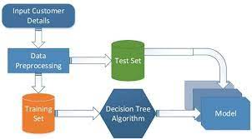
PROPOSED SYSTEM ARCHITECTURE
6

Slide 7
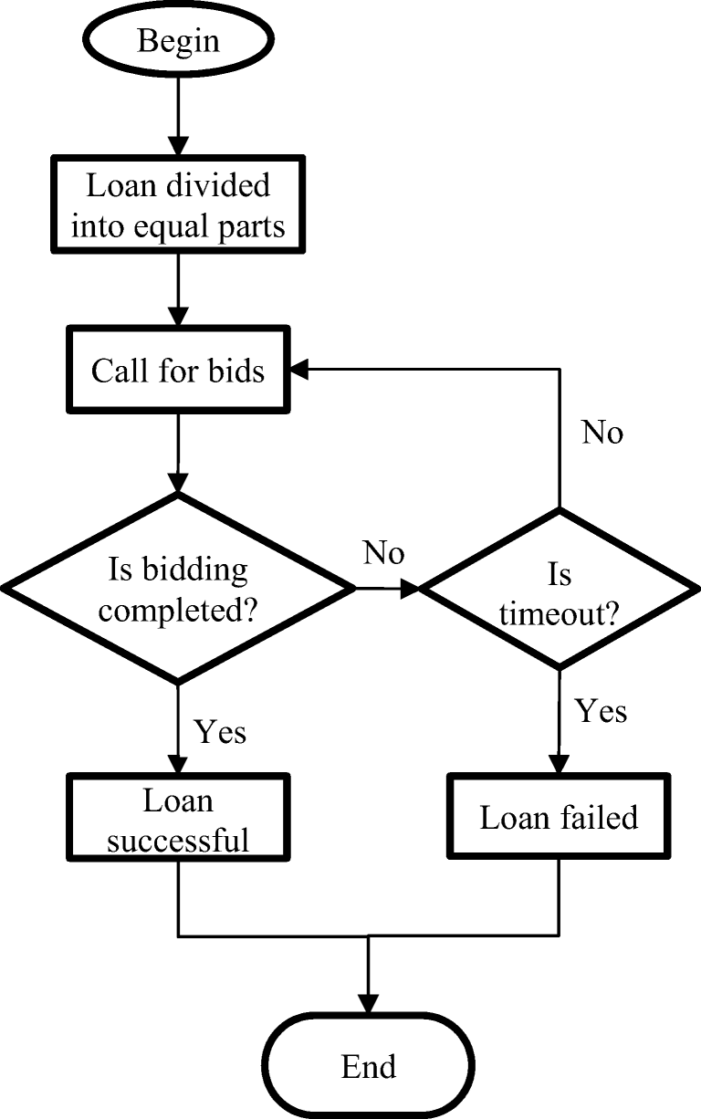
EXISTING SYSTEM ARCHITECTURE
7

Slide 8
SOFTWARE AND HARDWARE REQUIREMENTS
HARDWARE
SOFTWARE
Processor(INTEL i5)
Ram(Altleast 8 GB)
SSD(256 GB)
GPU
OS
Python
Colab
Machine learning
Data handling
Version control
8

Slide 9
MODULES
Data collection and preprocessing
Exporatory data analysis
Model development module
Loan amount estimation
Model evaluation and validation
Predicting and development module
Reporting and visualization module
9

Slide 10
SUMMARY OF MODULE-1
Data Collection and Preprocessing:
The Data Collection and Preprocessing module is the foundation of the loan prediction and estimation project. In this module, raw loan applicant data is gathered from various sources, such as databases or CSV files. This raw data often contains missing values, inconsistencies, and different formats, so it requires cleaning and preparation before being used for model training.
10

Slide 11
SUMMARY OF MODULE-2
Exploratory Data Analysis :
The Exploratory Data Analysis (EDA) module focuses on understanding the structure, patterns, and key insights from the dataset. It helps identify relationships between different variables, detect outliers, and uncover trends that will guide model building.
11

Slide 12
SUMMARY OF MODULE-3
Model Building:
The Model Building module is where the machine learning models for loan prediction and amount estimation are developed. Using the cleaned and processed data from previous modules, this step focuses on applying algorithms like Support Vector Machine (SVM) and Logistic Regression to classify loan approvals and predict loan amounts.
12

Slide 13
SUMMARY OF MODULE-4
Loan Amount Estimation:
The Loan Amount Estimation module focuses on predicting the loan amount a borrower is eligible for, based on relevant features such as income, credit score, and other financial indicators. This is typically done using regression techniques.
13

Slide 14
SUMMARY OF MODULE-5
Model Evaluation and Validation:
The Model Evaluation and Validation module ensures that the machine learning models built for loan prediction and amount estimation are reliable, accurate, and generalize well to new data. This module involves assessing the performance of both classification (loan approval) and regression (loan amount estimation) models using various evaluation metrics.
14

Slide 15
RESULTS AND DISCUSSION
The results show that the Random Forest model outperforms the other models in both loan approval prediction and loan amount estimation. Random Forest combines the strengths of multiple decision trees, allowing it to provide more accurate predictions by reducing overfitting and handling both numerical and categorical features effectively.
For loan amount prediction, the Random Forest regression model was also the best performing. This suggests that non-linear relationships between features and the loan amount are more effectively captured by Random Forest than by simpler models like Linear Regression.
The model's performance can further be improved by experimenting with different feature engineering techniques, using hyperparameter tuning to optimize the model’s parameters, and using ensemble methods to combine the predictions of multiple models.
15

Slide 16
CONCLUSION
Improved Decision-Making: The models developed provide financial institutions with reliable tools for predicting loan approval and estimating loan amounts, leading to more informed and data-driven lending decisions.
Enhanced Risk Management: By accurately assessing the likelihood of loan approval and predicting appropriate loan amounts, the models help minimize default risks and ensure better risk management.
Data-Driven Insights: The comprehensive data analysis and visualization modules offer valuable insights into applicant behavior and model performance, facilitating ongoing improvements and adaptations.
16

Slide 17
THANK YOU
17

