Slide 1
Project 2

Slide 2
What you’ll be using in project 2
File reading and writing
Double check whether your file is opened successfully
Close your file when you are done
Function
Pass by value
Pass by reference
Function overload
Templates

Slide 3
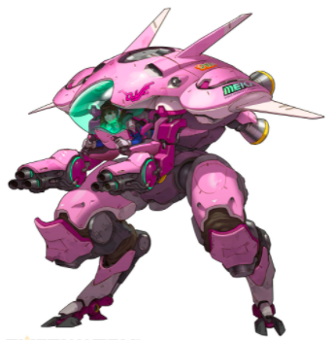
Design Mech battle system
https://youtu.be/0Ufktu4GPz0
Before D.Va goes into battle she would need information to load her mech.
Your program will read the enemy information from the monitoring system and prepare D.Va’s mech for the battle.

Slide 4


Read from file
The monitoring system will generate a file with information as following:
The first line is the number of bots in combat
The second line are the power of bots(int) and the power of the boss(float)
The last line are the number of loaded micro missiles and the loaded power of defense matrix

Slide 5
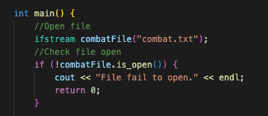
Read the combat file
Your program will read the file with file name “combat.txt”

Slide 6

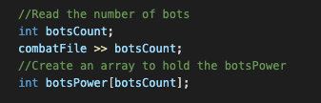
Read bots
Read the number of bots, save in botsCount
Then use that to initialize your array
Your compiler may or may not give a warning on using variable to define size, feel free to ignore the warning for now
Write a for loop and use botsCount to control the number of times your loop runs. Read bots power and save in the array within the loop.
Read boss power last, outside of the loop
Read the loaded micro missiles and the loaded power of defense matrix
Save in microMissiles and defenseMatrix

Slide 7


Calculate power needed
matrix_power function
Parameters:
an integer array storing bots' power
an integer indicating the number of bots
a float indicating the boss' power
Use a for loop to sum up all damages from the array (use number of bots to control the number of times your for loop runs
Add boss power on top of the sum
Return the sum
main()
Call matrix_power function to get matrixPowerRequired

Slide 8
Calculate power needed
single_missile_power function (templated)
Parameters:
an integer or a float
Use an if statement to check the parameter value
Calculate the return value based on condition
Return the value
Return type the same as parameter type
main()
Use a for loop to call single_missile_power function
Sum up the returned value into missilePowerRequired
Remember to call single_missile_power with boss power as well and add on top of missilePowerRequired

Slide 9
Load d.va
Function overloading with two functions
Takes in defenseMatrix by reference and matrixPowerRequired by value
Use if statement to check whether the power required is more than defenseMatrix
If yes, replace defenseMatrix value with the matrixPowerRequired
Otherwise, leave it as is
Takes in microMissiles by reference and missilePowerRequired by value
Calculate how many missiles needed for the missilePowerRequired(divide then round up)
Use if statement to check whether the number of missile needed is more than what we have
If yes, replace microMissiles
Otherwise, leave it as is

Slide 10

Generate the report
Use ofstream to open file
Make sure to check file open
Write to file
Close file when done
Thank you from D.Va

