Slide 1
Leap Motion Controlled Lego Mindstorm NXT Arm
GESTURE BASED URI DEVELOPMENT
Donal Burke | Kevin Delassus

Slide 2
Project Aims
Control a Lego made Mechanical Arm with a Leap Motion Controller
RMI communication between Lego arm and Leap Motion Controller

Slide 3
Technologies Used
Java 8 32bit
Leap Motion
Leap Motion SDK (macOS/Windows)
Lego Mindstorms NXT (Lejos)

Slide 4
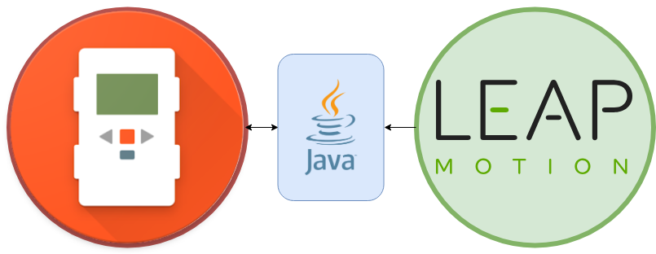

Slide 5
Mechanical Arm Setup
Build Arm
Flash a mini 32bit Java Virtual Machine onto Lego NXT Device
Download 32bit version of Java 8 and Eclipse
Download and Install Lejos Eclipse extension

Slide 6
Leap Motion Setup & Development
Install Leap Motion SDK (32 bit Java version) so it’s compatible with Lego Arm.
Develop different Gestures (Close Hand, Open Hand)
Integrate Leap Motion Listener with Lego arm (through RMI)

Slide 7
Leap Motion Gestures
Left Hand Gestures
Closed Fist – Stop
Swipe Up/Down – Move Up/Down
Circle Gesture – Rotate Arm
Right Hand Gestures
Right Hand Closed Fist – Close Claw
Right Hand Upside down Closed Fist – Open Claw

Slide 8
Issues
Compatibility with Java versions - 32 bit for Lego Arm and 64 bit for Leap Motion
Connection problems with Leap Motion
Leap Motion Accuracy

Slide 9
Live Presentation

Slide 10
Any Questions???

