Slide 1
Leap Motion Controlled Lego Mindstorm NXT Arm
GESTURE BASED URI DEVELOPMENT
Donal Burke | Kevin Delassus

Slide 2
Project Aims
Control a Lego made Mechanical Arm with a Leap Motion Controller

Slide 3
Technologies Used
Java 8 64bit and 32bit
Leap Motion
Leap Motion SDK (macOS/Windows)
Lego Mindstorms NXT (Lejos)

Slide 4
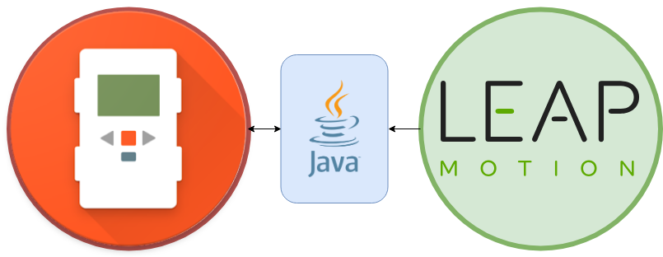

Slide 5
Mechanical Arm Setup
Build Arm
Flash a mini 32bit Java Virtual Machine onto Lego NXT Device
Download 32bit version of Java 8 and Eclipse
Download and Install Lejos Eclipse extension

Slide 6
Leap Motion Gestures
Right Hand Closed Fist – Close Claw
Right Hand Upside down Closed Fist – Open Claw
Left Hand Finger Circle – Rotate Arm Base
Left Hand Index Finger Tap – Rise Arm
Left Hand Middle Finger Tap – Lower Arm

Slide 7
Live Presentation

Slide 8
Any Questions???

