Slide 1
G-sigma: A Novel Function for Automatic Control of Exploration
Joe Beck, Kevin De Angeli, Joseph Lavalle-Rivera

Slide 2
Previous Work
“Comparing Exploration Strategies for Q-learning in Random Stochastic Mazes” Tijsma et. al. (2016)
Grid World mazes with sub-optimal exits. Apply Q-Learning with four exploration strategies
Exploration strategies:
  epsilon-greedy
  Softmax
  UCB-1(counter based)
  Pursuit(novel)
Discover optimal parameters (learning rate, “Exploration Rate”), compare between strategies.

Slide 3
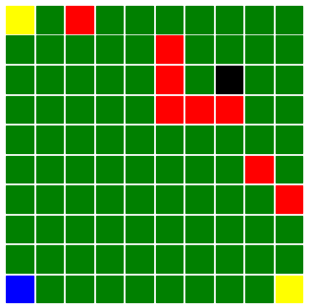
Experimental Setup
4 Exploration types x 2 (Optimistic Initialization) x 2(Reward Structure) = 16 Experiments
Randomly generate 10 mazes, run each maze 3 times each.
Each run consists of 30,000 epochs.
For last 100 epochs, record the return.
Average 3,000 recorded returns for results.
Reward Structures
Event | Unnormalized | Normalized
Step | 0 | -1
Block | -5 | 0
Suboptimal Goal | 50 | 0.5
Optimal Goal | 100 | 1

Slide 4
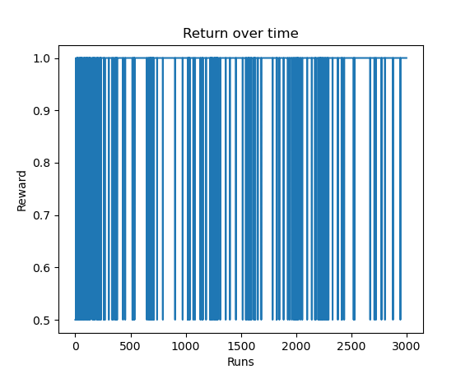
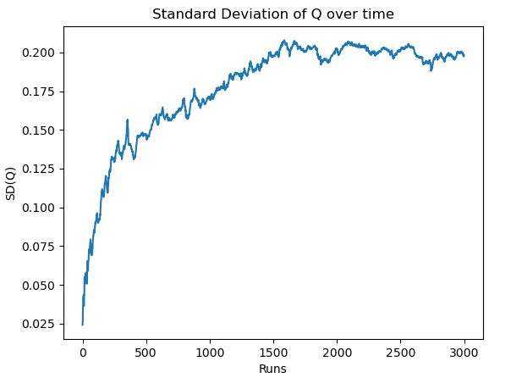
Exploration Problem
Explore vs Exploit (exploration rate)
Trapped or optimized?
Use Episodic Return?
A different measurement?

Slide 5
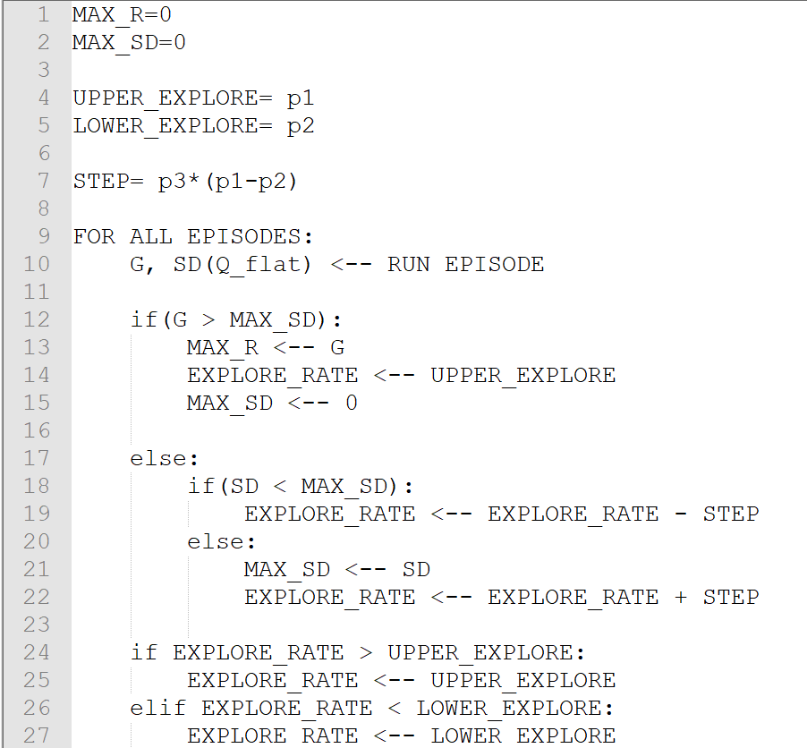
G-SIGMA
Combine episodic Return (G) and Standard deviation of Q values (sigma).
Increase exploration when the maximum return seen to date increases, or if the standard deviation of Q is increasing. Decrease exploration otherwise.

Slide 6
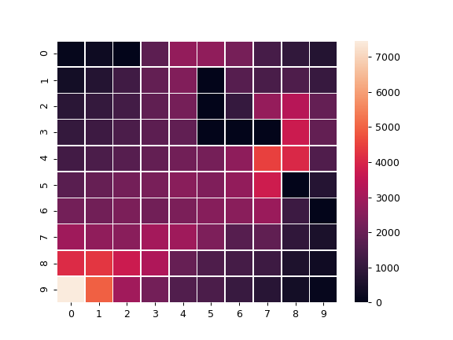
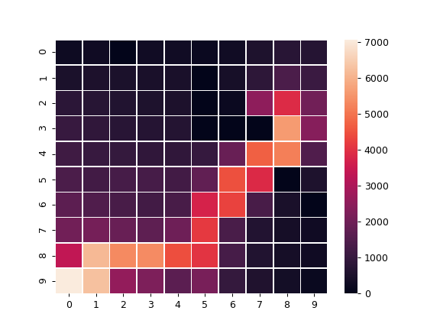
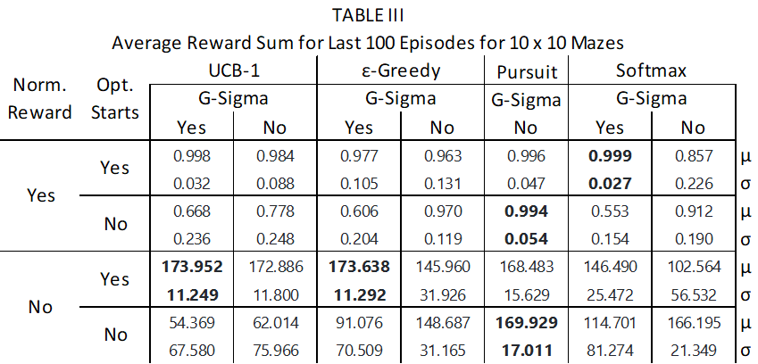
Results
UCB-1, Optimistic Initialization, non-normalized reward
Fixed Exploration Rate: C
G-SIGMA

Slide 7
Conclusions
G-Sigma required early exploration to be effective (Optimistic Q-values, UCB-1).
Standard Deviation assumptions seemed to hold.
Not a perfect replication of Tijsma et. al. paper conclusions.

