Slide 1
Use Case Descriptions
Write a brief description as shown in Chapter 3 for most use cases.

Slide 2
Use Case Descriptions
Write a fully developed use case description for more complex use cases
Typical use case description templates include:
Use case name
Scenario (if needed)
Triggering event
Brief description
Actors
Related use cases (<<includes>> / <<extends>>)
Stakeholders
Preconditions
Postconditions
Flow of activities
Exception conditions

Slide 3
Use Case Description Details
Use case name
Verb-noun
Scenario (if needed)
A use case can have more than one scenario (special case or more specific path)
Triggering event
Based on event decomposition technique
Brief description
Written previously when use case was identified
Actors
One or more users from use case diagrams

Slide 4
Use Case Description Details
Related use cases <<includes>>, <<extends>>
If one use case invokes another
Stakeholders
Anyone with an interest in the use case
Preconditions
What must be true before the use case begins
Post conditions
What must be true when the use case is completed
Use for planning test case expected results
Flow of activities
The activities that go on between actor and the system
Exception conditions
Where and what can go wrong

Slide 5
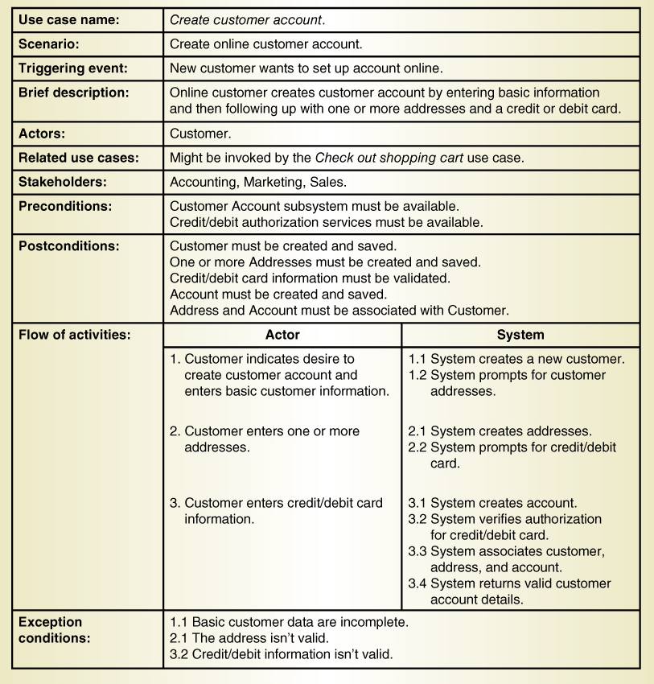
Fully Developed Use Case Description Use case: Create customer account

Slide 6
Fully Developed Use Case Description Create customer account (part 1 )

Slide 7
Fully Developed Use Case Description Create customer account (part 2 )

Slide 8
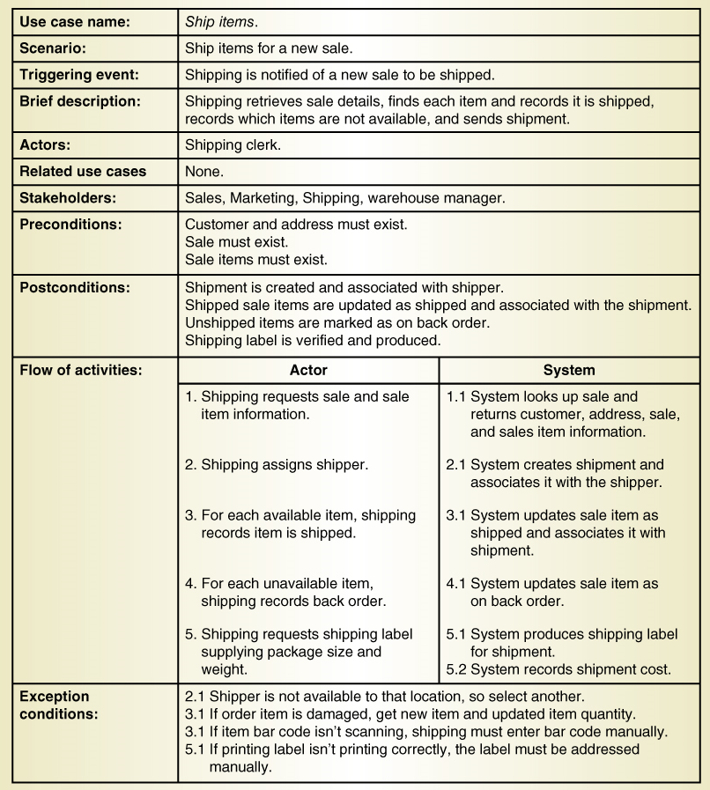
Another Fully Developed Use Case Description Example Use case Ship items

Slide 9
Fully Developed Use Case Description Ship items (part 1 )

Slide 10
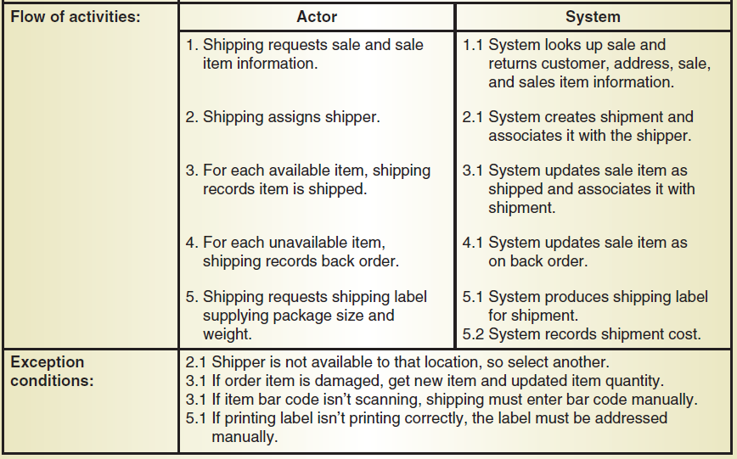
Fully Developed Use Case Description Ship items (part 2 )

Slide 11
Documenting Workflows with Activity Diagrams
Workflow– sequence of processing steps that completely handles one business transaction or customer request
Activity Diagram– describes user and system activities, the actor who does each activity, and the sequential flow of these activities
Useful for showing a graphical model of a workflow
A UML diagram

Slide 12
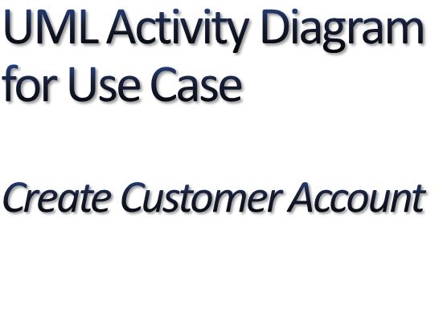


Note: this shows flow of activities only

Slide 13
Activity Diagram for Ship Items Use Case
Note:
Synchronization bar for loop
Decision diamond

Slide 14
Use Case Diagrams The <<Includes>>/<<excludes>> relationships

Slide 15
UML Activity Diagram for Use Case Fill shopping cart
Note: this shows a use case with <<includes>> and <<extends>> relationships

Slide 16
When to Use Activity Diagrams
The main reason to use activity diagrams is to model the workflow behind the system being designed.
Activity Diagrams are also useful for:
analyzing a use case by describing what actions need to take place and when they should occur
describing a complicated sequential algorithm
Activity diagrams do not give detail about how objects behave or how objects collaborate.

Slide 17
Components
An activity is an ongoing execution of a step in a workflow (such as an operation or transaction)
Represented with a rounded rectangle.
Text in the activity box should represent an activity (verb phrase in present tense).
Swim lanes – the vertical columns where the activities of the actor and the system are shown
Process Flow – the sequence in which the activities occur

Slide 18
How to Draw an Activity Diagram
Diagrams are read from top to bottom and have branches to describe conditions and parallel activities.
A branch describes what activities will take place based on a set of conditions.
All the YES/NO flows from branches will merge together at some point to indicate the end of the conditional behavior started by that branch.

