Slide 1
Auto-Scaling

Slide 2
Auto Scaling
a free service provided by Bluemix that automatically increases the instance of your cloud application

Slide 3
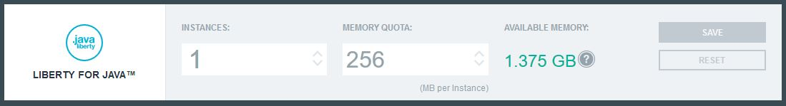
Manual Scaling
Instances
used for adding a new 'machine' to help the application run better
horizontal
Memory Quota
used to increase the memory of the existing instance
vertical

Slide 4
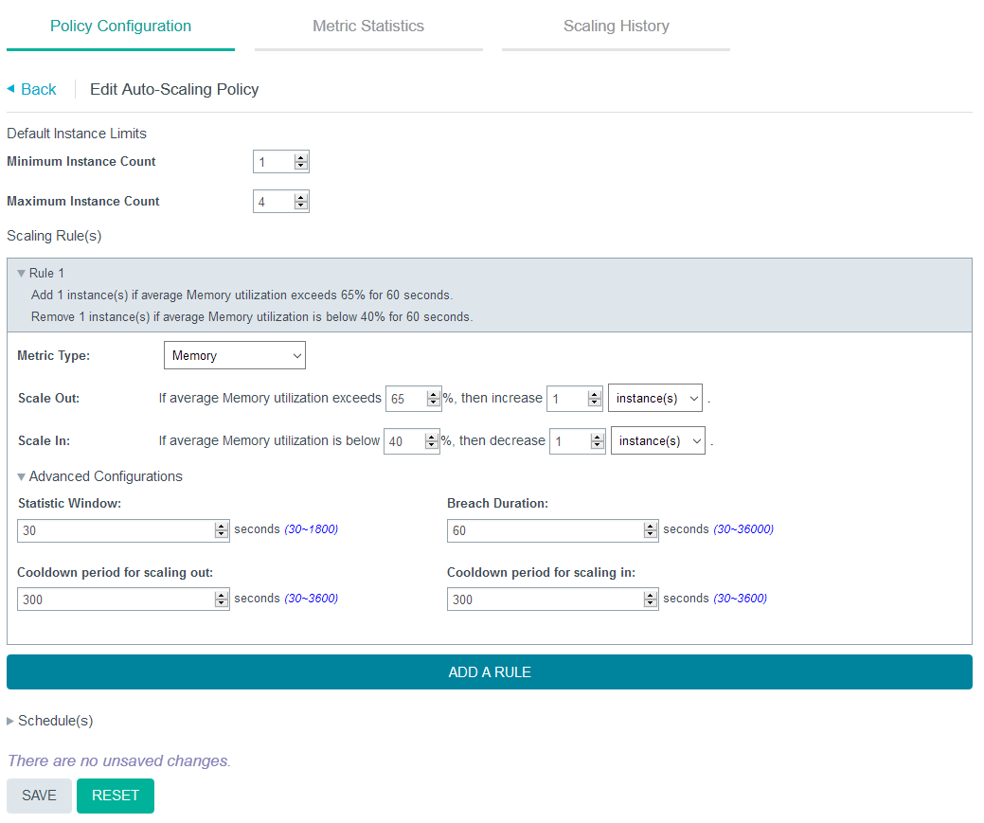
Policy Configuration
Statistic Window refers to the time period that the metric is measured
Breach Duration indicates how long must the application exceed the upper threshold before adding a new instance
Cooldown periods indicate how long the service will wait before it increases/decreases another instance

Slide 5
