Slide 1
Auto-scaling

Slide 2
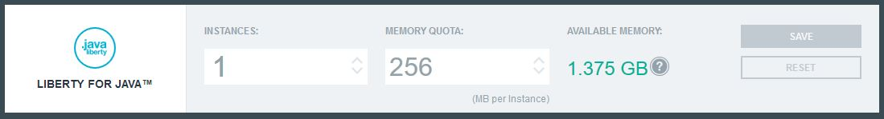
Instances
used for adding a new 'machine' to help the application run better
horizontal
Memory Quota
used to increase the memory of the existing instance
vertical

Slide 3
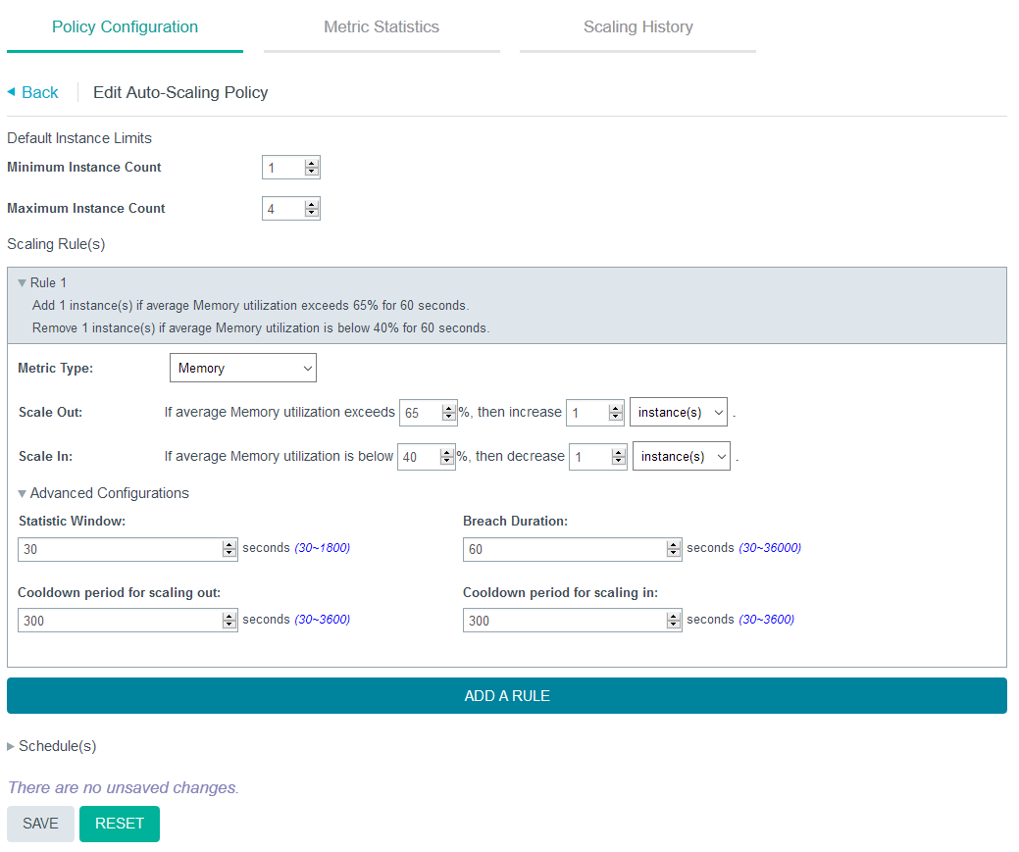
Policy Configuration
Statistic Window refers to the time period that the metric is measured.
Breach Duration indicates how long must the application exceed the upper threshold before adding a new instance.
Cooldown periods indicate how long the service will wait before it increases/decreases another instance.

Slide 4
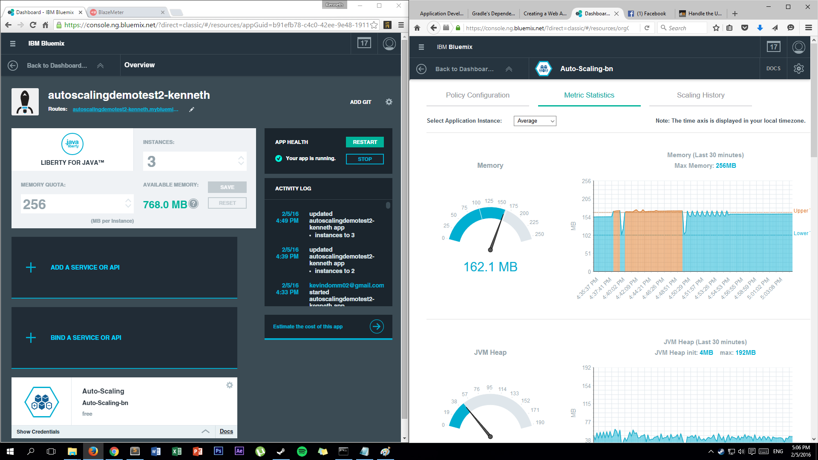

Slide 5
