Slide 1
Census 97
PSEG RUTGERS ANALYTICS BOOTCAMP PROGRAM
PROJECT 03
Bobby Chang
Kevin Downes
Eliezer Flores
16 April 2024

Slide 2
INTRODUCTION
Data Visualization Track
Data Sources: US Census data, New Jersey Geographic Information Network (NJGIN) Open Data & NJ State Police Crime data
US Census Data sources:
https://pypi.org/project/censusdis/
https://api.census.gov/data/2020.html
https://api.census.gov/data/2020/acs/acs5/variables.html
NJ State Police:
https://www.nj.gov/njsp/ucr/uniform-crime-reports.shtml
NJ County Boundaries:
https://njogis-newjersey.opendata.arcgis.com/datasets/newjersey::county-boundaries-of-nj/explore?showTable=true
PURPOSE
Develop a data visualization showing by NJ county the median household income, education statistics, and crime statistics to show any relationships

Slide 3
APPROACH | PROJECT LIFECYCLE
PROJECT ANALYSYS | NEW LIBRARIES | DATA GATHERING | DATA PREPARATION | VISUALIZATION
Defining the purpose of the project Identify the data source Create the project framework Determine the key findings | Censusdis, openpyxl, & jquery Establish understanding of new library Determine variables that could be used Determine the data format | Collect data from US Census Collect data from NJ State Police Collect data from NJGIN Apply data conversion techniques | Leverage Pandas dataframe to organize the required data Eliminate non-essential information Perform error handling Upload to PostgreSQL database | Build data visualization with JavaScript, HTML, Leaflet, jquery, and matplotlib
 | CensusDIS | Median household income, population, and education statistics
Jupyter Notebook, Visual Studio Code, and GitHub integration for team collaboration and code management lifecycle efficiently

Slide 4
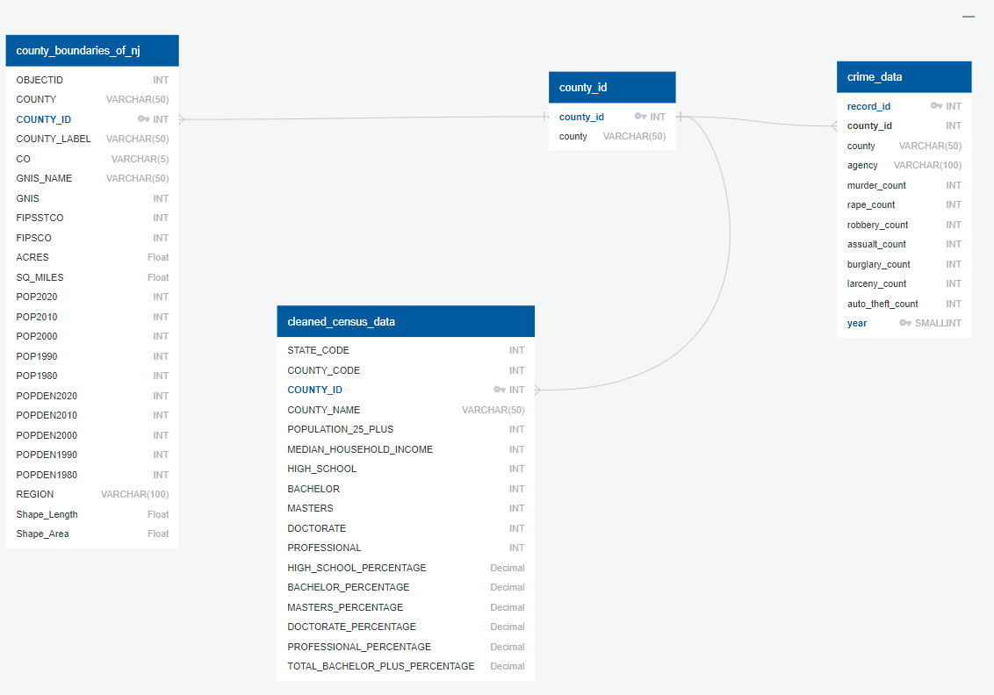
Project_3 DATA ARCHITECTURE – ENTITY RELATIONSHIP DIAGRAM

Slide 5

OBSTACLES | SOLUTIONS
CATEGORY | CHALLENGES | SOLUTION/WORKAROUND
Crime Data | File was in excel format while in class we only used csv | Used new python library openpyxl
 | Each county was on its own tab and the agency (police department) was in the same column as statistics categories | Created nested for loops to iterate through each sheet in the workbook and through each row in the current sheet
Census Data | Large set of variables to choose from (27,892) | Limited selection to variables that could provide higher level analysis
Postgres DB | CSV files were not loading data into the tables | All table names needed to be lower case
 | Needed unique id to link the data | Manually created county_id csv file
Data Visualization | Dynamic updating the legend to match the measure | map.remove()

Slide 6
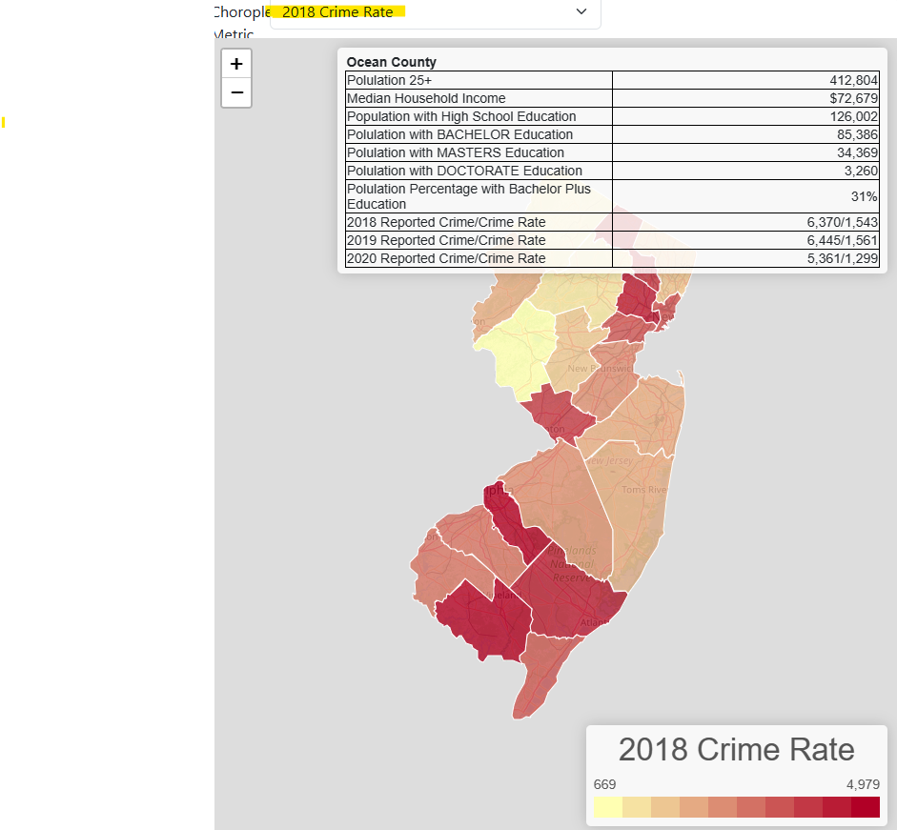
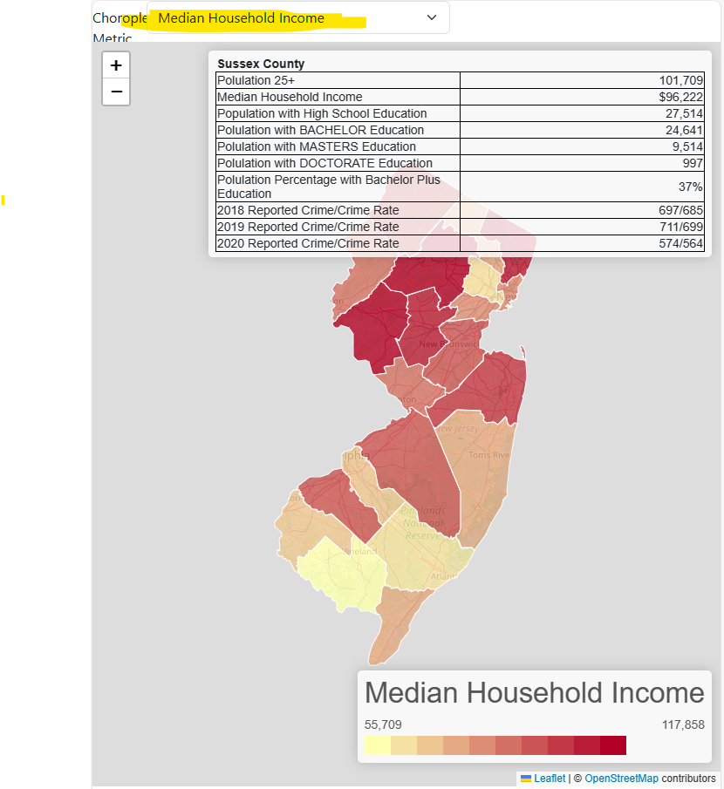
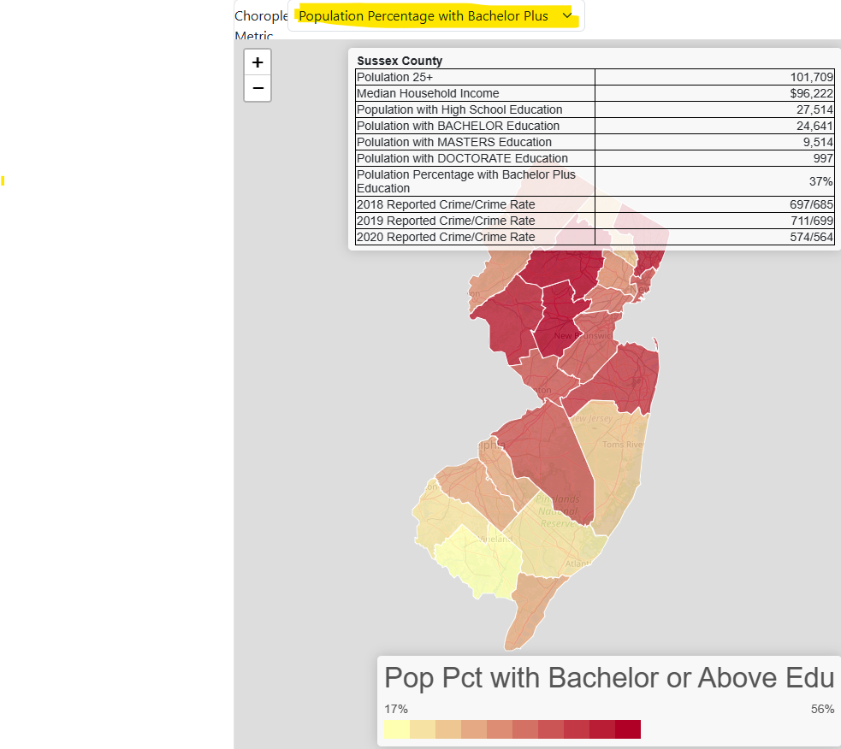
Data Visualization
Leaflet Choropleth Map provides a way to visualize different metric value over NJ counties. Select different metric from Crime and Census data helps us to discover Crime, Income, Education and Geography relationship.

Slide 7
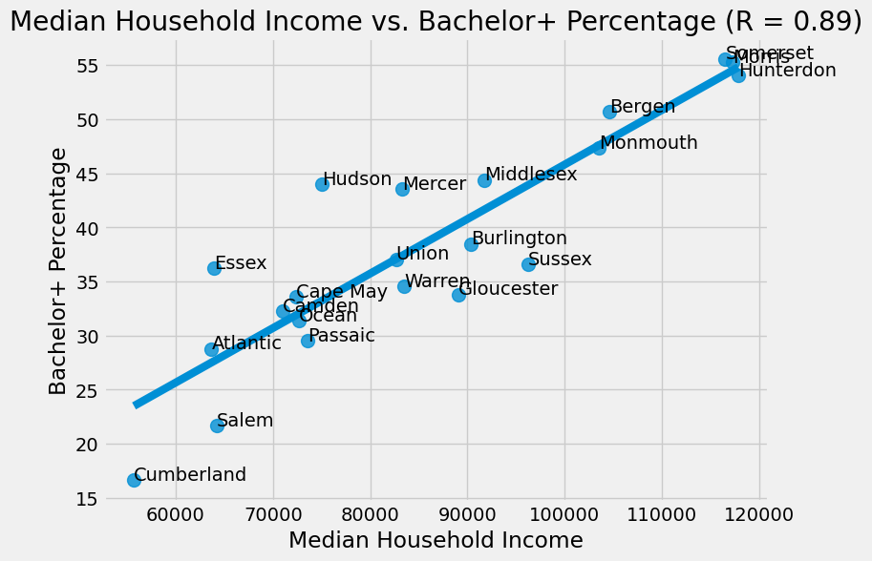
KEY FINDINGS 1– Positive correlation between median household income and education

Slide 8
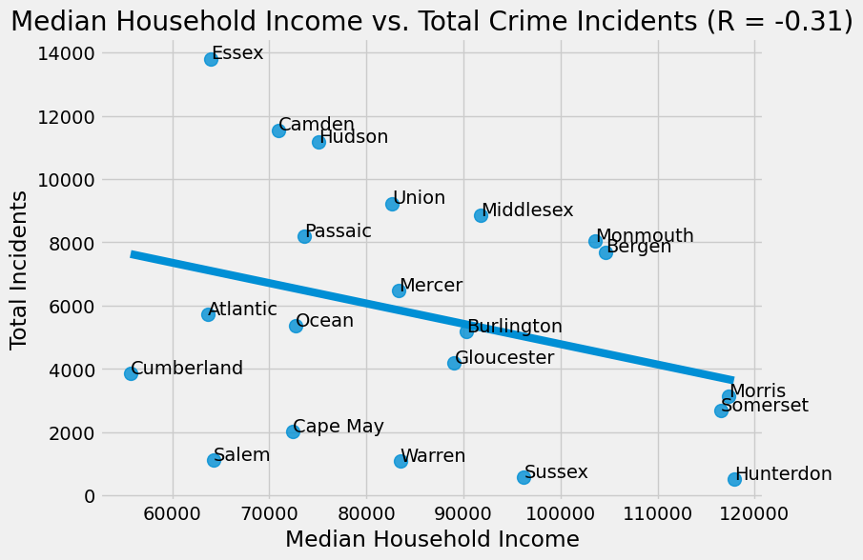
KEY FINDINGS 2 – Negative correlation between median household income and crime
.

Slide 9
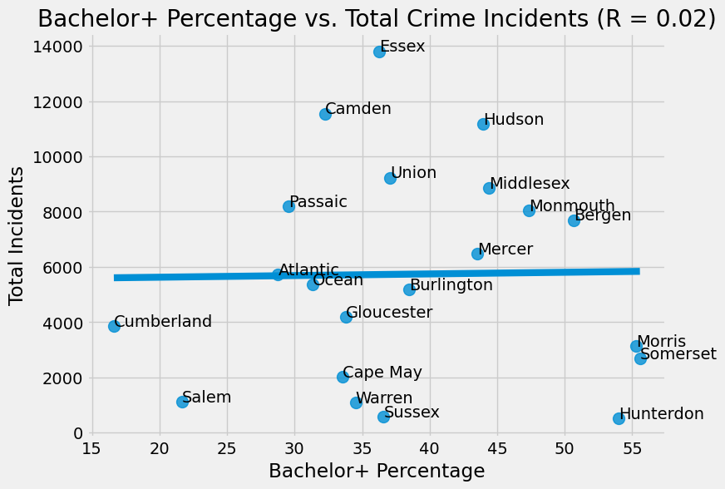
KEY FINDINGS 3 – Very weak correlation between higher education levels and crime

Slide 10
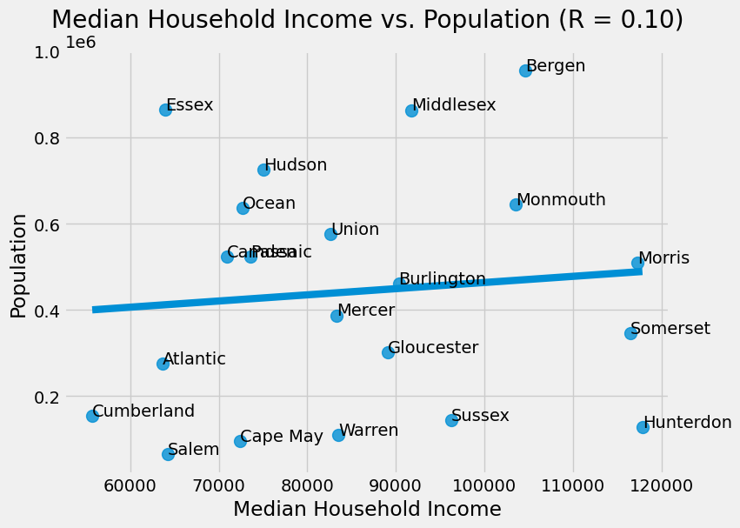
KEY FINDINGS 4 – Population has a weak correlation with median household income

Slide 11
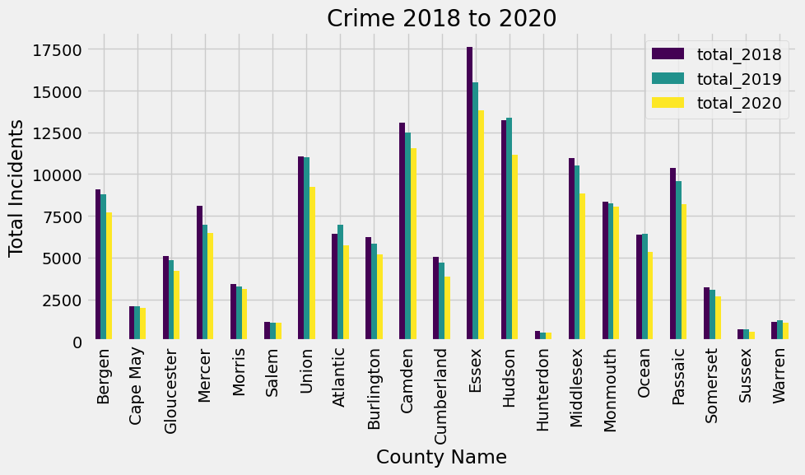
KEY FINDINGS 5 – Densely pop.counties crime dropped as opposed to low dense counties

Slide 12
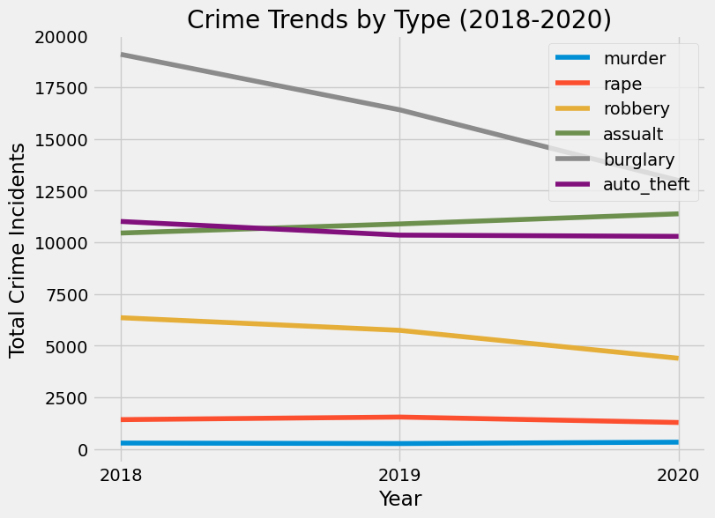
KEY FINDINGS 6 – Burglary & Robbery went down due to the early stage of the Pandemic.

Slide 13
Overall Findings
Education levels have a positive impact on the median household income of a county
Population of the county does not have a strong relationship with median household income
As household income goes up crime goes down, but higher levels of education did not show to reduce crime levels

Slide 14
Enhancements
Directions for future work
Get more years for census data
More time to view additional census variables from the API
NJ crime data was only up to 2021 Q1
Crime data didn’t include white collar crimes
Further analysis down to city/town level potentially have different results
Using MongoDB to easier save GeoJSON data to database

