Slide 1
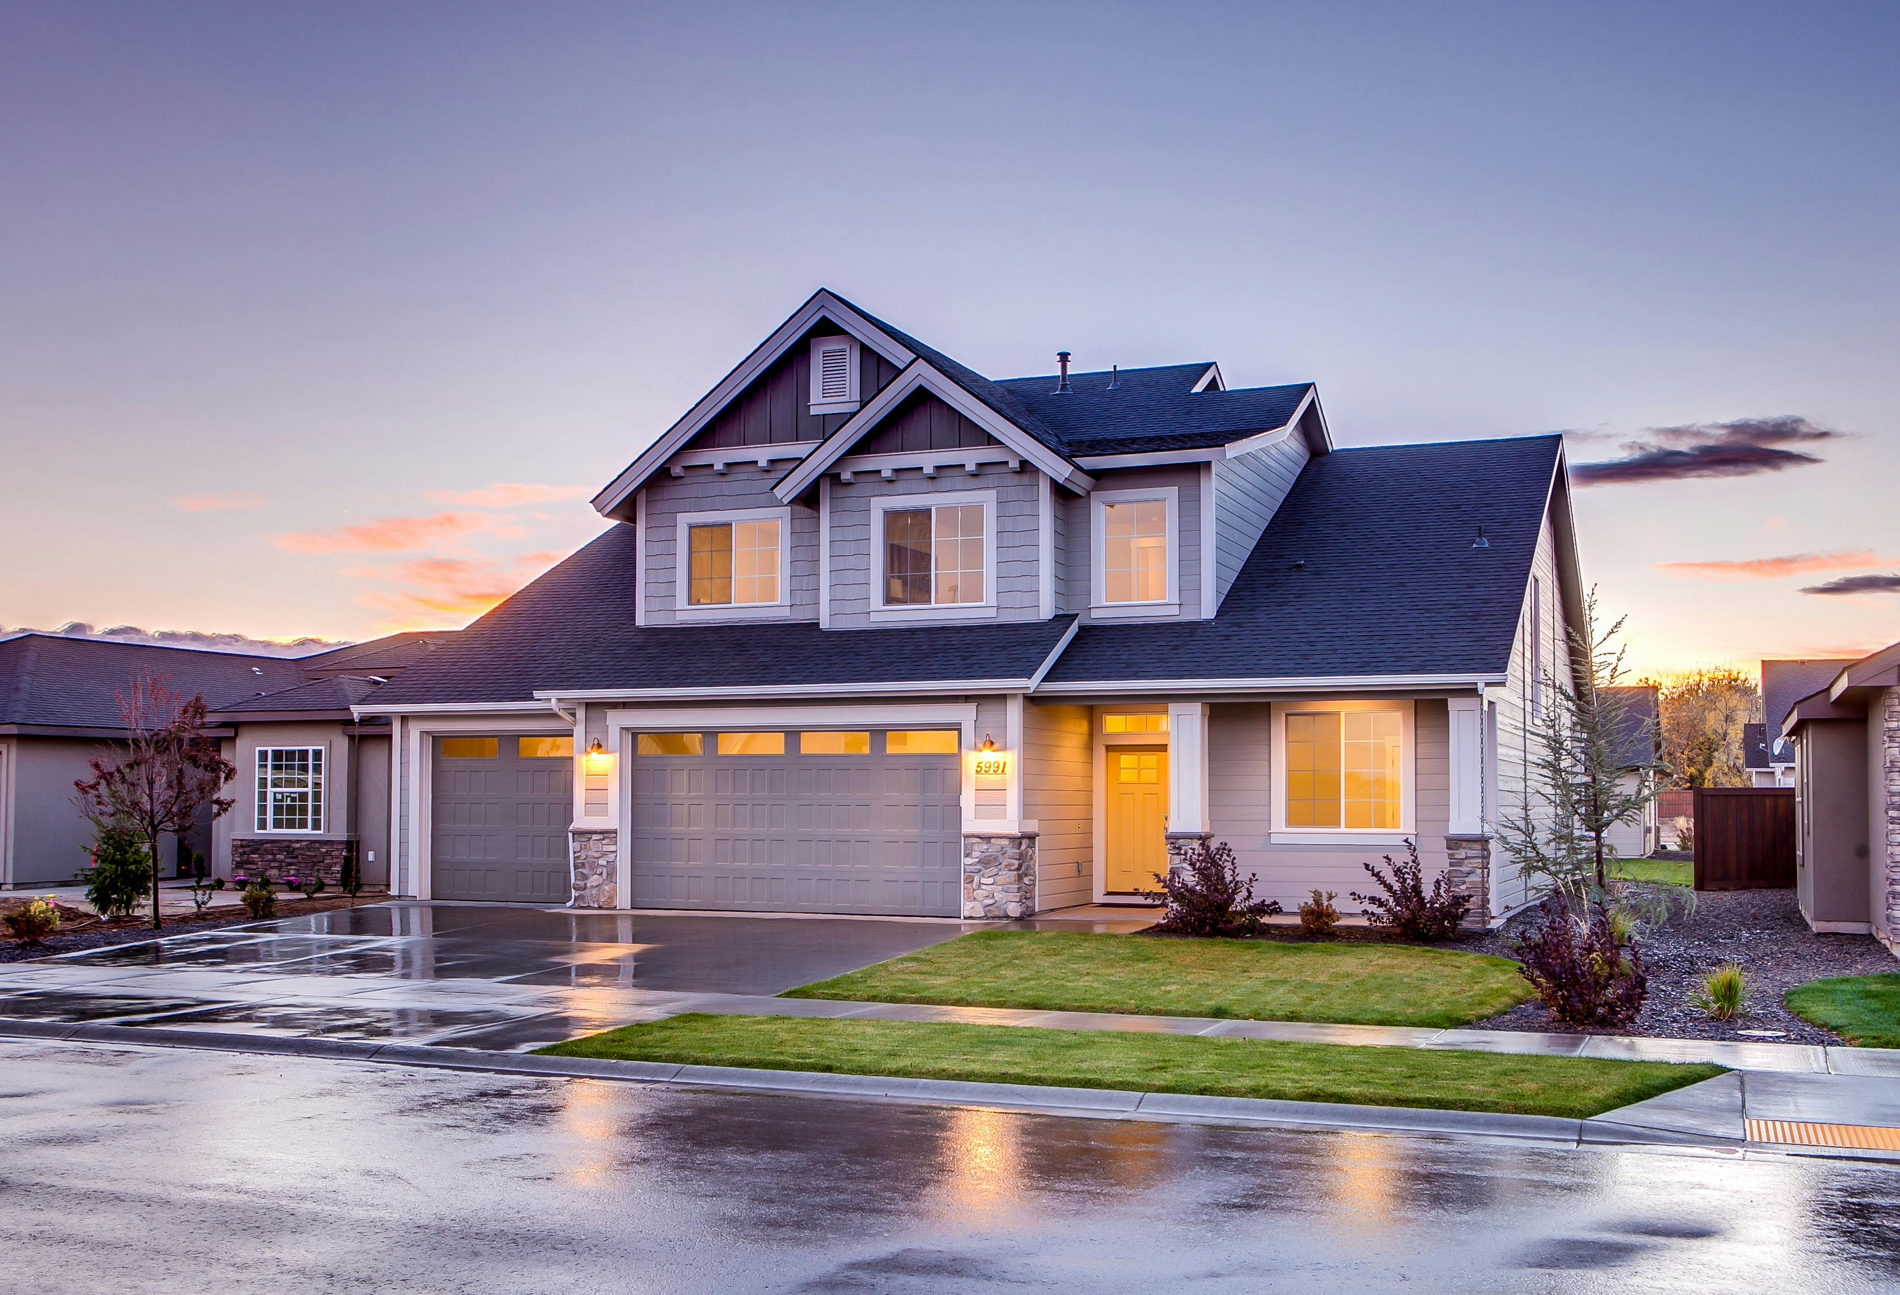
Census 97 – Machine Learning
PSEG RUTGERS ANALYTICS BOOTCAMP
PROJECT 04
Bobby Chang
Kevin Downes
Eliezer Flores
27 June 2024

Slide 2
INTRODUCTION
Machine Learning
Data Sources:
Housing Data set from Kaggle
https://www.kaggle.com/datasets/sukhmandeepsinghbrar/housing-price-dataset
PURPOSE
Utilizing machine learning techniques to predict the housing price based on the impact of various housing characteristics
Techniques Used
Linear Regression
Decision Tree
Random Forest
Neural Network

Slide 3
APPROACH | PROJECT LIFECYCLE
PROJECT ANALYSYS | LIBRARIES | DATA GATHERING | DATA PREPARATION | VISUALIZATION
Defining the purpose of the project Identify the data source Create the project framework Determine the key findings | Scikit-learn PySpark Pandas Matplotlib TensorFlow | Identified housing data set from Kaggle to include over 21,000 records | Leverage Pandas dataframe to organize the required data Eliminate non-essential information that impacted analysis (id, date stamp) | Initial visualizations for reference Built Decision Tree Diagram Random Forest Actual vs Predicted Price
Jupyter Notebook, Google Co-lab, Visual Studio Code, and GitHub integration for team collaboration and code management lifecycle efficiently

Slide 4

OBSTACLES | SOLUTIONS
CATEGORY | CHALLENGES | SOLUTION/WORKAROUND
Housing Data | Wanted Central NJ MLS Data from Zillow API | Found data on Kaggle
Model Analysis | Multiple fields were not related to housing | Removed them from the analysis
 | Original results based on all fields were below average | Feature Engineering to try the data model
Data Visualization | Decision Tree diagram to load | tree.plot_tree()
Impact Analysis | Finding the impact of each field on the model | importances = model.feature_importances_ sorted(zip(model.feature_importances_, X.columns), reverse=True)

Slide 5
Machine Learning - Regression
Regression is a technique for investigating the relationship between independent variables or features and a dependent variable or outcome. It is used as a method for predictive modelling in machine learning in which an algorithm is used to predict continuous outcomes.
Supervised Machine Learning
Housing Data Set was continuous

Slide 6
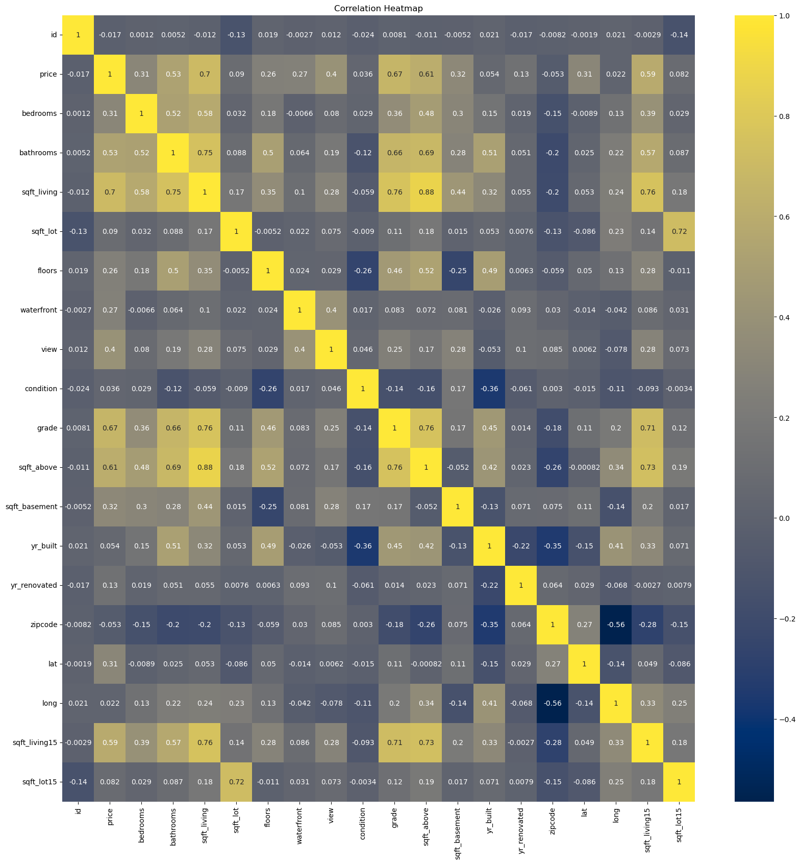
Initial Correlation Heatmap

Slide 7
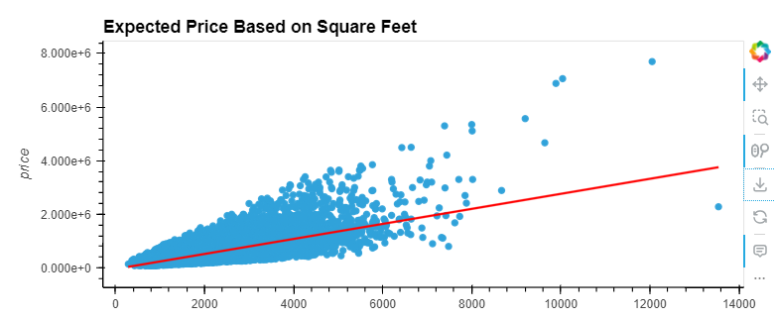
Linear Regression Analysis
Linear Regression: This type is the least complicated form of regression, where the dependent variable is continuous
Linear Regression using square feet living space came out to an r2 score of 0.49

Slide 8
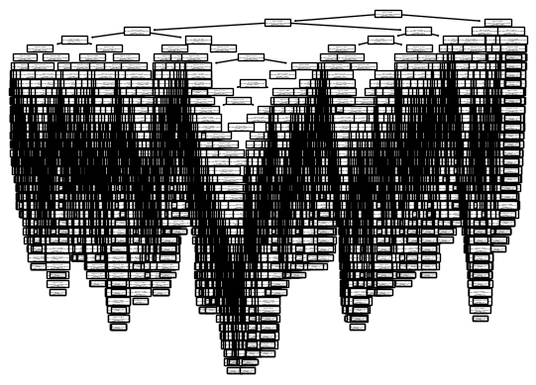
Decision Tree Analysis
Decision Tree Regression: The primary purpose of this regression is to divide the dataset into smaller subsets. These subsets are created to plot the value of any data point connecting to the problem statement.
Decision Tree analysis came out to a r2 score of 0.61

Slide 9
Decision Tree Model Importance Rankings
importances = model.feature_importances_
sorted(zip(model.feature_importances_, X.columns), reverse=True)
[(0.5639706340717785, 'sqft_living'),
(0.1529469118502252, 'zipcode'),
(0.06504614620828417, 'yr_built'),
(0.04698343226276476, 'sqft_lot'),
(0.034555902226778276, 'view'),
(0.03334182596585831, 'sqft_above'),
(0.032547881613468665, 'waterfront'),
(0.0269782914412466, 'bathrooms'),
(0.017191438991653825, 'bedrooms'),
(0.011515274926571634, 'sqft_basement'),
(0.008345069422745616, 'floors'),
(0.006577191018624381, 'yr_renovated')]

Slide 10
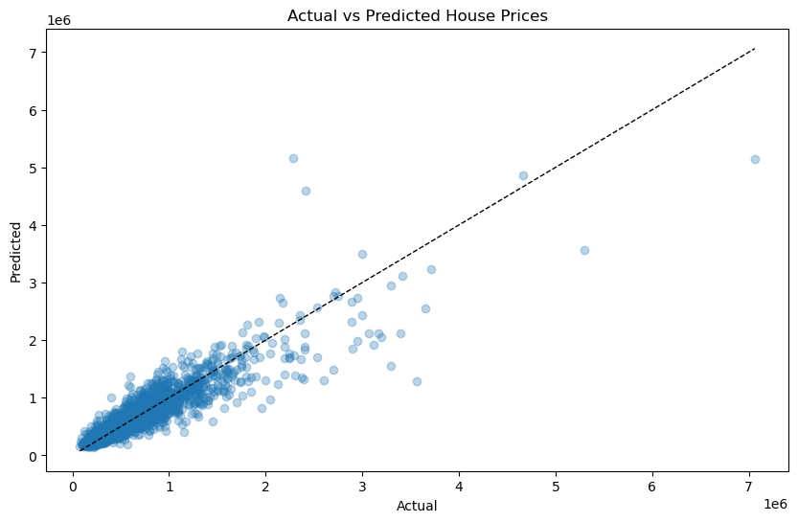
Random Forest Analysis
Random Forest Regression: Random Forest regression is heavily used in Machine Learning. It uses multiple decision trees to predict the output. Random data points are chosen from the given dataset and used to build a decision tree via this algorithm.
Random Forest analysis came out to r2 score of 0.84

Slide 11
Random Forest Model Importance Rankings
importances = model.feature_importances_
sorted(zip(model.feature_importances_, X.columns), reverse=True)
[(0.34430317388261505, 'sqft_living'),
(0.27537970156790254, 'grade'),
(0.17654161249814534, 'lat'),
(0.08139516390156905, 'long'),
(0.036633367112501695, 'sqft_lot'),
(0.03650177418700237, 'yr_built'),
(0.019562916929063798, 'zipcode'),
(0.016447179925379283, 'bathrooms'),
(0.007901695562693026, 'bedrooms'),
(0.005333414433127923, 'condition')]

Slide 12
Neural Network Analysis
Neural Network is an advanced form of machine learning that contains multiple layers of nodes, which perform individual computations.
Used Tensor Flow & the Rectified Linear Unit (ReLU) function
# Define the model - deep neural net
nn_model = tf.keras.models.Sequential()
nn_model.add(tf.keras.layers.Dense(units=64, activation="relu", input_dim=X_train.shape[1]))
nn_model.add(tf.keras.layers.Dense(units=32, activation="relu"))
nn_model.add(tf.keras.layers.Dense(units=1, activation="linear"))
nn_model.compile(
optimizer=tf.keras.optimizers.Adam(learning_rate=0.2),
loss='mean_squared_error')
# Train the model
fit_model = nn_model.fit(X_train_scaled, y_train, epochs=50)
# Evaluate the model using the test data
model_loss = nn_model.evaluate(X_test_scaled,y_test,verbose=1)
print(f"Loss: {model_loss}")
Neural Network Analysis came out to a r2 score of 0.85
Note: Changing Epoch from 50 to 100 had no impact on score

Slide 13
PySpark Query 1 - The Average Price for a 4 Bedroom House Sold per Year
a = """
SELECT
YEAR(yr_built) AS YEAR,
ROUND(AVG(price), 2) AS AVERAGE_PRICE
FROM home_sales
WHERE bedrooms = 4
GROUP BY YEAR
ORDER BY YEAR DESC
"""
spark.sql(a).show()
|YEAR|AVERAGE_PRICE|
+----+-------------+
|2015| 940324.31|
|2014| 712226.14|
|2013| 729881.97|
|2012| 606583.35|
|2011| 627180.8|
|2010| 605018.37|
|2009| 553977.4|
|2008| 806330.48|
|2007| 764035.91|
|2006| 738474.06|
|2005| 667901.81|
|2004| 658634.77|
|2003| 615643.01|
|2002| 640074.65|
|2001| 731348.23|
|2000| 761055.96|
|1999| 676729.2|
|1998| 653719.7|
|1997| 624072.42|
|1996| 715369.01|

Slide 14
PySpark Query 2 – The Average Price for each year the home was built that has 3 bedrooms, 3 bathrooms, 2 floors and is greater than or equal to 2,000 sq ft.
c = """
SELECT
YEAR(yr_built) AS YEAR_BUILT,
ROUND(AVG(price), 2) AS AVERAGE_PRICE
FROM home_sales
WHERE bedrooms = 3
and bathrooms = 3
and sqft_living >= 2000
and floors = 2
GROUP BY yr_built
ORDER BY yr_built DESC
"""
spark.sql(c).show()
+----------+-------------+
|YEAR_BUILT|AVERAGE_PRICE|
+----------+-------------+
| 2015| 1550000.0|
| 2014| 933142.67|
| 2013| 570685.0|
| 2012| 572500.0|
| 2011| 639750.0|
| 2010| 721000.0|
| 2009| 1011250.0|
| 2008| 1064500.0|
| 2007| 949777.78|
| 2006| 954444.69|
| 2005| 792503.85|
| 2004| 719500.0|
| 2003| 851750.0|
| 2002| 863200.0|
| 2001| 860875.0|
| 2000| 795511.25|
| 1999| 845605.56|
| 1998| 922142.86|
| 1997| 679970.0|
| 1996| 1490000.0|
+----------+-------------

Slide 15
Overall Findings – Machine Learning Technique Comparison
Random Forest outperforms both Linear Regression & Decision Tree
Advantages of Random Forests:
Robustness to Overfitting:
Decision Trees: Prone to overfitting especially if data is deep and complex
Random Forests: By averaging the predictions of multiple trees, reduces the risk of overfitting leading to better generalization on unseen data
Handling Non-Linearity:
Linear Regression: Assumes a linear relationship between the features and the target variable
Random Forests: Can capture complex, non-linear relationships between features and the target variable without requiring explicit feature transformation or interaction terms

Slide 16
Overall Findings – Random Forest & Neural Network
Random Forest
Feature Importance: provides insights into feature importance, helping to identify which features are the most significant in predicting the target variable
Handling Missing Values: often fill in missing data by using proximity to other data points.
Robustness to Noisy Data: the averaging helps to reduce the impact of noise in the data, making it more robust compared to single models
Neural Networks usually need more data to achieve the same level of accuracy as Random Forest gains little performance enhancements when a certain amount of data is reached while Neural Networks benefit from increasing data leading to improving accuracy
Machine Learning Technique | Score
Linear Regression | 0.49
Decision Tree | 0.61
Random Forest | 0.84
Neural Network | 0.85

Slide 17
Appendix - Data Field Definitions
Field | Definition
id | Unique identifier for each property
date | Date of property listing
price | Property price in currency
bedrooms | Number of bedrooms
bathrooms | Number of bathrooms
sqft_living | Living area size in square feet
sqft_lot | Total lot size in square feet
floors | Number of floors
waterfront | Indicates if property has waterfront view (0 for no, 1 for yes).
view | Quality level of property view (0 to 4)
condition | Overall condition rating (1 to 5)
grade | Overall grade rating (1 to 13)
sqft_above | Living area above ground level in square feet
sqft_basement | Basement area in square feet
yr_built | Year property was built
yr_renovated | Year property was last renovated (0 if never)
zipcode | Property location zip code
lat | Latitude coordinate of property location
long | Longitude coordinate of property location
sqft_living15 | Living area size of 15 nearest properties in square feet
sqft_lot15 | Lot size of 15 nearest properties in square feet

