Slide 1

Wilson Financial Milestone 4

Slide 2




THE TEAM
Jonathan Kobyluck
John Hadden
Kevin Finnissee

Slide 3

Group Intro
Our group consists of Kevin Finnissee, John Hadden, and Jonathan Kobyluck.

Slide 4

Case Study Description
Wilson Financial consists of Jake and Ned Wilson who wanted to start a business in financial management and advising. They got their license and hired some people to help with the business.
Now they need to decide on whether or not to change their billing structure.

Slide 5

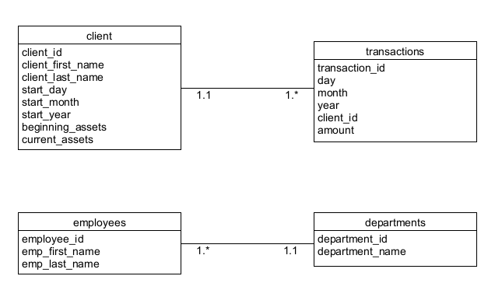
Group ORD

Slide 6
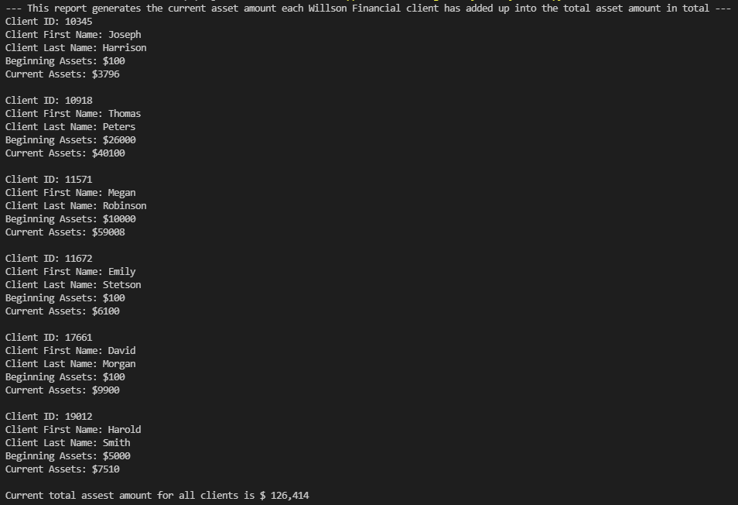
Reports Description
Assets
This report generates the current amount each Wilson Financial client has added up into the total asset amount in total

Slide 7
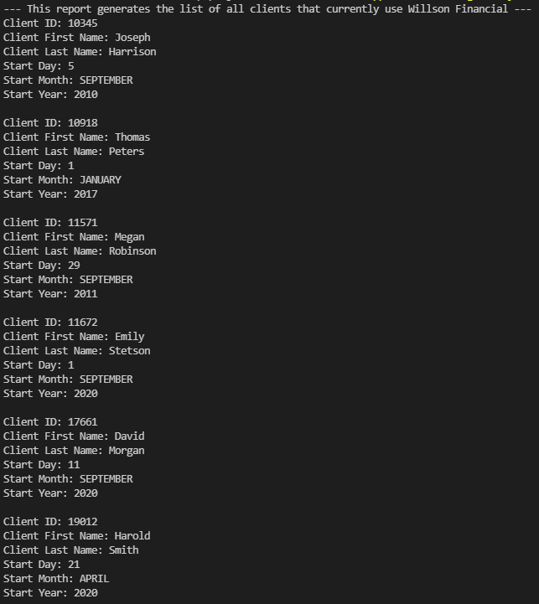
Reports Description
Clients
This report generates the list of all clients that currently use Wilson Financial

Slide 8
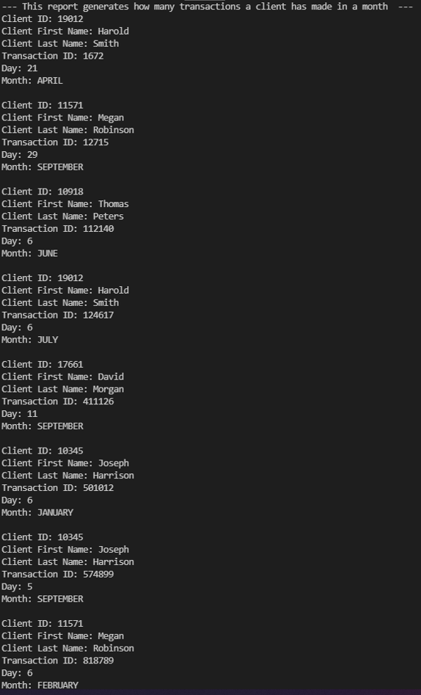
Reports Description
Transactions
This report generates how many transaction a client made in a month

Slide 9

THANK YOU!

